Slide 1
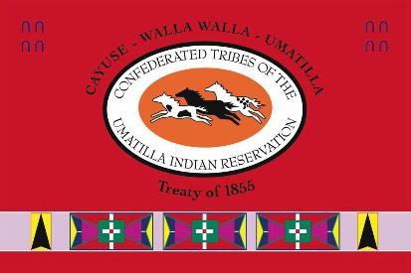
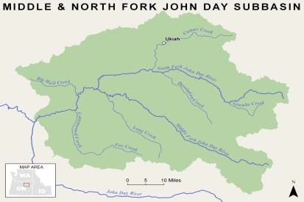
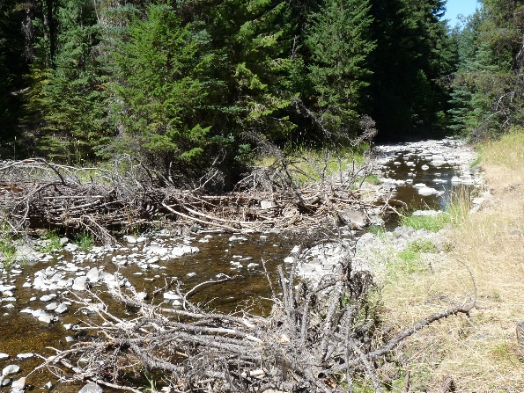
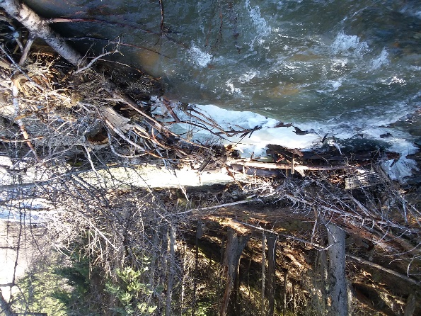
Confederated Tribes of the Umatilla Indian Reservation DNR Fisheries Program Project Semiannual Report
N.F. John Day Habitat Improvement Project
Period: 1 January to 31 June 2019
Project Statement/Goal: Protect, enhance, and restore functional, healthy and sustainable floodplain, channel and watershed process to protect and restore fisheries and aquatic species in the North Fork John Day Subbasin.
Project Objectives: Project objectives address limiting factors as identified in planning documents, inter and intra planning efforts, coordination with landowners, and during baseline surveys and assessments.
Project Inputs: | Funding | FY17 Budget | Total Staff | New 2019 Staff
 | BPA | $886,998 | 2 bio; 1 tech | 1 bio
 | Staff: John Zakrajsek, Mitchell Daniel, Delbert Jones
 | Collaborators: NFJDWC, ODFW, Confederated Tribes of the Warm Springs Indian Reservation, Umatilla National Forest, Wallowa-Whitman National Forest
Outputs: (specific 6-mo task accomplishments)
Completed and submitted the 1 February 2018 to 31 January 2019 Annual Report to
BPA.
Secured an implementation contractor for the Granite Creek Restoration effort.
Met with landowners and ODFW staff to finalize design objectives, structure role, and
large wood sourcing to improve in-stream complexity of Hidaway Creek by Ukiah, OR.
Met with a landowner to discuss prospective restoration actions as a first step toward
a potential conservation agreement near Ukiah, OR.
▪ Received a 50% design for the Bull Run Creek Mine Tailing restoration Project.
▪ Participated in the Ukiah Fishing Derby.
▪ Brought on a Habitat Biologist II.
Typical channel form of Hidaway Creek and presence of large wood which is not functional save during high flow events.
Outcomes: (broader results/changes from cumulative accomplishments)
▪ Met reporting obligations to BPA for the 2018 performance period.
▪ Continued to develop existing and new restoration actions in the Camas and Granite
Creek focus basins and fulfill contractual obligations with BPA.
▪ Continued to work toward meeting goals and completing expected actions outlined
in the 2013 ISRP Geographical Review process.
▪ Continued to educate local communities in the value of the CTUIR’s First Foods and
Umatilla River Vision and their role in land management.
▪ Improved the CTUIR’s NFJD Fishery Habitat Project’s capacity by hiring additional
qualified staff.
One of the few naturally occurring and functional large wood accumulations within the Hidaway Creek project site.
Impacts (work supports long-term progress towards)
Contribute to achievement of healthy watersheds (DNR River Vision) and increased
traditional first food abundance and use opportunities.
Contribute to achievement of Subbasin Plan and ESA Recovery Plan goals.
Assist in the recovery of Endangered Species Act listed summer steelhead trout and
bull trout and unlisted spring Chinook salmon.
Address water quality limiting factors as per Clean Water Act 303d list.

