Slide 1
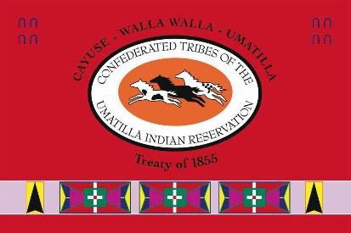
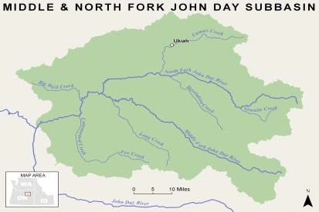
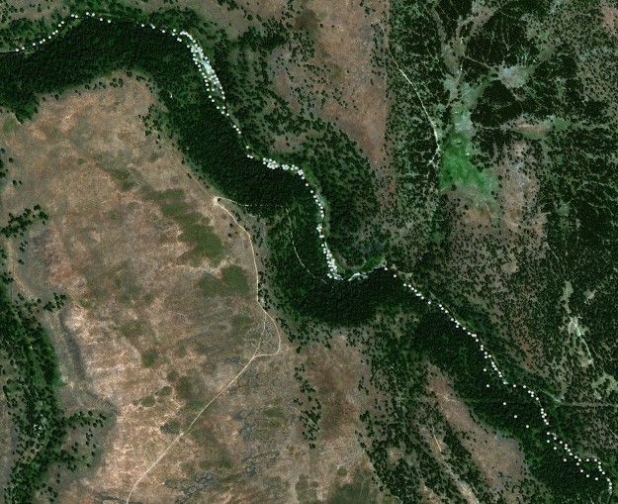
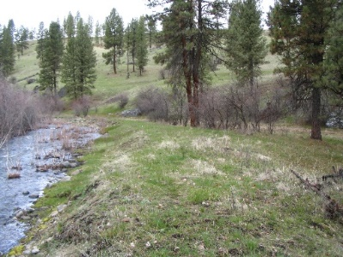
Confederated Tribes of the Umatilla Indian Reservation DNR Fisheries Program Project Semiannual Report
N.F. John Day Habitat Improvement Project
Period: 1 July 2019 to 31 December 2019
Project Statement/Goal: Protect, enhance, and restore functional, healthy and sustainable floodplain, channel and watershed process to protect and restore fisheries and aquatic species in the North Fork John Day Subbasin.
Project Objectives: Project objectives address limiting factors as identified in planning documents, inter and intra planning efforts, coordination with landowners, and during baseline surveys and assessments.
Project Inputs: | Funding | FY17 Budget | Total Staff | New 2019 Staff
 | BPA | $886,998 | 2 bio; 1 tech | None
 | Staff: John Zakrajsek, Mitchell Daniel, Delbert Jones
 | Collaborators: NFJDWC, ODFW, Confederated Tribes of the Warm Springs Indian Reservation, Umatilla National Forest, Wallowa-Whitman National Forest
Outputs: (specific 6-mo task accomplishments)
▪ Advanced the Desolation Creek Reach 3 design to the 80% level with expected
completion in 2020.
▪ Worked with the CTUIR’s Cultural Resources Program to complete surveys for the
Desolation Creek Reach 3 restoration effort and to outline surveys costs and
scheduling for the Hideaway Creek large wood restoration effort.
▪ Coordinated with the Umatilla National Forest and Trout Unlimited to begin
developing restoration efforts in Desolation Meadows.
▪ Attended the OWEB FIP Technical meeting to provide information as requested
regarding the CTUIR’s Desolation Creek Reach 3 grant application and Grant SWCD’s
10 Road Relocation design application. The road design and its subsequent
implementation will allow CTUIR to complete in-stream design and implementation
actions in the Desolation Creek Action Plan’s highest ranked Tier 1 reach.
Aerial image of the Hidaway Creek project site located 0.5 miles upstream of the Camas/Hidaway Creek confluence. White dots indicate the location of 203 large wood structures to be developed (left)
Outcomes: (broader results/changes from cumulative accomplishments)
▪ Continued to develop new and ongoing restoration actions on private and public
lands in Tier 1 & 2 reaches as defined in the Desolation Creek Action Plan.
▪ Continued to develop and design restoration actions in the Camas Creek, Desolation
Creek, and Granite Creek focus areas.
▪ Secured e $600,000 in funding for the Granite Creek Restoration effort and
contributed to Grant SWCD’s award of ~$90,000 to fund the 10 Road relocation road.
Impacts (work supports long-term progress towards)
Contribute to achievement of healthy watersheds (DNR River Vision) and increased
traditional first food abundance and use opportunities.
Contribute to achievement of Subbasin Plan and ESA Recovery Plan goals.
Assist in the recovery of Endangered Species Act listed summer steelhead trout and
bull trout and unlisted spring Chinook salmon.
Address water quality limiting factors as per Clean Water Act 303d list.
Man made berm in Desolation Creek’s Reach 3 reducing floodplain connectivity that will be removed as part of the restoration effort.(left).

