Slide 1
Confederated Tribes of the Umatilla Indian Reservation
North Fork John Day Fisheries Enhancement Project BPA Project # 2000-031-00
2021 ISRP Review Proposal Presentation
Mike Lambert – Fisheries Habitat Program Manager, John Zakrajsek - Habitat Biologist III, Mitchell Daniel - Habitat Biologist II

Slide 2
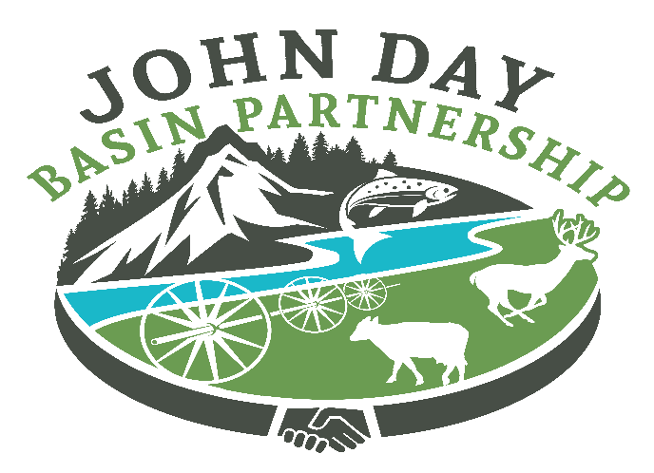
Focus and Organization
First Foods and CTUIR Organization
Focus Basins
Active coordination with focal basin collaborators
John Day Partnership (JDP)

Slide 3
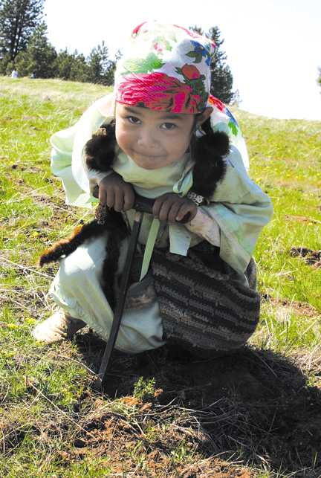
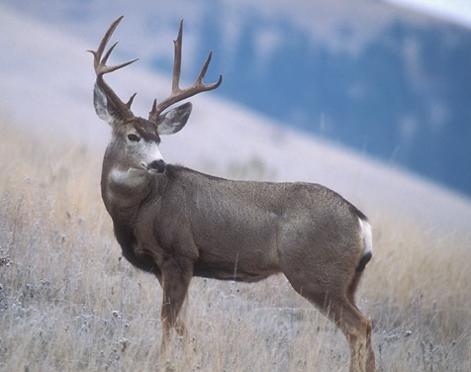
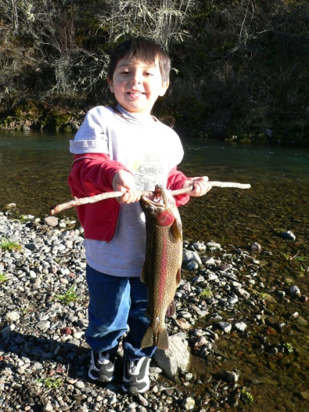
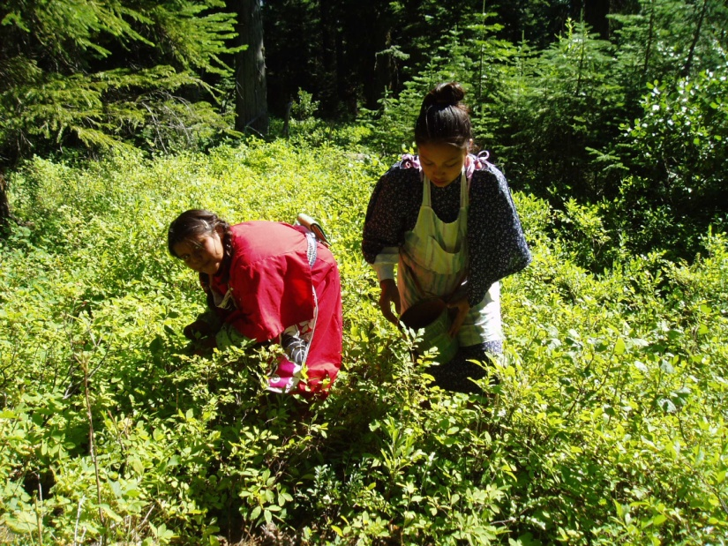
CTUIR Guidance
First Foods Policy (2006)
Umatilla River Vision (2008)
Upland Vision (2019)
Climate Change (2015)
PHaMS (2015)

Slide 4
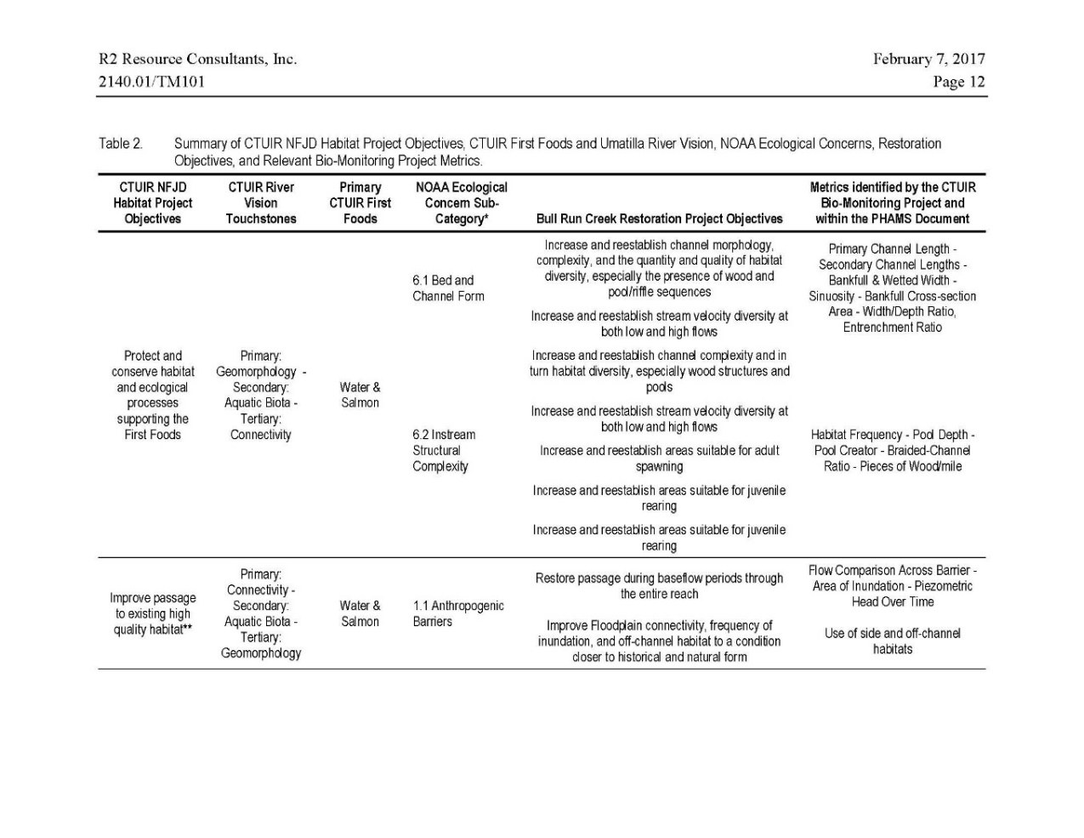
Goals and Objectives
Overarching Goal – Ties to regional planning and recovery documents and CTUIR’s efforts to address regional issues
Restoration Action Specific Goals – Ties CTUIR guidance documents to specific restoration actions
Restoration Action Specific Objectives – Outlines restoration action specific collaboration and ties to adaptive management

Slide 5
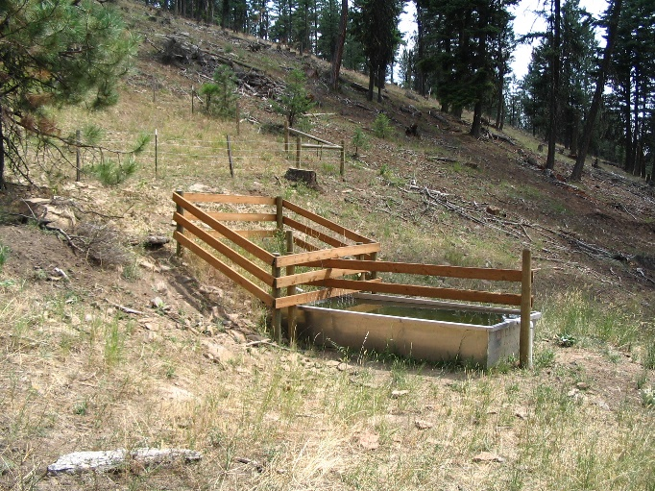
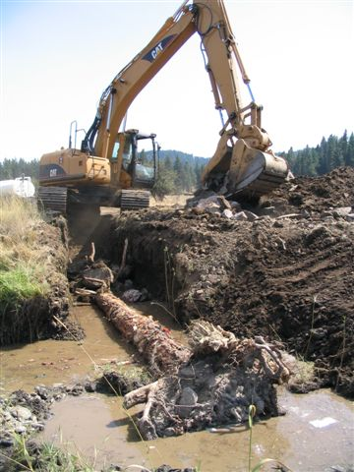
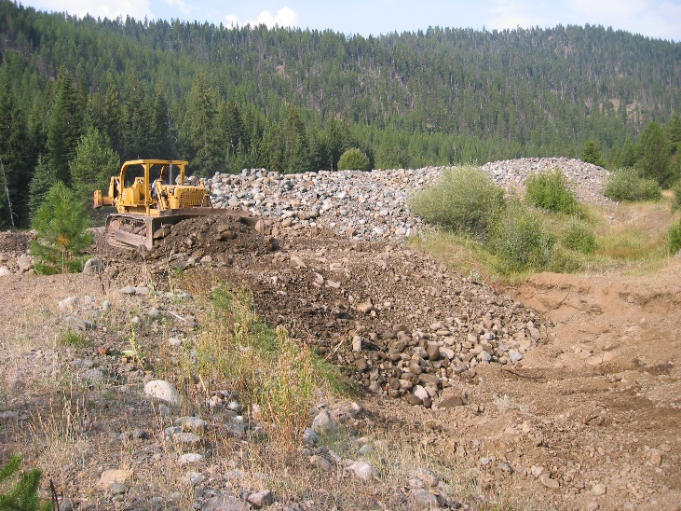
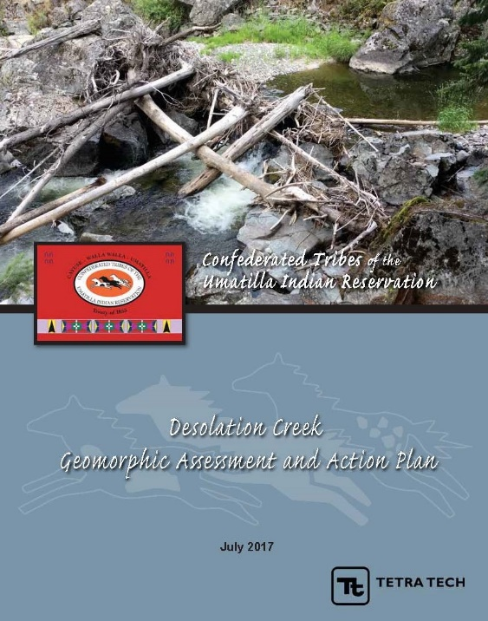
Restoration Progression
2002
2006
2020
Restoration progression
Treatments as of 2021
  Stream treatments – 508 Km
  Terrestrial treatments – 8,078 ac

Slide 6
Proposed 2013 ISRP Geographic Review Actions
Ongoing CTUIR Deliverables
Manage and Administer Project
Outreach and Education
Maintain Structures and Native Vegetation
Collect and Generate Field Data
16 Restoration Action Specific Deliverables
1 riparian fencing refresh (UNF and CTUIR)
4 reach scale actions are in design or various stages of implementation (CTUIR led)
Development of the Camas Creek Geomorphic Assessment (NFJDWC and CTUIR)
1 grazing management plan developed by landowner with assistance from others
5 actions in the Bull Run Creek Basin completed through WWNF, NFJDWC, and CTUIR collaboration
1 culvert replacement to be completed in 2021 through UNF and NFJDWC collaboration with a second culvert dependent upon completion of the first
1 culvert replacement completed by ODFW
1 instream restoration action completed by NFJDWC & CTUIR collaboration with the balance of actions implemented by the CTWSRO
1 large wood addition not completed

Slide 7
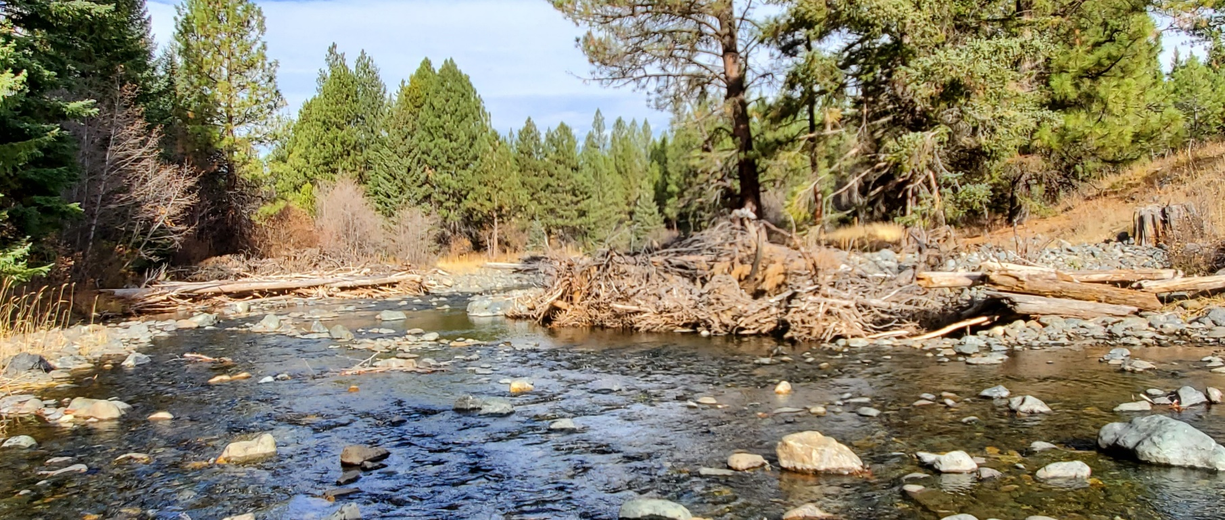
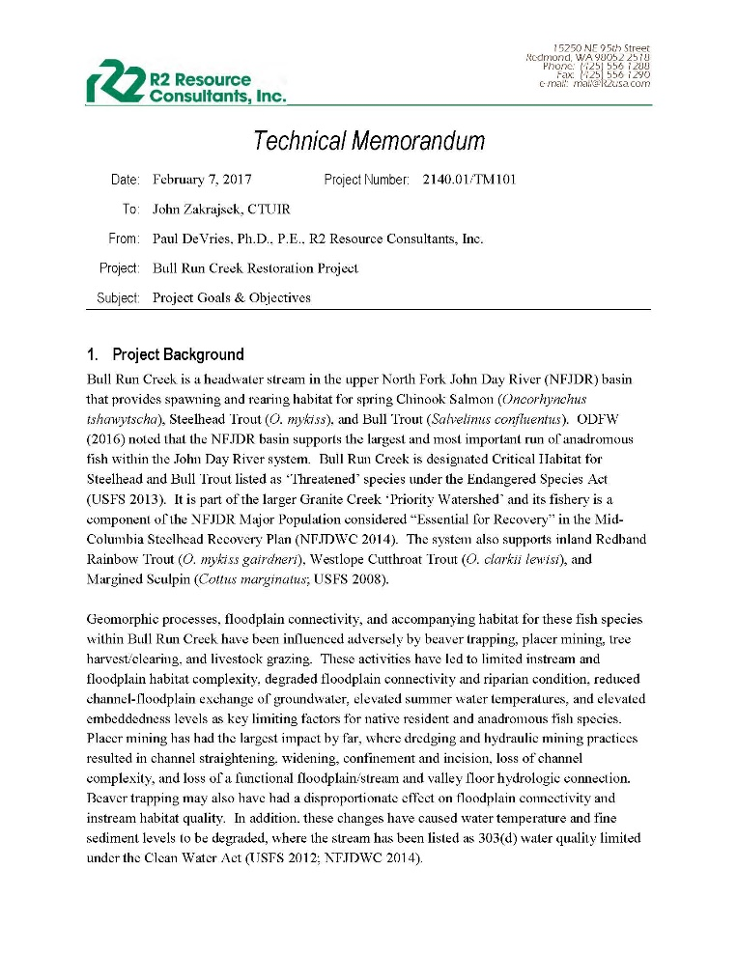
Post 2013 ISRP Geographic Review Adjustments
Collaboration !!!!
Statements of Goals and Objectives
Prioritization
Second biologist hired
Refinement of restoration treatments
  hand crew
  stage zero

Slide 8
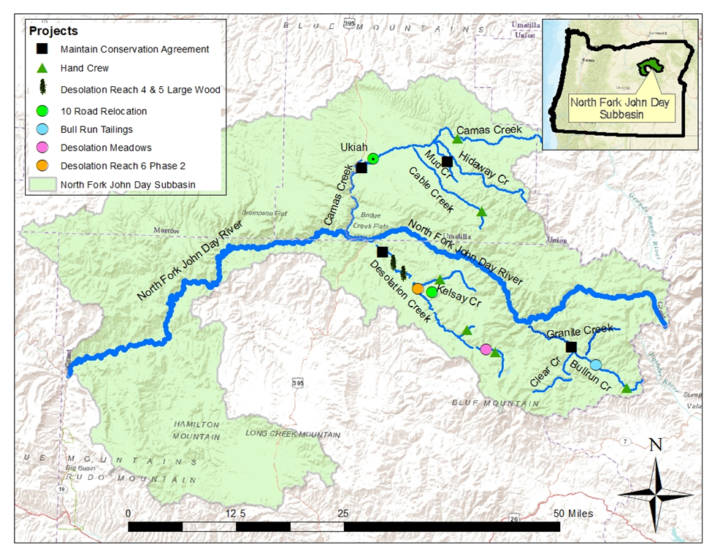
2021 ISRP Review Proposed Actions
Maintain four conservation agreements
Five large instream actions – 19.3 Km
Six hand crew areas - 28 Km
One road relocation – 2.3 Km
One passage barrier – 1

Slide 9
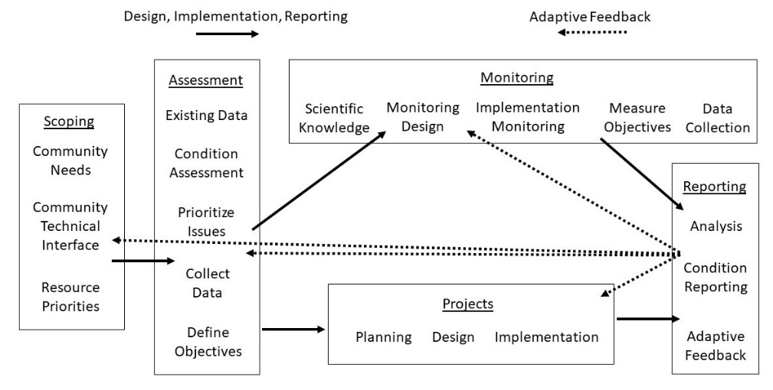
Adaptive Management Implications
Refine MAMP development and implementation
Continue Bio-Monitoring Project collaboration
Hidaway Creek RM 1.3 large wood approach
Stage zero evaluation
Role of hand crew work
Soil amendment use

