Slide 1
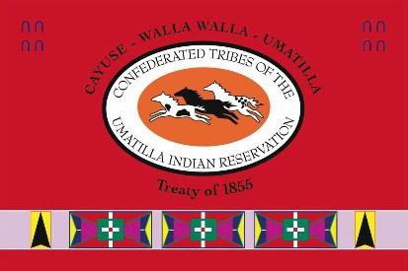
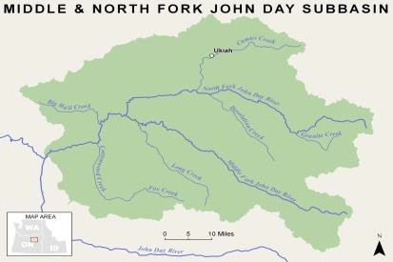
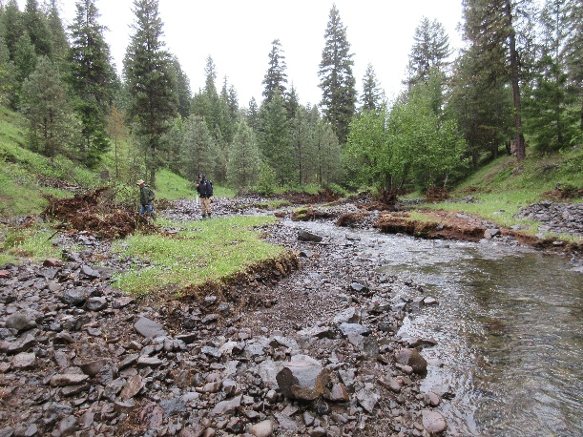
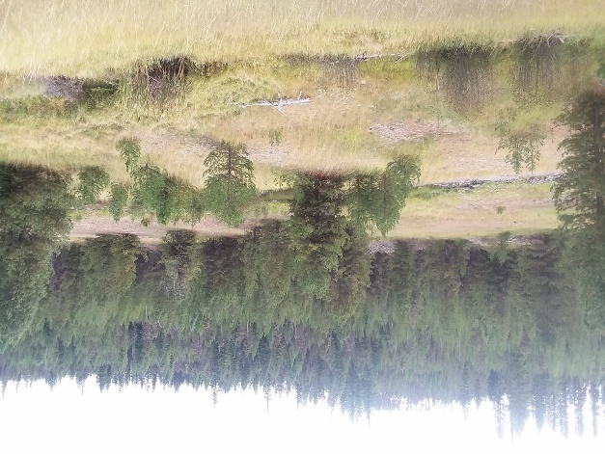
Confederated Tribes of the Umatilla Indian Reservation DNR Fisheries Program Project Semiannual Report
N.F. John Day Habitat Improvement Project
Period: 1 January to 31 June 2020
Project Statement/Goal: Protect, enhance, and restore functional, healthy and sustainable floodplain, channel and watershed process to protect and restore fisheries and aquatic species in the North Fork John Day Subbasin.
Project Objectives: Project objectives address limiting factors as identified in planning documents, inter and intra planning efforts, coordination with landowners, and during baseline surveys and assessments.
Project Inputs: | Funding | FY17 Budget | Total Staff | New 2020 Staff
 | BPA | $1,237,902 | 2 bio; 1 tech | none
 | Staff: John Zakrajsek, Mitchell Daniel, Delbert Jones
 | Collaborators: NFJDWC, ODFW, Confederated Tribes of the Warm Springs Indian Reservation, Umatilla National Forest, Wallowa-Whitman National Forest
Outputs: (specific 6-mo task accomplishments)
Completed and submitted the 1 February 2019 to 30 April 2020 Annual Report to BPA.
Worked through contracting large wood sourcing issues related to the Granite Creek
RM 7.5 Restoration Project (0.8 mles long) to ensure implementation in 2020.
Secured conformation from the Wallowa-Whitman National Forest allowing BPA to
become lead federal agency for NHPA and ESA consultation. Awaiting letter the forest
has found regarding mine tailing eligibility for the Bull Run Creek Tailings.
Ensured cultural resource surveys were completed on Hidaway Creek.
Accepted 100% design for the Desolation Creek Reach 3 restoration effort; 2-mile
floodplain restoration project. Proposed for 2021 or 2022 construction depending on funding
Discussed potential irrigation diversion efficiency treatments along Owens Creek with
Water Acquisition Project.
Worked with collaborators to define out year hand crew work in the Camas and
Desolation Creek basins.
Owens Creek at after the rain in late may where channel incision lowered substrate levels by approximately 2.5’ in this location. Talking with the landowner about potential restoration treatments.
Outcomes: (broader results/changes from cumulative accomplishments)
▪ Met reporting obligations to BPA for the 2018 and 2019 performance period.
▪ Continued to develop existing and new restoration actions in the Camas, Desolation,
and Granite Creek focus basins.
▪ Continued to work toward meeting goals and completing expected actions outlined
in the 2013 ISRP Geographical Review process.
▪ Continued to educate local communities in the value of the CTUIR’s First Foods and
Umatilla River Vision and their role in land management.
A portion of the Granite Creek RM7.5 site managed by the Umatilla National Forest to be restored in 2020. Note leveled tailings in the foreground and tailing piles to the rear.
Impacts (work supports long-term progress towards)
Contribute to achievement of healthy watersheds (DNR River Vision) and increased
traditional first food abundance and use opportunities.
Contribute to achievement of Subbasin Plan and ESA Recovery Plan goals.
Assist in the recovery of Endangered Species Act listed summer steelhead trout and
bull trout and unlisted spring Chinook salmon.
Address water quality limiting factors as per Clean Water Act 303d list.

