Slide 1
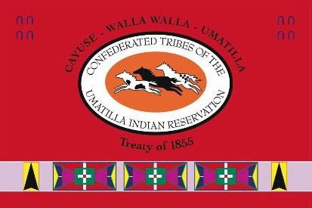
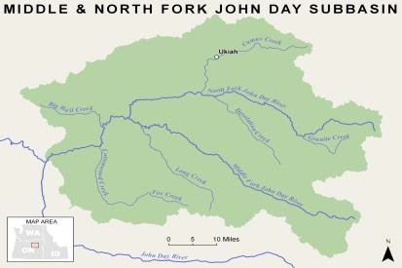
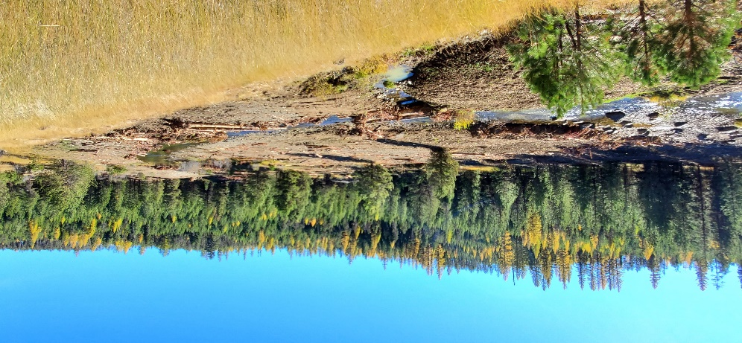
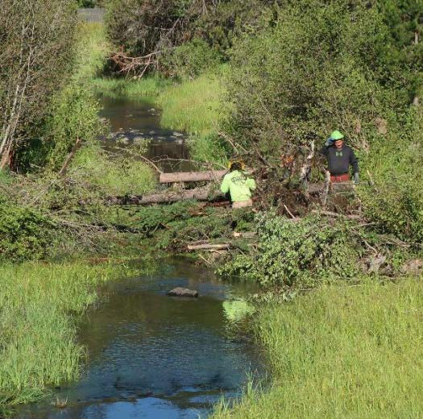
Confederated Tribes of the Umatilla Indian Reservation DNR Fisheries Program Project Semiannual Report
N.F. John Day Habitat Improvement Project
Period: 1 July to 31 December 2020
Project Statement/Goal: Protect, enhance, and restore functional, healthy and sustainable floodplain, channel and watershed process to restore habitat for the CTUIR’s First Foods in the North Fork John Day Subbasin.
Project Objectives: Project objectives address limiting factors as identified in planning documents, inter and intra planning efforts, coordination with landowners, and during baseline surveys and assessments.
Project Input: | Funding | FY20 Budget | Total Staff | New 2020 Staff
 | BPA | $1,237,902 | 2bio: 1 tech | none
 | Staff: John Zakrajsek, Mitchell Daniel, Delbert Jones
 | Collaborators: NFJDWC, ODFW, Confederated Tribes of the Warm Springs Indian Reservation, Umatilla National Forest, Wallowa-Whitman National Forest
Outputs: (specific 6-mo task accomplishments)
Implemented the Granite Creek RM 7.5 design along 0.4 miles of Granite Creek including two meander bends, five side channels, and 93 large wood features.
Constructed 1.1 miles of riparian exclusion fence along 0.5 miles of Starveout Creek as part of a joint ODFW, Grant SWCD, and CTUIR collaborative effort.
Completed hand crew work along 0.7 miles of Camas Creek (10 structures) and 1.8 miles of North Fork Cable Creek (29 structures) during a Umatilla National Forest, Trout Unlimited, and CTUIR collaborative effort.
Helped the North Fork John Day Watershed Council to secure $124,000 in funding for the Hideaway Creek RM 1.3 Restoration Project through OWEB’s FIP incentive.
Secured a construction contractor and completed a Fill/Removal Permit for the Hideaway Creek RM 1.3 Restoration Project’ 2021 implementation.
Worked with Wallowa-Whitman National Forest and North Fork John Day Watershed Council staff to move the Bull Run Creek design to the 80% design step.
Contributed to John Day Partnership Steering and Outreach Committee’s effort.
Gave tours of the Granite Creek RM 7.5 Restoration Project to the public and agency staff.
Outcomes: (broader results/changes from cumulative accomplishments)
Met contract obligations for 2020.
Continued to develop existing and new restoration actions in the Camas, Desolation, and Granite Creek focus basins.
Continued to work toward meeting goals and completing expected actions outlined in the 2013 ISRP Geographical Review process.
Continued to educate local communities in the value of the CTUIR’s First Foods and Umatilla
River Vision and their role in land management.
Granite Creek site shown work completed during 2020.
Veterans crew member working to place wood by hand in Camas Creek during the summer of 2020.
Impacts (work supports long-term progress towards)
Contribute to achievement of healthy watersheds (DNR River Vision) and increased traditional First Food abundance and use opportunities.
Contribute to achievement of Subbasin Plan and ESA Recovery Plan goals.
Assist in the recovery of Endangered Species Act listed summer steelhead trout and bull trout and unlisted spring Chinook salmon.
Address water quality limiting factors as per Clean Water Act 303d list.

