Slide 1
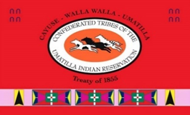

Tucannon River 2017/2020 Lidar Analysis update
Presented by
Mike Gieschen, Mischa Hey, and Kris Fischer
Oct. 19th 2022

Slide 2
Recent Efforts
2010 Geomorphic Assessment and Prioritization
  Topographic Lidar and Imagery Collection
2017 Geomorphic Assessment and Re-Prioritization
  Blue/Green Lidar Topo-Bathy and Imagery Collection
2020 LiDAR analysis
  Blue/Green Lidar Topo-Bathy and Imagery Collection
2021 Tucannon Long Term Monitoring Plan
  Identifies useful metrics for tracking moving forward, 7 of these are evaluated in this analysis

Slide 3
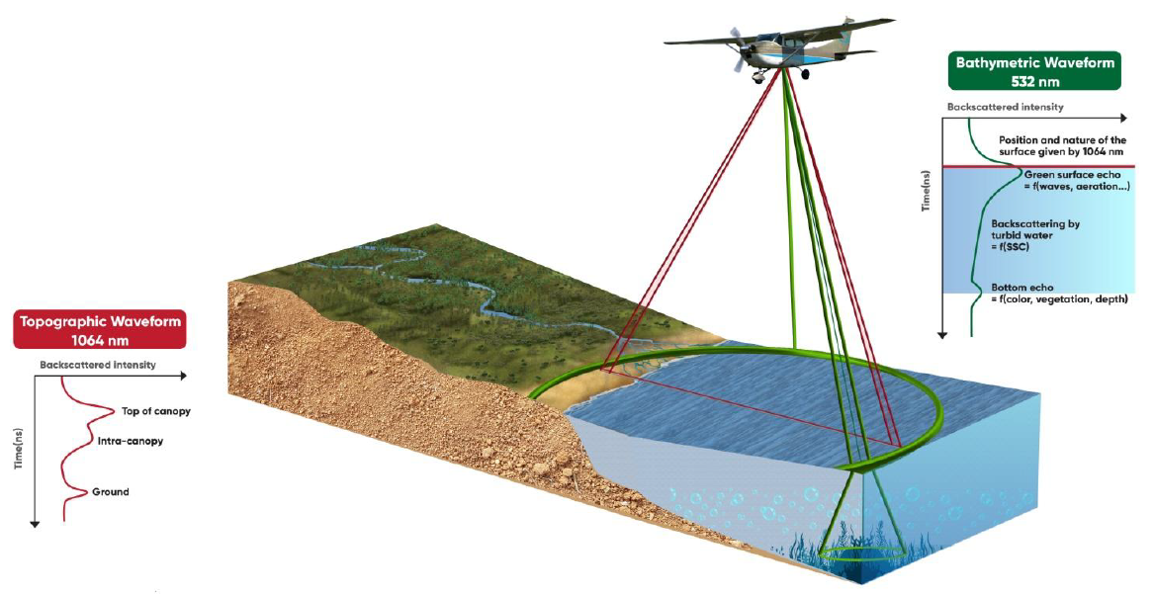
What is Topobathymetric Lidar?

Slide 4
Going Green

Slide 5
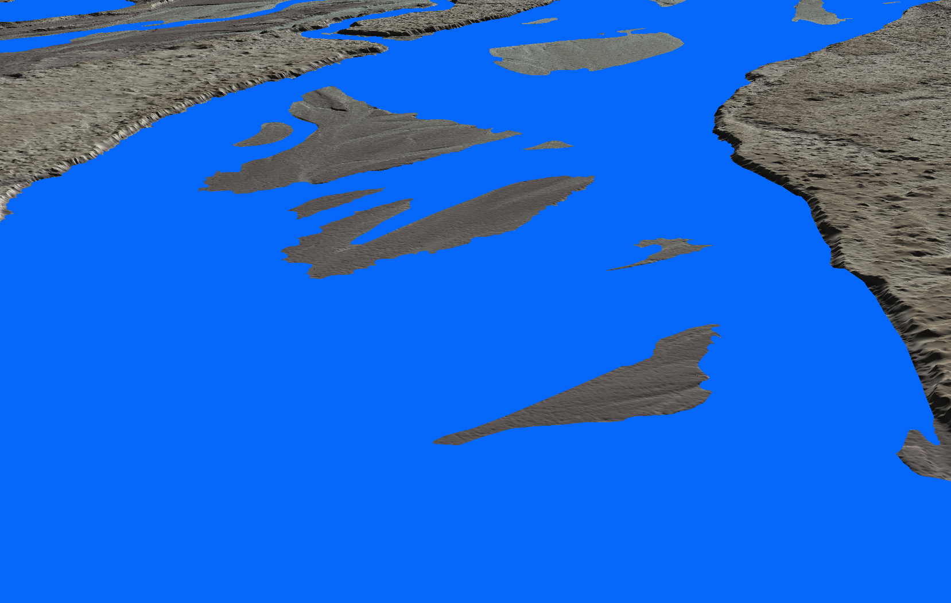
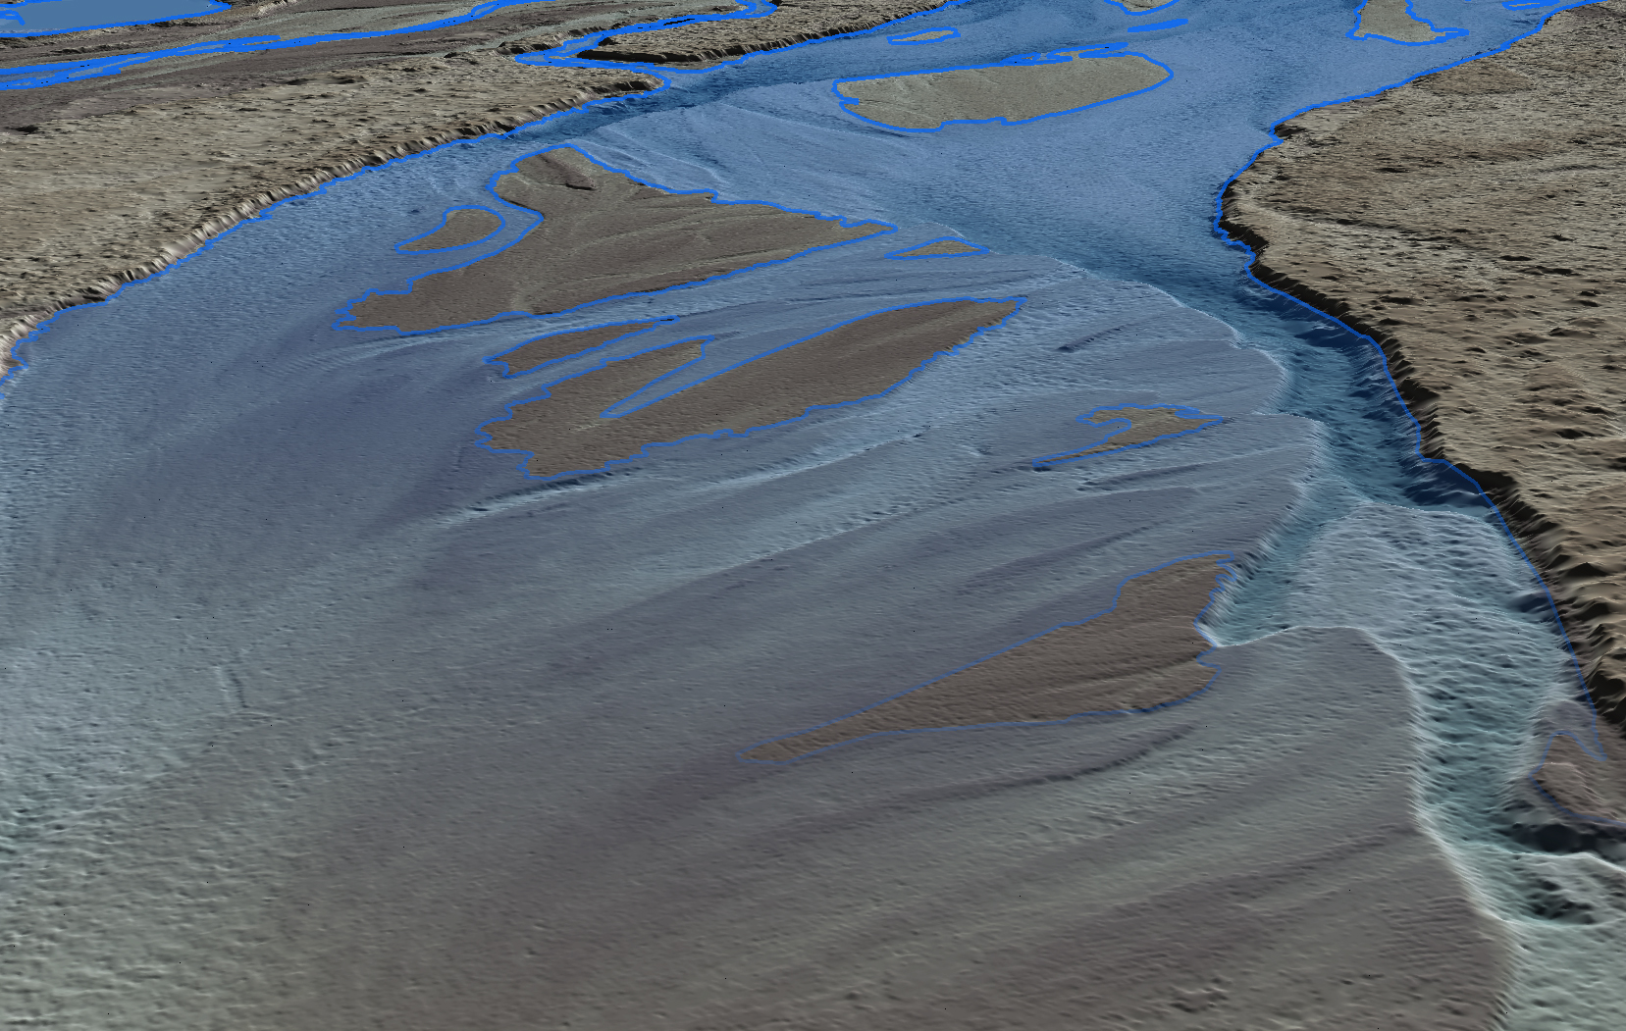
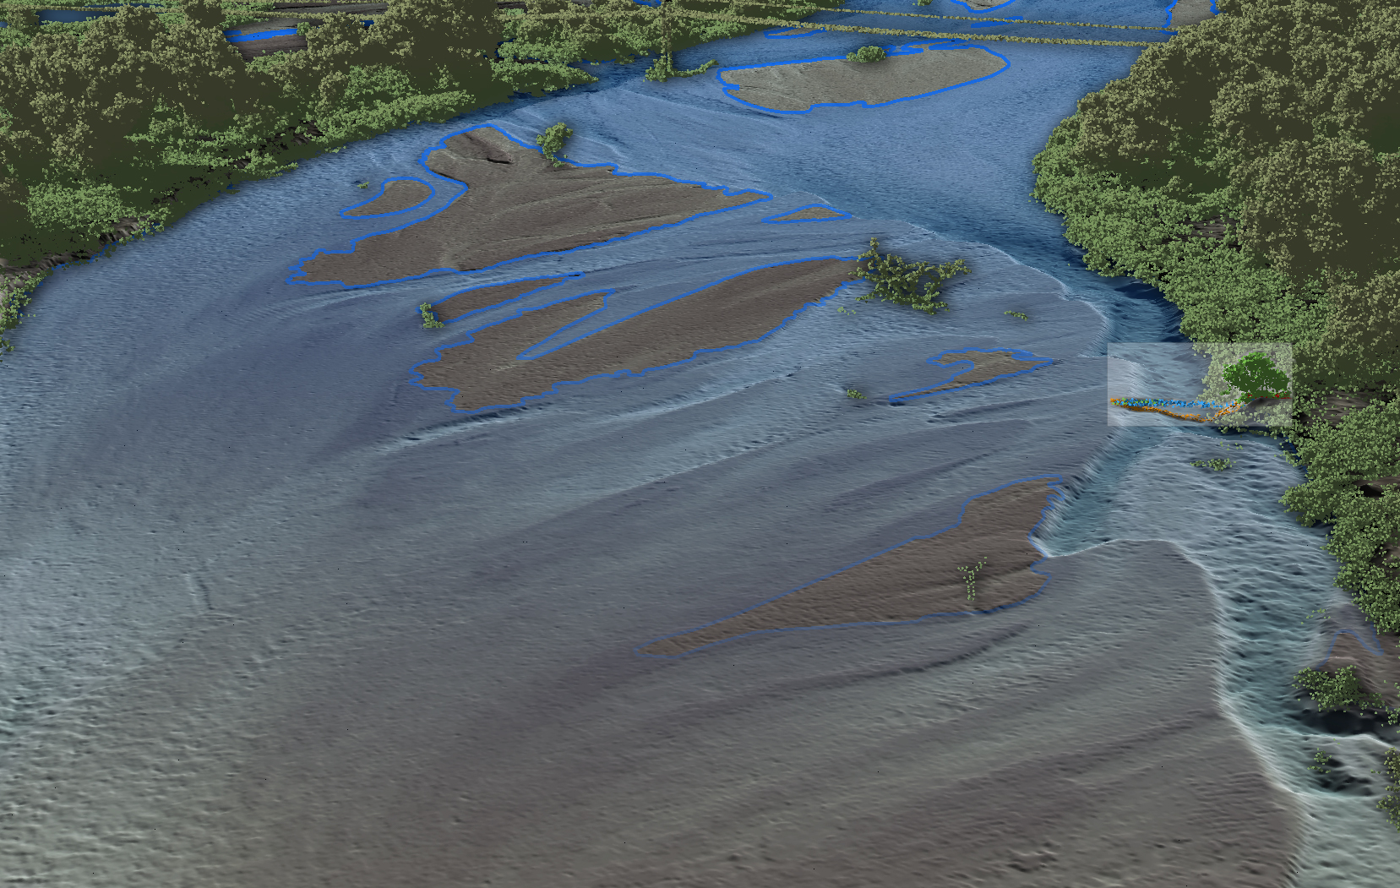
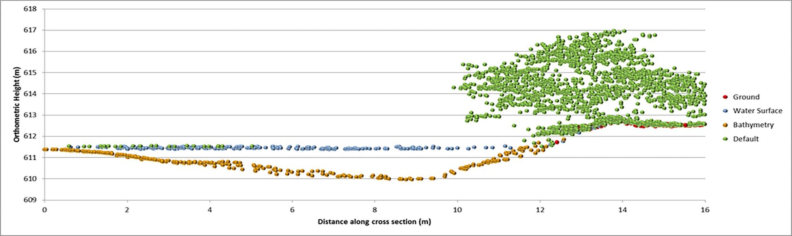
TOPOGRAPHIC DEM WITH WATER MASKED OUT
UNDERWATER TOPOGRAPHY REVEALED WITH GREEN LASER
TOPOBATHY DEM WITH ABOVE GROUND LIDAR RETURNS

Slide 6
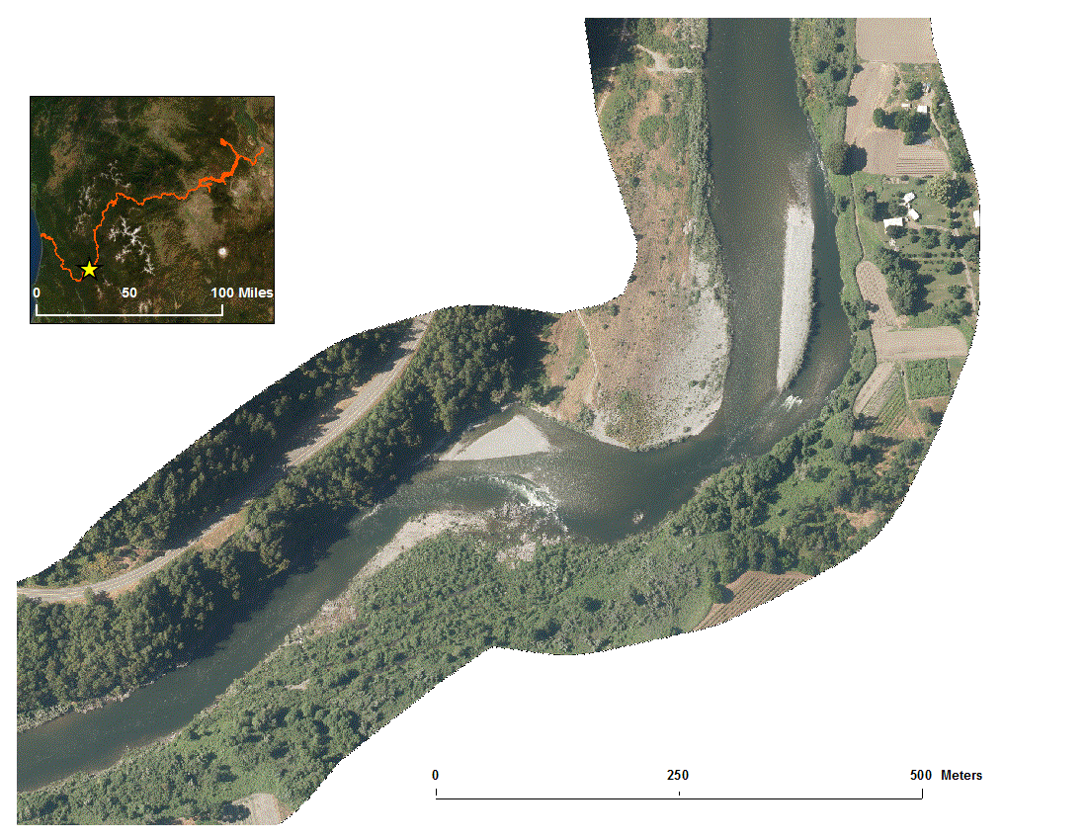
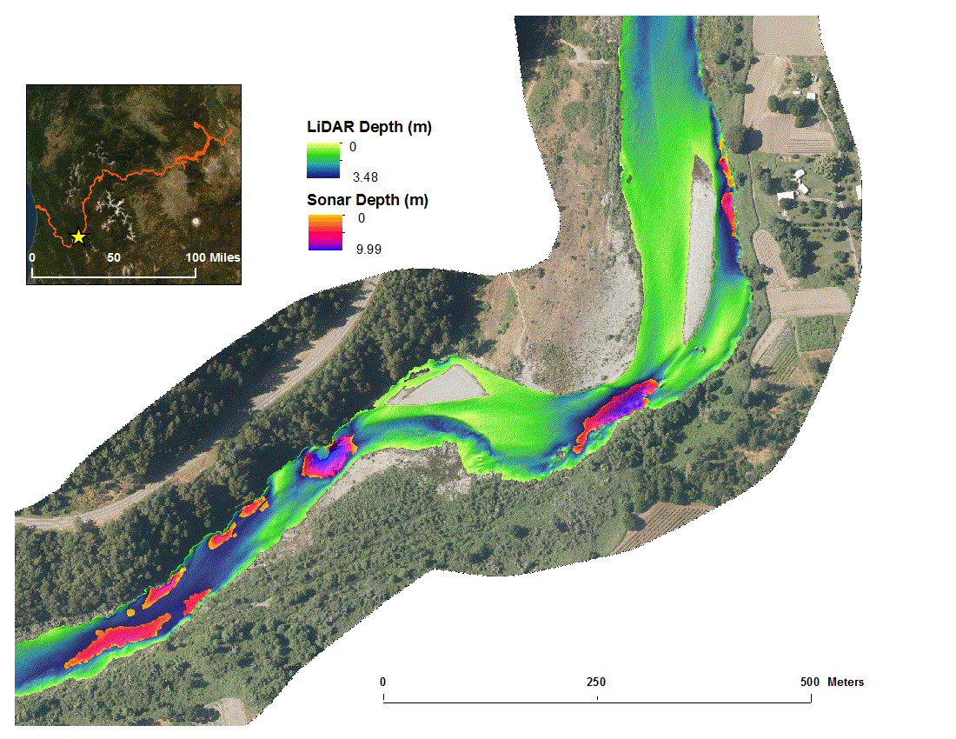
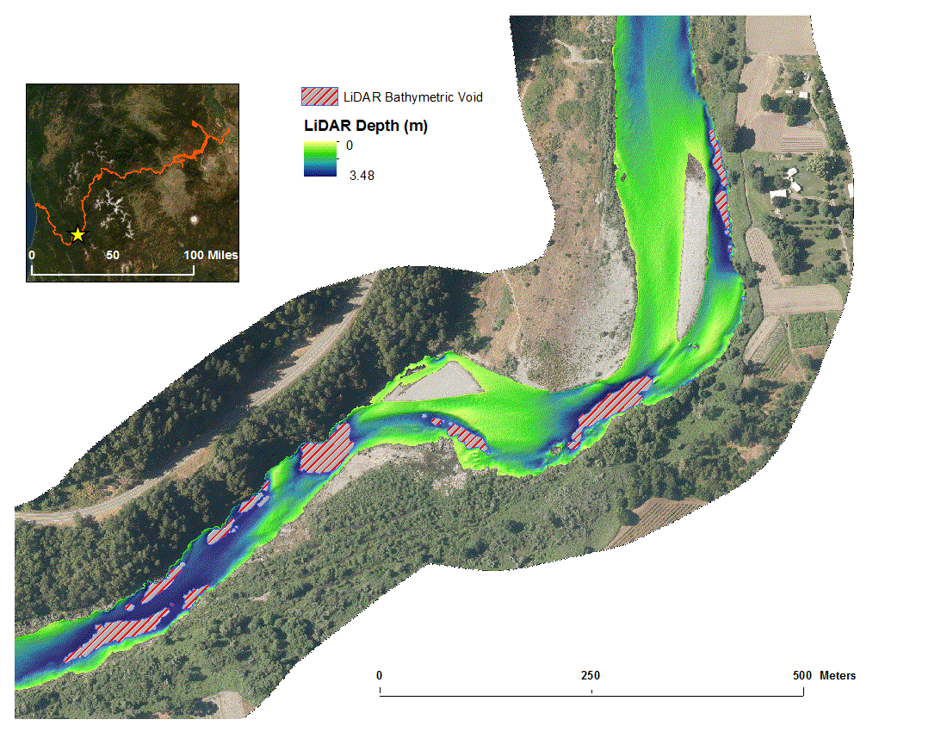
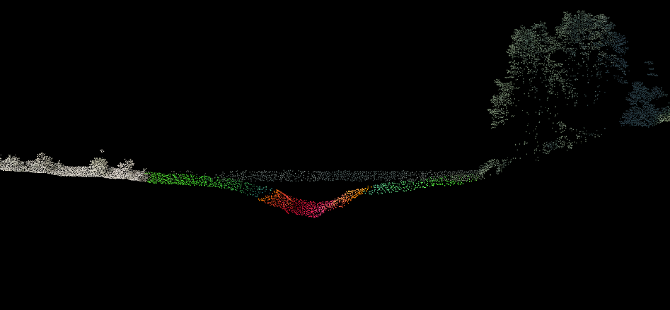
Lidar/Sonar Integration
River Mile 56
2m cross section
LiDAR
Sonar

Slide 7
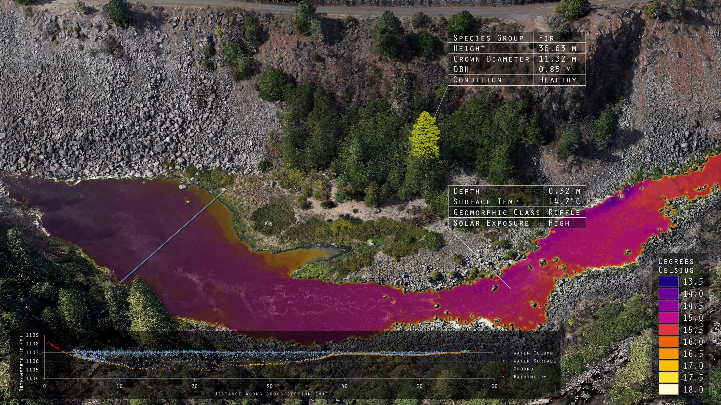
Data fusion for analytics

Slide 8
Restoration and Geomorphic Timeline
2009 – Only 2-Year Event Between 1997 and 2010
2010 LiDAR Collection and Assessment
2010-2020 Implementation of Restoration Efforts
2017 – The Only 2-year Flow in this 10-Year Period Occurs
2020 First Flow Event Over the 10 Years Since 1997
2020 - Lidar Collection and Additional Assessments
2018 Second Assessment and Prioritization
Tucannon Monitoring and Long-Term Stories
1996 – 25+ Year Flow Event
Notes:
Pull in historic high flows

Slide 9
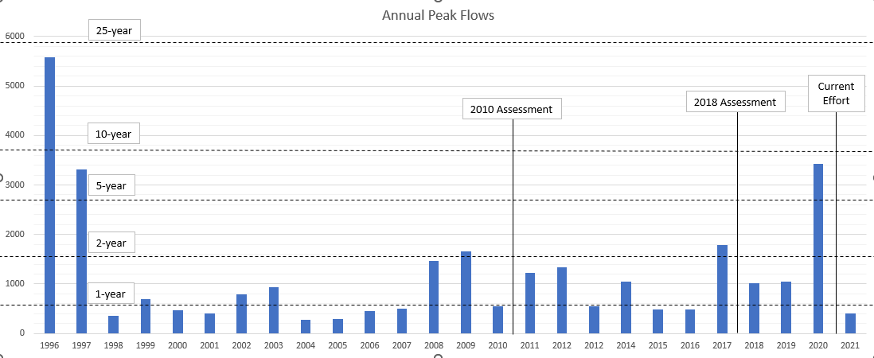
Restoration and Geomorphic Timeline
Flow At Starbuck Gage (cfs)
Notes:
Pull in historic high flows

Slide 10
What can this information tell us?
What is the geomorphic response in the Tucannon to a high flow event.
  DEM of Difference Geomorphic Change Detection
  Change in Transport Capacity
How does this affect the key habitat metrics
  Change in Complexity and Floodplain Connectivity
  HSI
What other metrics in the literature can be tracked?
  Geomorphic Unit Tool (GUT)
  Confinement Degree/Index

Slide 11
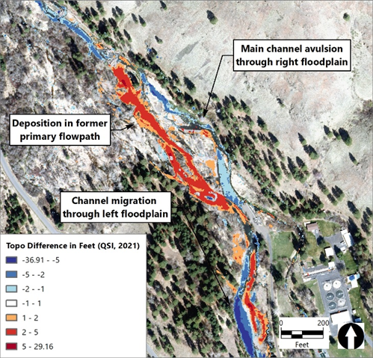
Geomorphic Change
Identify areas of Geomorphic Change
  Main Channel Deposition/Erosion
  Avulsions
  Channel Migration and Bar Building
  Floodplain Deposition
Find drivers of those changes
  Continued trends
  Large wood material build up
  Restoration
  Over confinement
PA 14.1

Slide 12
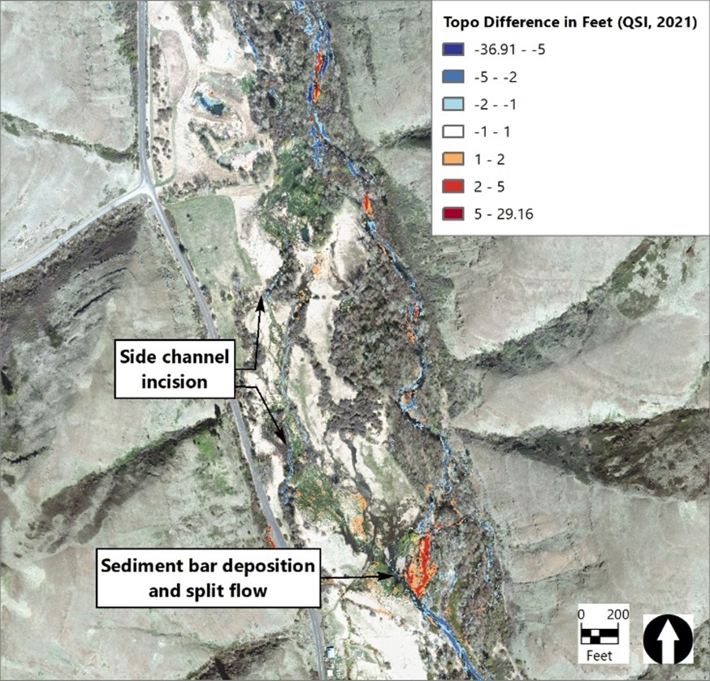
Geomorphic Change
Identify areas of Geomorphic Change
  Main Channel Deposition/Erosion
  Avulsions
  Channel Migration and Bar Building
  Floodplain Deposition
Find drivers of those changes
  Continued trends
  Large wood material build up
  Restoration
  Over confinement
PA 18.1

Slide 13
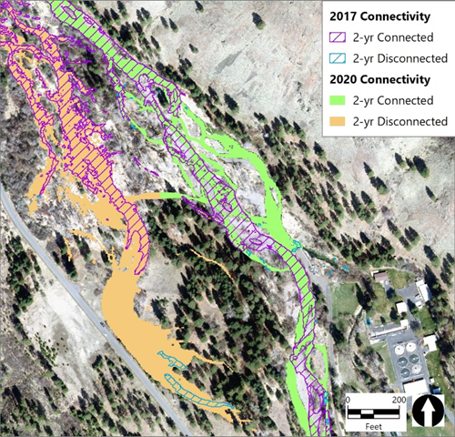
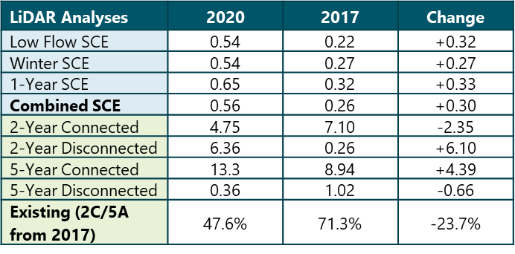
Change in FP Connectivity
PA 14.1

Slide 14
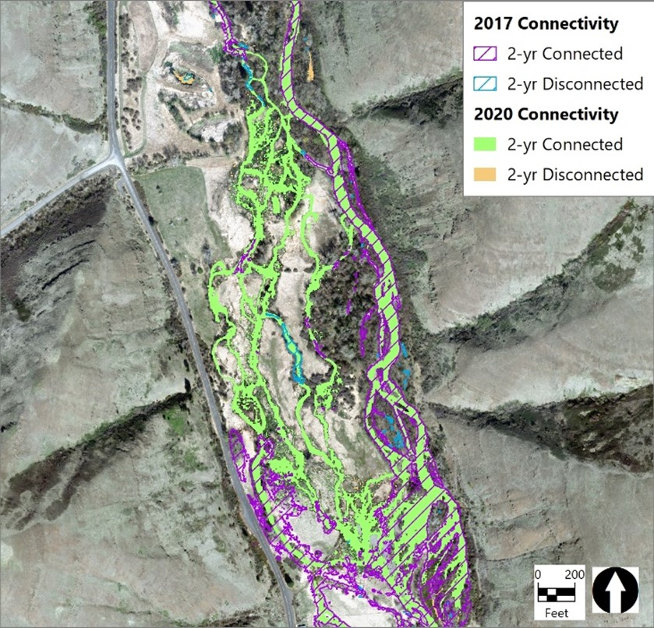
Change in FP Connectivity
LiDAR Analyses | 2020 | 2017 | Change
Low Flow SCE | 1.26 | 0.24 | +1.02
Winter SCE | 1.45 | 0.41 | +1.04
1-Year SCE | 1.61 | 0.49 | +1.12
Combined SCE | 1.40 | 0.36 | +1.04
2-Year Connected | 21.5 | 19.7 | +1.75
2-Year Disconnected | 0.37 | 0.48 | -0.11
5-Year Connected | 25.6 | 28.2 | -2.65
5-Year Disconnected | 0.52 | 0.74 | -0.22
Existing (2C/5A from 2017) | 74.2% | 68.2% | +6.00%
PA 18.1

Slide 15
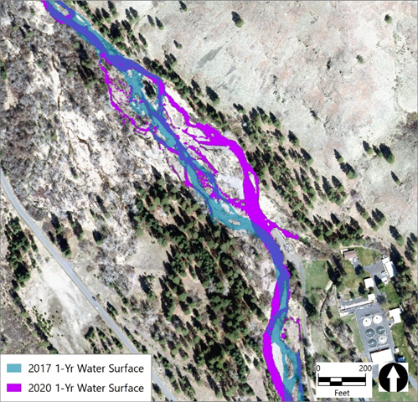
Change in Complexity
PA 14.1

Slide 16

Change in Complexity
LiDAR Analyses | 2020 | 2017 | Change
Low Flow SCE | 1.26 | 0.24 | +1.02
Winter SCE | 1.45 | 0.41 | +1.04
1-Year SCE | 1.61 | 0.49 | +1.12
Combined SCE | 1.40 | 0.36 | +1.04
2-Year Connected | 21.5 | 19.7 | +1.75
2-Year Disconnected | 0.37 | 0.48 | -0.11
5-Year Connected | 25.6 | 28.2 | -2.65
5-Year Disconnected | 0.52 | 0.74 | -0.22
Existing (2C/5A from 2017) | 74.2% | 68.2% | +6.00%
PA 18.1

Slide 17
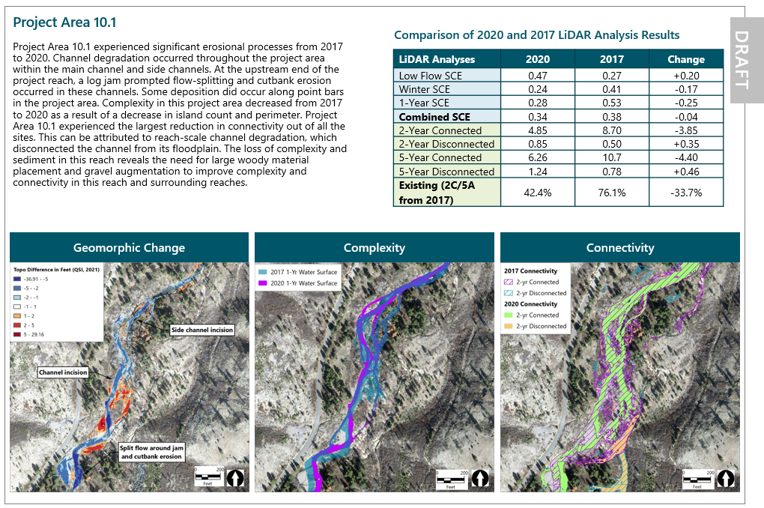

Slide 18
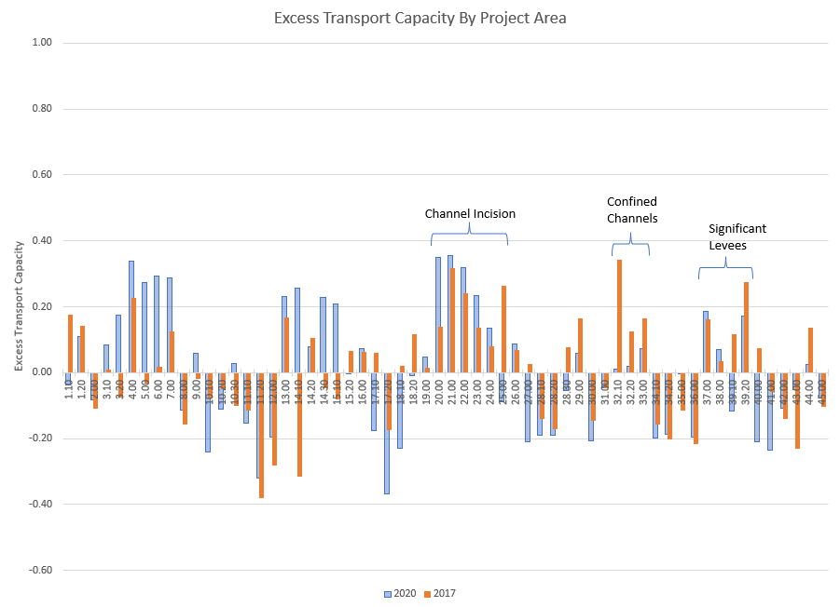
Change in Transport Capacity

Slide 19
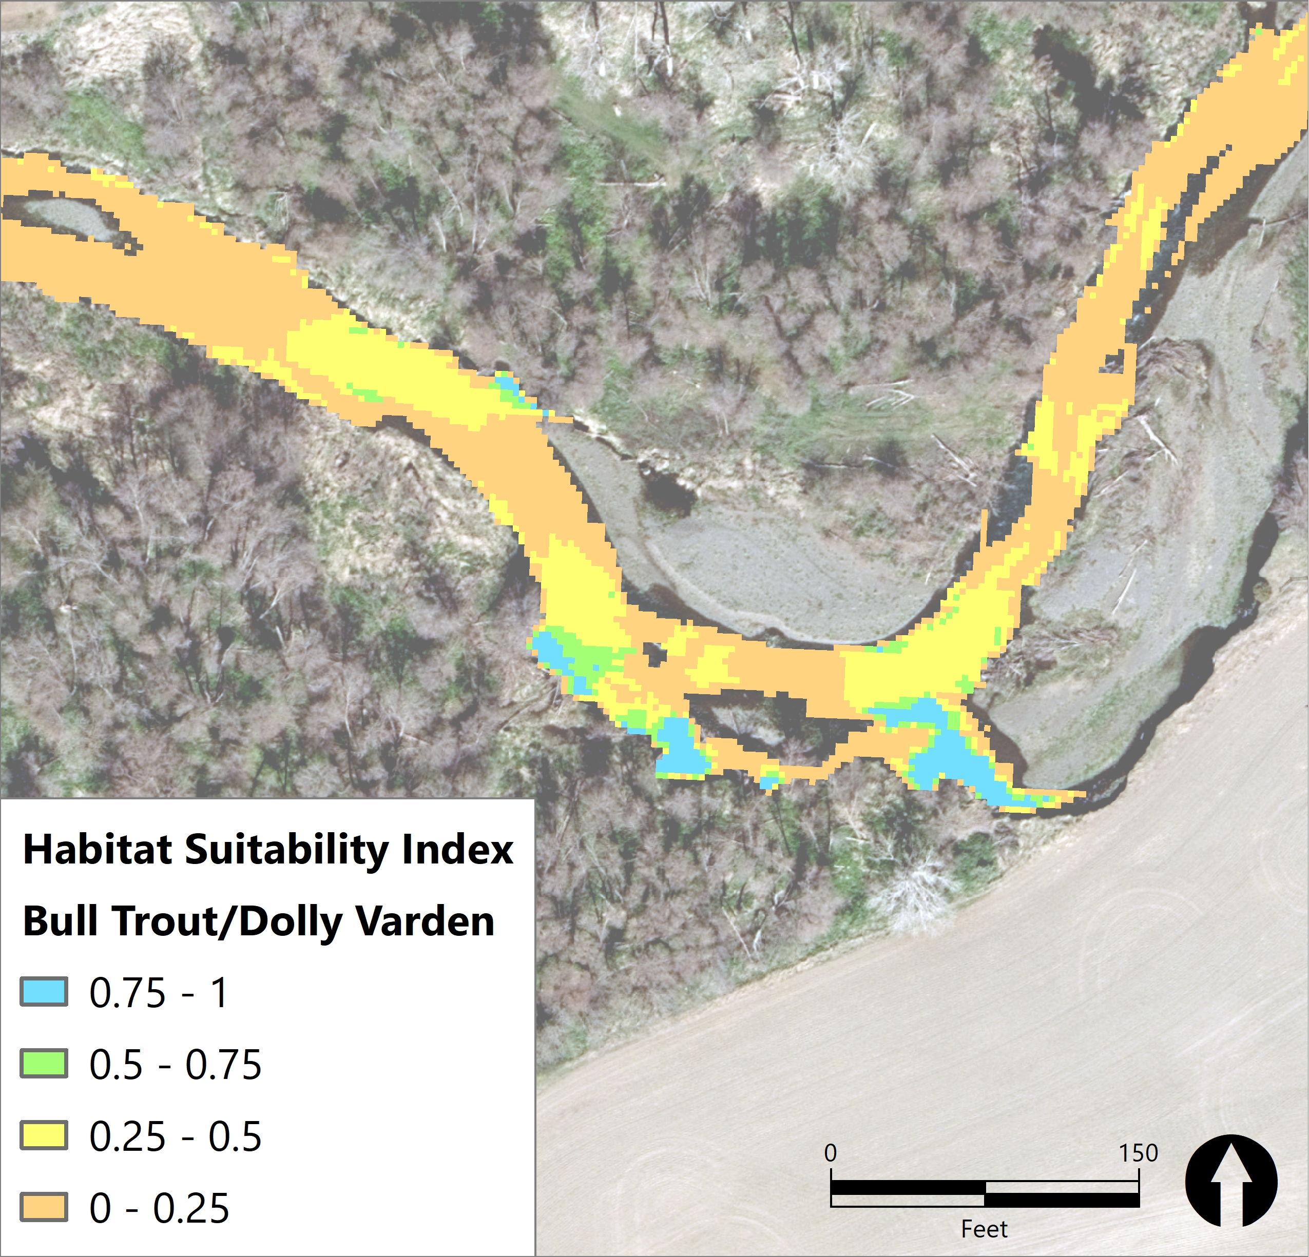
HSI and % Slow Water Habitat
Project Area | Flow Regime | Species | MEAN | MEDIAN | PCT90
36 | Low Winter | Bulltrout/Dolly Varden | 0.209 | 0.172 | 0.425
36 | Low Winter | Juvenile Chinook | 0.185 | 0.135 | 0.405
36 | Low Winter | Juvenile Steelhead | 0.211 | 0.138 | 0.501
36 | Mean Winter | Bulltrout/Dolly Varden | 0.149 | 0.066 | 0.375
36 | Mean Winter | Juvenile Chinook | 0.118 | 0.066 | 0.300
36 | Mean Winter | Juvenile Steelhead | 0.159 | 0.100 | 0.369
36 | 1-year | Bulltrout/Dolly Varden | 0.113 | 0.000 | 0.365
36 | 1-year | Juvenile Chinook | 0.098 | 0.000 | 0.300
36 | 1-year | Juvenile Steelhead | 0.124 | 0.051 | 0.329

Slide 20
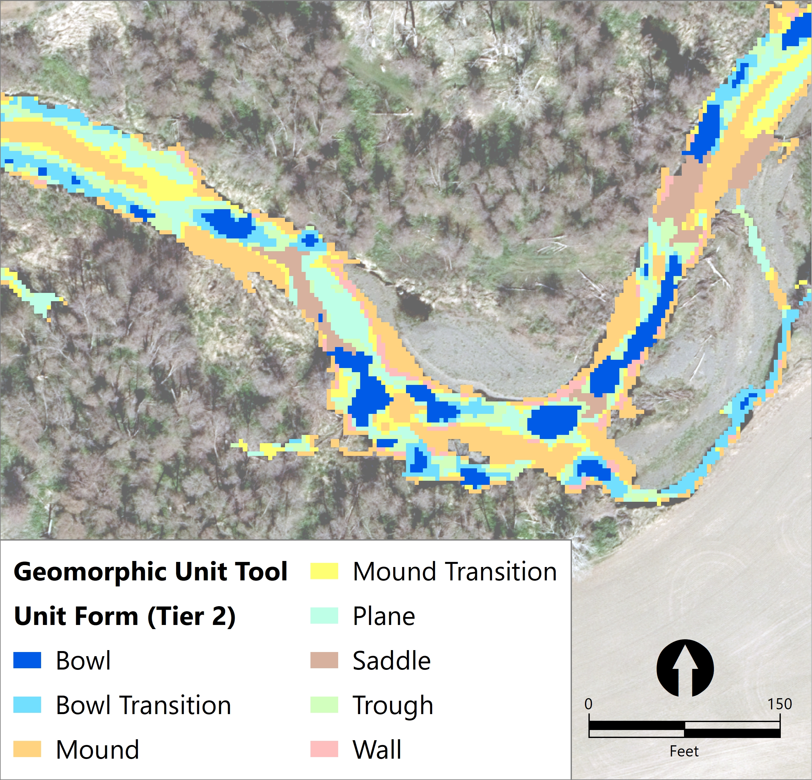
Geomorphic Unit Tool (GUT)
Identifies geomorphic units in 3 tiers of detail
Based on topography, bankfull with and thalweg identification
“Bowls” are areas that may indicate the presence of a pool when LiDAR was flow.
Summarized Bowl (Pool) Statistics for Each PA

Slide 21
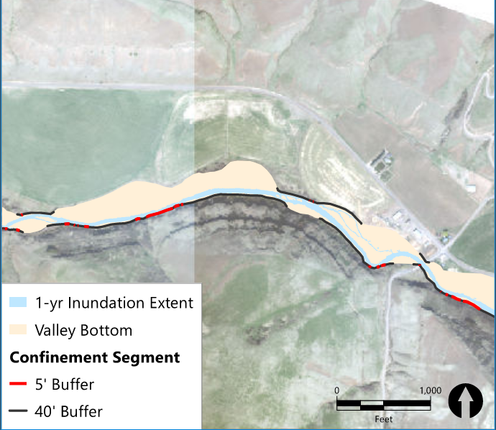
Confinement Index/Degree
Delineated Valley Bottom and Alluvial Plain
Confinement Degree
  Where bankfull channel is limited by the valley bottom.
  Directly (5’) or within 1 channel width (40’)
Confinement Index
  Width of Channel Compared to width of alluvial plain

Slide 22
Long Term Story of Restoration
  What watershed scale story can we tell about restoration with this information?
  Why have some restoration efforts sustained through flow events, while others have not?
  What is the effect of restoration projects on reaches immediately upstream and downstream?

Slide 23
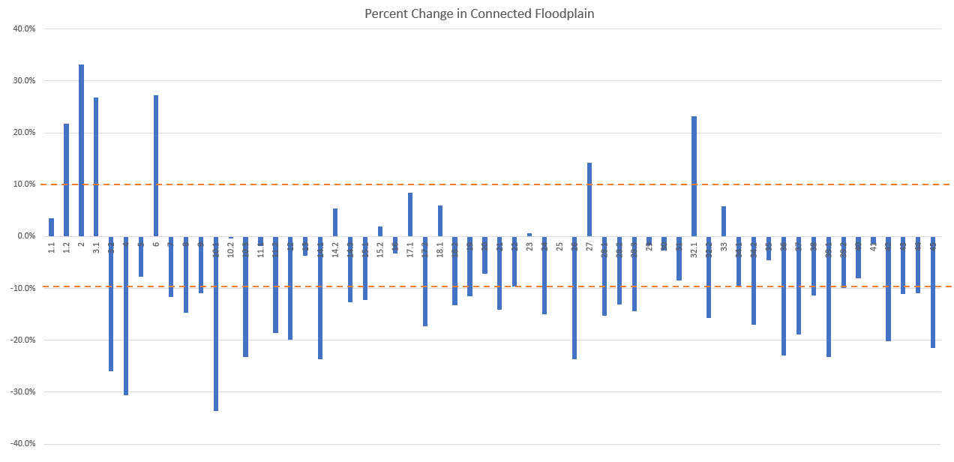
General trend of decrease in FP Connectivity

Slide 24
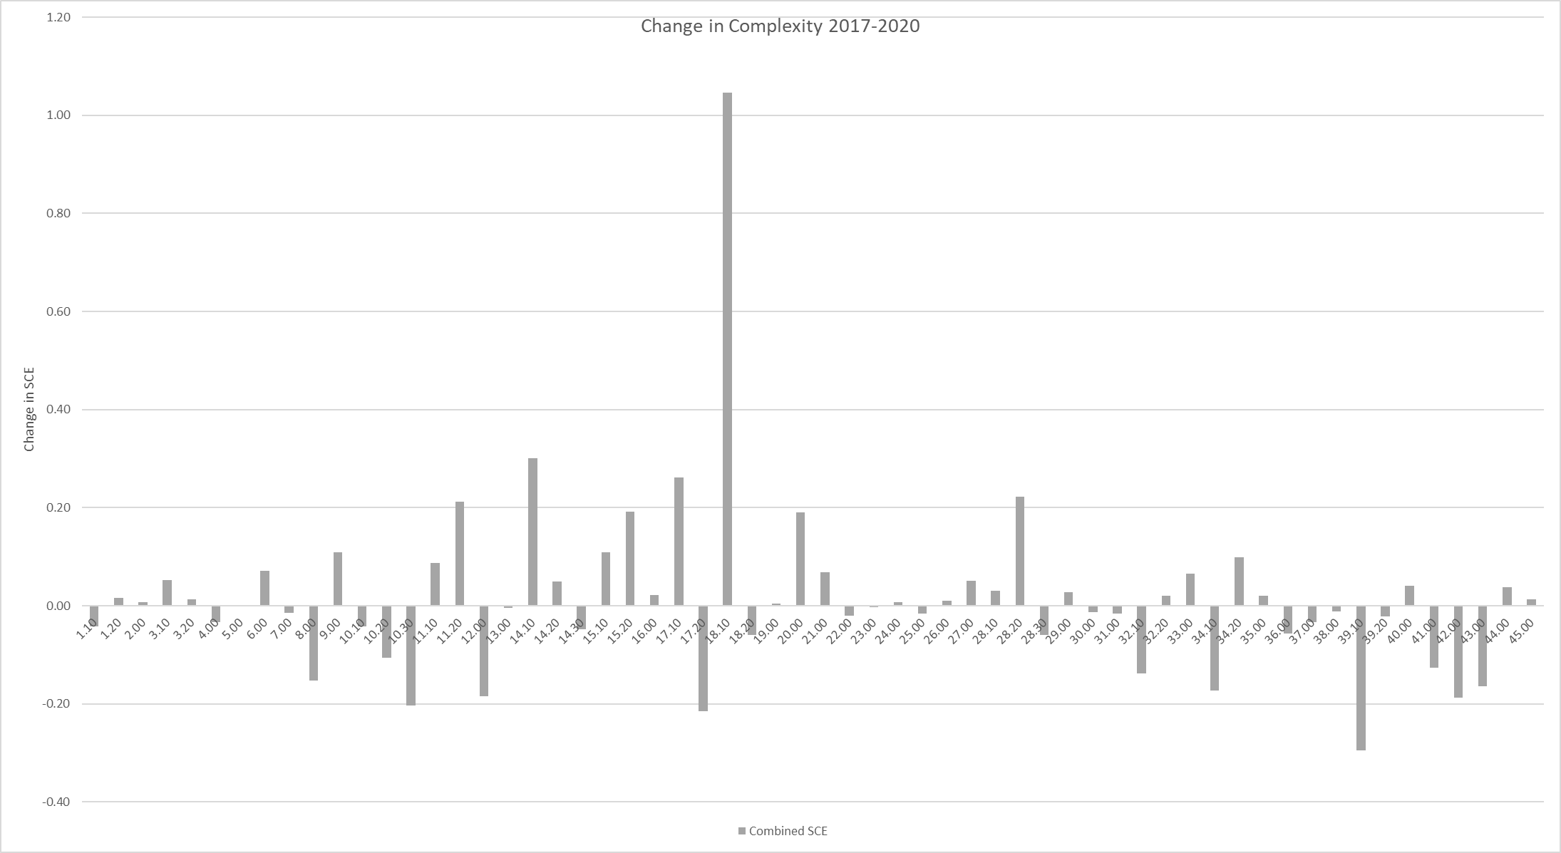
Restored Sites with Positive Response
Restored Sites with No Response
Restored Sites with Negative Response
Notes:
Highlight 18.

Slide 25
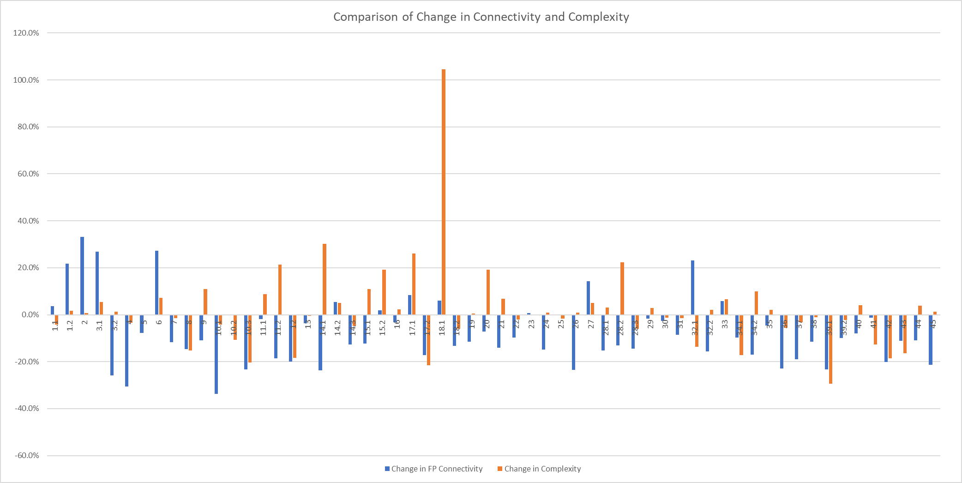
Restored Sites with Different Connectivity and Complexity Response

