Slide 1
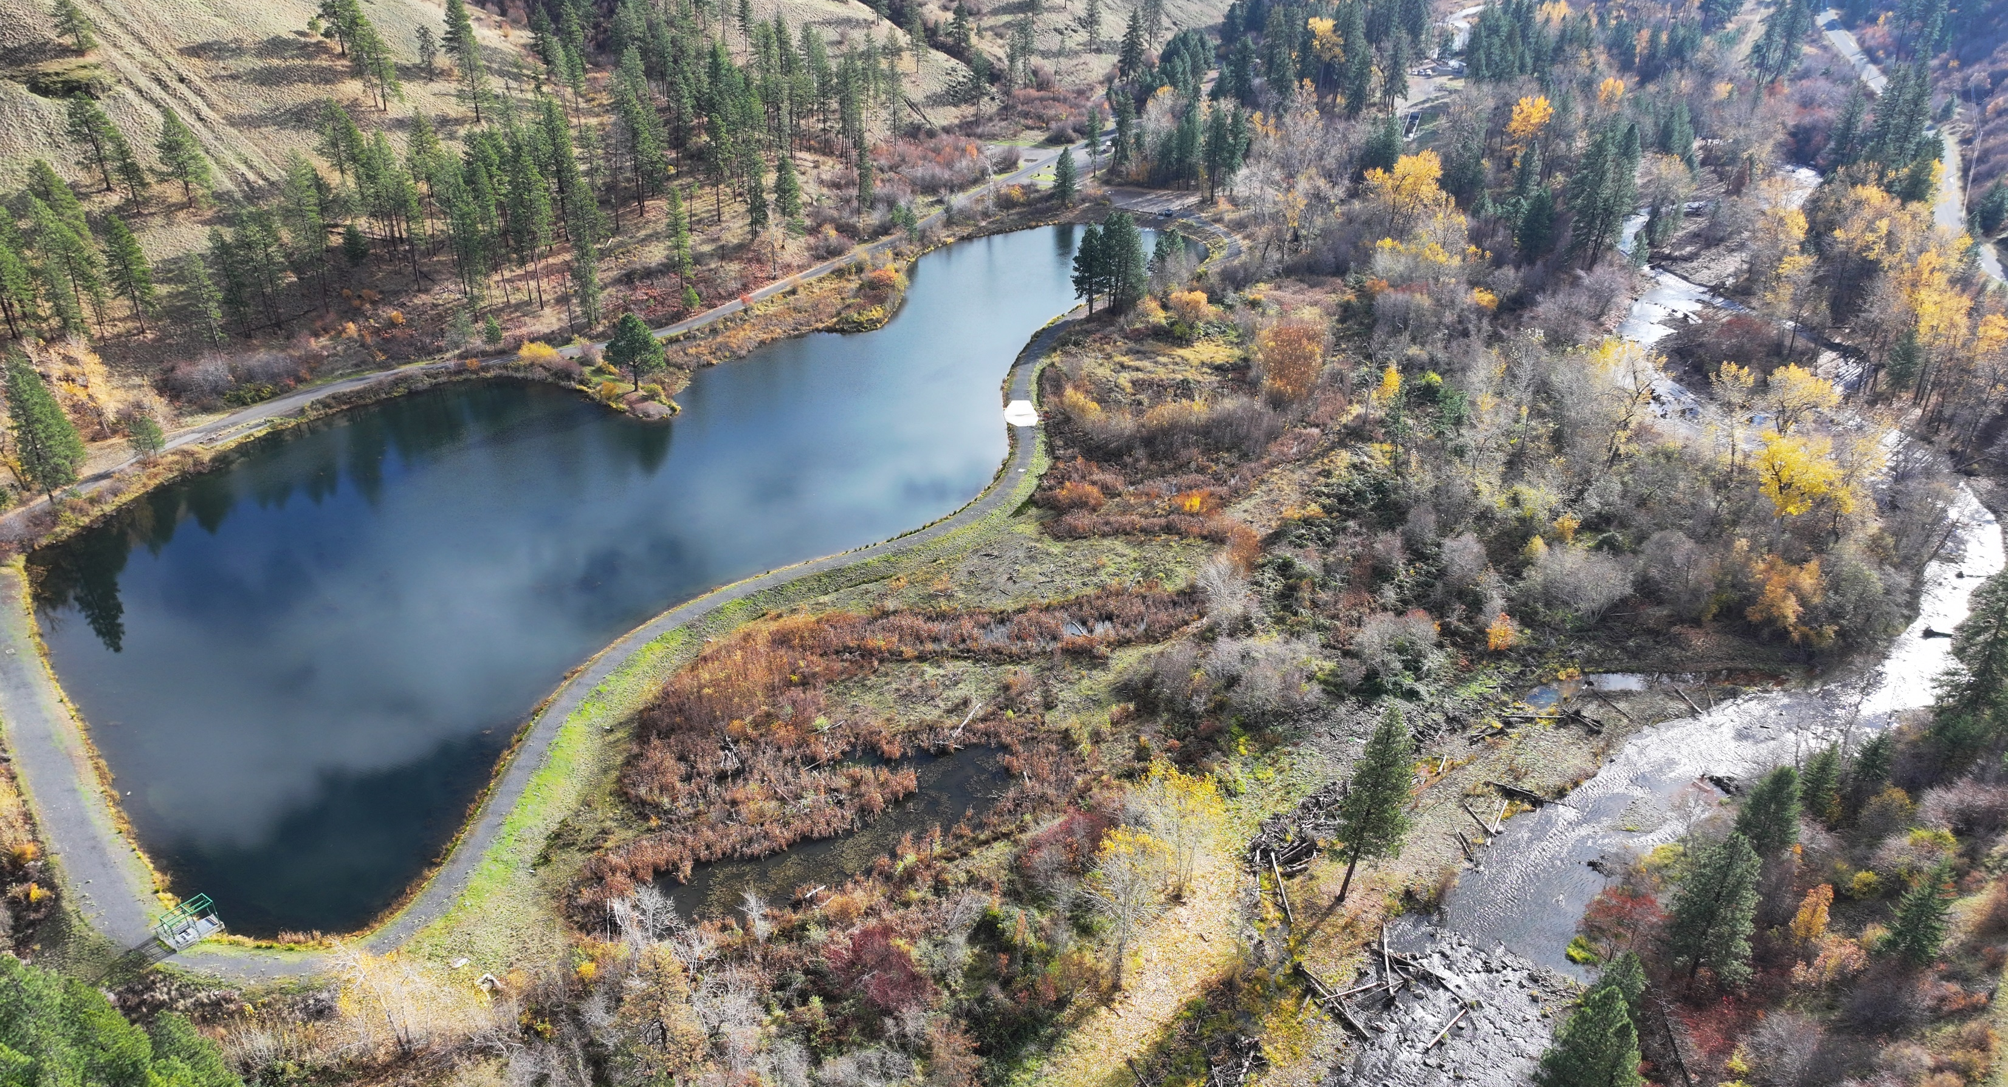








Tucannon River (PA 5-15) W.T. Wooten Wildlife Area - Assessment and Conceptual Design Project Update
Rainbow Lake, 2024
Kris Fischer -
CTUIR Tucannon Basin Fish Habitat Enhancement Project Leader
CTUIR Fish and Wildlife Commission 4/8/25
Liz Eastman, NPT Fisheries

Slide 2
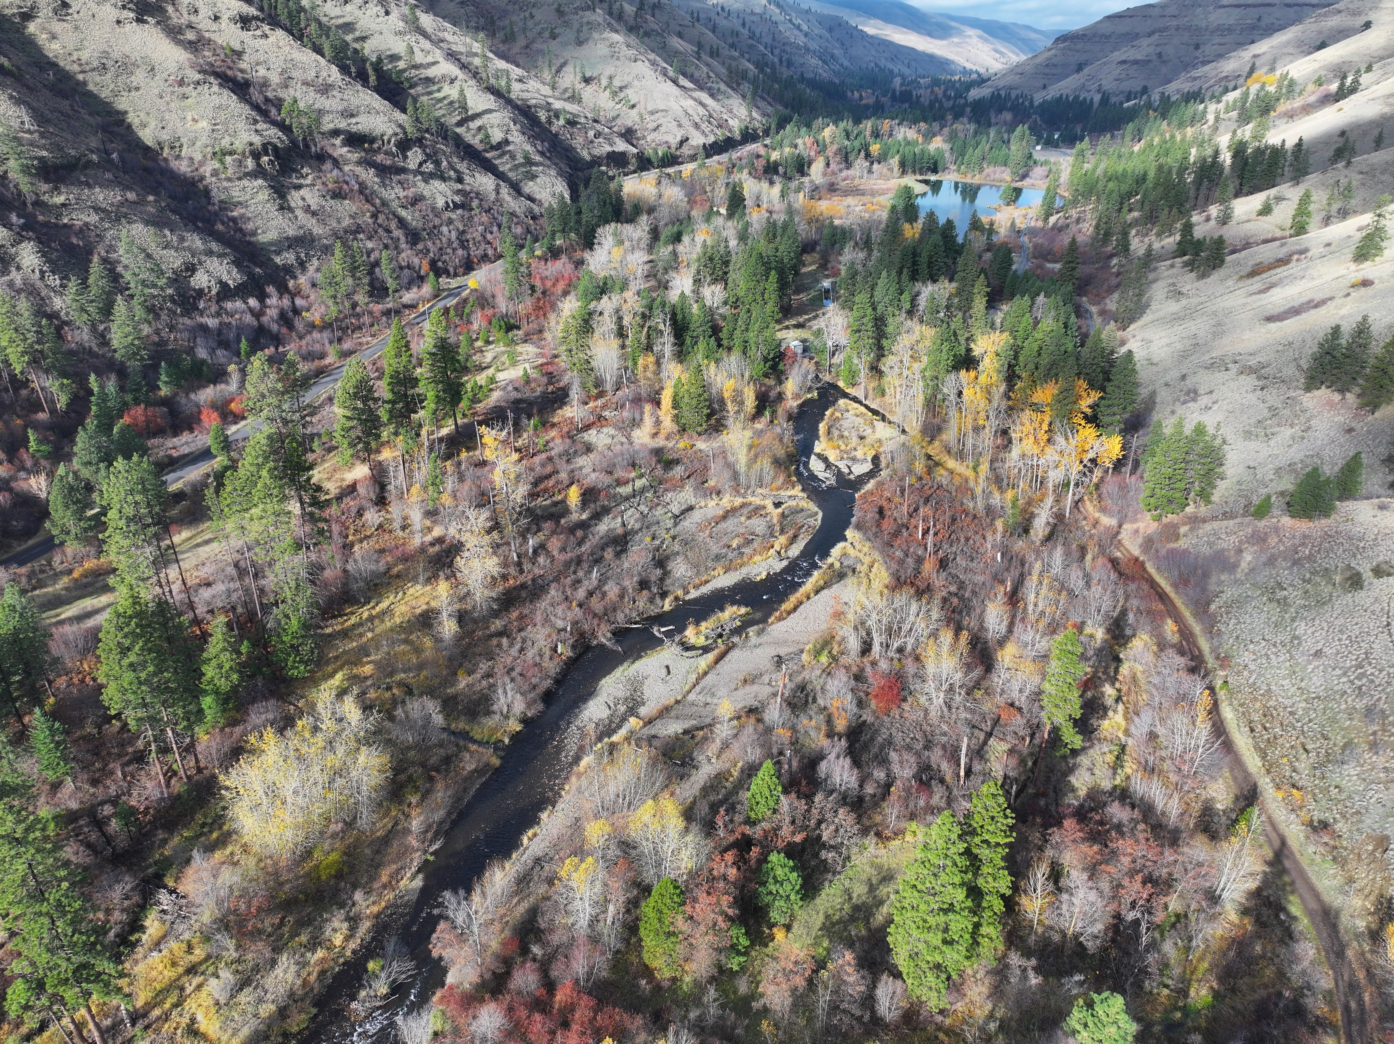
OUTLINE
Introduction and Need
Project Goals
Approach
Next Steps and Opportunity to Provide Input
Photo: Liz Eastman, NPT Fisheries

Slide 3
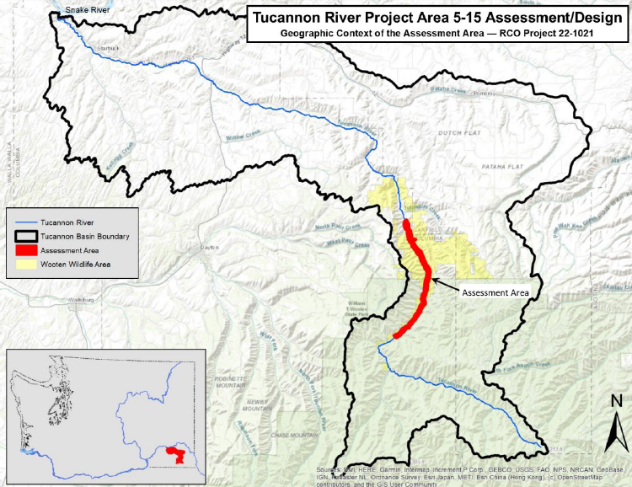

Slide 4


Action Needed: Chinook Reaching Quasi-Extinction Status Fewer than 50 wild pairs showing up

Slide 5

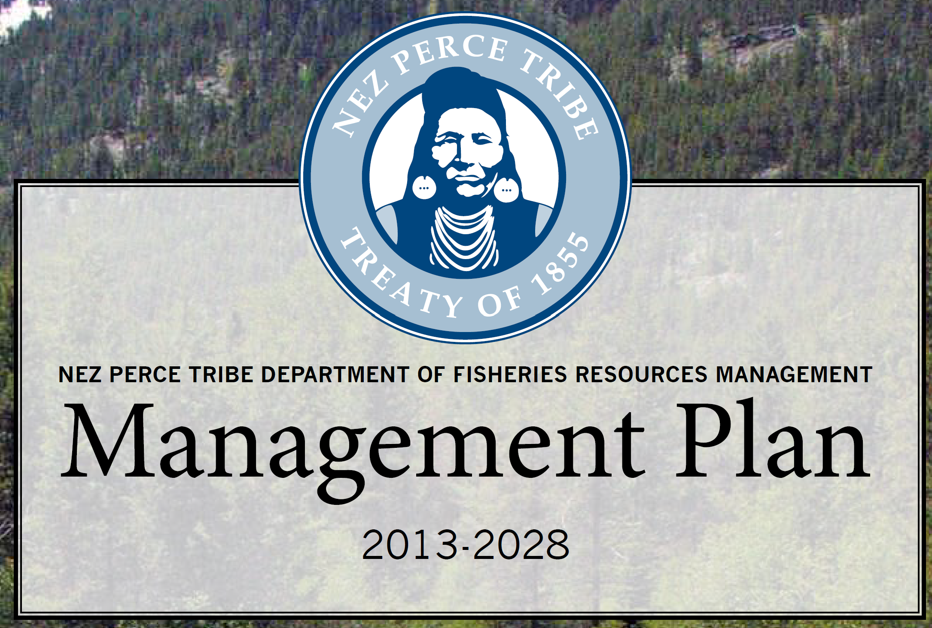
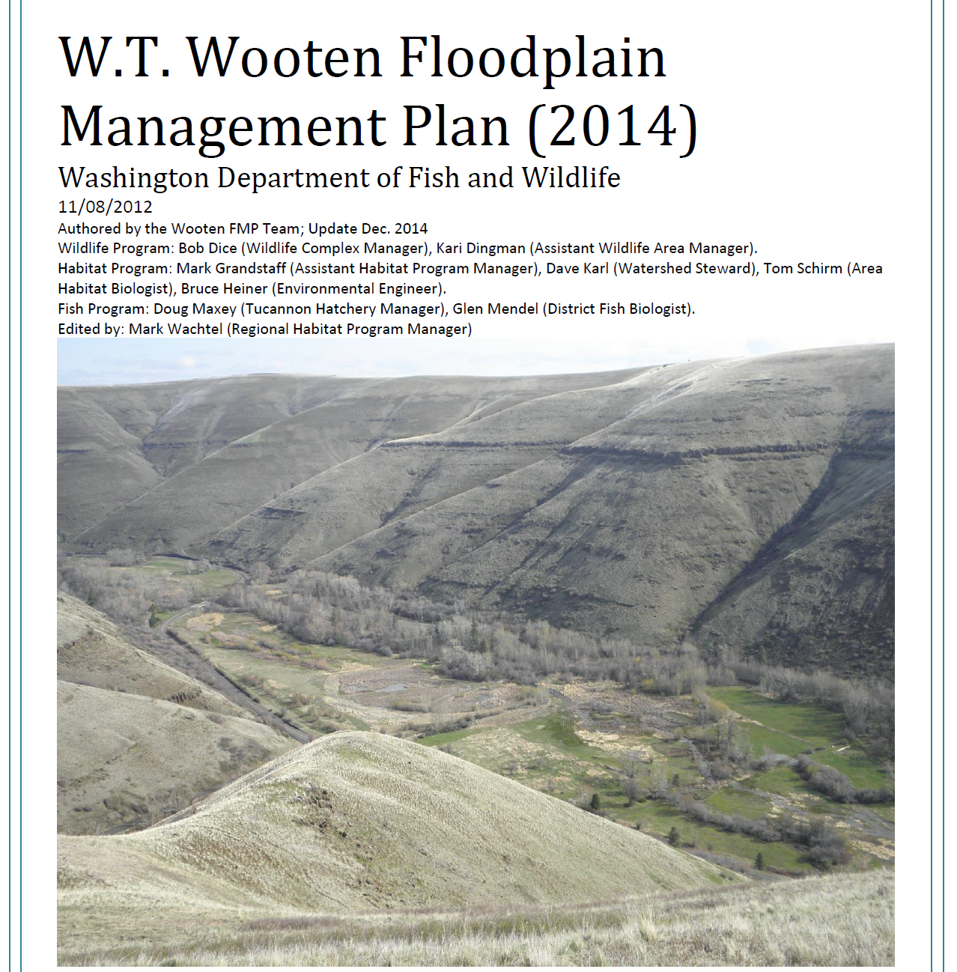




Co-Management Model
CTUIR River Vision
Riparian Vegetation
Connectivity
Hydrology
Geomorphology
Aquatic Biota

Slide 6
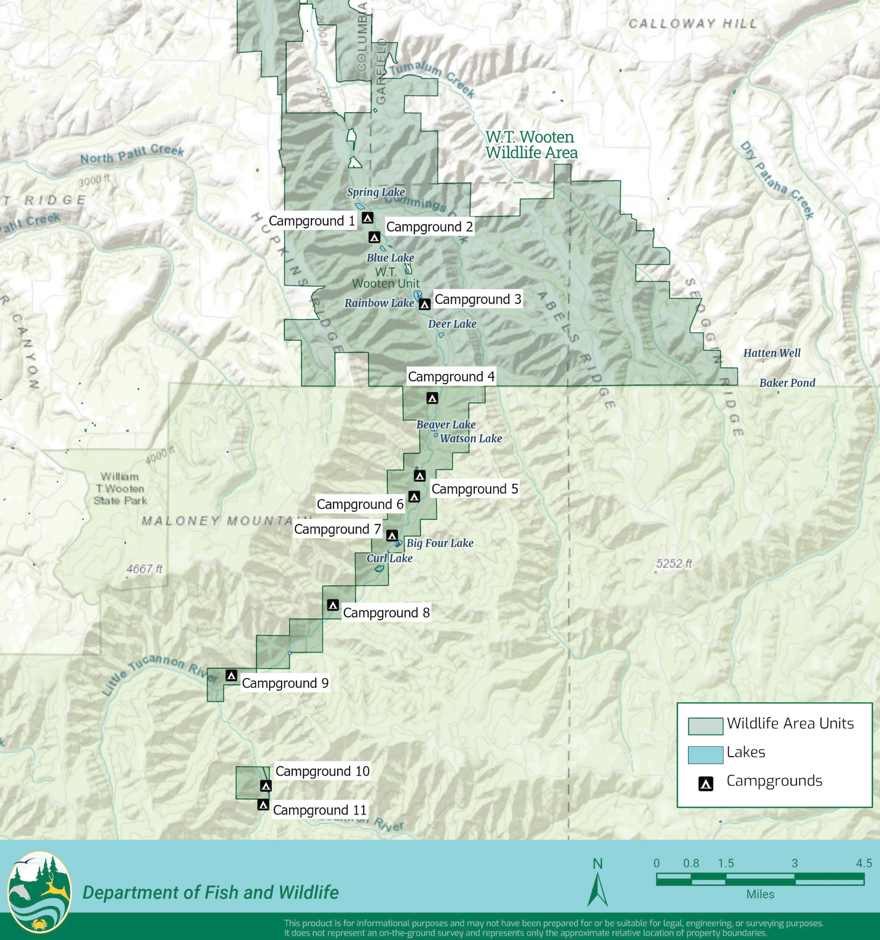
Project Area Highlights
~10 miles of river
Valley bottom ~ 1,000 feet wide
8 lakes in floodplain (not including Camp Wooten)
8 campgrounds
Tucannon Fish Hatchery
Full road access along valley

Slide 7
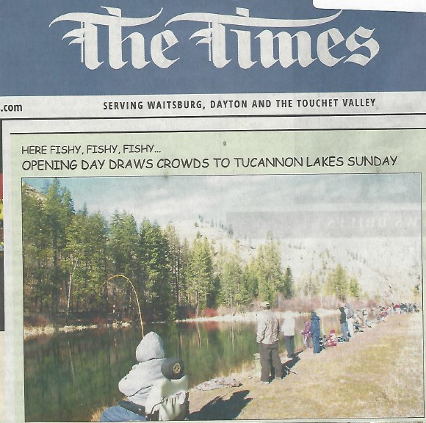

Slide 8
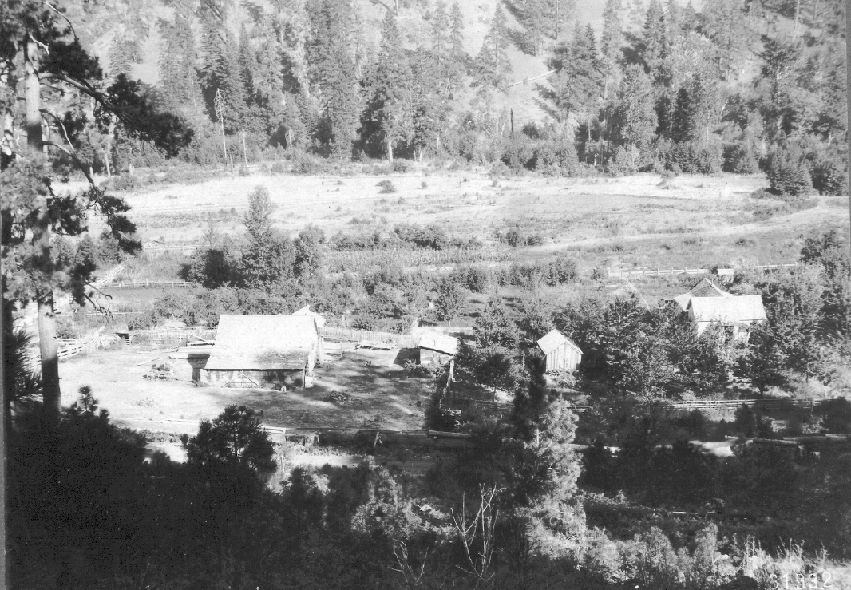
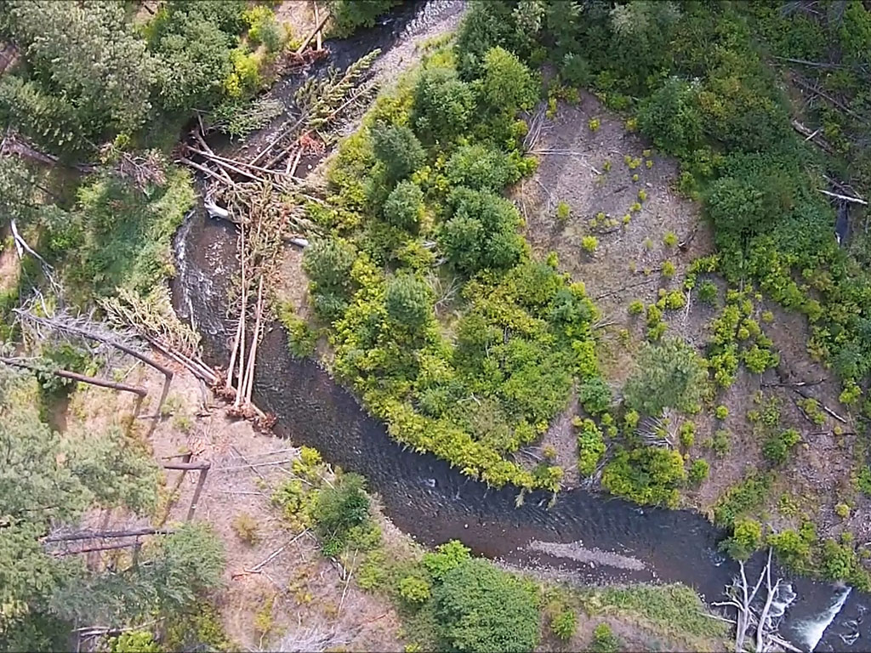
Project Area History
Tucannon R. is the ancestral boundary between the Umatilla and Nez Perce Tribes
Homesteading and logging period (late 1800s-early 1900s)
WDFW acquires land (1941-1943)
Lakes constructed in compensation for Lower Snake Dams (1950s)
Road improvements and recreational uptick (1970s)
Restoration period (1990s-present)
USFS

Slide 9
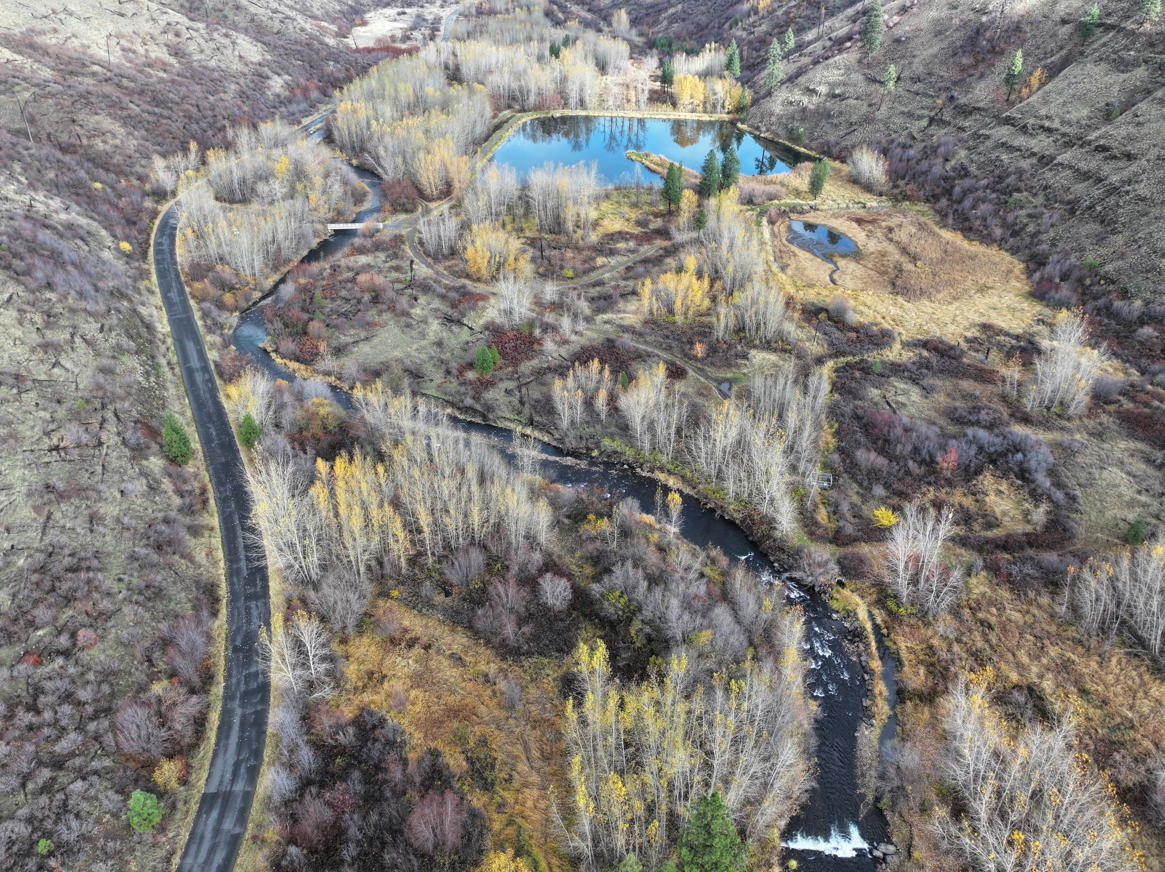
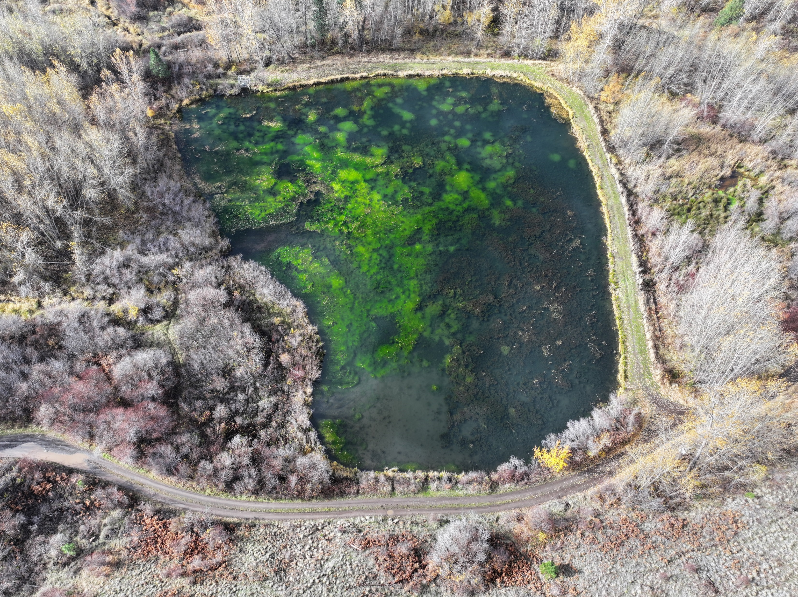
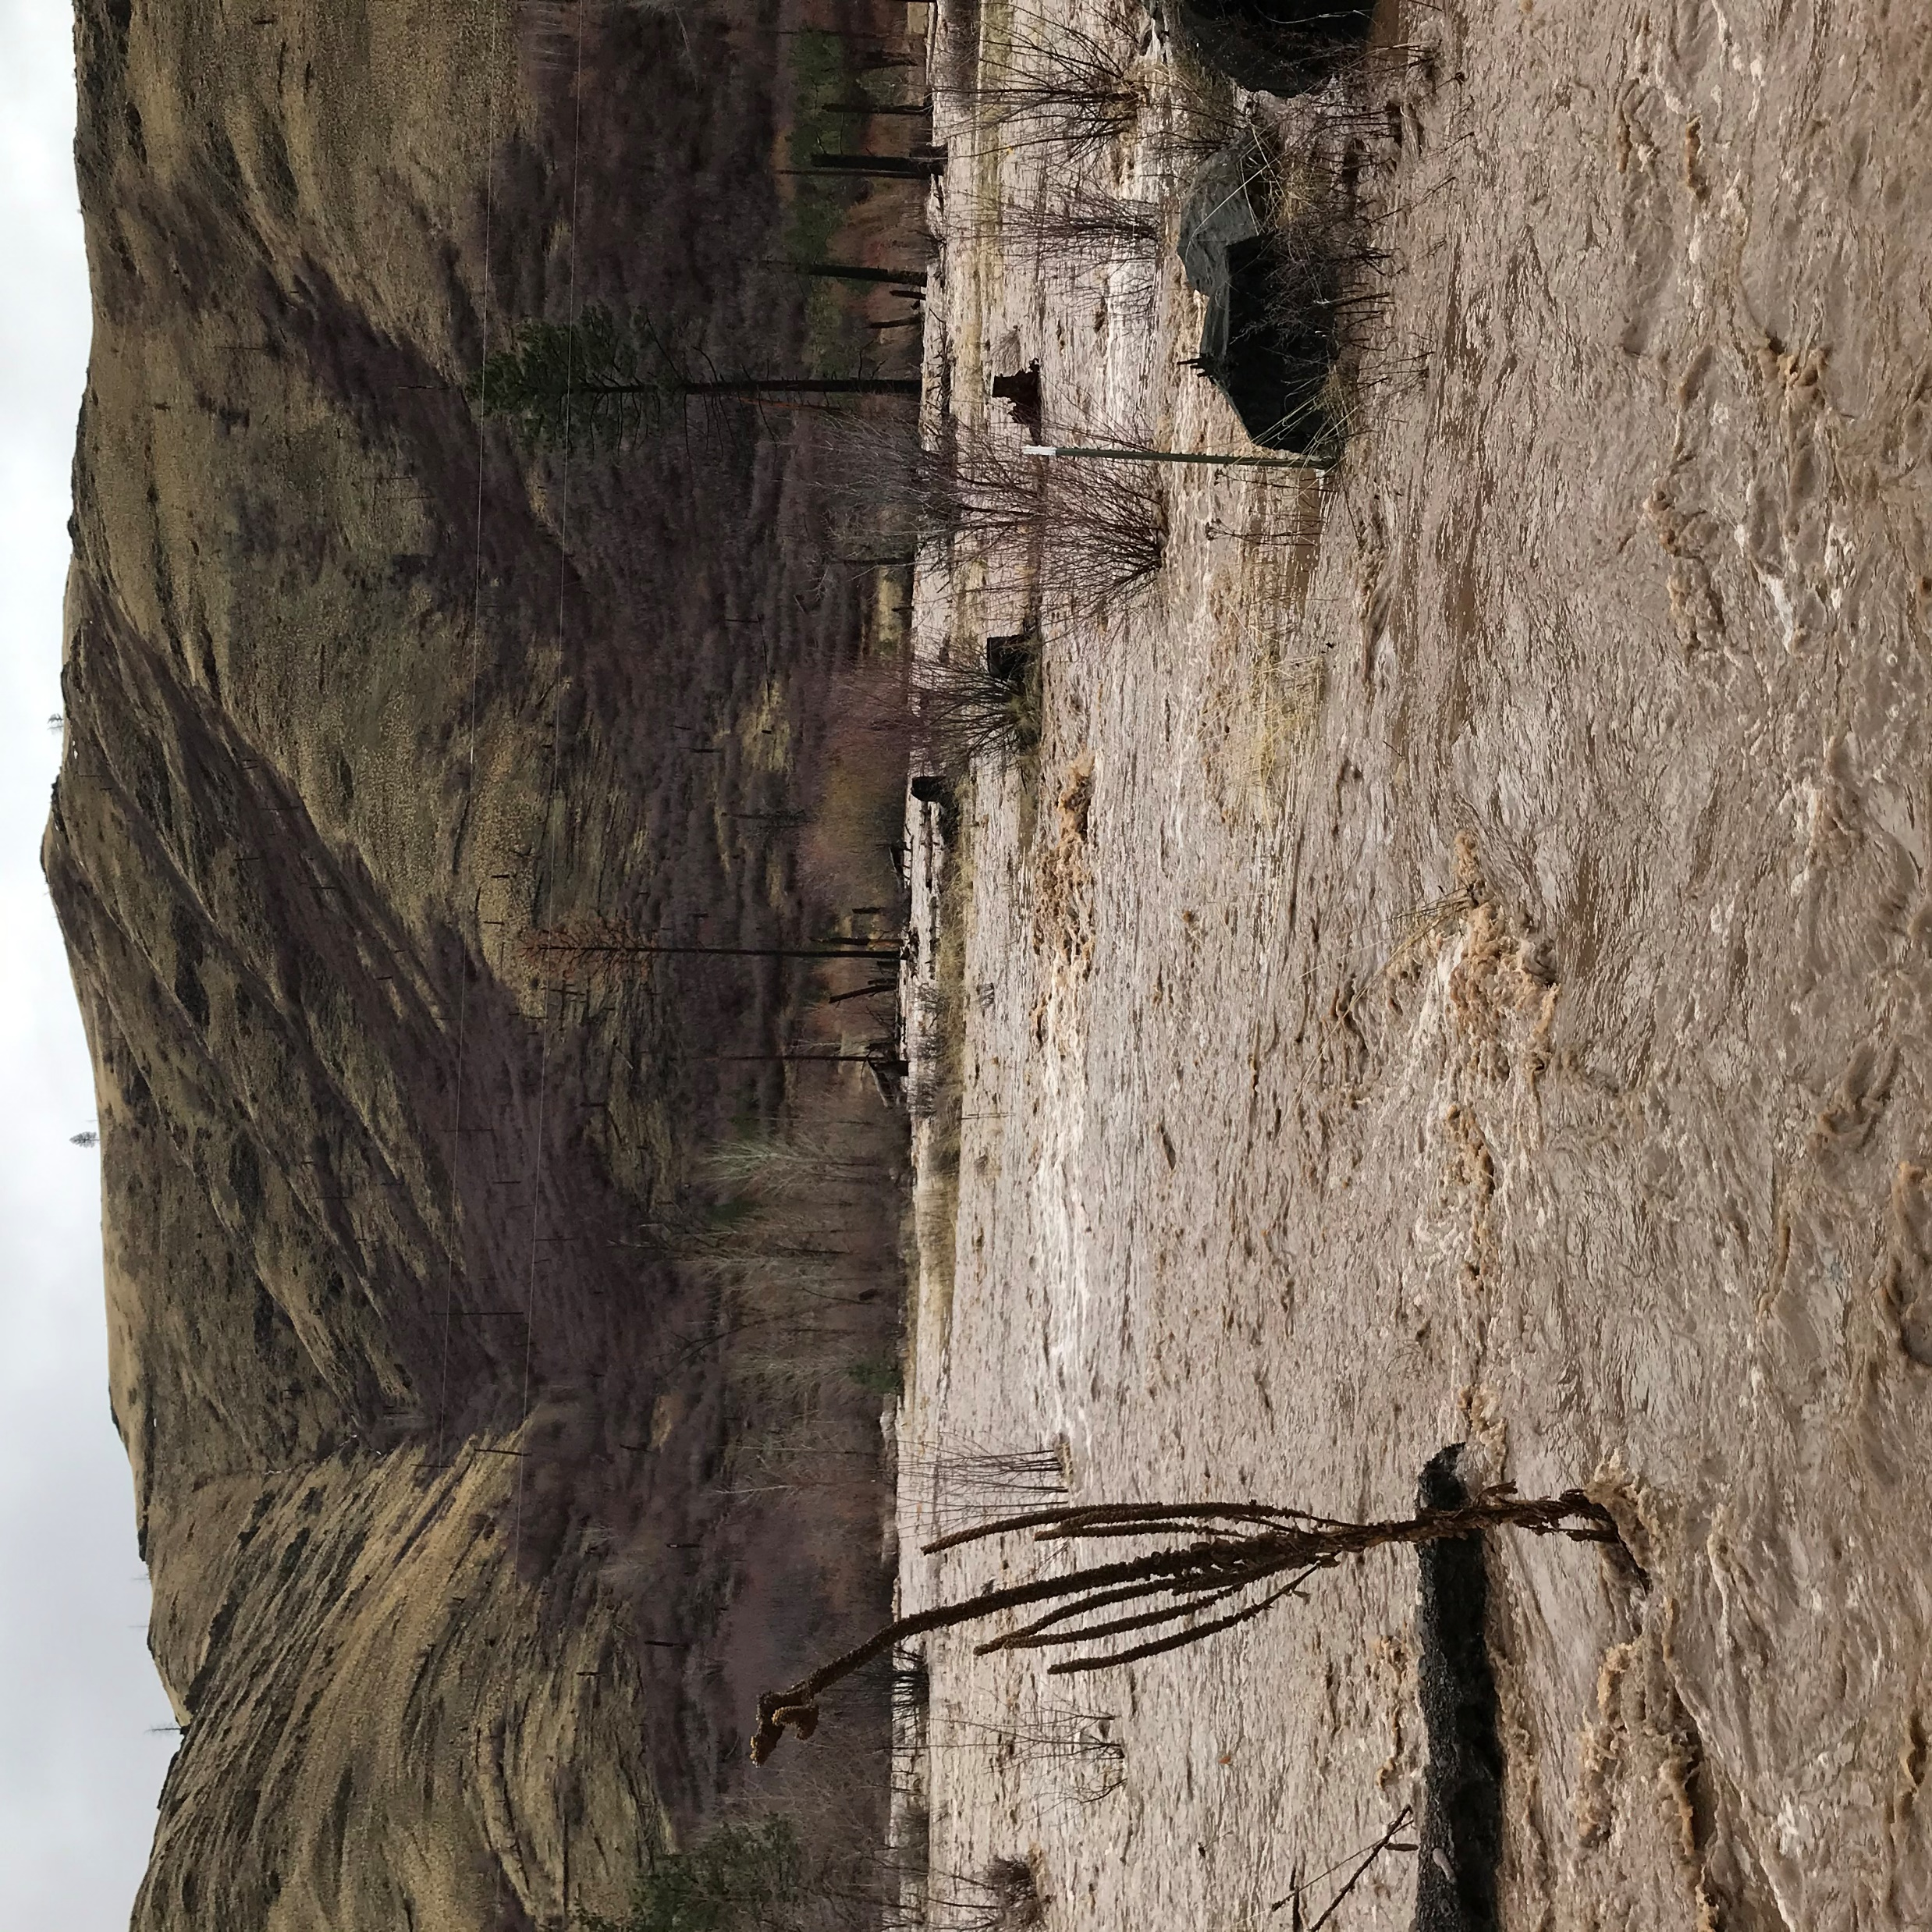
Erosion at Road
Degraded Dams
Edge of Historical Floodplain
Watson Lake
Algae Blooms
Bridge
Beaver Lake
Erosion at Road
Incision
Intake Channel
Large Floods
The status quo isn’t sustainable
Photo: Liz Eastman, NPT Fisheries

Slide 10
Comprehensive, Multi-Use Strategy Needed
Fish and Ecosystems
Some Considerations
Urgency for salmon recovery
Long-term investments
Needs to be sustainable for land managers (WDFW)
Climate change is a disruptor
Community input is critical
Recreation and Human Connection
Infrastructure

Slide 11
Project Vision
Restore physical and ecological floodplain function to benefit key fish and aquatic species, while broadening and enhancing recreational opportunities, through coordinated planning and conceptual restoration designs for the floodplain and adjacent lands of WT Wooten Wildlife Area.

Slide 12
Project Goals
Floodplain Infrastructure: Assess the impacts of floodplain confining infrastructure on listed salmonids habitat, as well as other aquatic species.
Lakes Management: Identify management needs and potential alternatives for each of the Tucannon Lakes.
River Assessment and Design: Develop an assessment and accompanying conceptual designs to prioritize the restoration of physical and ecological functions of the river, floodplain, and riparian habitats.
Salmon Recovery: Restoration actions will maximize recovery potential for ESA-listed spring Chinook, summer steelhead, and bull trout on the Tucannon River.
Recreational Uses and Benefits: Restoration actions will account for the multi-use nature of the project area.
Actionable Plan: Prioritized conceptual designs will provide direction to the co-managers for implementation of restoration construction projects.

Slide 13
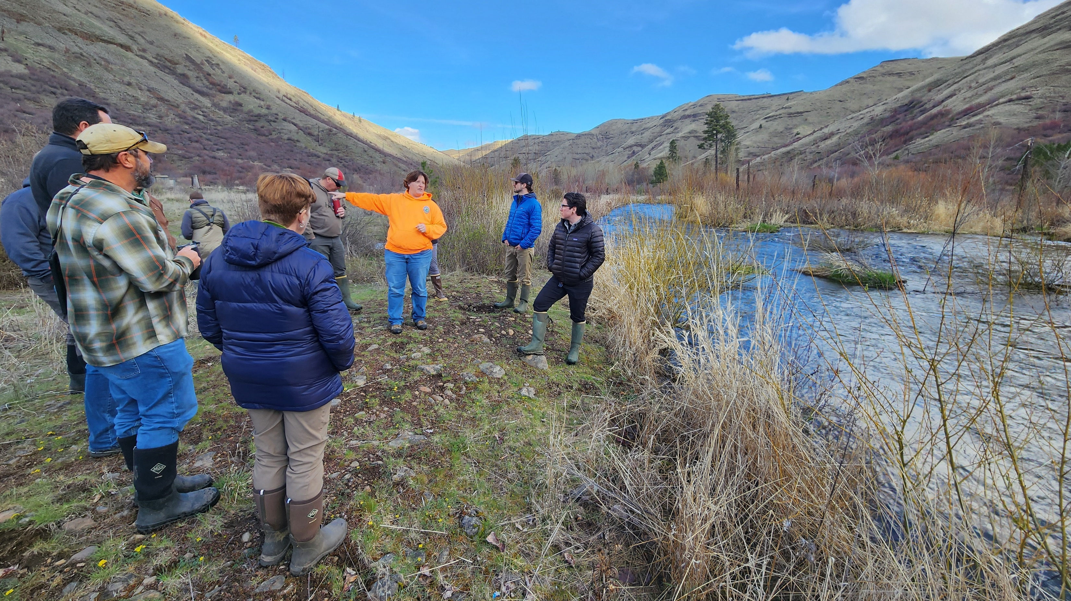

Slide 14
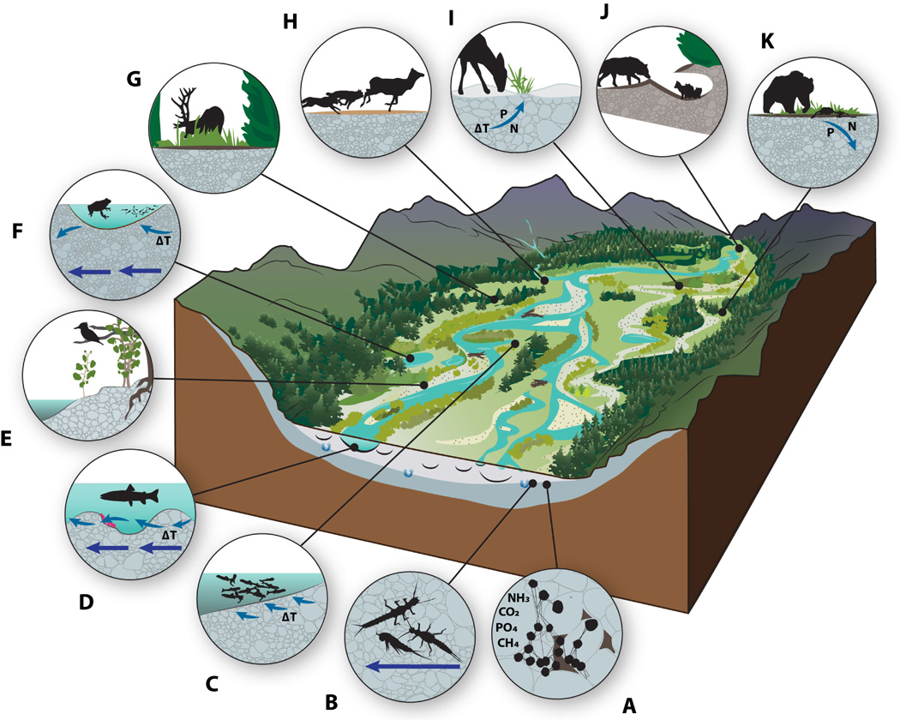
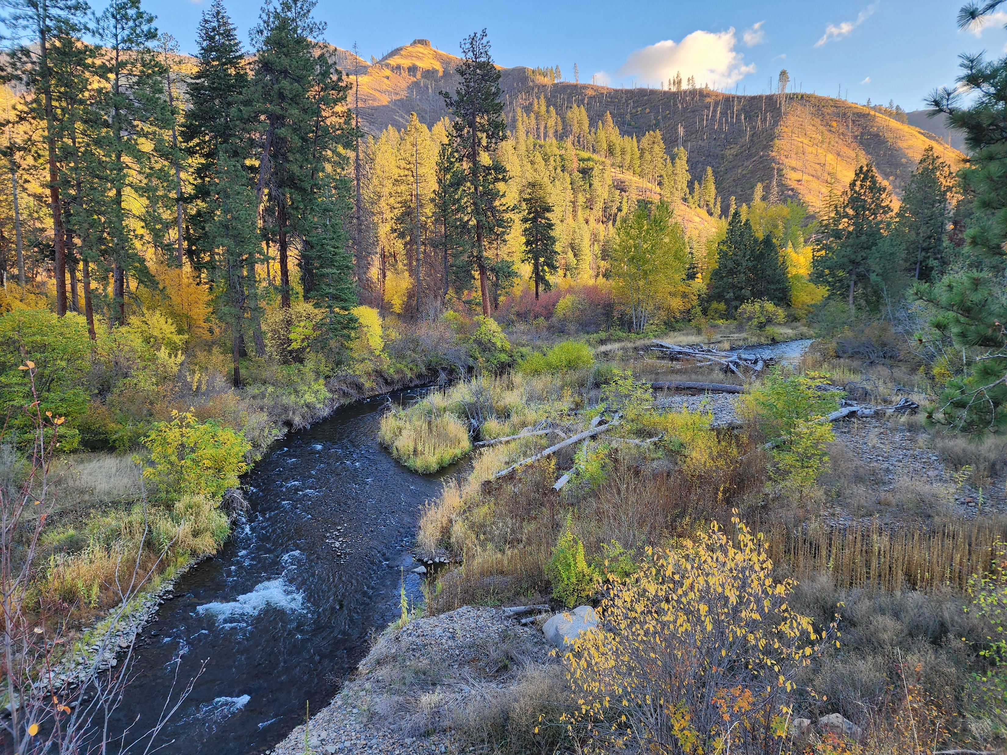
Floodplains are Key
Hauer et al. (2016)

Slide 15
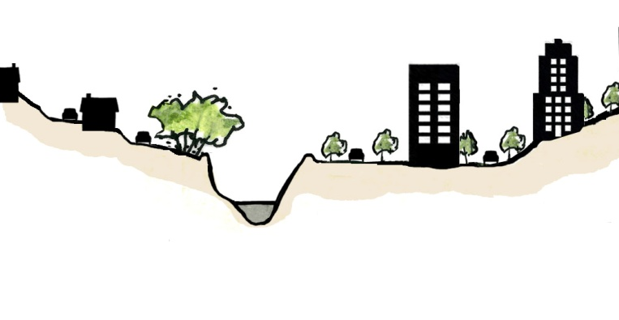
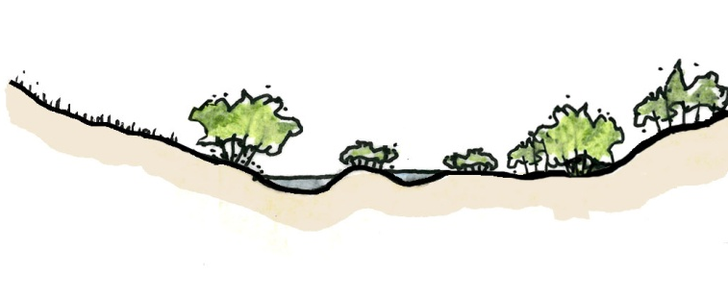
Lateral and Vertical Disconnection of Floodplains
Historic Floodplain or Valley Bottom
Laterally Constrained Floodplain
Incision Causes Further Disconnection

Slide 16
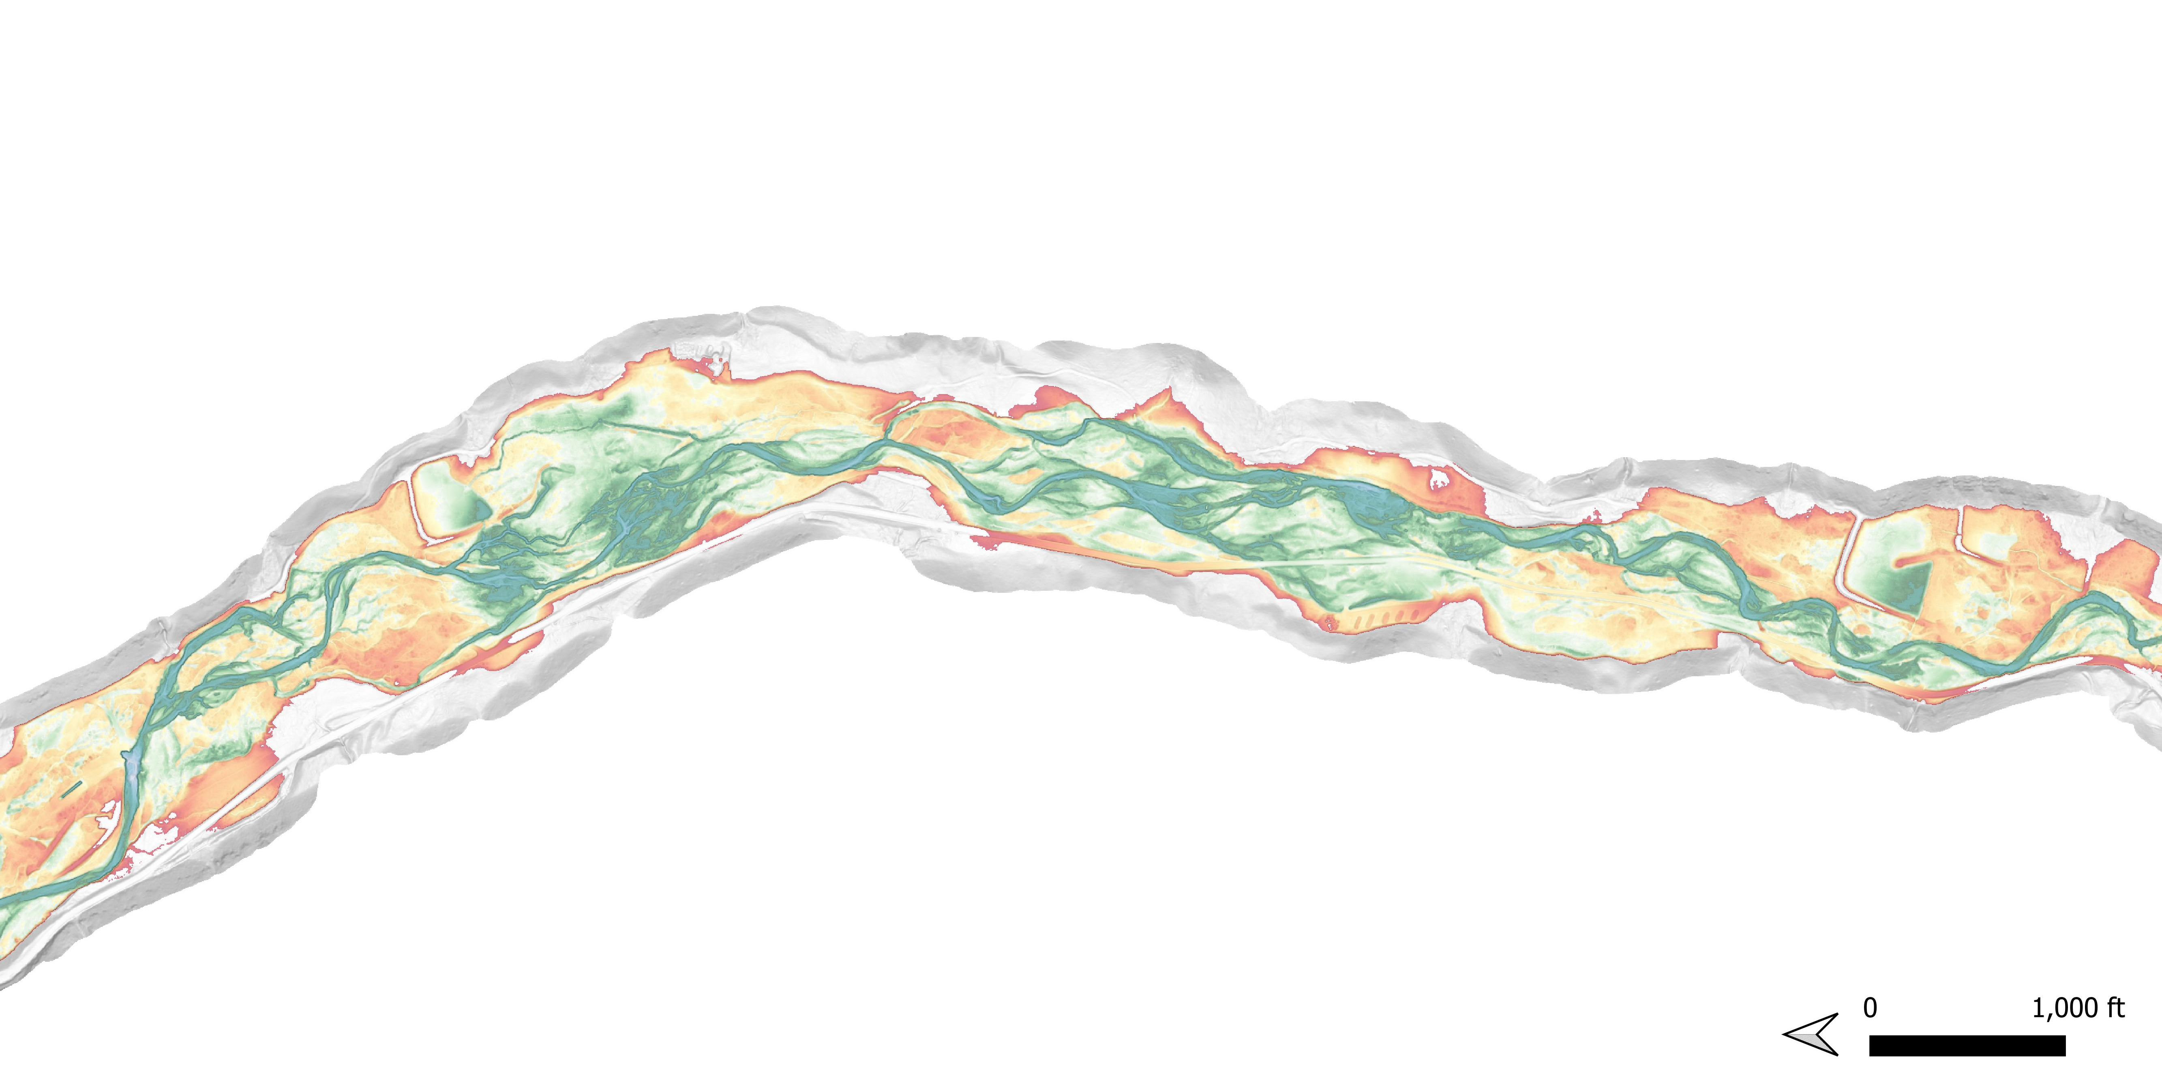
State of the Floodplain
Yellows/Reds– Above regular flooding levels
Greens – At or below regular flood levels
Blues – At or below river level
Deer Lake
Beaver/Watson Lake
Flow

Slide 17
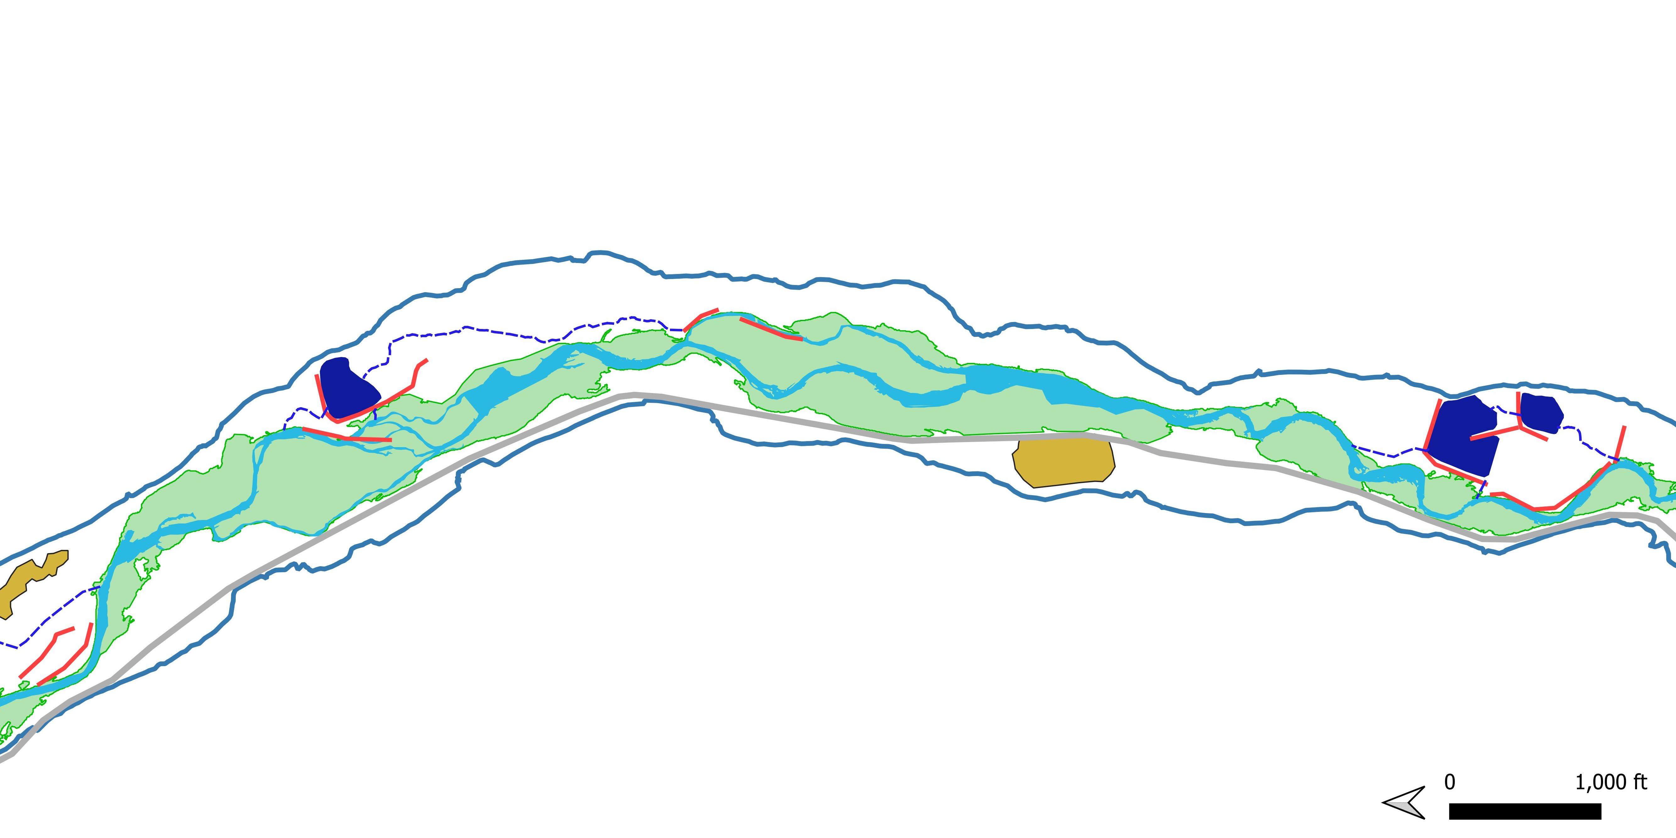
State of the Floodplain
Connected Floodplain (green)
Beaver and Watson Lakes
Historic Floodplain
Deer Lake
Campground
Key Drivers of Disconnection:
Lakes (and their intakes)
Levees
Roads
Stream incision
Flow

Slide 18
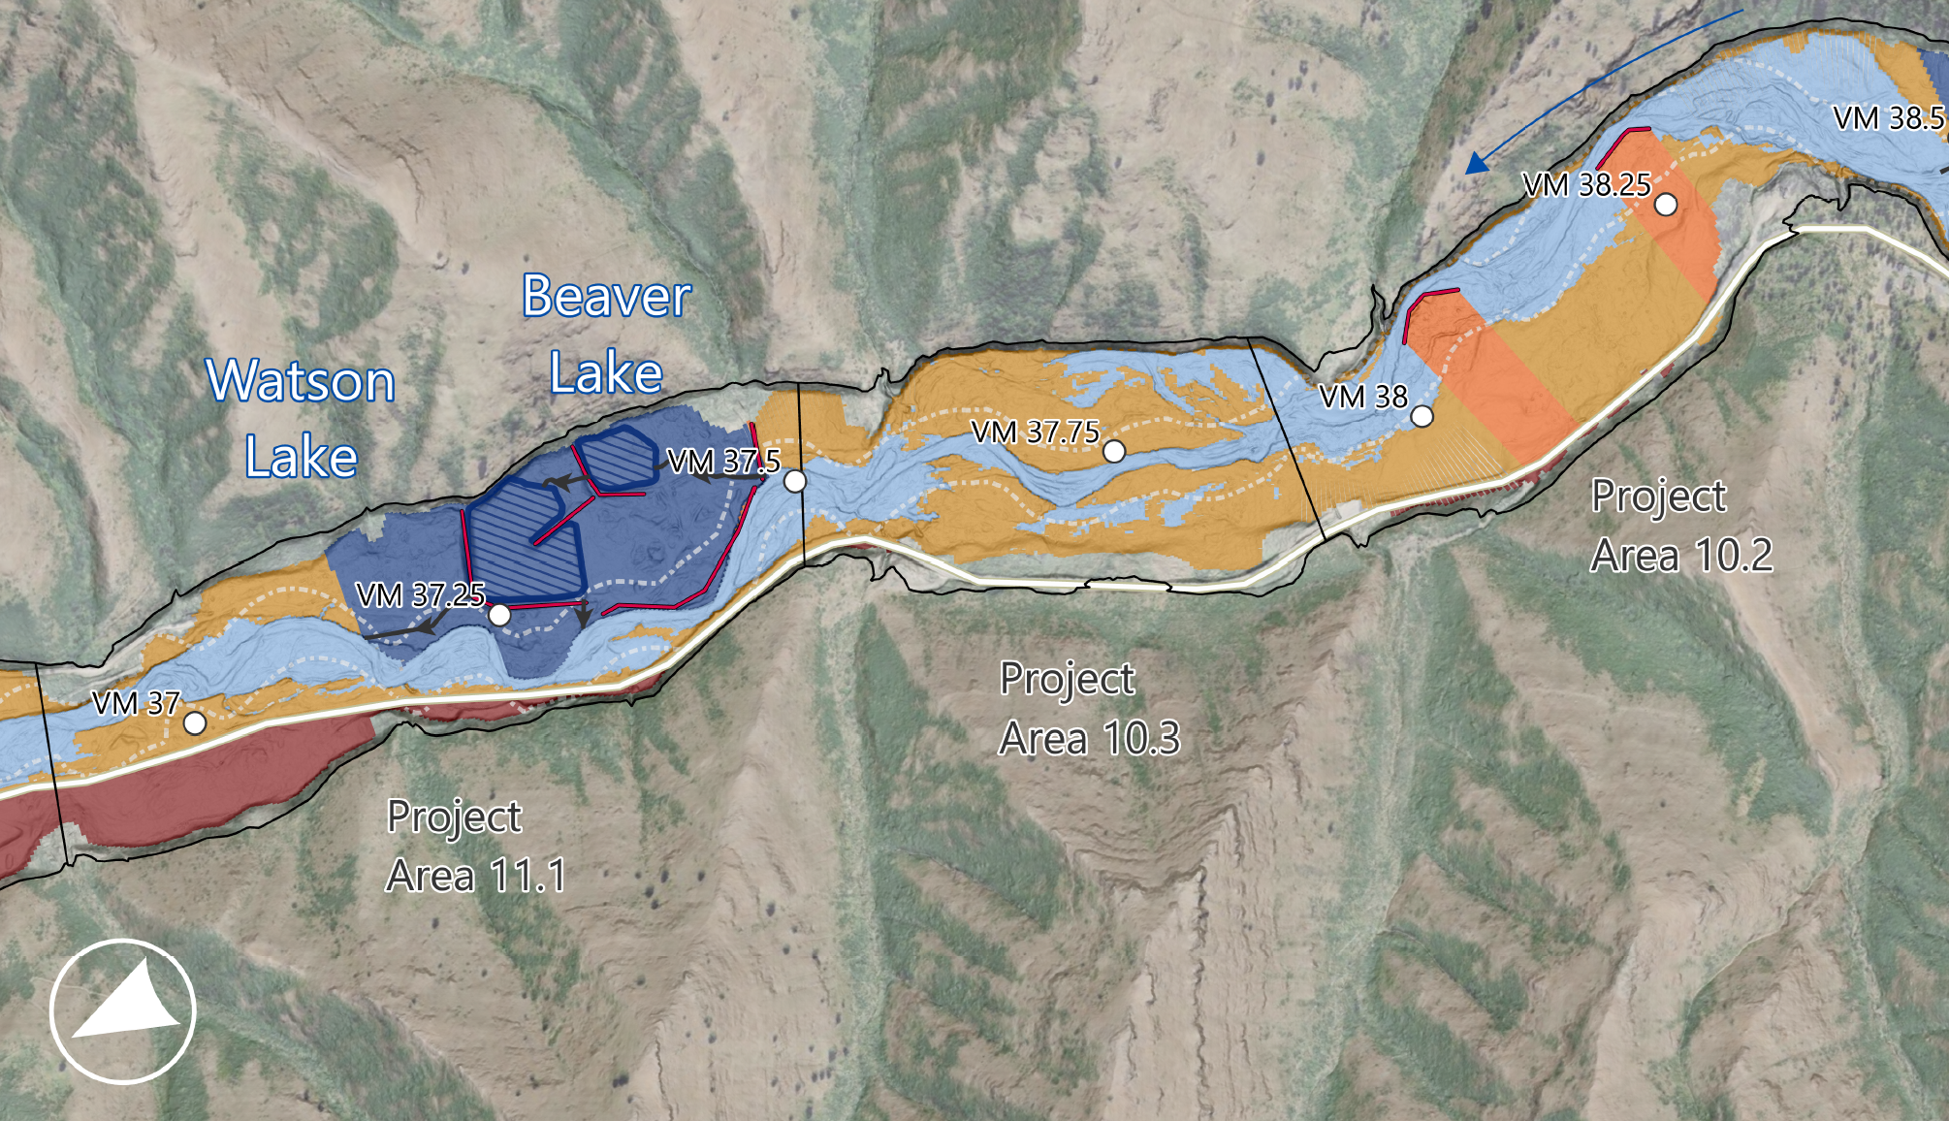
State of the Floodplain
Connected
Disconnection by Lake
Disconnection by Levee
Disconnection by Incision
Disconnection by Road

Slide 19
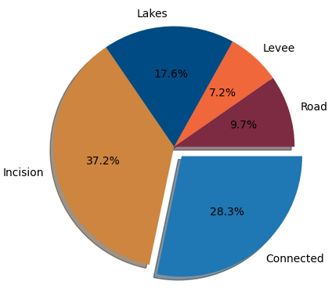
State of the Floodplain
Floodplain is ~30% of its historical extent
Lakes, levees, and road infrastructure disconnect ~35% of historical floodplain
~37% of historical floodplain is vertically disconnected

Slide 20
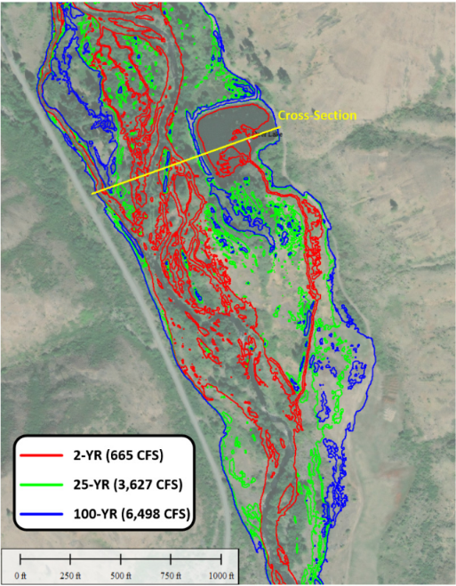
Lake Issues and Needs
Deer Lake
Out of compliance with dam safety regulations - 6 of 8 lakes
Direct flooding from river – 4 of 8 lakes
Require intake or outflow infrastructure upgrades - 6 of 8 lakes

Slide 21
Fish and Ecosystems
Recreation and Human Connection
Infrastructure

Slide 22
Key Point
We have an opportunity to rebuild the river, ecosystems, and recreational infrastructure so that all function together for the benefit of current and future generations

Slide 23
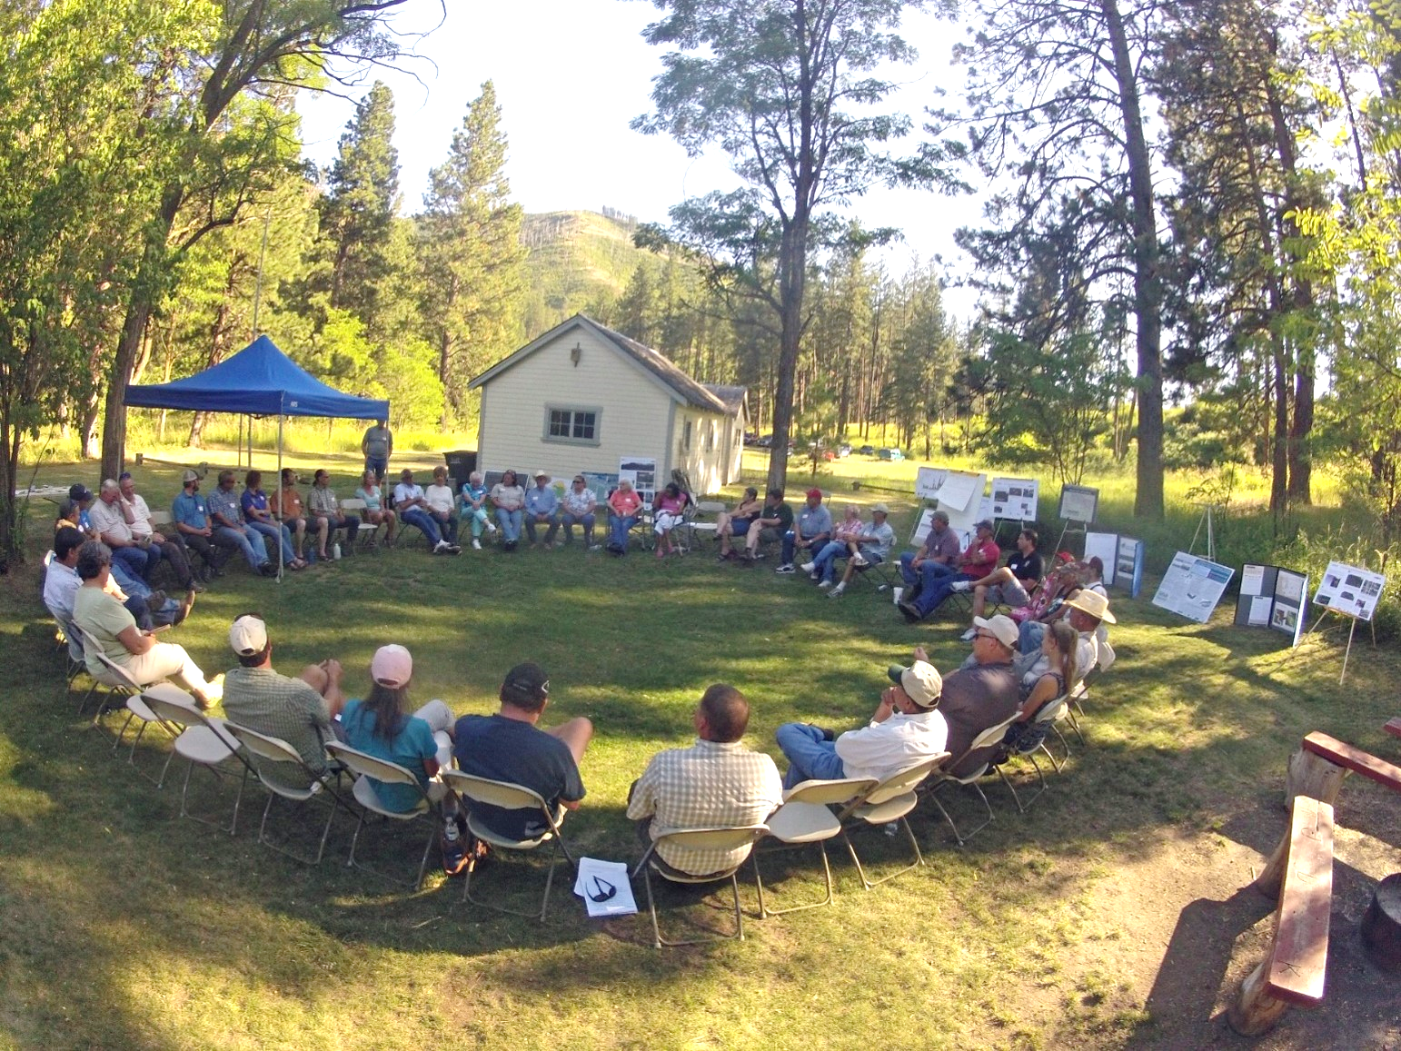
Project Approach
Assessments (through early 2025)
Lakes and Infrastructure
Ecosystem and Floodplain
Recreation
Conceptual Alternatives
(target completion: end of 2025)
Public Meetings and Input
(2 more meetings in the assessment and alternatives process)

Slide 24
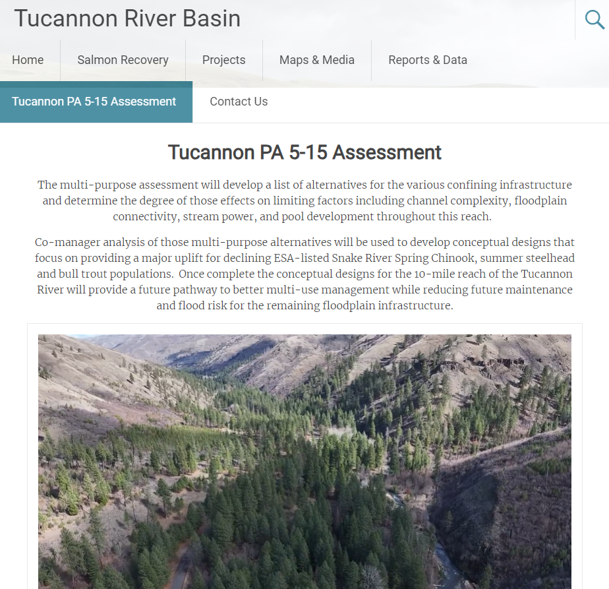

Check Out Our Webpage
https://tucannonriver.org/tucannon-pa5-15-assessment/
Watch a drone fly-through of the project area
Fill out a survey!
Info on Future Public Meetings
Ask questions and provide feedback after attending this meeting

Slide 25
https://tucannonriver.org/tucannon-pa5-15-assessment/
Fill out a survey!
Info on Future Public Meetings
Ask questions and provide feedback after attending this meeting
Access a recording of this meeting
Thank You!
Photo: Liz Eastman, NPT Fisheries

