Slide 1
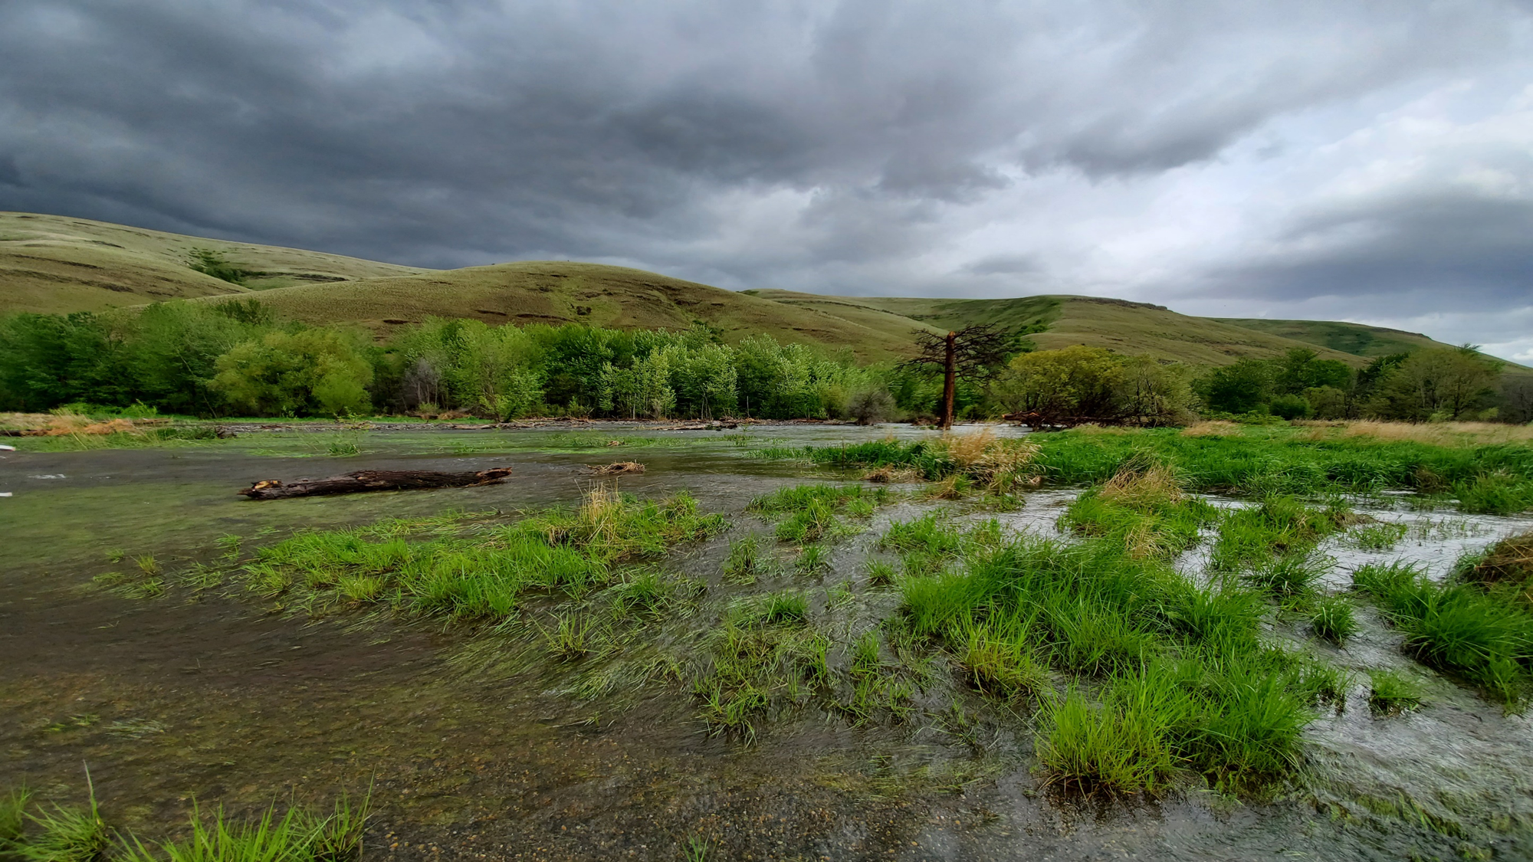
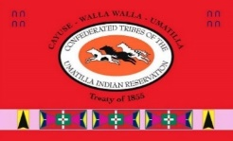
“2024 CTUIR Fisheries Habitat Retreat – Tucannon Basin”
Panoramic of PA-18
Kris Fischer, Tucannon Basin Project Leader
Notes:
Slide 1 – Good afternoon everyone. My name is Kris Fischer and I work for the Umatilla Tribe’s as the Tucannon Basin Habitat Enhancement Project Leader. I would like to recognize my geomorphic change detection team, AnchorQEA and NV5.

Slide 2
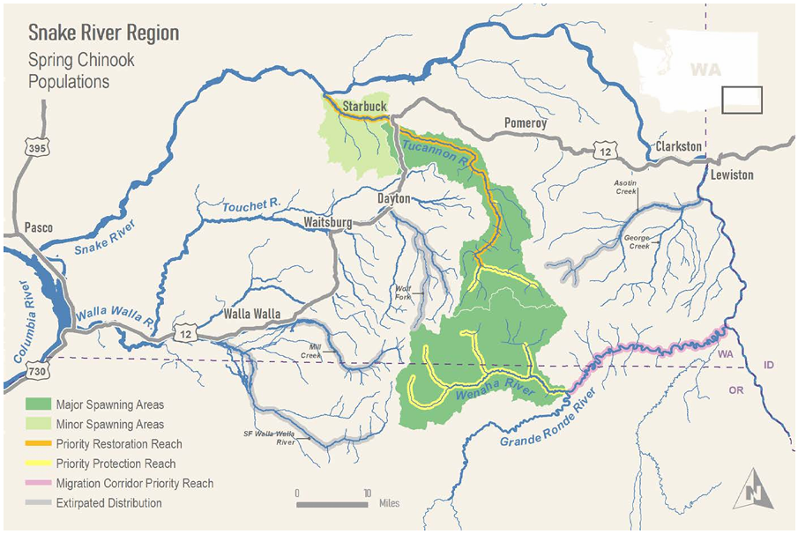
Lessons Learned -
It takes a lot of effort to move “Channel Evolution Stages”
This level of effort can seem destructive to some of our critters, but we hope the destruction is short-term.
Project areas with “room for the river” are more resilient to larger flow events.
LiDAR is only a snapshot in time, there’s more to learn after the next flow event.
Sediment input during large flow events speeds up the recovery process!

Slide 3
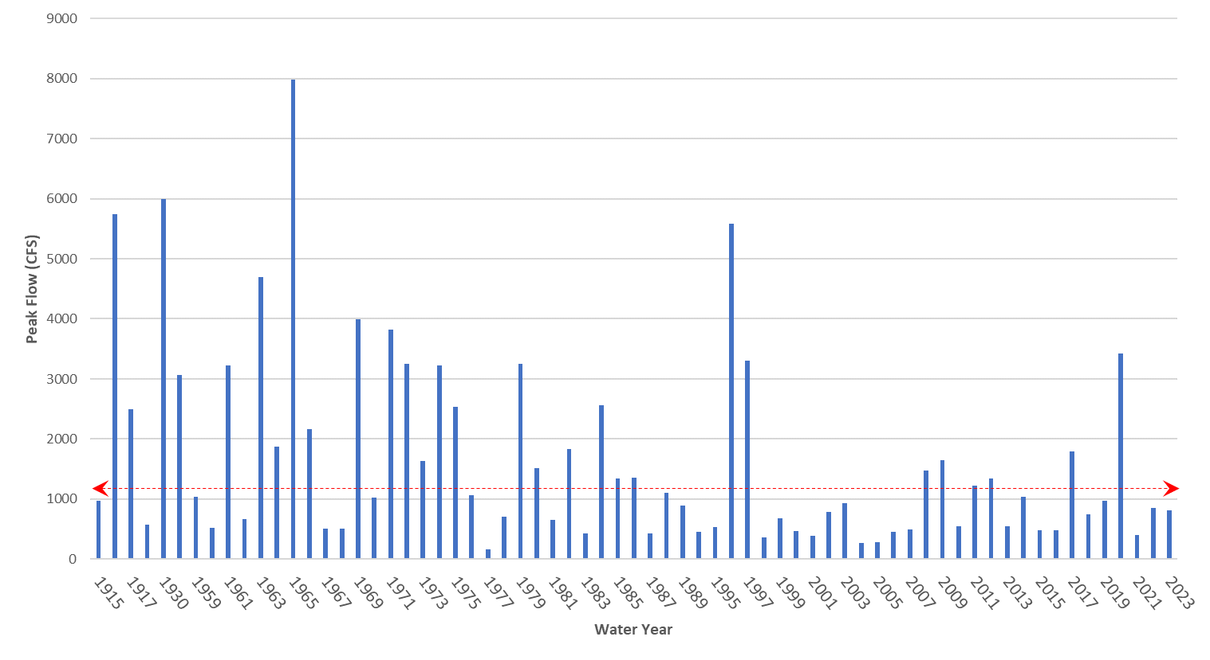
Peak stream flows recorded at the USGS Starbuck stream gage for the entire period of record 1914 to present. The dotted line indicated the approximate 2 yr flood return interval estimated for the basin at RM 8.8.

Slide 4
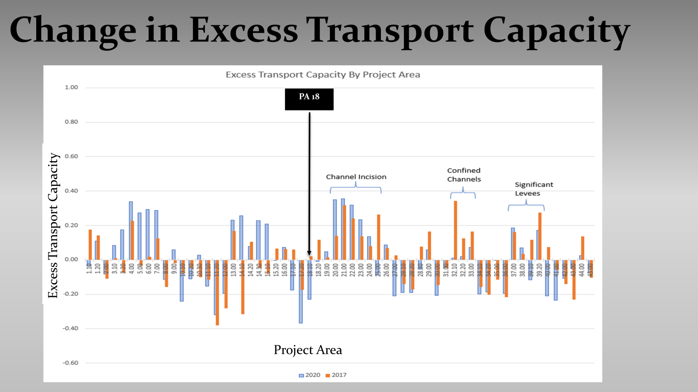

Slide 5
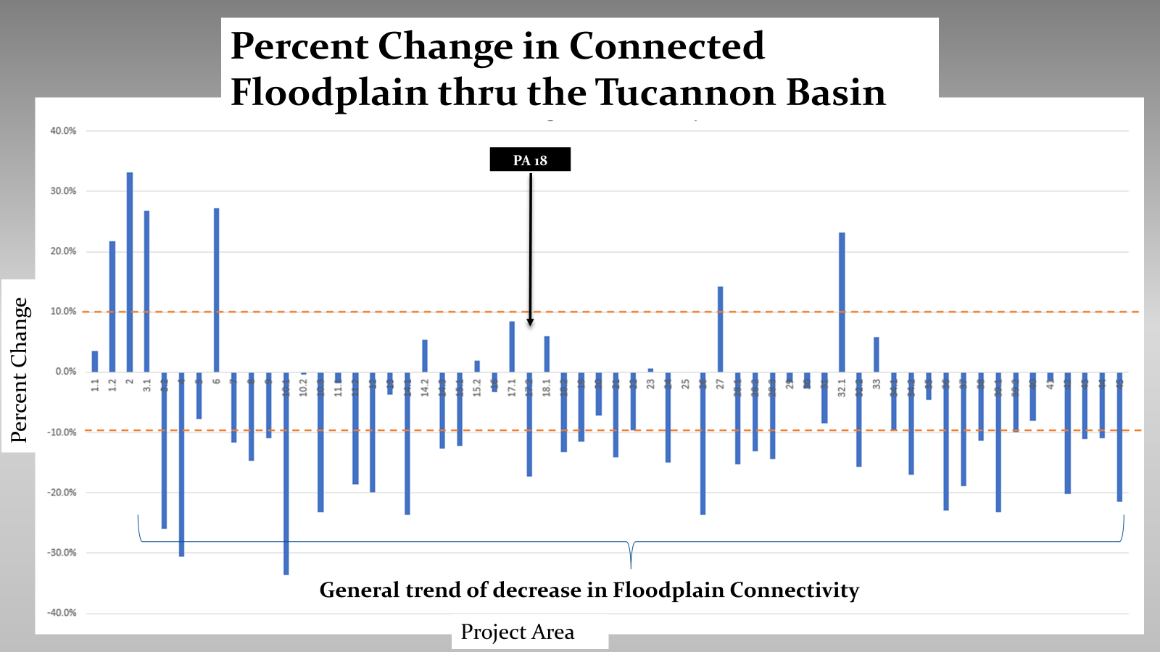

Slide 6
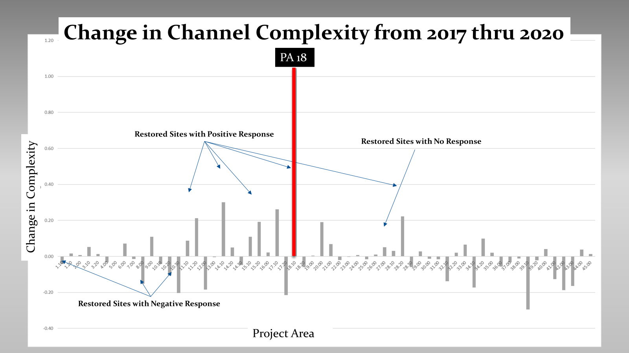

Slide 7
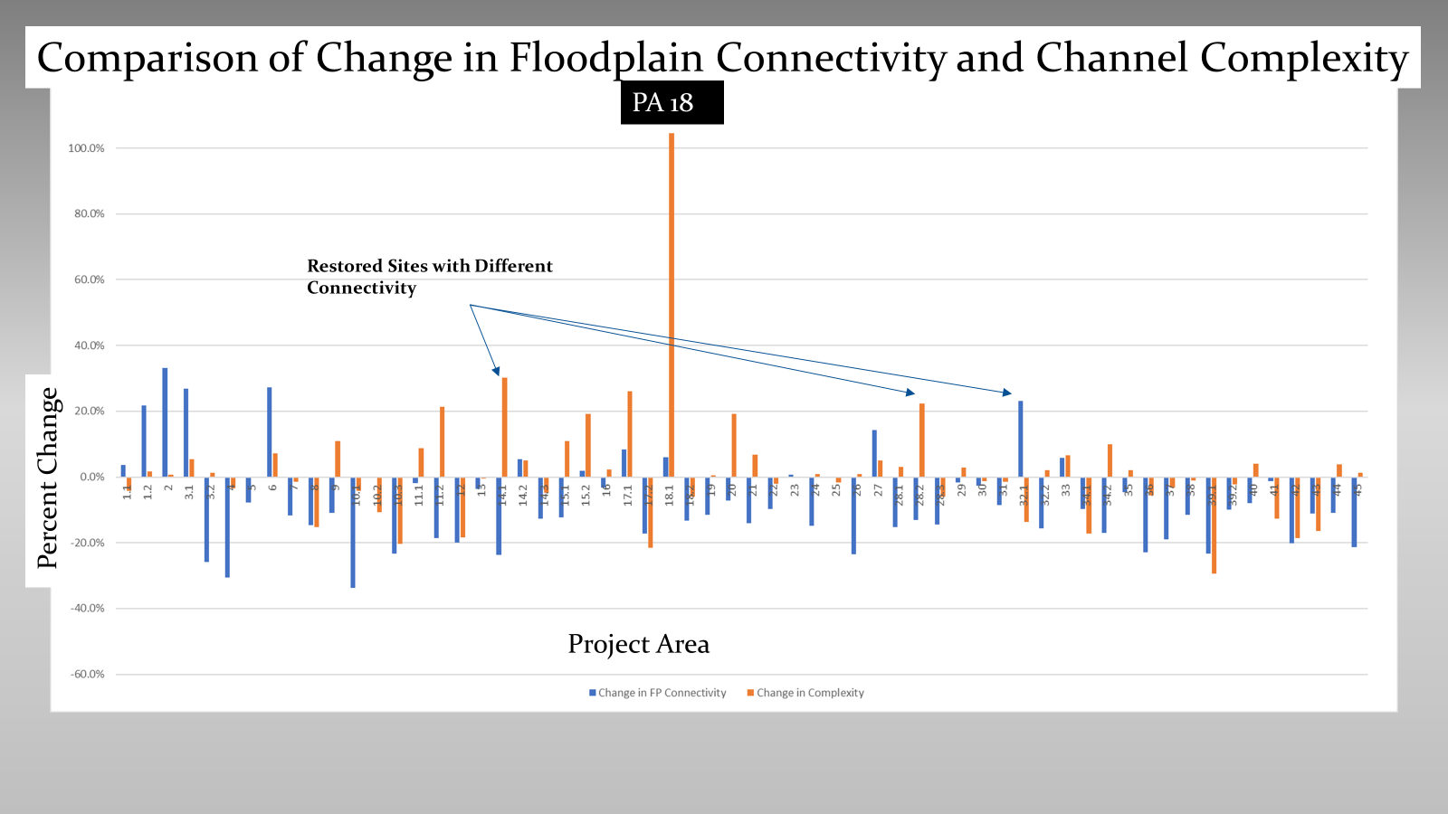

Slide 8
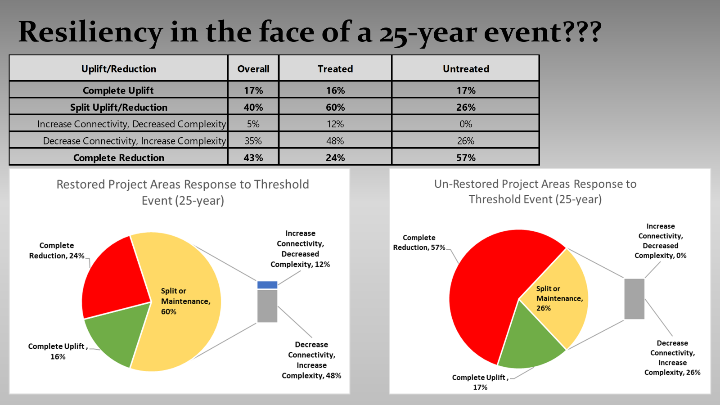
Lessons Learned -
It takes a lot of effort to move “Channel Evolution Stages”
This level of effort can seem destructive to some of our critters, but we hope the destruction is short-term.
Project areas with “room for the river” are more resilient to larger flow events.
LiDAR is only a snapshot in time, there’s more to learn after the next flow event.
Sediment input during large flow events speeds up the recovery process!

Slide 9
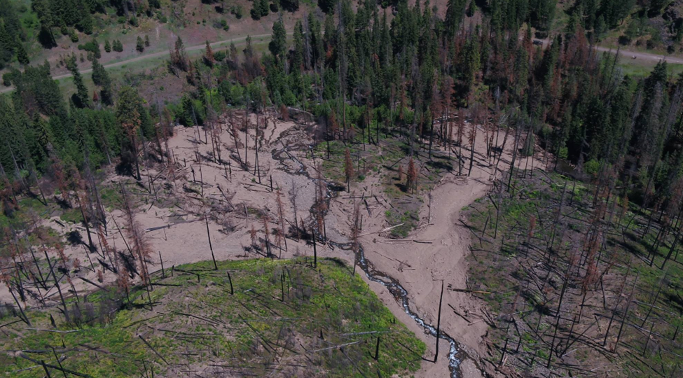

Slide 10
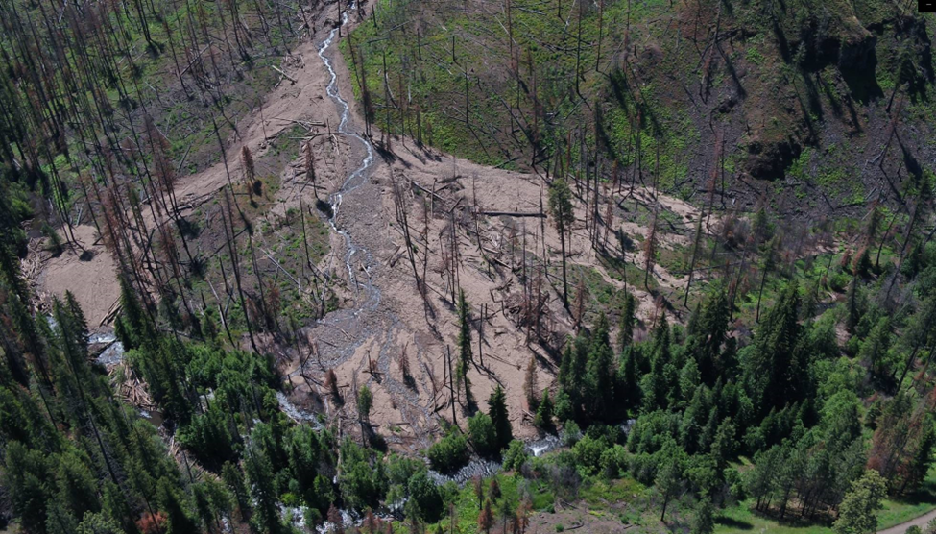

Slide 11
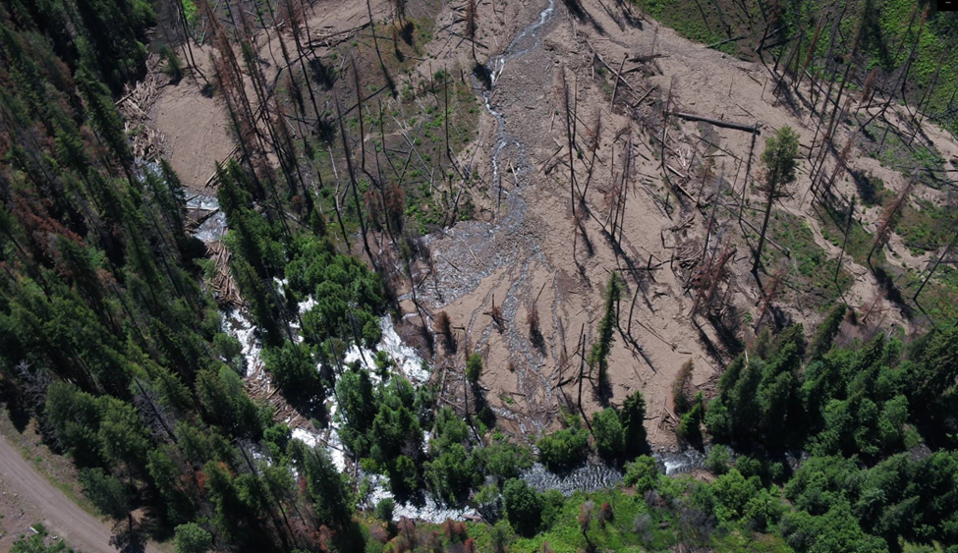

Slide 12
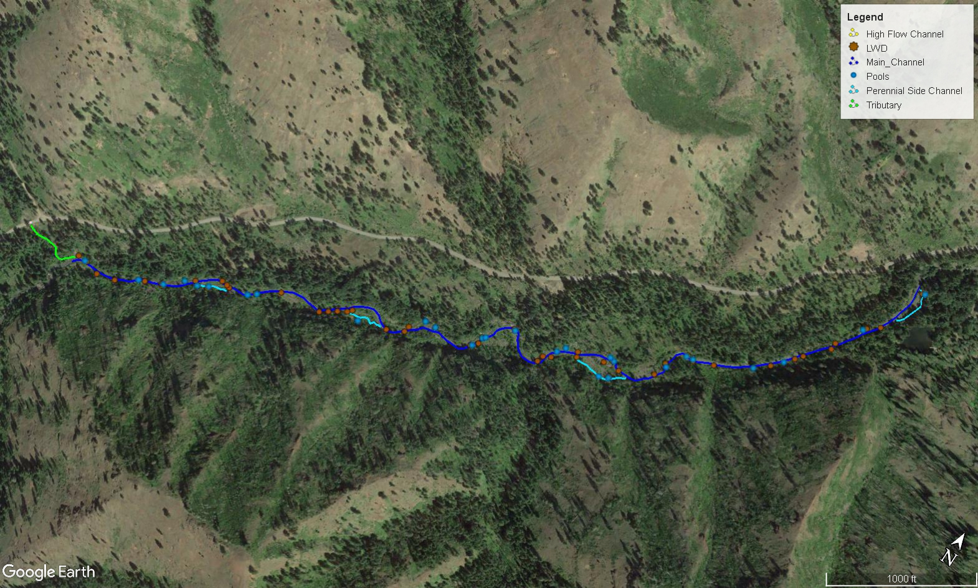
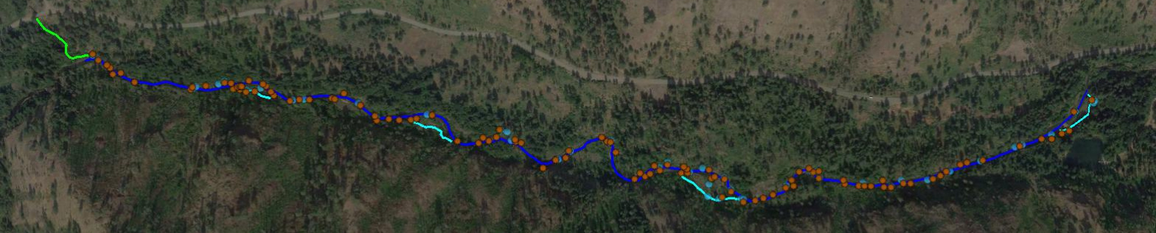
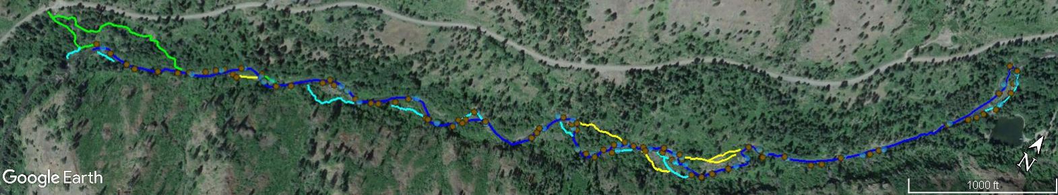

PA3_Pre/Post Project 2014-2017
Pre-project July 2014
108 LWD (>6m long & 0.3m dia.)
29 pools
0.34 miles perennial side channel
0.0 miles of high flow channels
1.7 total perennial stream miles
Post-project July 2014
389 LWD (>6m long & 0.3m dia.)
51 pools
0.34 miles perennial side channel
0.0 miles of high flow channels
1.7 total perennial stream miles
Post-project September 2017
327 LWD (>6m long & 0.3m dia.)
50 pools
0.68 miles perennial side channel
0.27 miles of high flow channels
2.13 total perennial stream miles
Figure 2: Project Area 3 restoration actions and outcomes between 2014 and 2017, illustrating the position and frequency of log jams, pools and side channels. The three separate maps represent the time frame from pre-project in 2014, post-project 2014 and post project 2017, shown respectively from top to bottom. Project metric data, collect using rapid habitat approach are collected as part of project implementation/effectiveness monitoring, is provided within the map tables for each time interval. The yellow arrow indicates the approximate location of the CHaMP/AEM monitoring treatment site.

Slide 13
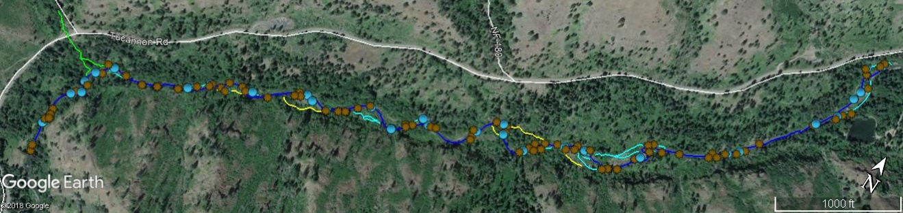
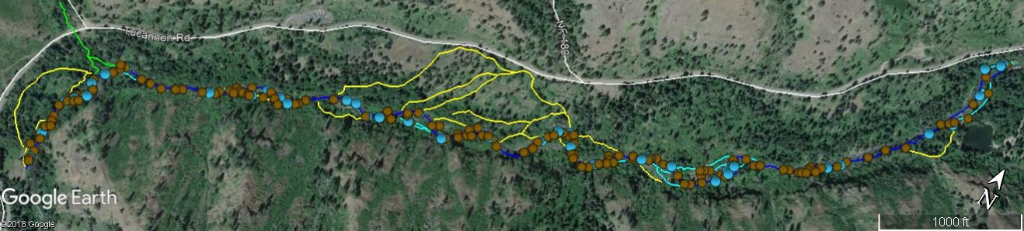
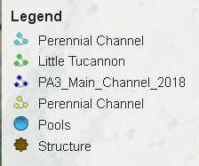
Pre-project July 2018
349 LWD (>6m long & 0.3m dia.)
36 pools
0.61 miles perennial side channel
0.26 miles of high flow channels
2.15 total perennial stream miles
Post-project Sept 2018
1014 LWD (>6m long & 0.3m dia.)
43 pools
0.61 miles perennial side channel
1.68 miles of high flow channels
2.15 total perennial stream miles
PA3_Figure 3: Project Area 3 restoration actions and outcomes for wood loading implementation in 2018, illustrating the position and frequency of log jams, pools and side channels. The upper maps represent the time frame from pre-project in July 2018, post-project September 2018 shown on the bottom. Project metric data, collect using rapid habitat data collected as part of project implementation/effectiveness monitoring, is provided within the map tables for each time interval. The two white ovals indicate areas of the floodplain targeted with LWD structures specifically to reconnect disconnected flow paths. It is anticipated during a higher flow some of the new flow paths would become perennial. To accommodate new perennial flow floodplain LWD was placed in these channel to create as roughness.

Slide 14
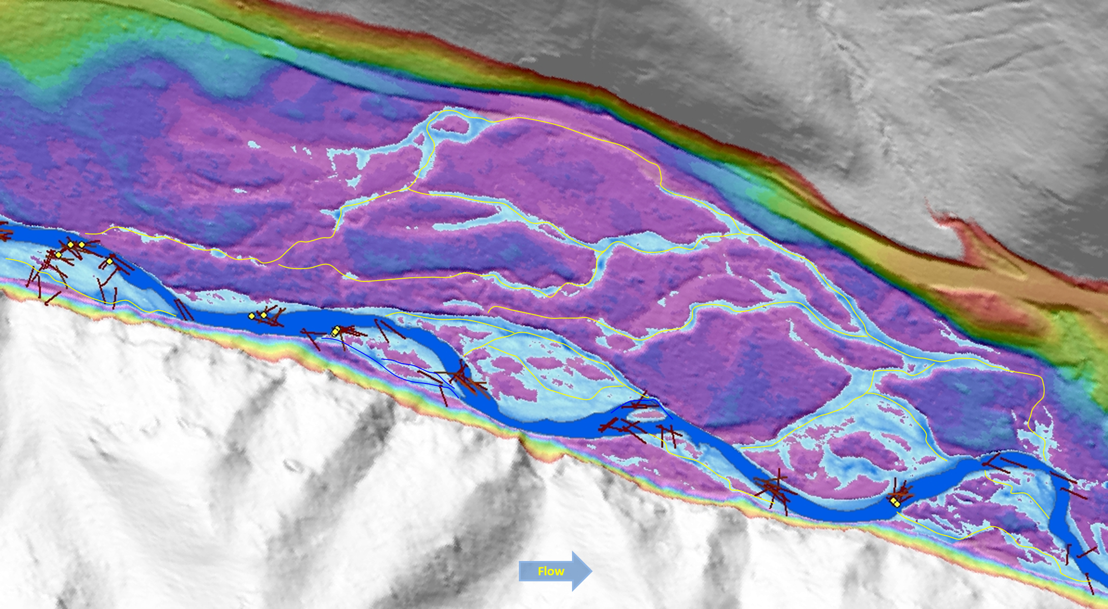
The above map illustrates the middle third of Project Area 3, in November 2017. The map is a relative elevation model generated from a November 2017 bathymetric LiDAR survey, with the water surface layer (at 130 cfs) in dark blue and the 2 yr flood in light blue. The brown lines represent as –built log structures with each line a separate log, while the yellow dots indicating a ballast rock (~3 ton rock) placed in 2018 by helicopter. The yellow lines trace the anticipated high water flow paths this part of the 2018 restoration action is intending to connect beyond a 2 yr flow interval. The yellow arrow indicates the approximate location of the location of the log jam illustrated in the photo time series in Figure 4.

Slide 15
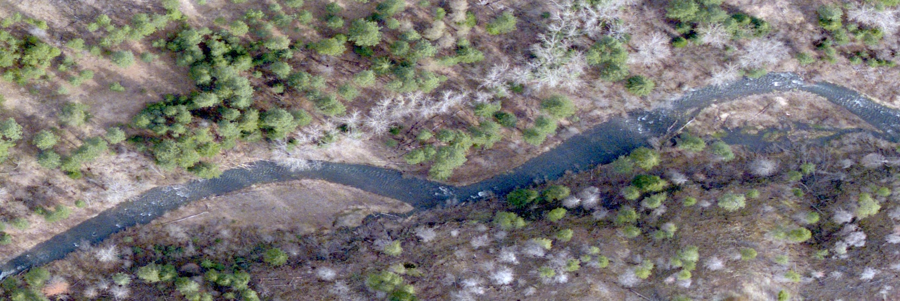
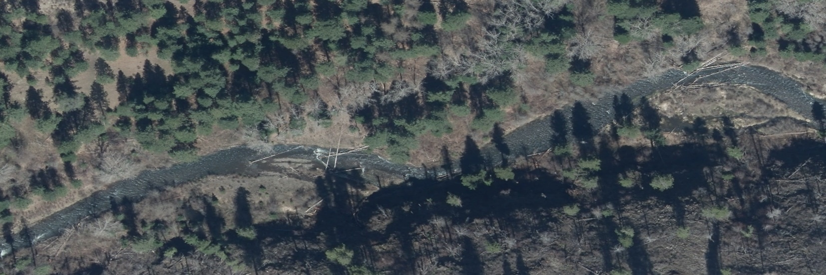
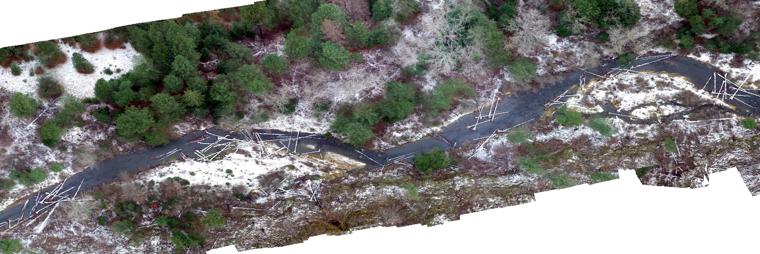

Slide 16
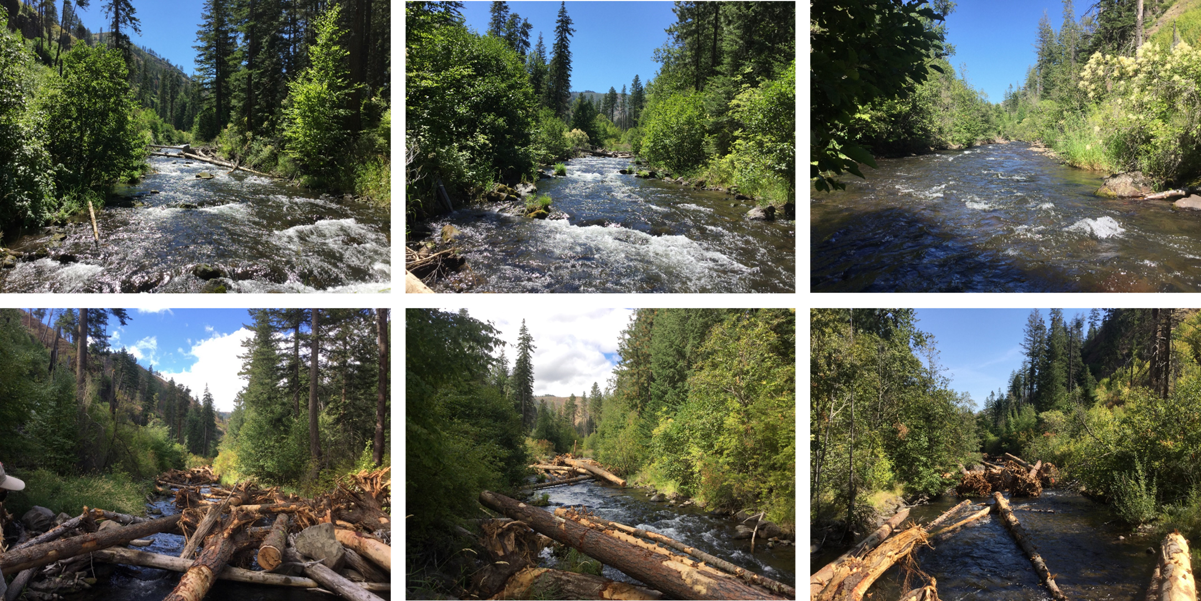
Pre/post photos taken in 2018 on PA3 illustrating the LWD densities placed during the project. The upper left image has a number of logs remaining from the 2014 wood loading. That structure was one that had a number of its original key logs strip away during the March 2017 high flow, in 2018 the structure was reconfigured to increase its stability as well as protected somewhat by the addition structures upstream and downstream. The goal of the structures in this photo series is to create bank scour and accumulate bed load with structure placed in and alternating configuration with the first one to created scour and the next to capture bed load.

Slide 17
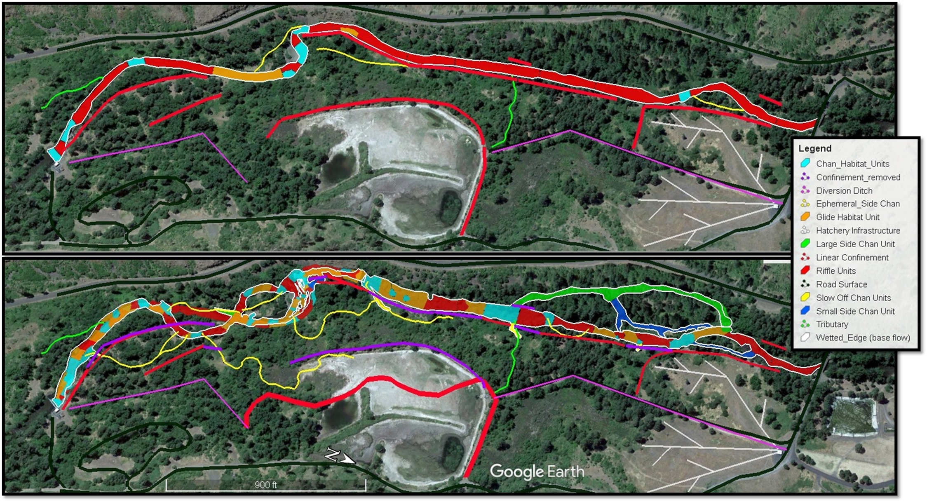
Figure 13-10: Project Area (PA) 13 valley bottom delineation map highlight channel habitat units surveyed during the RHS conducted in 2021 prior to implementation in 2022 (upper) and post project in 2023 (lower).

Slide 18
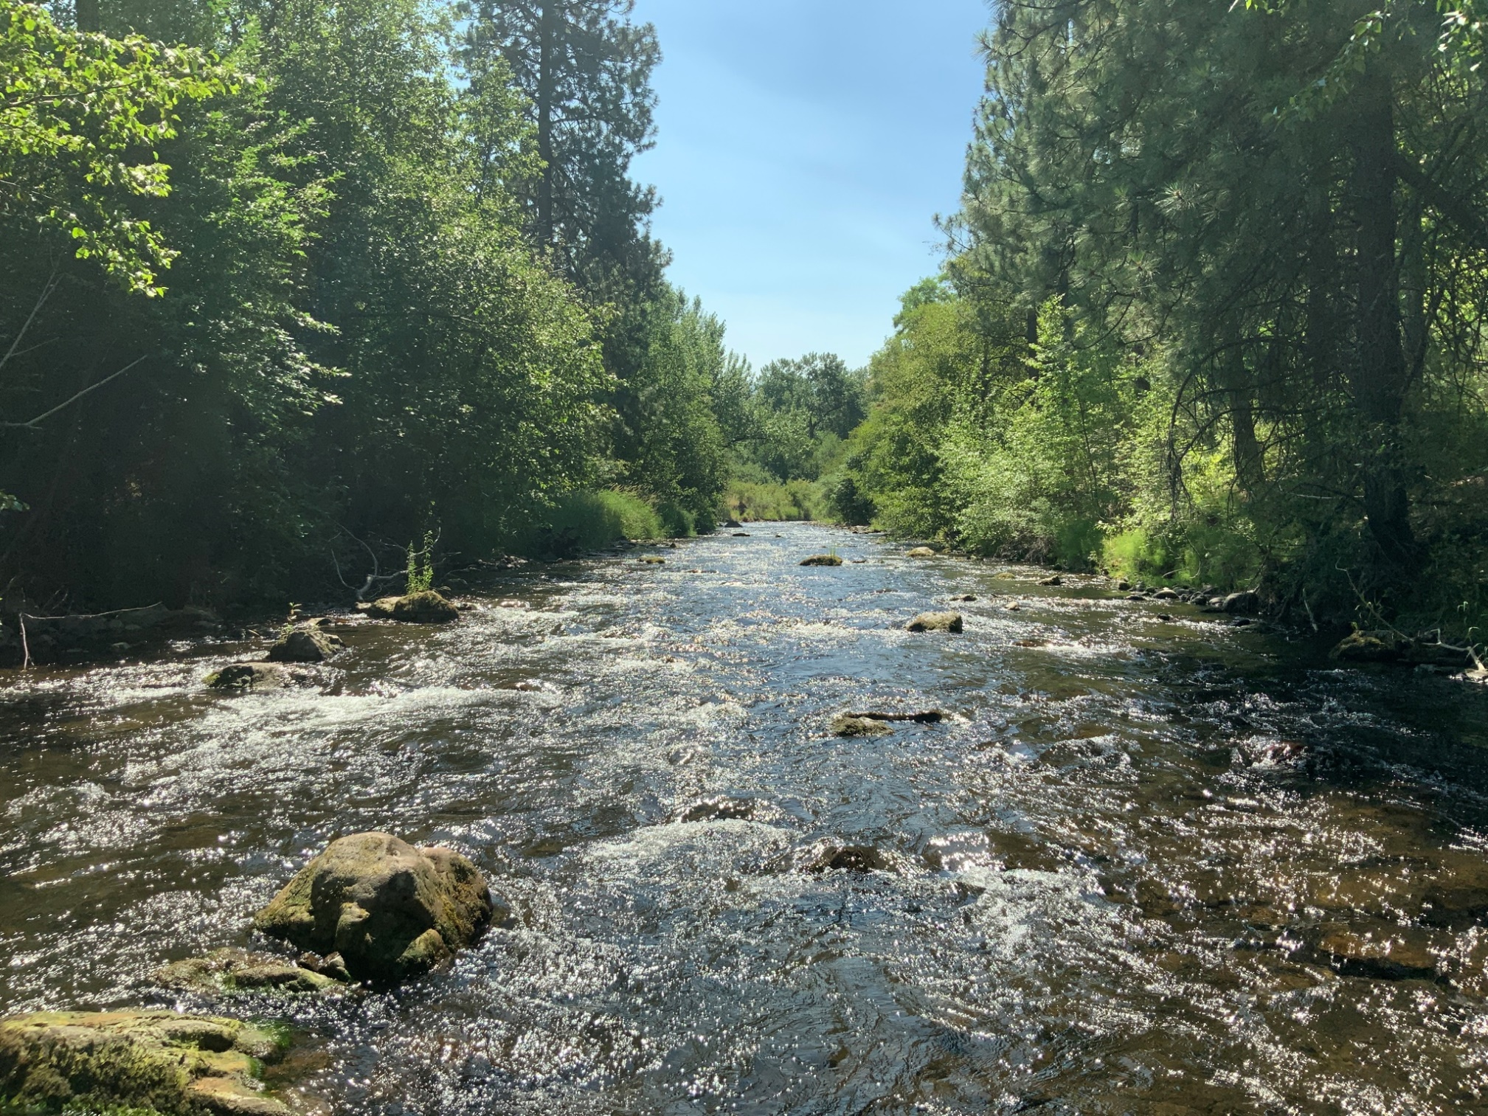
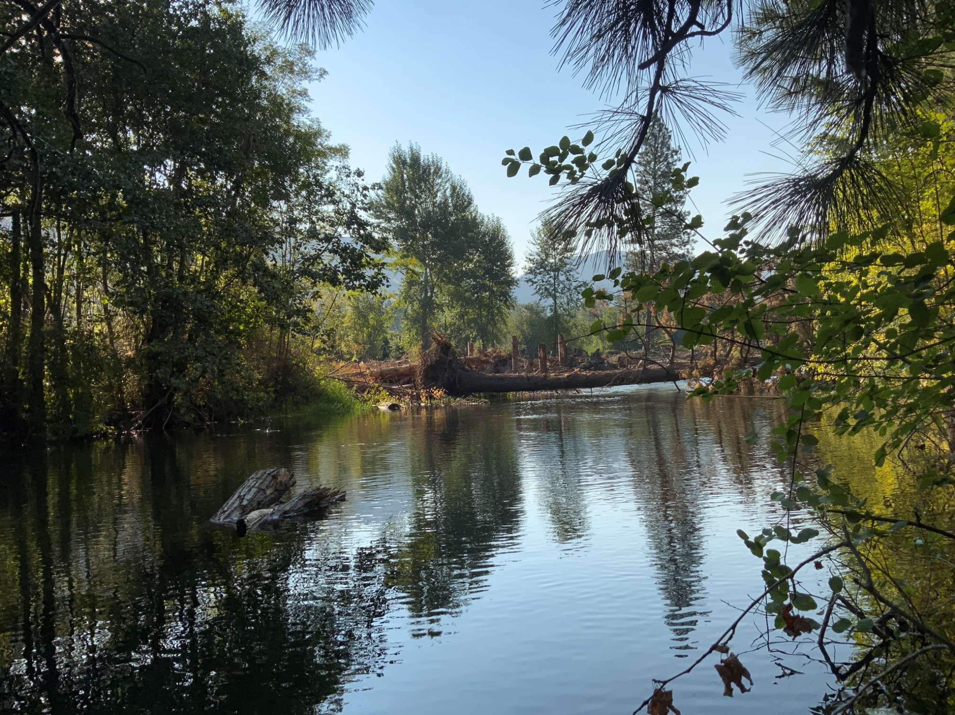
Slowing the River Down
Pre-project
Post-project
Thank You!

Slide 19
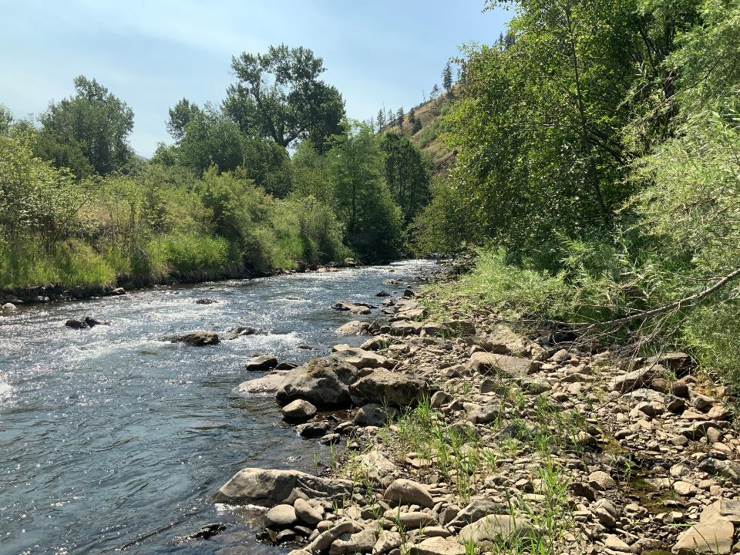
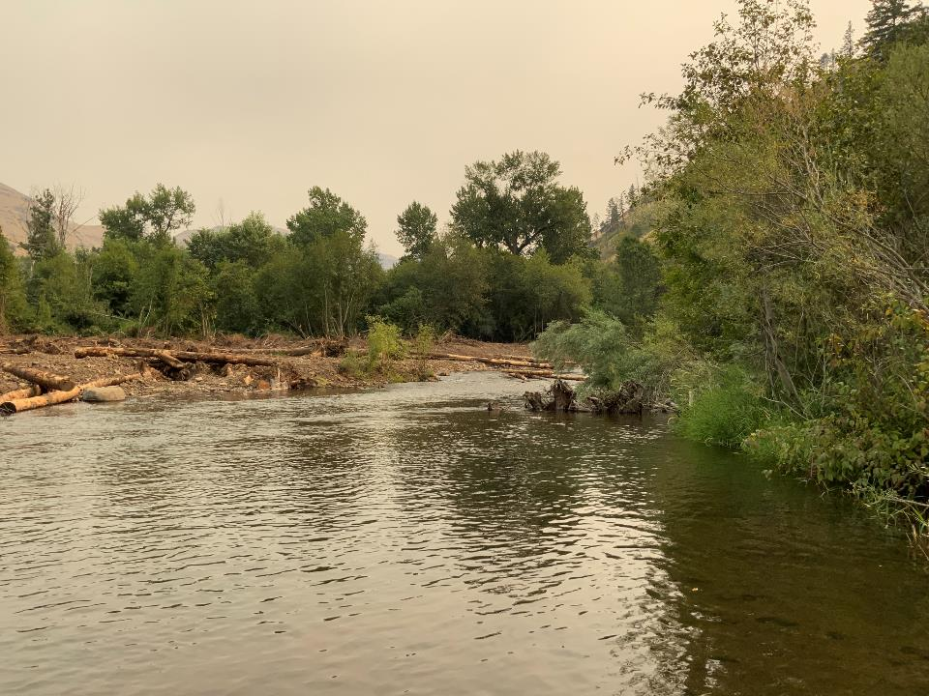
Phase I pre 2021 and post 2022 photo point levee removal.

Slide 20
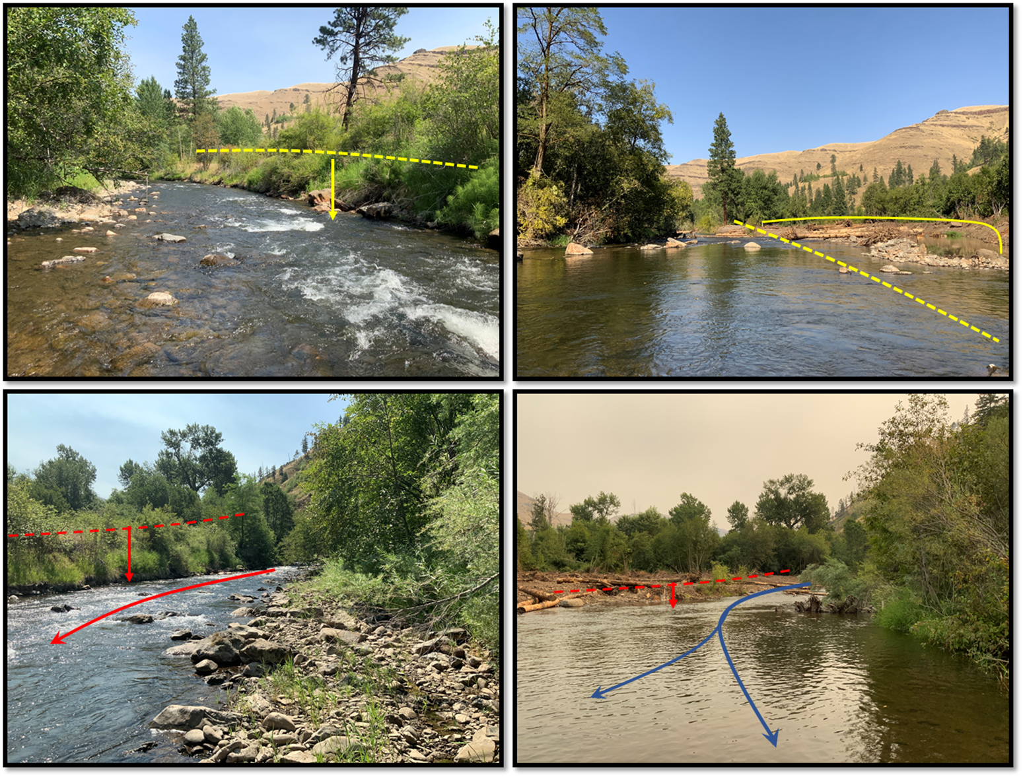
Figure 13-15: Project Area 13 channel reached impacted by levee and riprap removal pre-project (left upper/lower) and post project as-built 2022. The upper photo set shows the upper leveed section with channel fill placed to elevate water surface to activate low-lying floodplain and side channels.

Slide 21
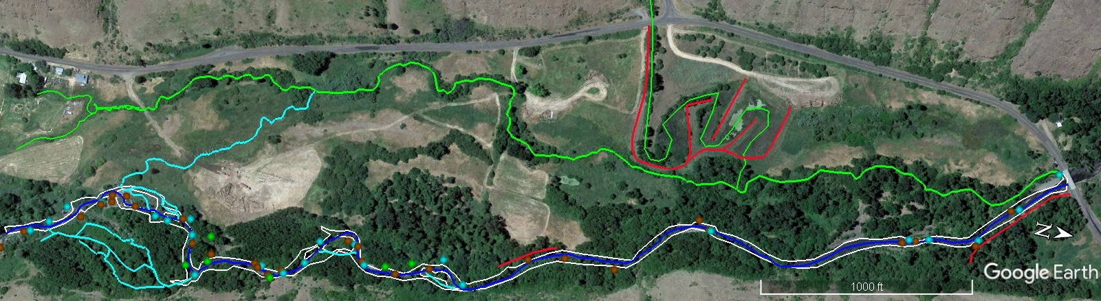
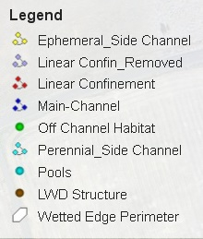
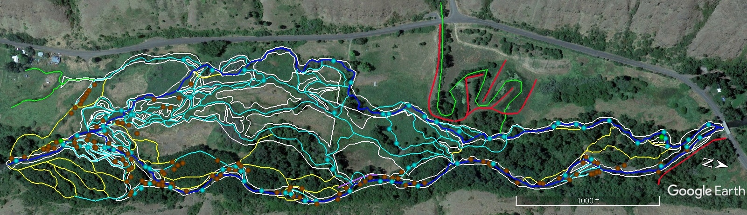
Pre-project July 2017
55 LWD (>6m long & 0.3m dia.)
23 LWD Jam Count (#)
28 Pools (#)
950 (m²) Pool Area
18 Pools > 1 m Deep
Pre-project Metrics
1,410 - Perennial Side Channel (m)
713 - Ephemeral Side Channel (m)
1.78 - Main Channel (km)
5.19 - Wetted Channel Area (ac)
1,026- Confinement (m)
Post-project Aug 2023
412 LWD (>6m long & 0.3m dia.)
96 LWD Jam Count (#)
77 Pools (#)
6,659 (m²) Pool Area
43 Pools > 1 m Deep
Pre-project Metrics
6,985 - Perennial Side Channel (m)
3,023 - Ephemeral Side Channel (m)
3.45 - Main Channel (km)
27. 16 - Wetted Channel Area (ac)
937 - Confinement (m)

Slide 22
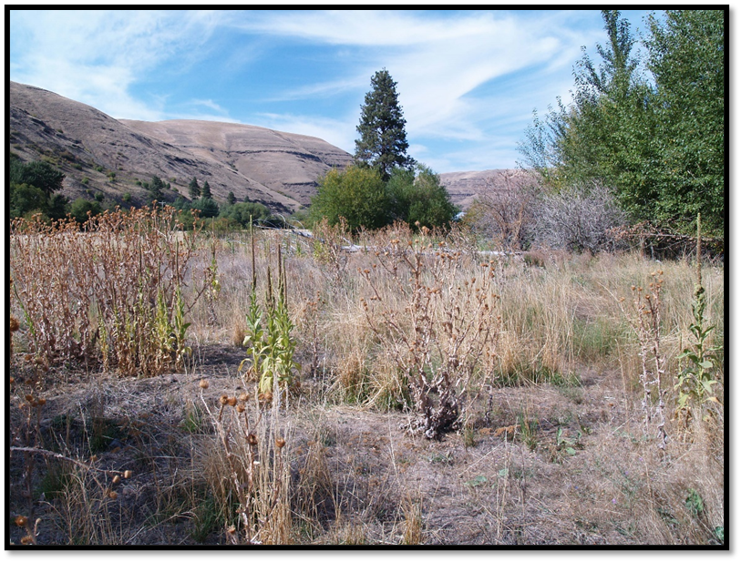
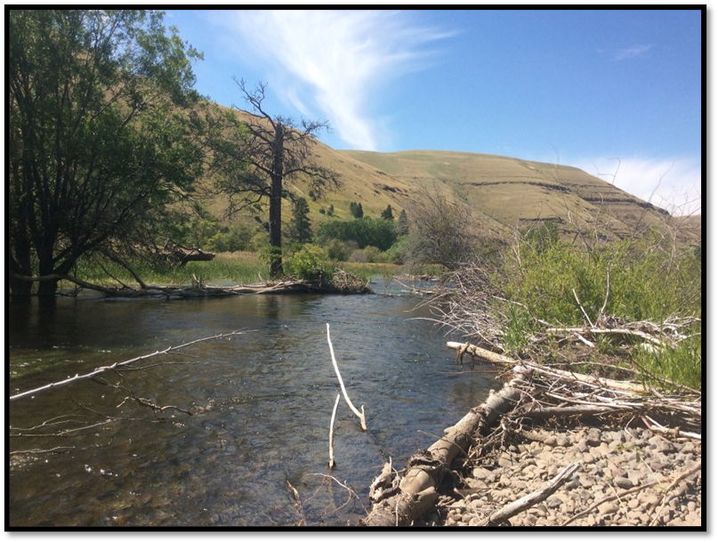
Project Area 18.1 pre-project 2017, treated with LWD and side channel connectivity.
Project Area 18.1 post project 2023, red arrow indicated focal point (above & below)

Slide 23
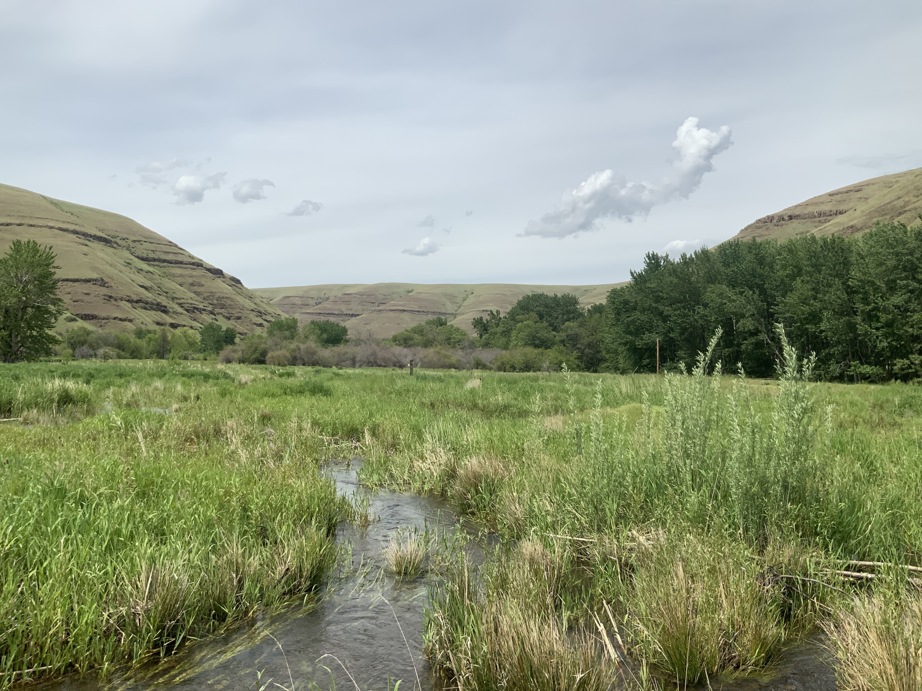
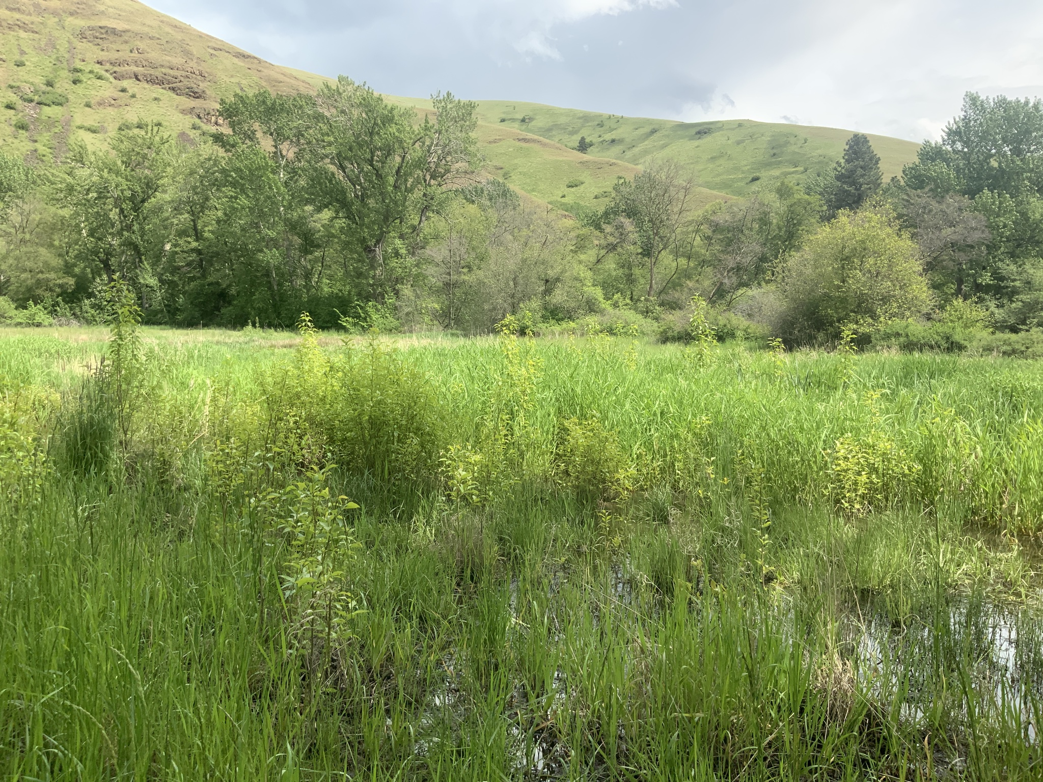
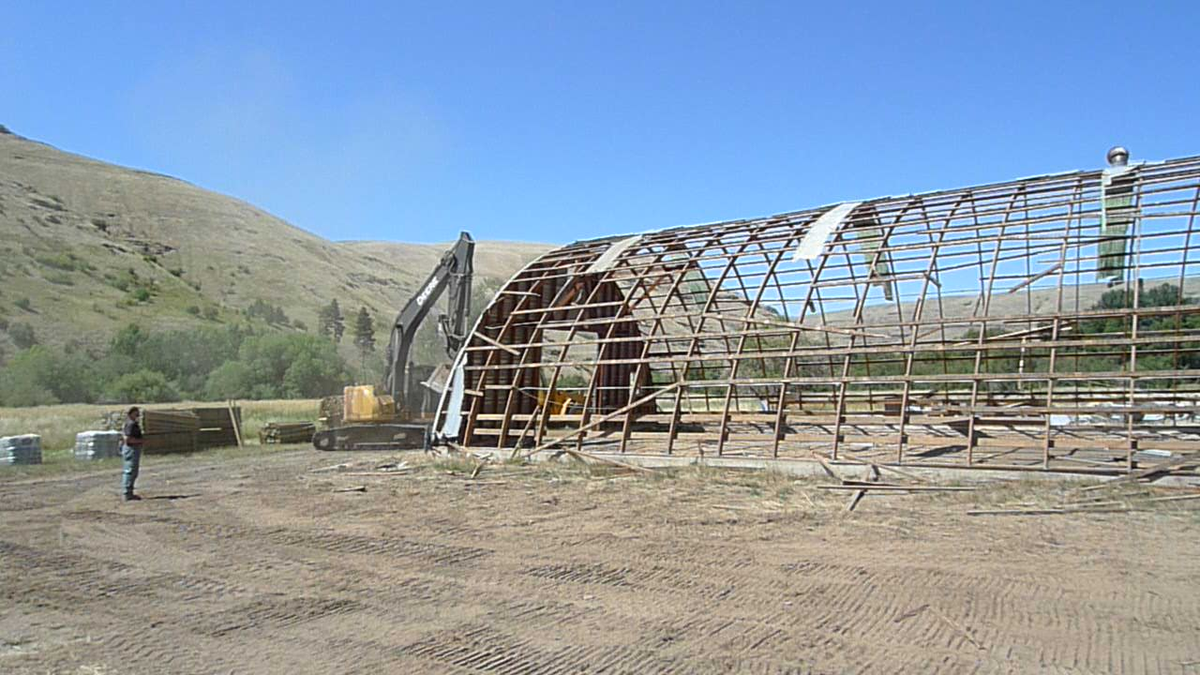
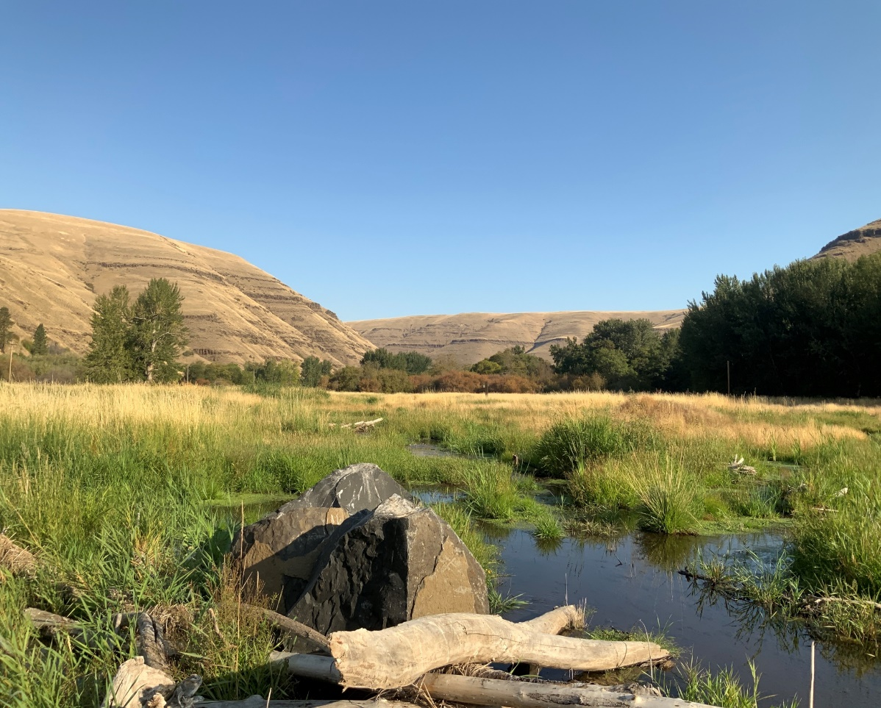
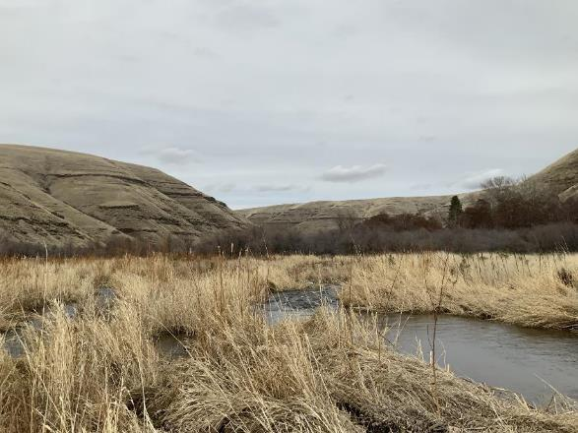
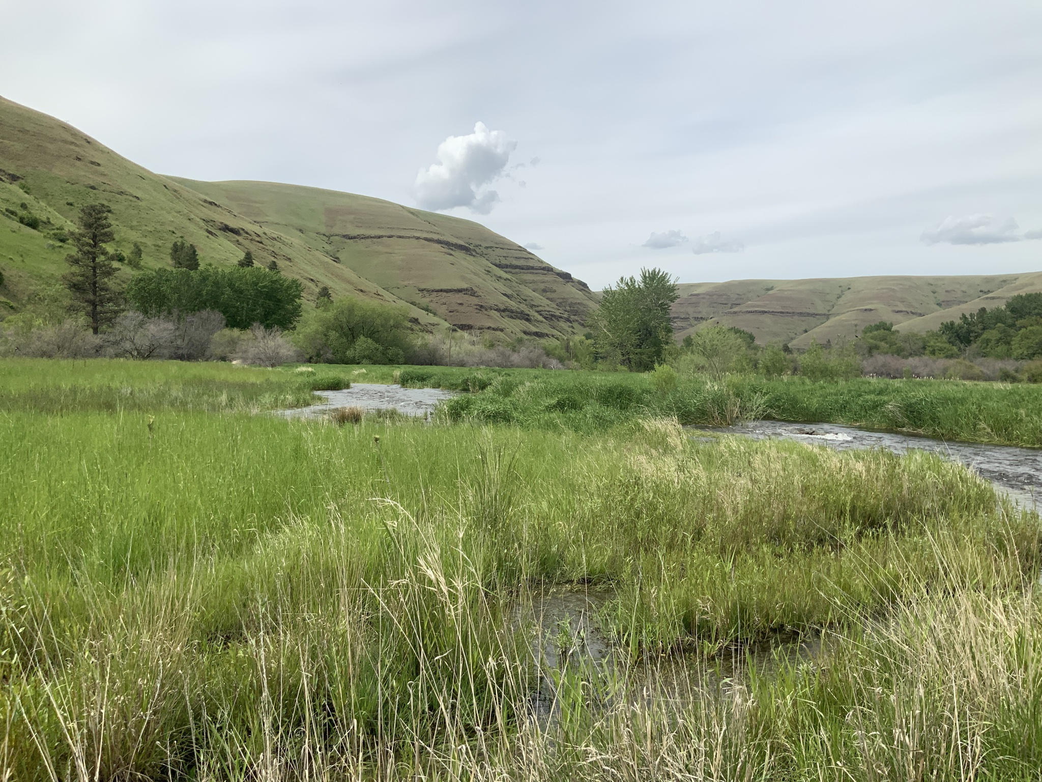
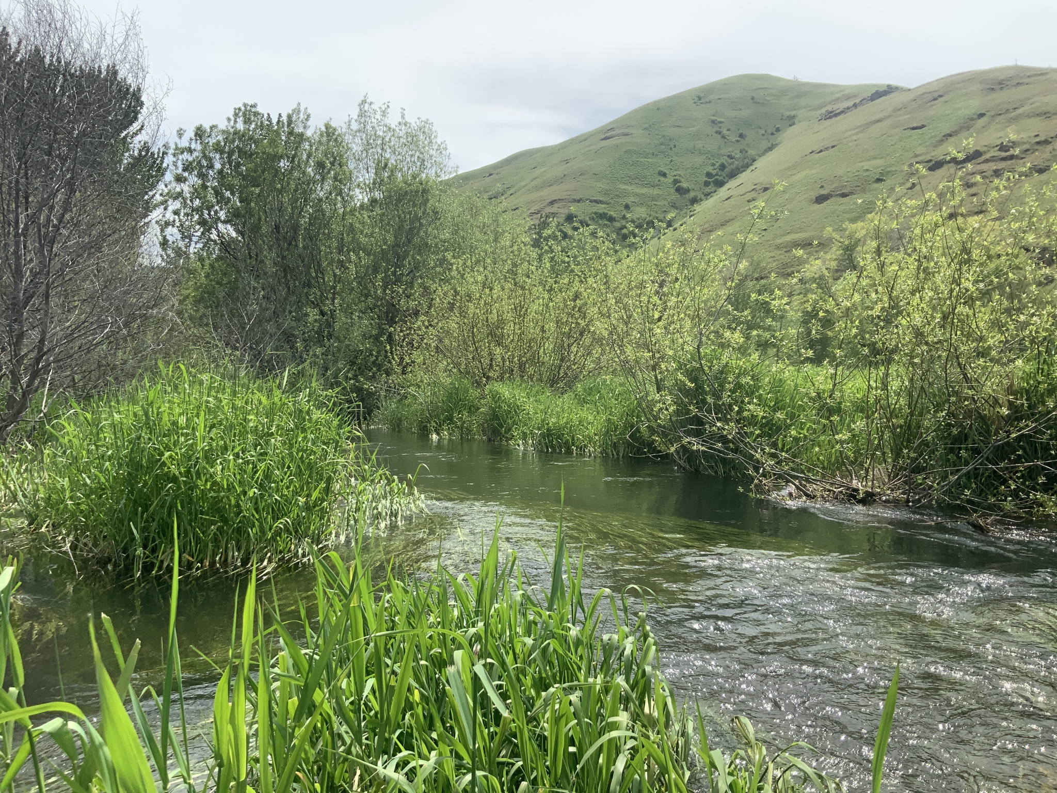
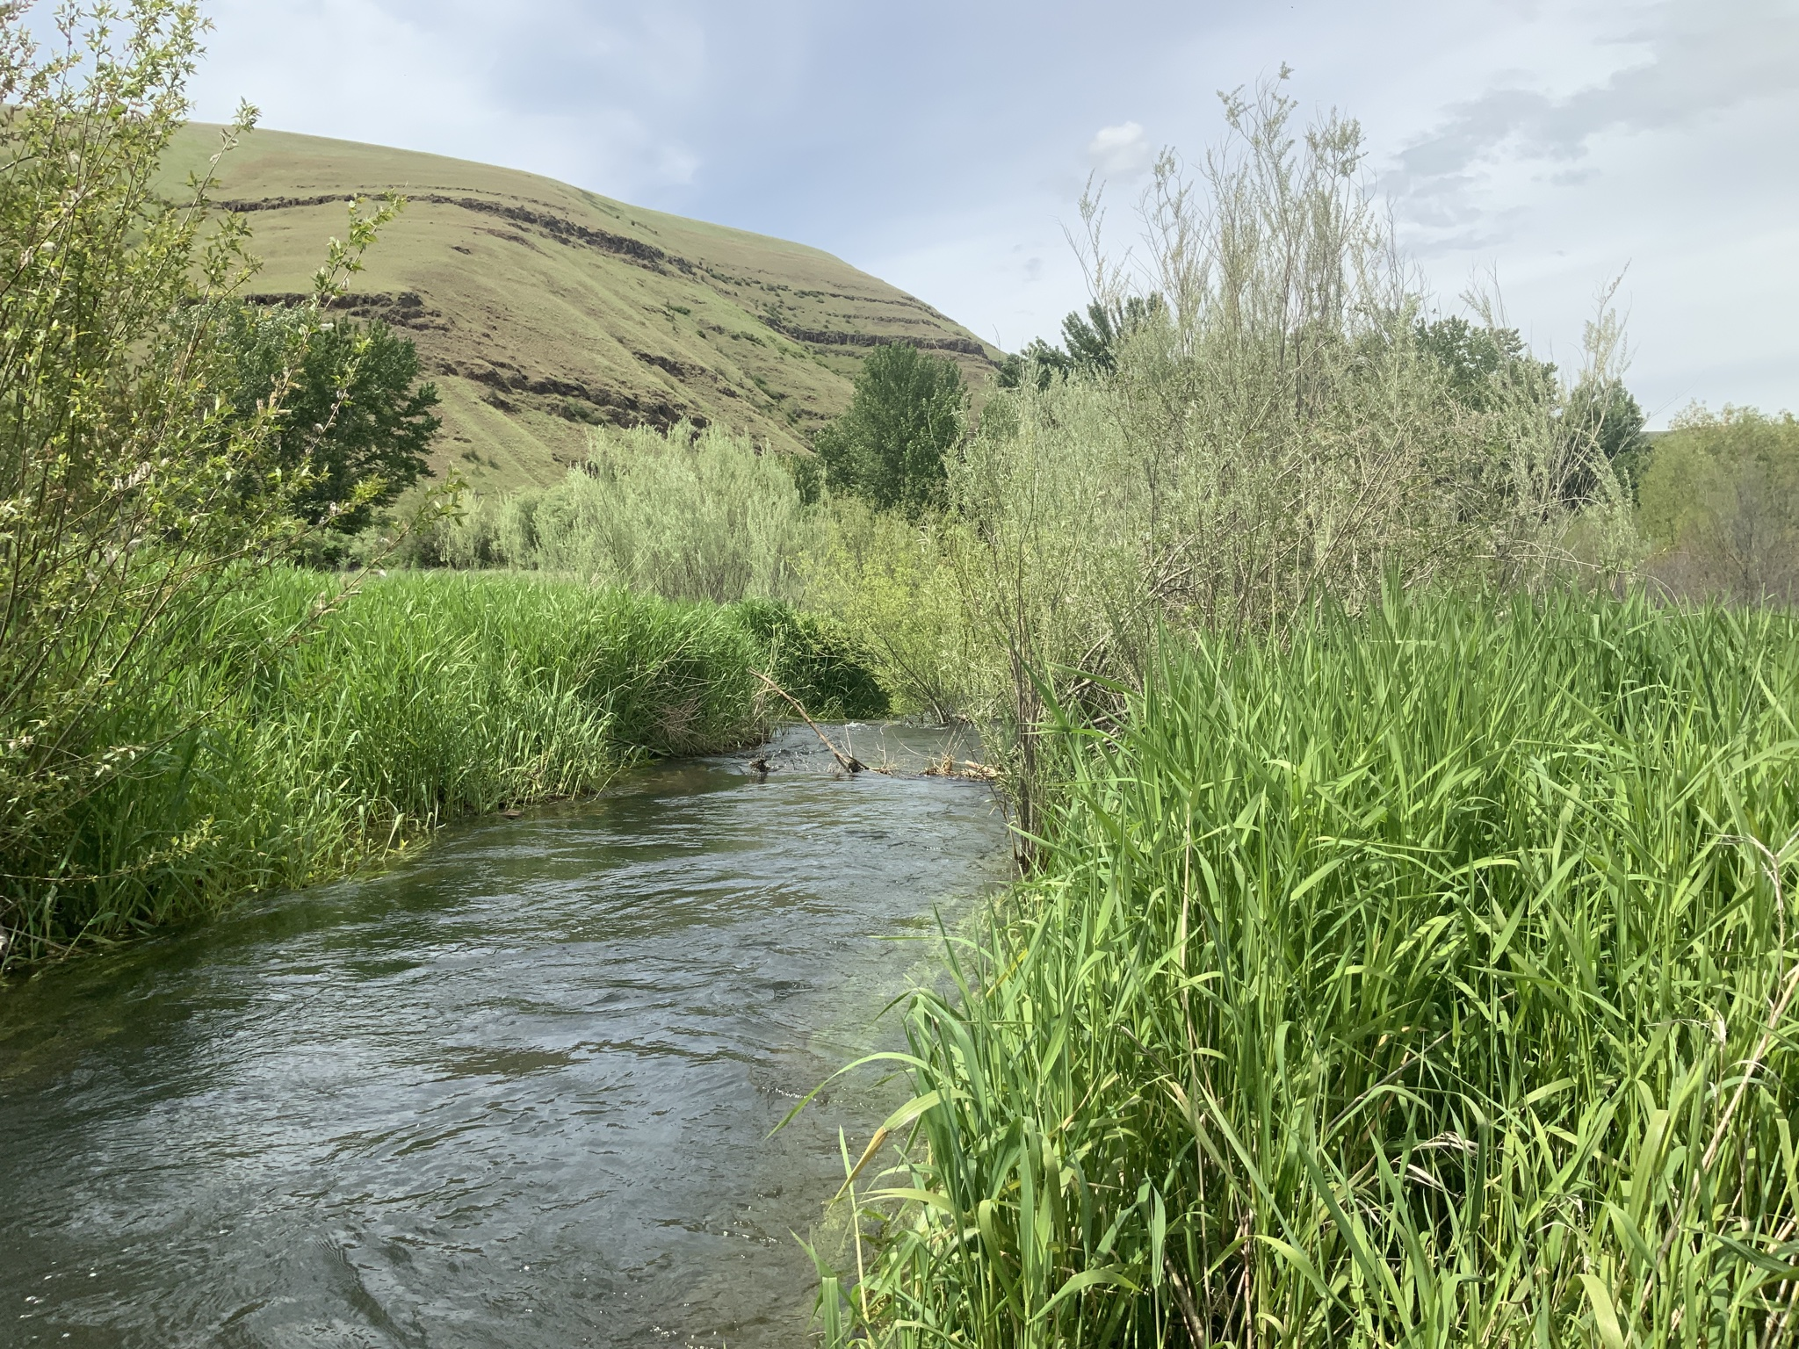
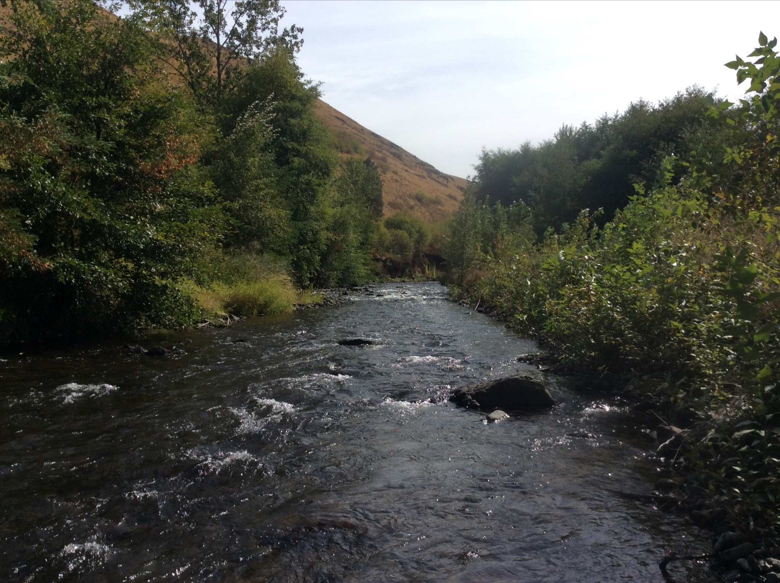
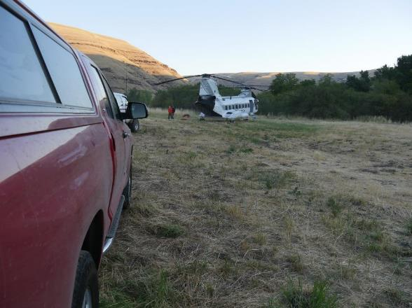
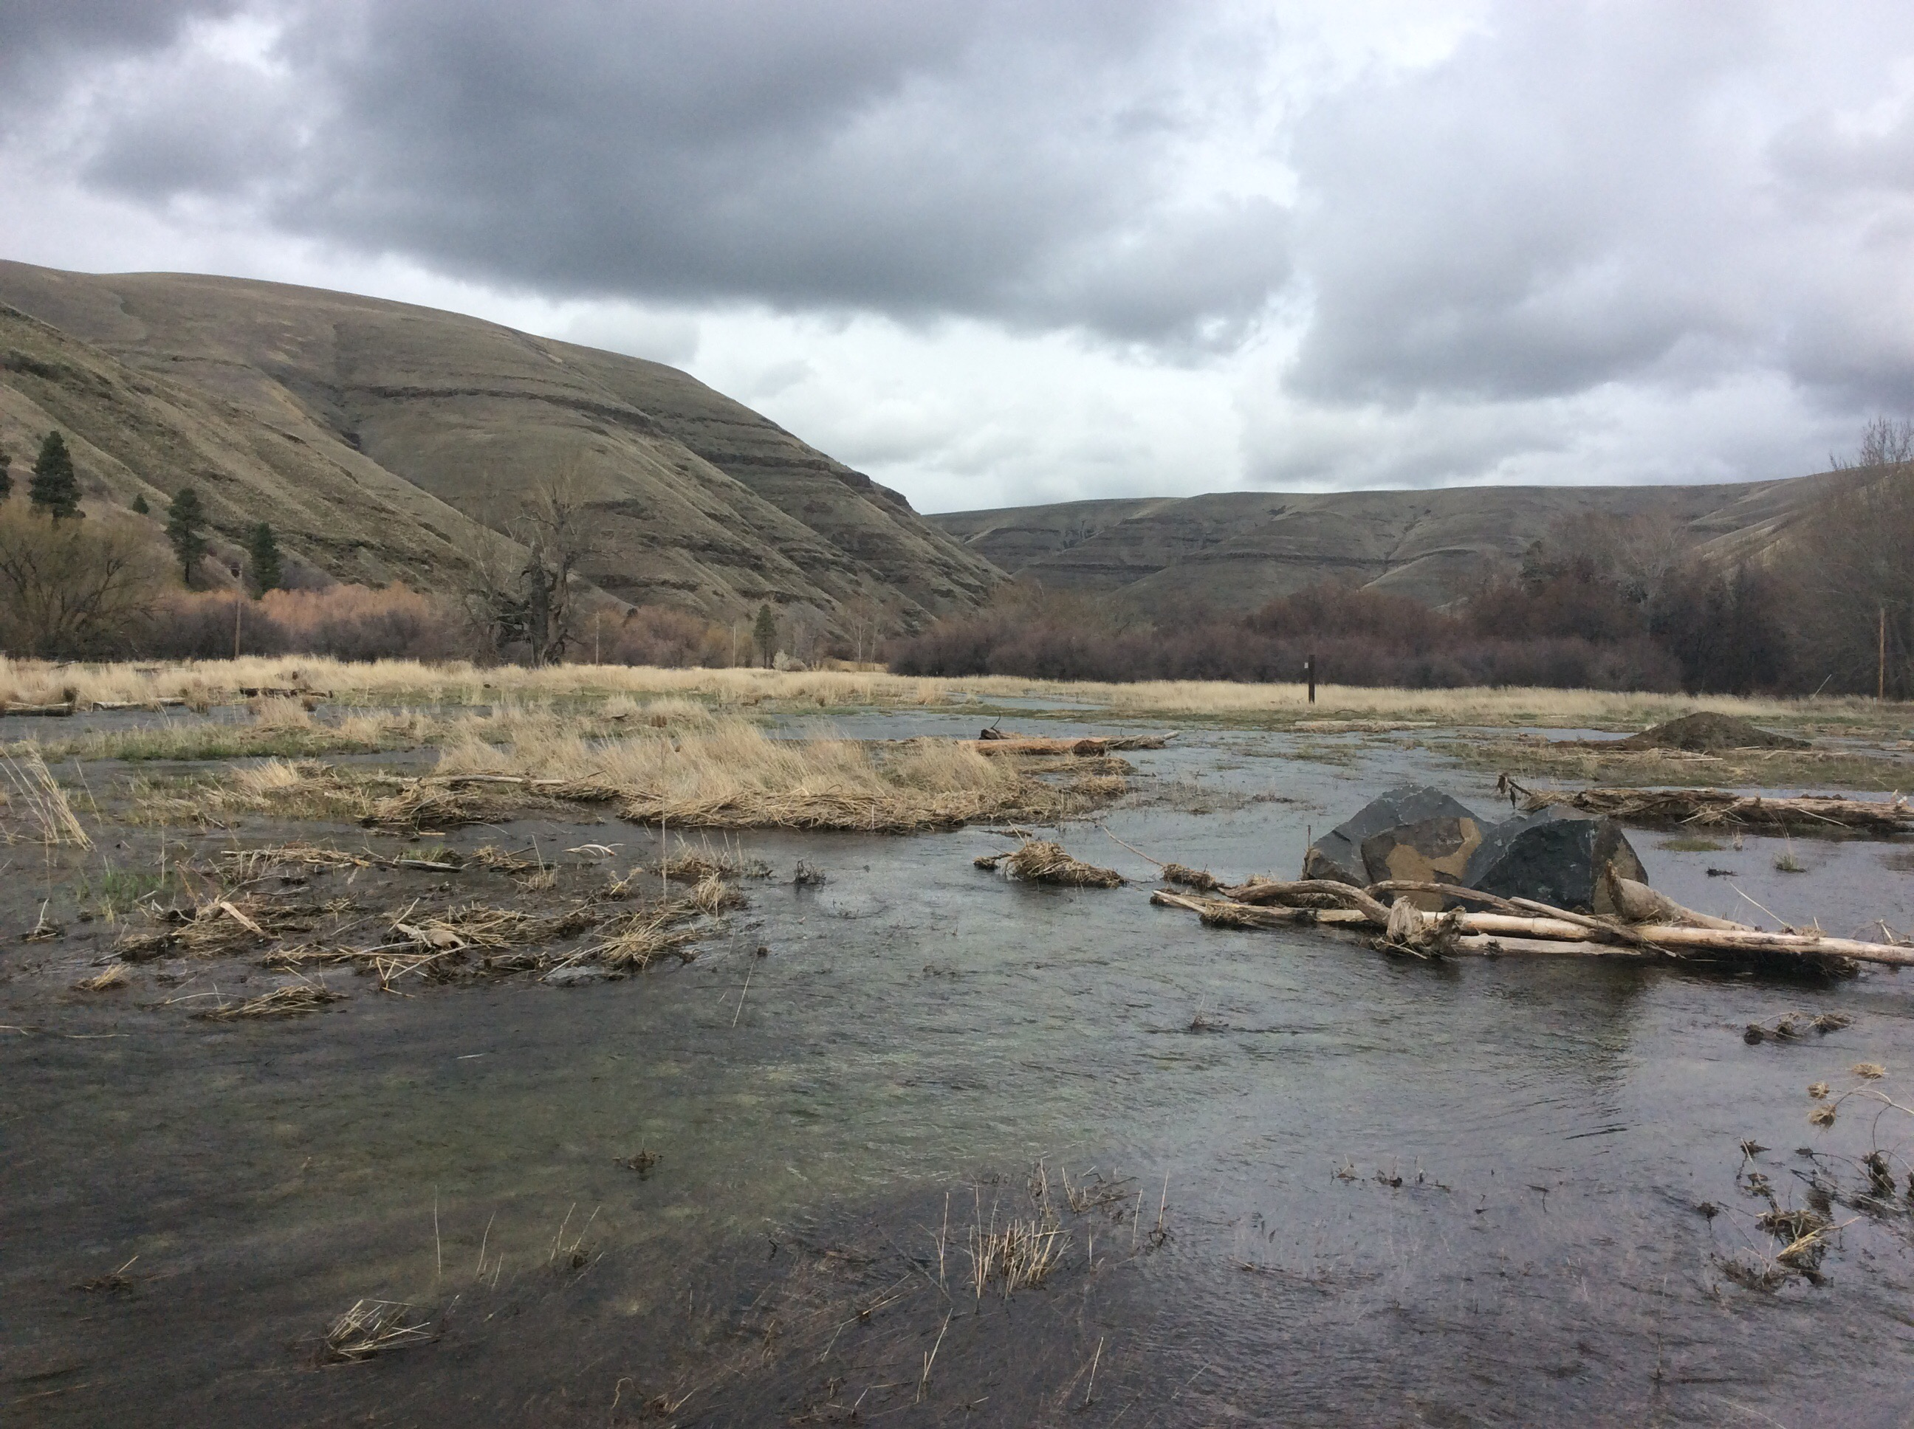
Creation of Wetlands
August 2012
July 2020
Spring 2023
During Project Construction 2017
Spring 2023 High Quality Salmonid Habitat
During Project Construction 2017
Post 2020 Flood
Notes:
Project that follows the model using a basic “let the river do the work” This can take a long time..

Slide 24
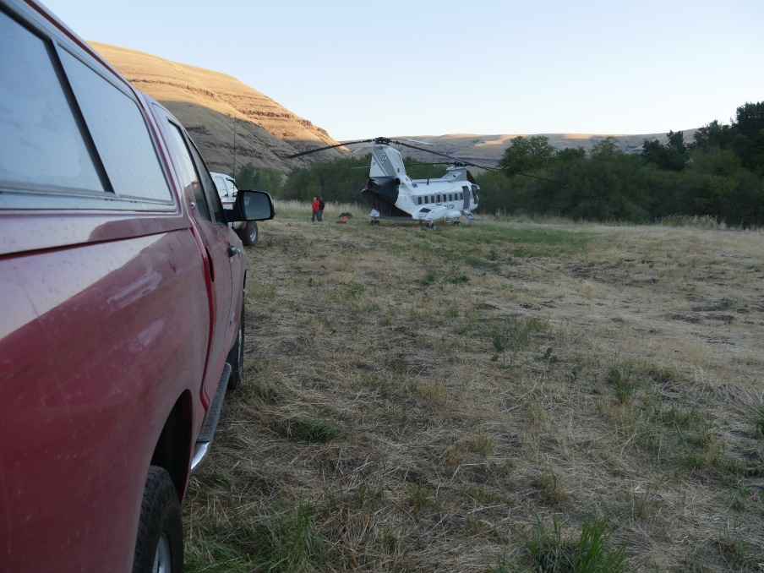
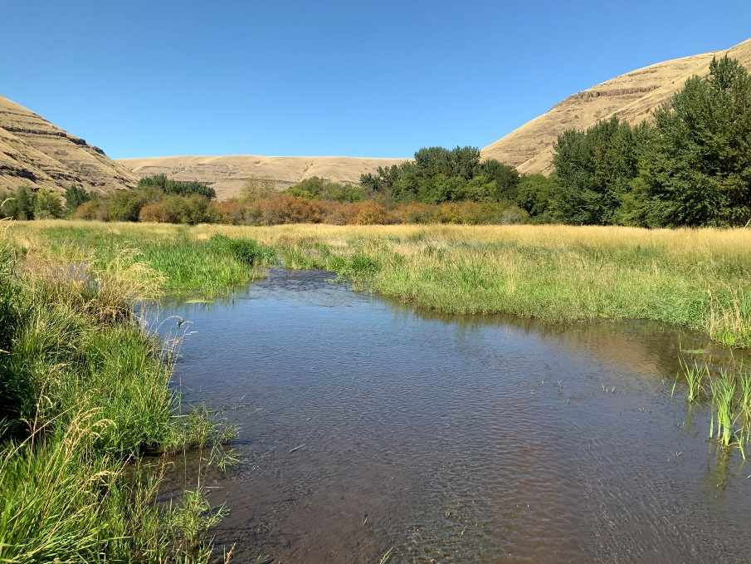
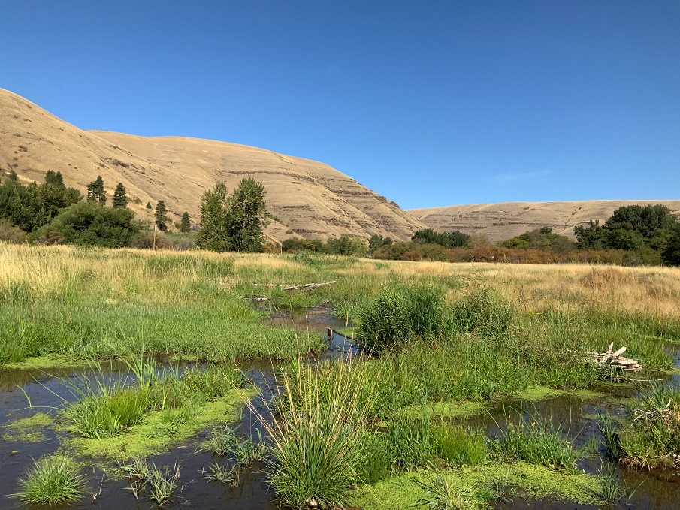
2017
2019
2019

Slide 25
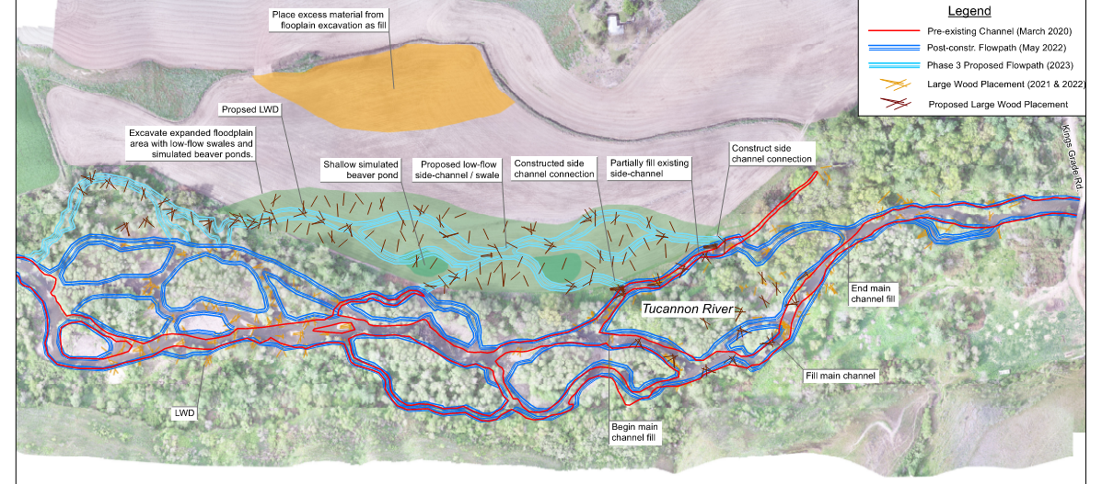
Pre-project July 2020
107 LWD (>6m long & 0.3m dia.)
43 pools (#)
1,956 (m²) pool area
474 m perennial side channel
669 m of high flow channels
1.51 km main channel length
Post-project September 2021
911 LWD (>6m long & 0.3m dia.)
81 pools (#)
5,730 (m²) pool area
2,231 m perennial side channel
2410 m of high flow channels
1.65 km main channel length
Proposed Summer 2023
226 LWD (>6m long & 0.3m dia.)
745 m perennial side channel
6.9 Acres of enhanced floodplain
7.1 Acres of passively created wetland
Notes:
Slide 10 – Here is an overview of the downstream reach metrics. You can see where we used channel fill to reconnect side channels and placed wood, including the channel spanners. Take notice of the pre-project and post-project metrics, we placed over 800 trees, doubled the amount of pools and increased the channel length while reconnecting the floodplain. The overview shows the summer 2023 work in light blue, which includes the re-connection of the 7 acres, and includes an additional 250 logs and 745 meters of side channel length.

Slide 26
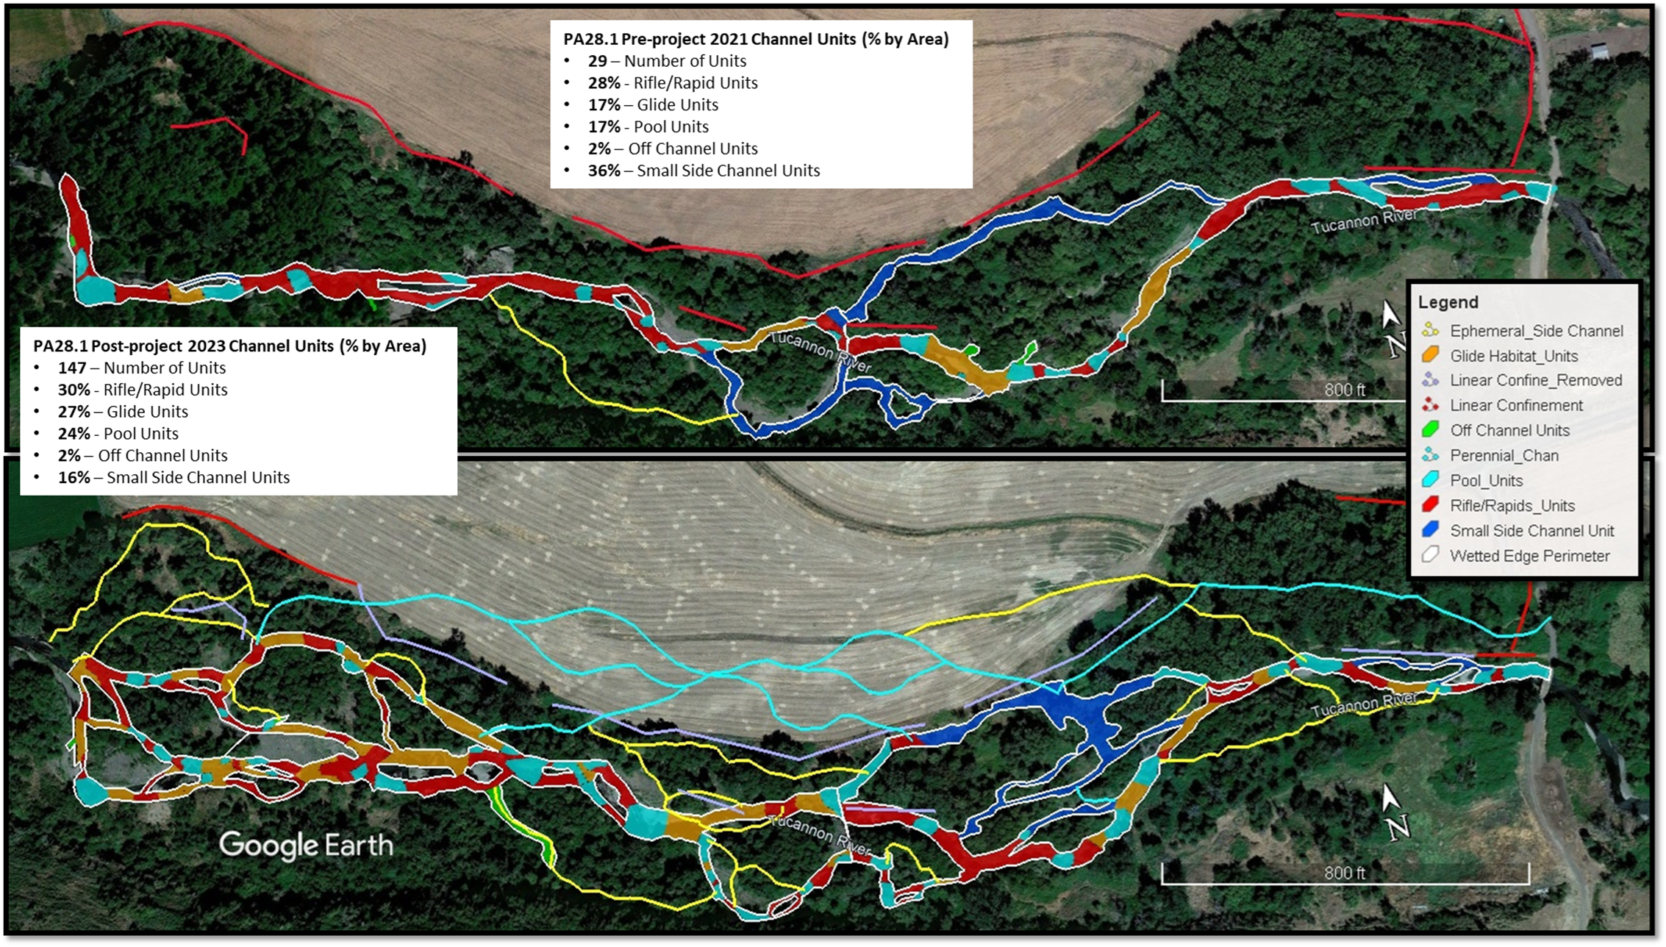
Project Area 28.1 channel habitat units delineated for the wetted channel at base flow using the RHS approach. Pre-project conditions were delineated in 2021 (upper) following implementation of Phase 0.5 in 2020 with the post project as-built condition illustrated following Phase III (lower). All though the first partial phase was not captured the change remain significant for illustration.

Slide 27

PA 28.1 post restoration photos take in the fall of 2023. The upper two right photos show the newly opened floodplain and the channel present on the floodplain.

