Slide 1
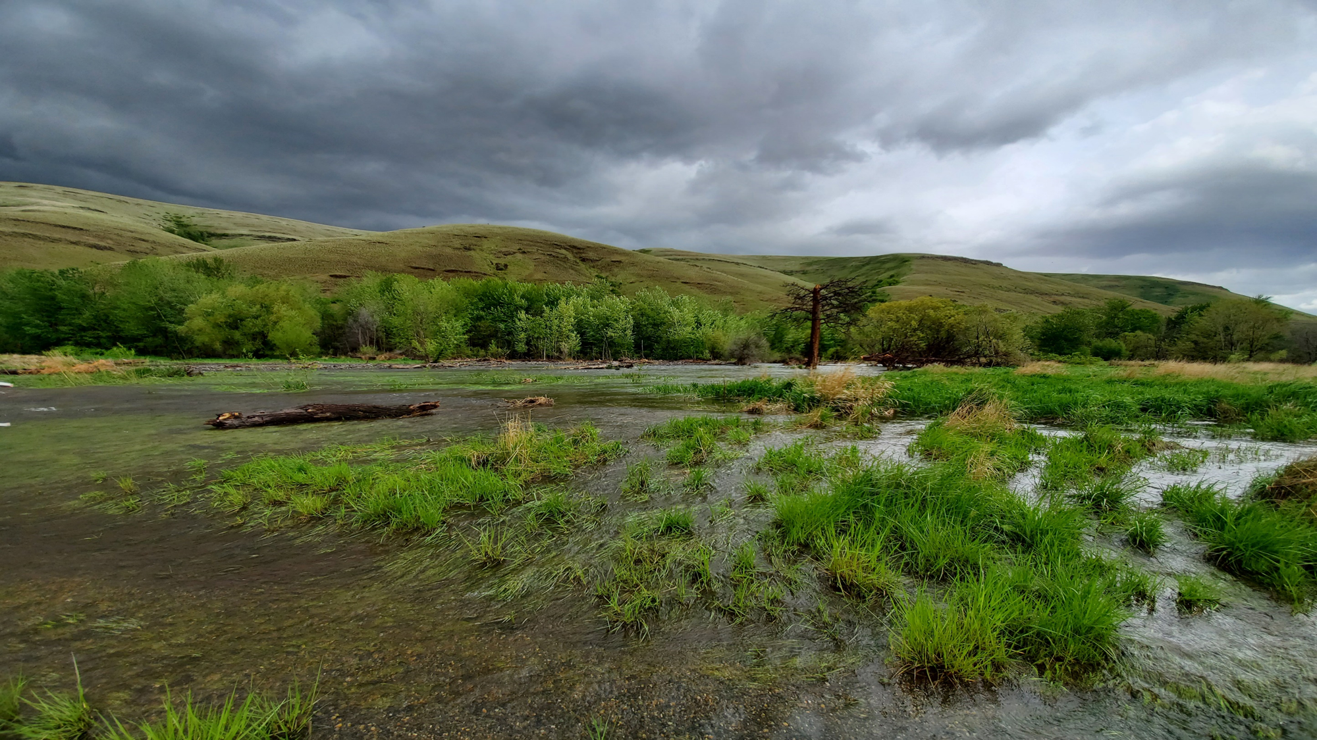
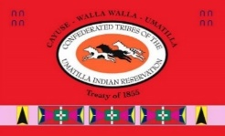


“Using repeat green LiDAR surveys to monitor/plan floodplain restoration in the Tucannon River, WA”
Panoramic of PA-18
Kris Fischer, Tucannon Basin Project Leader
Notes:
Slide 1 – Good afternoon everyone. My name is Kris Fischer and I work for the Umatilla Tribe’s as the Tucannon Basin Habitat Enhancement Project Leader. I would like to recognize my geomorphic change detection team, AnchorQEA and NV5.
I turned 50 last week, which after some deep though lead me to start this presentation with a retrospective.

Slide 2
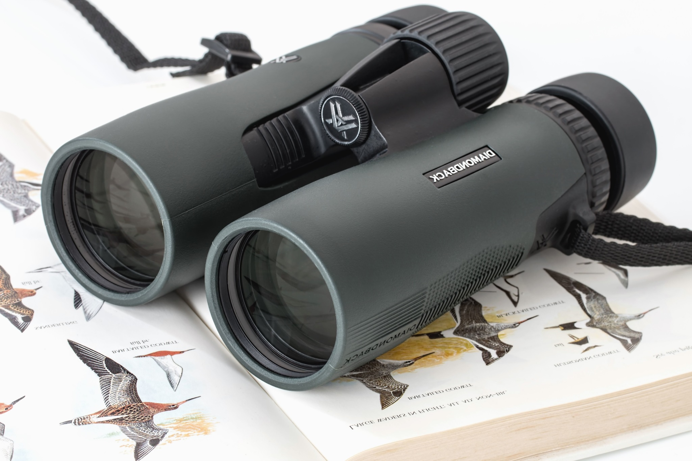
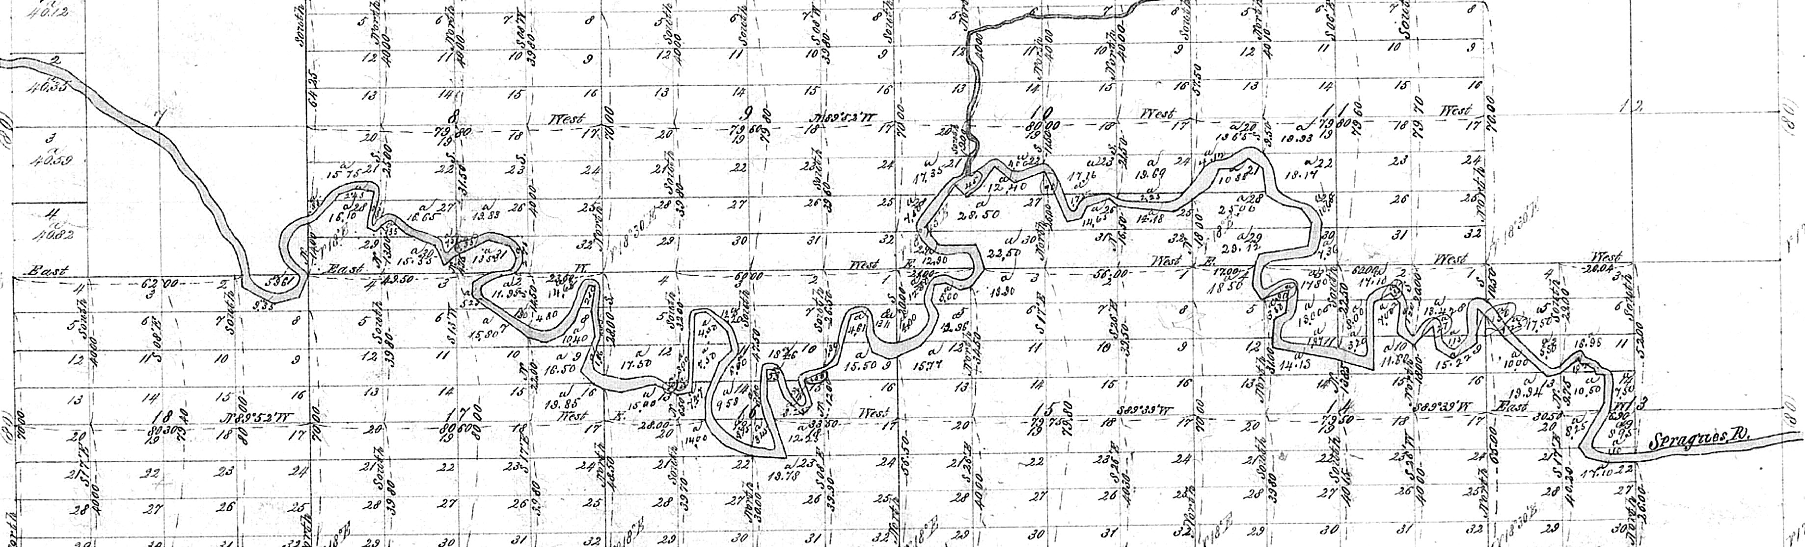
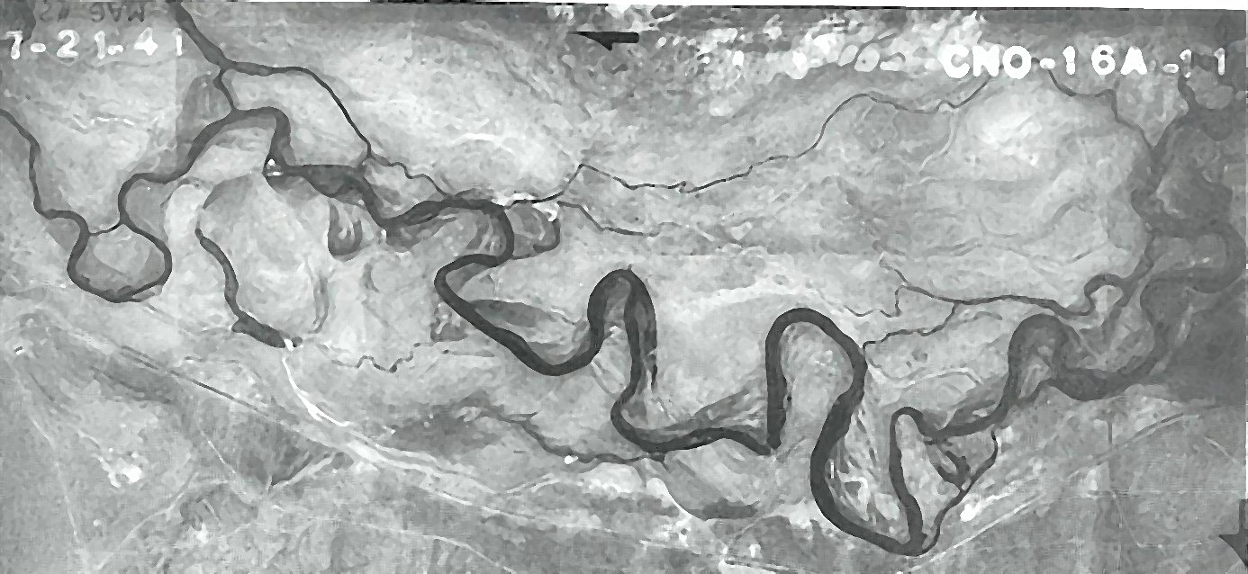
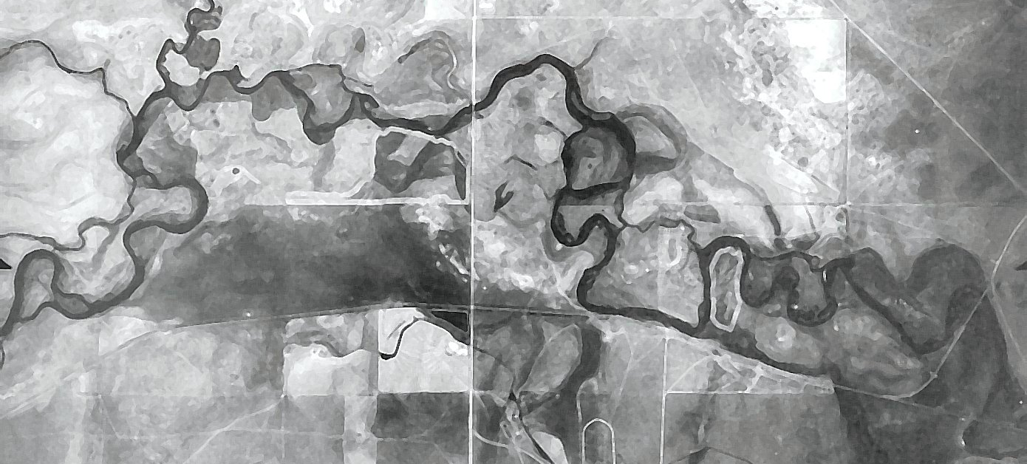
Seeing our Watersheds
1872
1940-41
Notes:
When I started my career in 2000, we mostly looked back at old photos to see what was occurring in our watersheds. Anyone remember cadastral surveys or NRCS aerial photos? We spent time on the ground using binoculars.

Slide 3
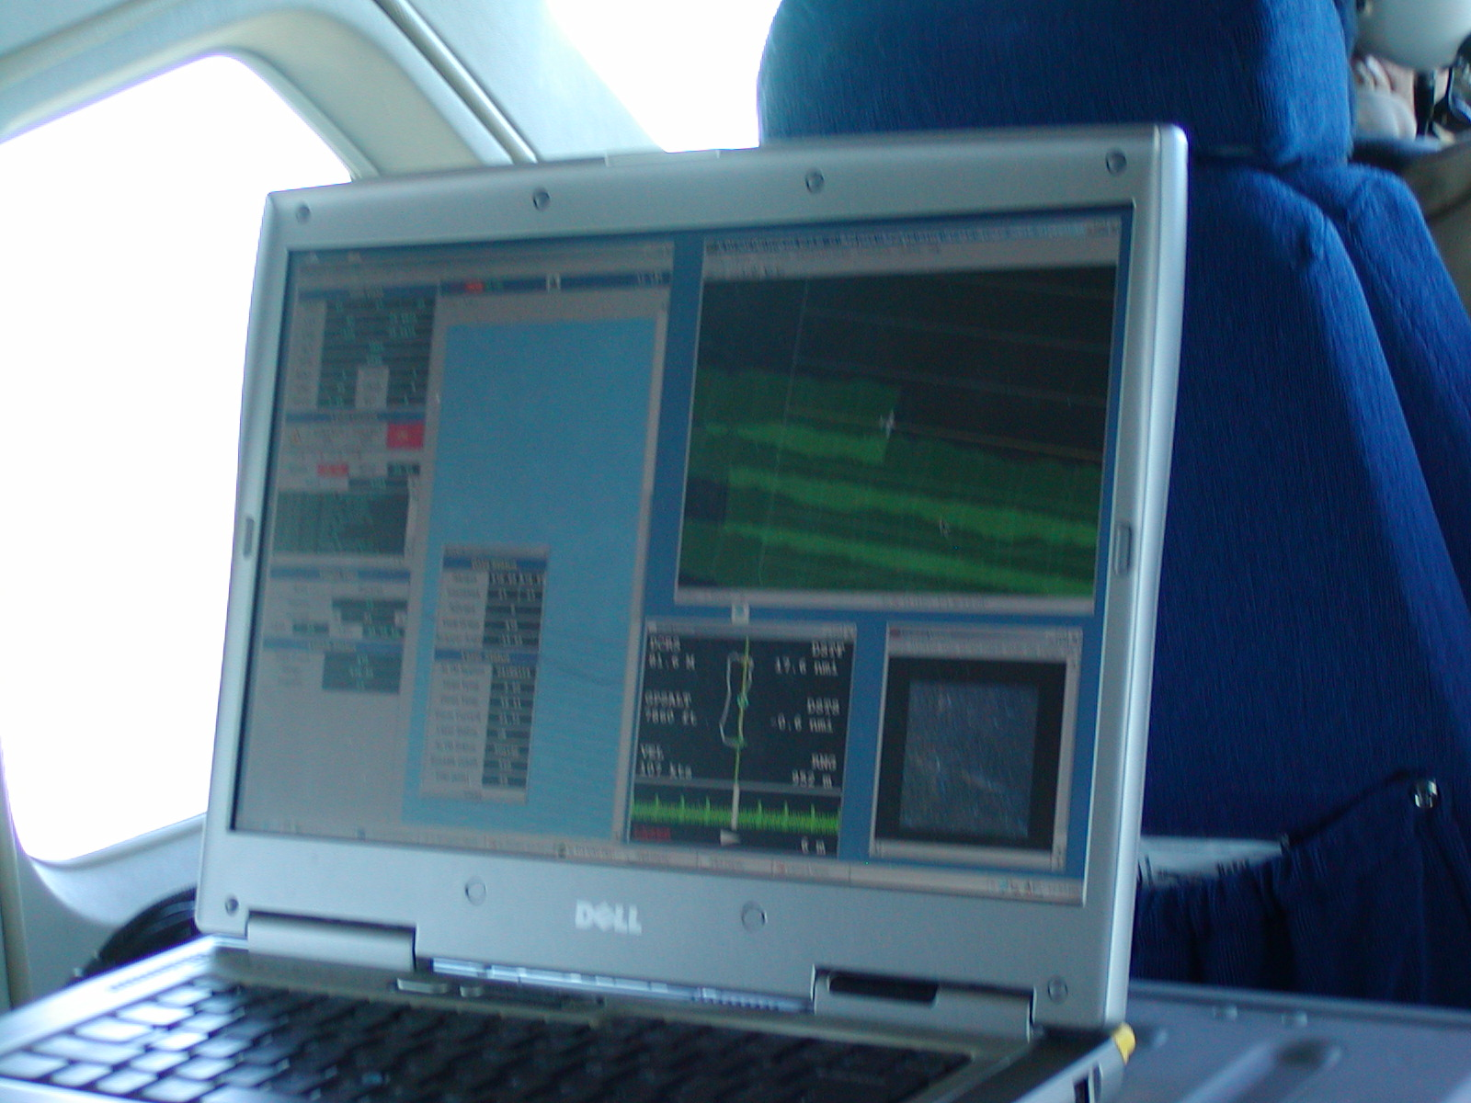
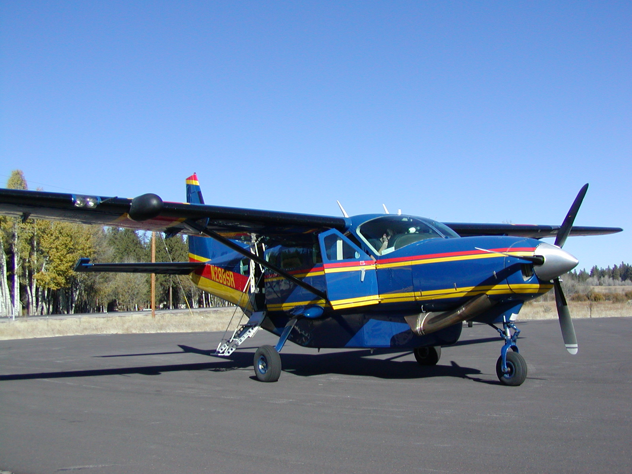
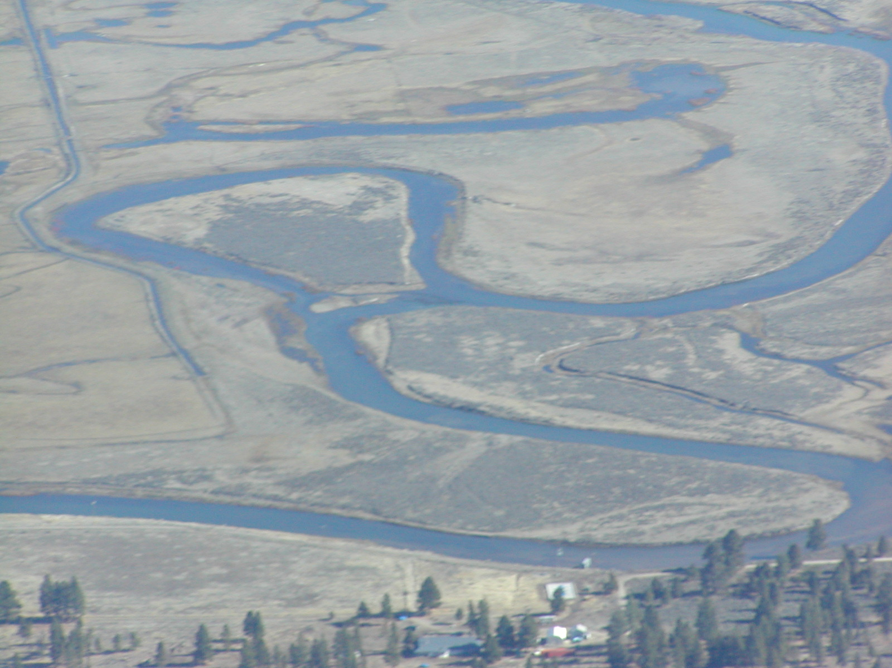
Really, Seeing our Watersheds
Notes:
In 2004, Matt Boyd and Russ Fox of then “Watershed Sciences” called saying they had some new sensor technology which they were calling LiDAR and really needed to try it out. So on a fine day in November 2004, they flew into Chiloquin International Airport and picked me up for a ride in their airplane.
We took off that day to fly the Sprague River, flying back and forth to map the river and its floodplain from valley wall to valley wall. Would have been nice if someone would have mentioned this airplane didn’t have a bathroom and that we would be flying until the GPS blackout period or approximately 6.5 hours.
Of course I took my camera and Matt and Russ had theirs. Just seeing the Sprague River from the air was exciting after spending 4 years seeing the river from the ground.

Slide 4
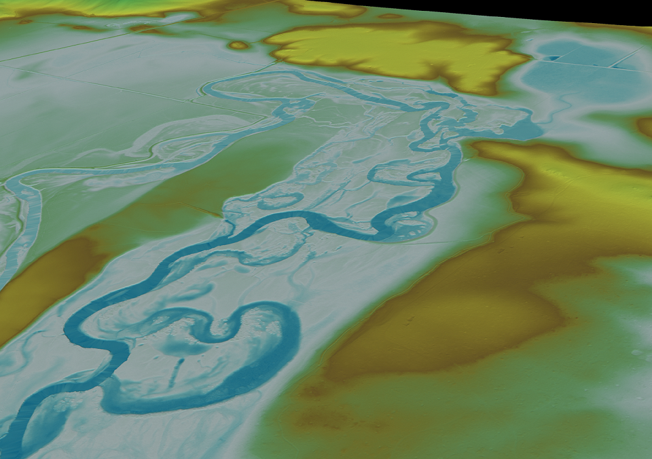

View toward Kamkaun Spring, Bare Earth Data
LiDAR Survey (November, 2004)
Notes:
The November 2004 flight produced LiDAR data unlike anything any of us had ever seen. The detail of the Spague River with all its past and present meanders was incredible. This photo was of the bare earth data at KamKaun Spring near Beatty Oregon.

Slide 5
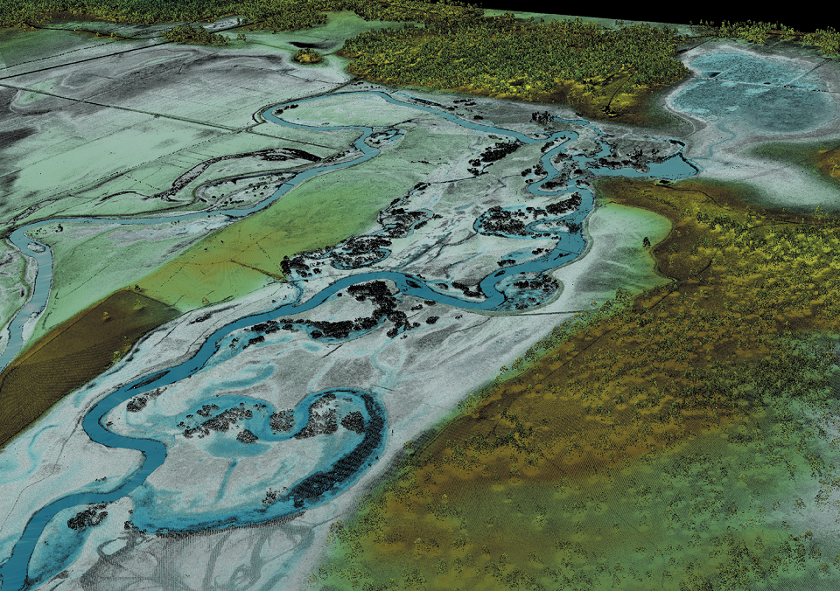
View toward Kamkaun Spring, First Return Data with Intensity
LiDAR Survey (November, 2004)
Notes:
This photo shows the first return data at the same location showing all the trees on the floodplain. This level of detail seemed unimaginable and our crews gathered around these large format posters in the conference room looking at them in “aw”. These photos and the real data in ArcGIS lead us to fly LiDAR again the next year on the Wood River System. Giving use 2 datasets to analysis and help plan restoration projects.

Slide 6
Past Efforts
1999 Sprague River FLIR
Sprague River TMDL
2004 Sprague River LiDAR
Red Lidar and Imagery Collection for restoration planning efforts
2005 Wood River Valley LiDAR
Red Lidar and Imagery Collection for restoration planning efforts
2007 Sprague River FLIR
Winter-time FLIR data collection to look for cold water springs
Notes:
After the 2004 and 2005 LiDAR flights we turned to the need for FLIR data for the Sprague River. We decided on a winter-time FLIR flight to highlight the then warm water springs flows though the Sprague River system. After 2 or 3 weeks of waiting for a winter-time weather window we finally collected the data. These early LiDAR data collection events and the utility of the data analysis stuck with me my whole career.

Slide 7
Recent Efforts
2010 Geomorphic Assessment and Prioritization
Topographic LiDAR and Imagery Collection
2017 Geomorphic Assessment and Re-Prioritization
Red/Green LiDAR Topo-Bathy and Imagery Collection
2020 LiDAR analysis
Red/Green LiDAR Topo-Bathy and Imagery Collection
2021 Tucannon Long Term Monitoring Plan
Identifies useful metrics for tracking moving forward, 7 of these are evaluated in this analysis
Notes:
Which leads me back to todays talk. The recent efforts of the 2017 and 2020 red/green LiDAR collection efforts in the Tucannon Basin. And the Tucannon Geomorphic Change detection analysis. And the lead up to the 2021 Tucannon Long Term Monitoring Plan.

Slide 8
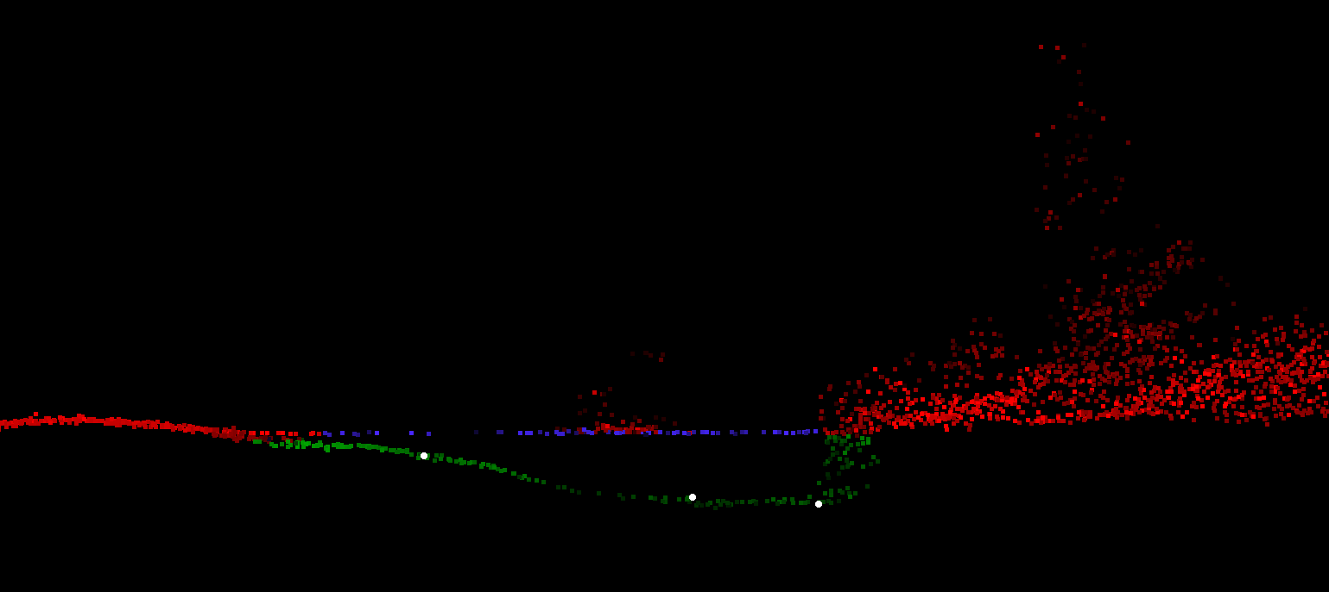
Seeing our Watersheds
Notes:
Here’s an example of one of the pools we focused on during the 2020 flight. Kris Buelow and I took turns surveying the actual pool depths with the total station. The white dots are the actual surveyed depths and the green dots are the green LiDAR points. As you can tell the pool was about 3.5 feet deep and was tracked by the green LiDAR accurately. As part of the QA, Buelow and I surveyed over 500 points in 6 different pools over 3 different days in late November of 2020.

Slide 9
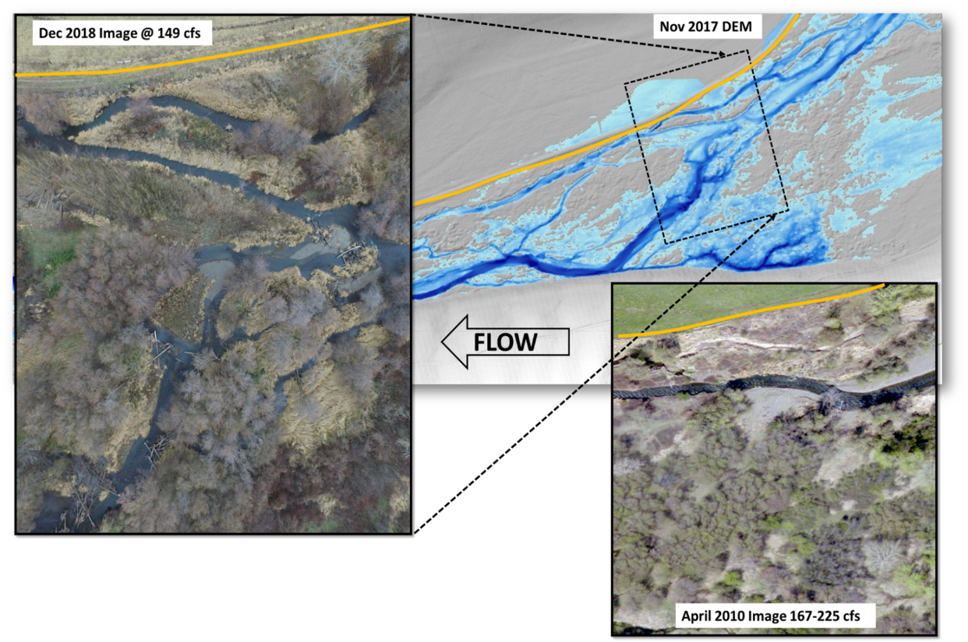
Recovery Program Goals & Objectives:
Goal: Restore the Tucannon River to an ecologically functioning watershed which possesses resiliency in the presence of future climate and cultural changes, and supports the CTUIR fish management goals allowing tribal members harvest opportunities for spring Chinook and steelhead.
Species of interest:
Spring Chinook
Summer Steelhead
Fall Chinook
Bull Trout
Lamprey
Objectives:
Floodplain Connectivity
Channel Complexity
Stream Power
Notes:
Using River Vision to rebuild ecological resilience within these river systems, means putting the missing ecological pieces back like puzzle pieces, allowing these systems to be resistant to disturbance, both natural and un-natural, so that the channel processes and forms are still recognizable to the native species that depend on them. Thus allowing CTUIR to meet their fish management goals of allowing tribal member's harvest opportunities for first foods.
Looking at the REM’s since the 2012 restoration plan, allowed us to rethink the objectives during the 2020 restoration plan. Where we moved from the more traditional limiting factors to focus on floodplain connectivity, channel complexity to reduce stream power in the Tucannon.
The examples show channel changes from 2010 to the 2017 DEM to the 2018 image. For the context the Tucannon has been straightened and leveed in place. The Tucannon implementers are trying to increase channel length and floodplain connectivity.

Slide 10
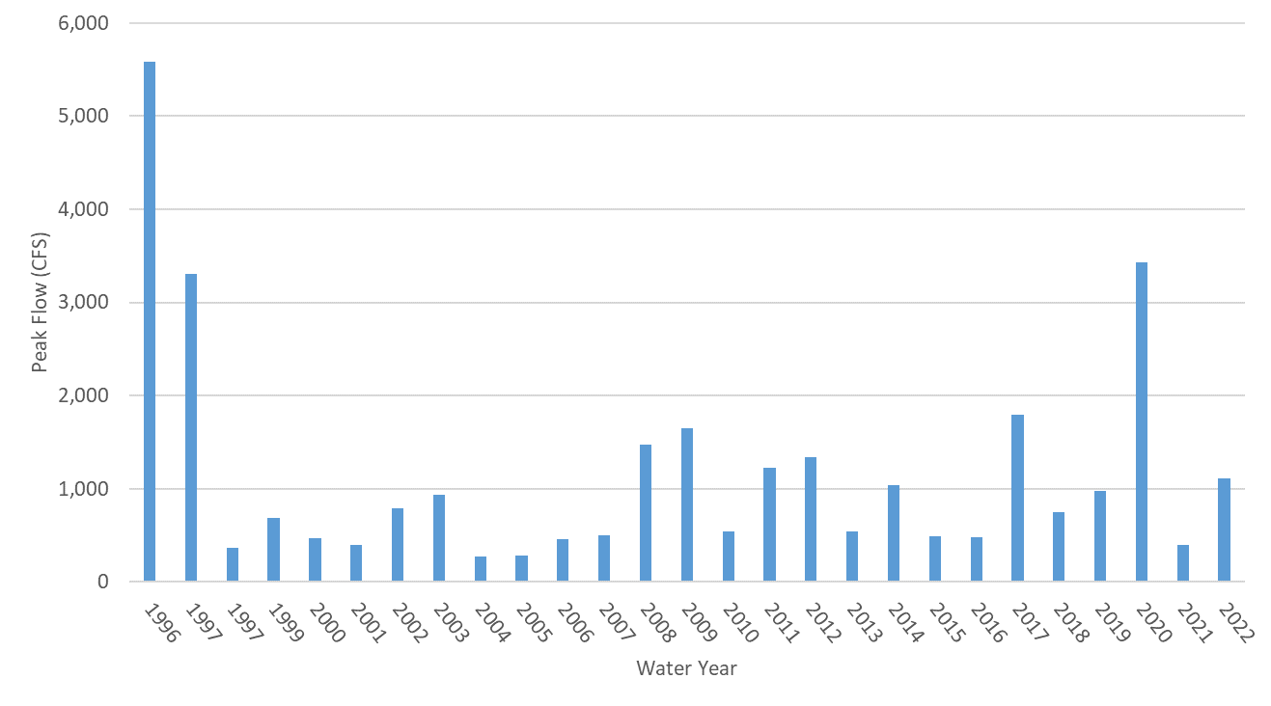
Restoration and Geomorphic Timeline
2010 LiDAR
2017 LiDAR
2020 LiDAR
50 Year
25 Year
10 Year
5 Year
2 Year
Notes:
Since restoration started in the Tucannon in 2010, events above the 5 year have been limited. We originally thought we would use time or years to resurvey. But have learned that we don’t get to choose the reoccurrence intervals and have since relied on event based sampling.
Starting with the 2010 restoration plan the Lidar. We have since recollected LiDAR data in 2017 and then again in 2020. With an update to our restoration plan in 2020. As we learned from our first 25 year event in the Tucannon since the BPA programmatic started. This event was caused by rain on snow in February 2020 as the Northern Blue Mountains received 9 inches of rain in 36 hours.

Slide 11
What can this information tell us?
What is the geomorphic response in the Tucannon to a high flow event.
- DEM of Difference Geomorphic Change Detection
- Change in Transport Capacity
How does this affect the key habitat metrics
- Change in Complexity and Floodplain Connectivity
- Habitat Suitability Index (HSI)
What other metrics in the literature can be tracked?
- Geomorphic Unit Tool (GUT)
- Confinement Degree/Index
Notes:
So what has the repeat 2017 and 2020 red/green LiDAR taught us? We decided to take a look at the data and hired NV5 and AnchorQEA to help analyze the datasets. We wanted to look at the geomorphic change detection between the 2017 and 2020 datasets. Look at changes in transport capacity, look for changes in channel complexity and floodplain connectivity. Looked for changes in habitat suitability for spring chinook and steelhead juveniles and look at bull trout. This led us to use geomorphic unit tool (GUT Analysis) and look at confinement.

Slide 12
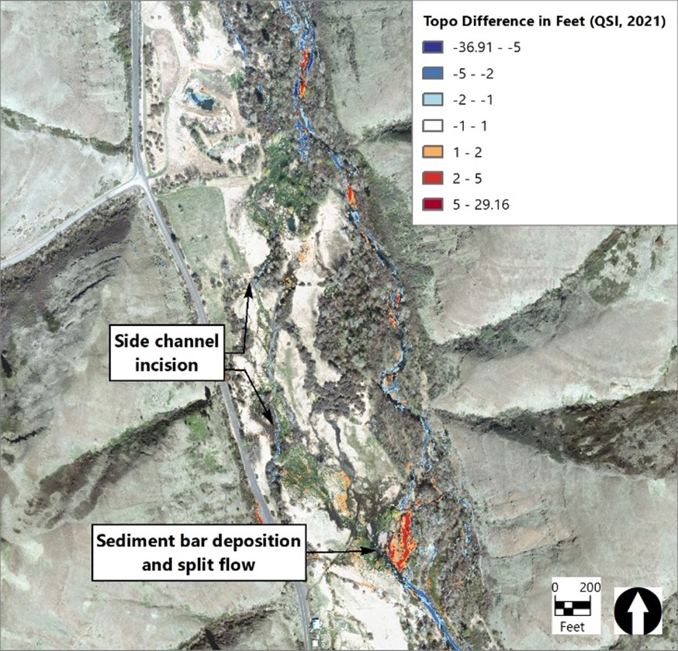
Geomorphic Change PA 18
Identify areas of Geomorphic Change
Main Channel Deposition/Erosion
Avulsions
Channel Migration and Bar Building
Floodplain Deposition
Find drivers of those changes
Continued trends
Large wood material build up
Restoration
Over confinement
Notes:
First the geomorphic change at PA 18. As you can see we had sediment deposition (red/orange) of 2-5 feet causing split flow. You can also see side channel incision in blue, most between 1-2 feet after the 2020 high flows.

Slide 13
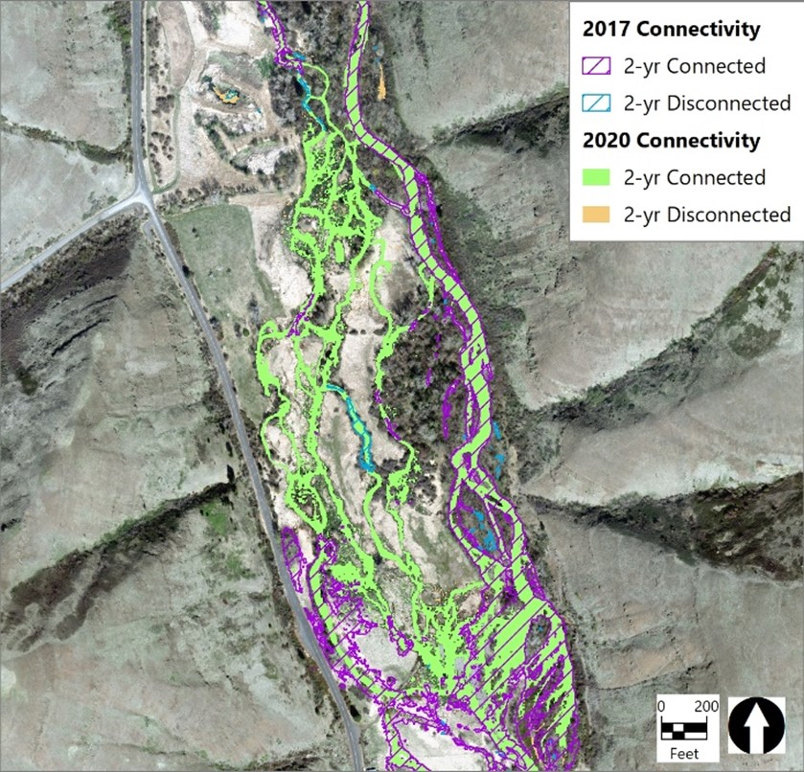
Change in Floodplain Connectivity
PA 18.1
FC For 2-Year Connected
2020 Analysis | 2017 Analysis | Change from 2017
21.5 | 19.7 | +1.75
Notes:
Next we looked at changes in floodplain connectivity. As you can tell by the green 2-yr connected, we saw large changes at this project area in the about of 2 year floodplain connectivity in 2020. This metric went from 19.7 acres to 21.5 acres at this site alone.

Slide 14
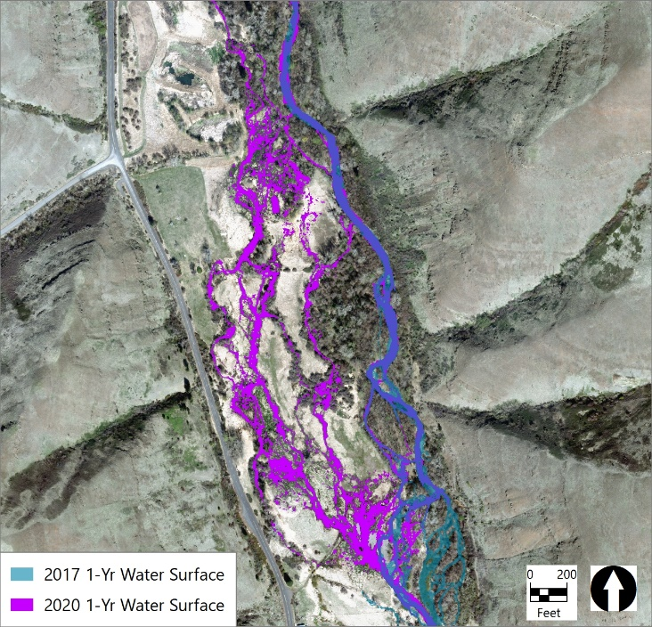
Change in Channel Complexity
PA 18.1
RCI For 1-Year Flow
2020 Analysis | 2017 Analysis | Change from 2017
94.67 | 29.18 | 65.49
Notes:
Next we analyzed changes in channel complexity. Using River Complexity Index (RCI) we saw large changes in both sinuosity and the number of side channel nodes which both increase RCI. This was one of the first restoration sites that used a mix of helicopter and ground based large wood additions. And until recently was one of the heaviest treated sites in the Tucannon. You can tell by the purple on this map, that the 2020 flows did a lot of work at this site.

Slide 15
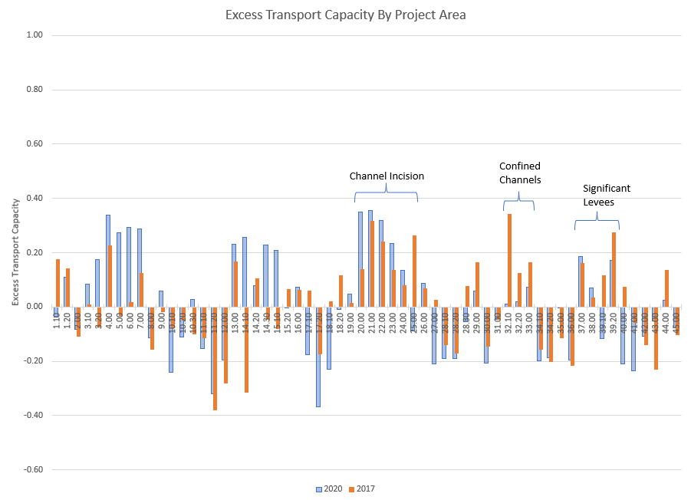
Change in Excess Transport Capacity
PA 18
Notes:
Next we started to look at Stream Power, or Excess Transport Capacity. For reference I’ve highlighted PA 18 on this graphic. With Excess transport capacity on the Y-axis and the project area numbers on the X-axis going from upstream starting a 1 and going downstream to 45 near the mouth at the Snake River. Some sites continued to incise, others are still confined and we still have significant levees in some project areas. The ability to analyze the whole Tucannon for stream power starts to allow us to refocus our restoration efforts in areas where you don’t expect to see excess stream power like lower in the Tucannon in historically depositional reaches.

Slide 16
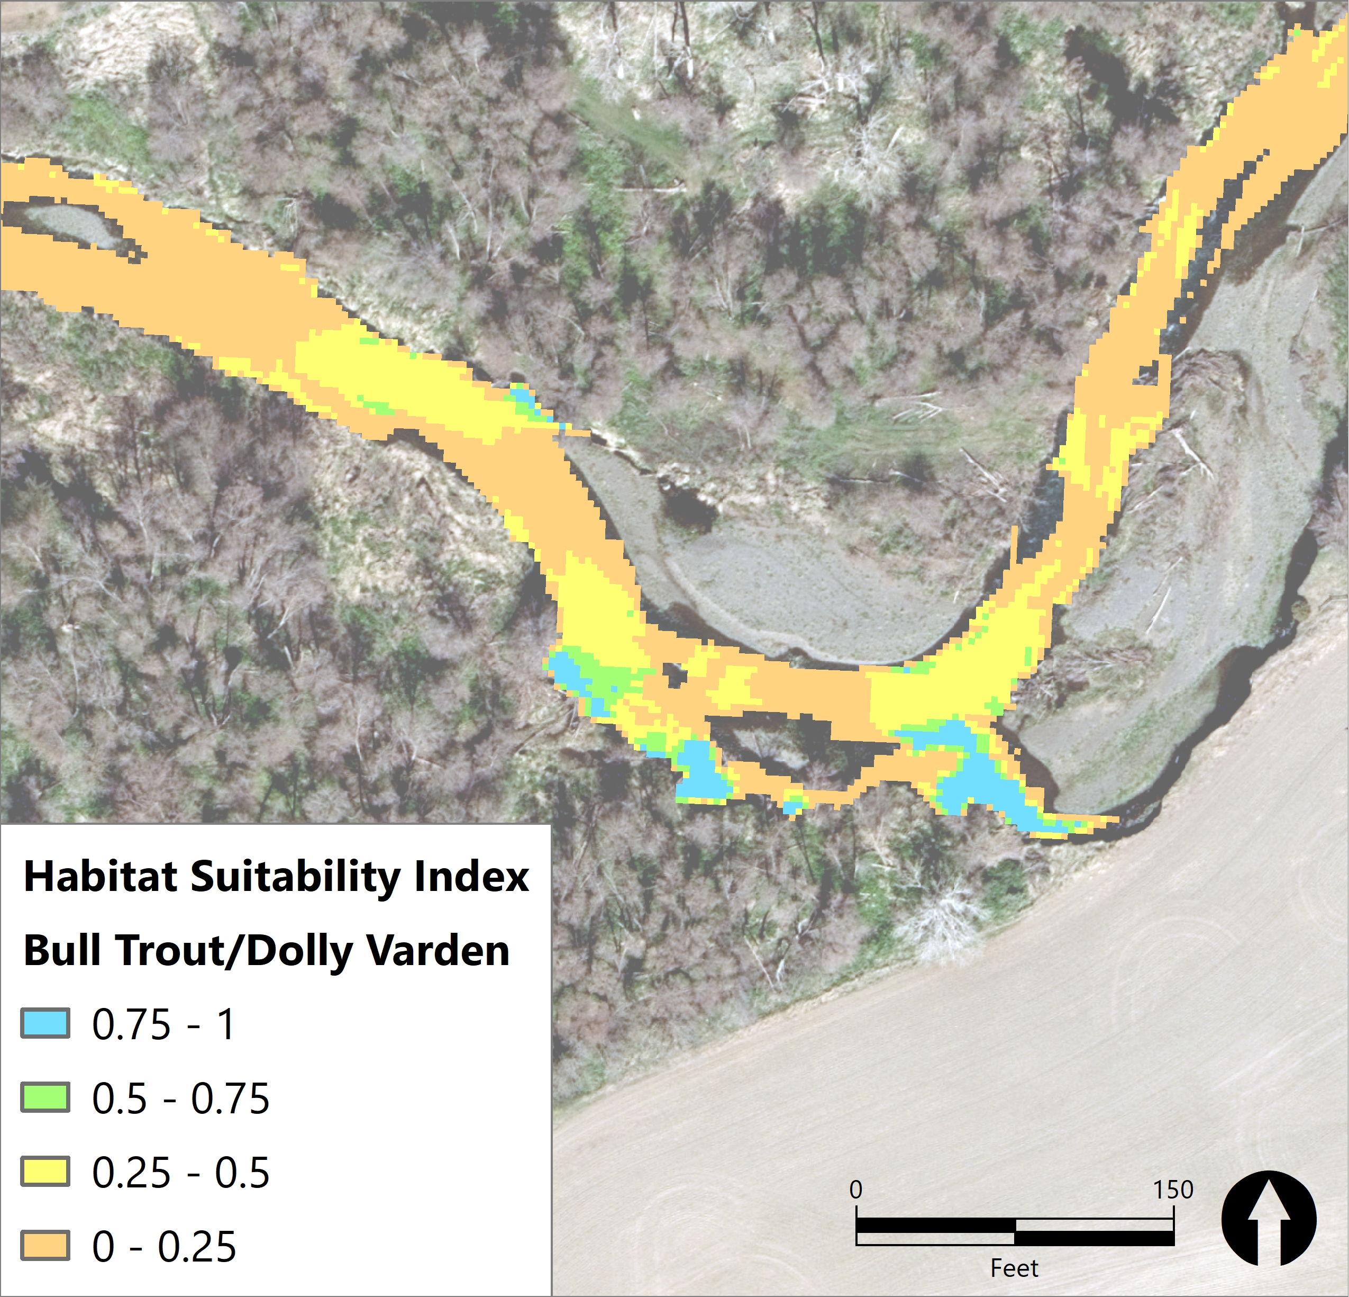
HSI and % Slow Water Habitat
Project Area | Flow Regime | Species | MEAN | MEDIAN | PCT90
36 | Low Winter | Bulltrout/Dolly Varden | 0.209 | 0.172 | 0.425
36 | Low Winter | Juvenile Chinook | 0.185 | 0.135 | 0.405
36 | Low Winter | Juvenile Steelhead | 0.211 | 0.138 | 0.501
36 | Mean Winter | Bulltrout/Dolly Varden | 0.149 | 0.066 | 0.375
36 | Mean Winter | Juvenile Chinook | 0.118 | 0.066 | 0.300
36 | Mean Winter | Juvenile Steelhead | 0.159 | 0.100 | 0.369
36 | 1-year | Bulltrout/Dolly Varden | 0.113 | 0.000 | 0.365
36 | 1-year | Juvenile Chinook | 0.098 | 0.000 | 0.300
36 | 1-year | Juvenile Steelhead | 0.124 | 0.051 | 0.329
Notes:
Part of the struggle we have is communicating to our fish restoration folks and explaining what these physical habitat metrics mean for fish. So we added metrics such as Habitat Suitability Index and Percent slow water habitat. For HSI we looked at WDFW curves for the Tucannon and focused on Juvenile Spring Chinook and steelhead, but also looked at bulltrout. We expect this to bridge the gap between those doing fish research and those of us doing habitat restoration in the Tucannon.

Slide 17
Long Term Story of Restoration
What watershed scale story can we tell about restoration with this information?
Why have some restoration efforts sustained through flow events, while others have not?
What is the effect of restoration projects on reaches immediately upstream and downstream?
Notes:
Using the 2017 and 2020 green lidar datasets has allowed us to look not only at the watershed scale. But also look at changes during a major event. Can we see positive effects from, the 15 restoration projects completed in the 55 mile Tucannon River. How do project areas react to restoration upstream and downstream?

Slide 18
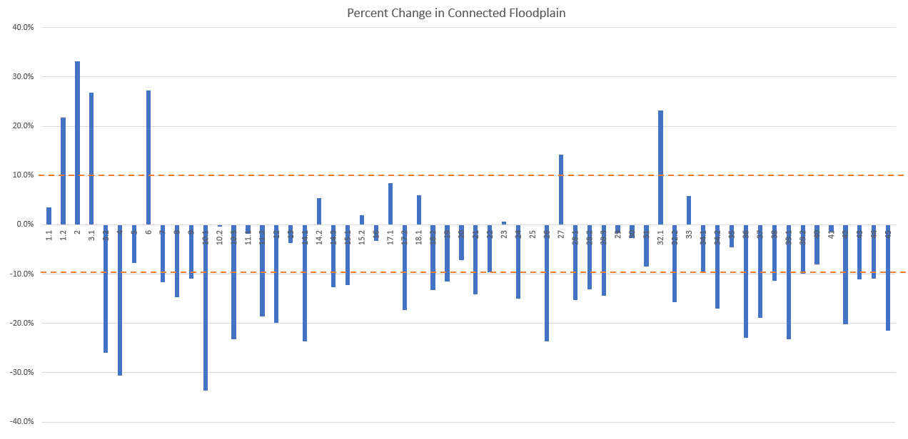
Percent Change in Connected Floodplain thru the Tucannon Basin
PA 18
General trend of decrease in Floodplain Connectivity
Notes:
Using the power of watershed scale analysis. We are trying to explain why the general trend of decreased floodplain connectivity is still happening in the basin after a 25 year event. Why some sites remained connected, and some did not. Again PA 18 for reference.

Slide 19
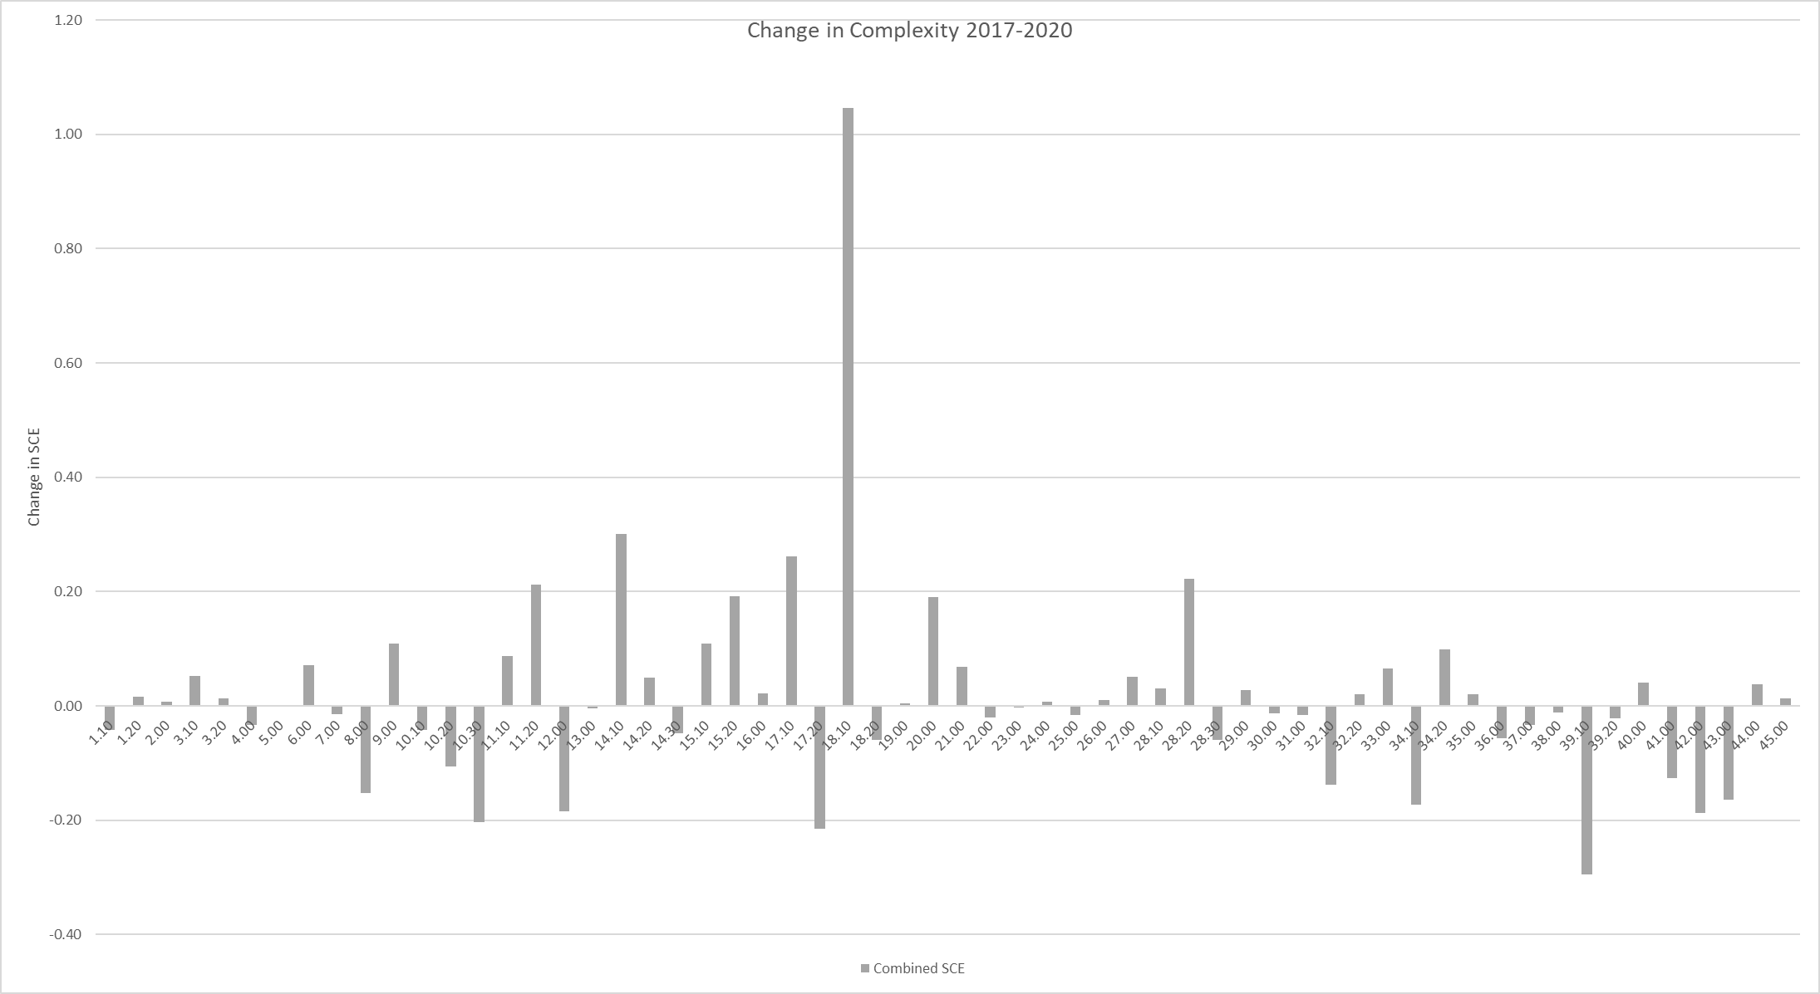
Change in Channel Complexity from 2017 thru 2020
Restored Sites with Positive Response
Restored Sites with No Response
Restored Sites with Negative Response
Notes:
Looking at channel complexity from 2017 thru 2020 for the watershed. We start to identify restored sites with negative response, positive response and no response. Again with PA 18 highlighted.

Slide 20
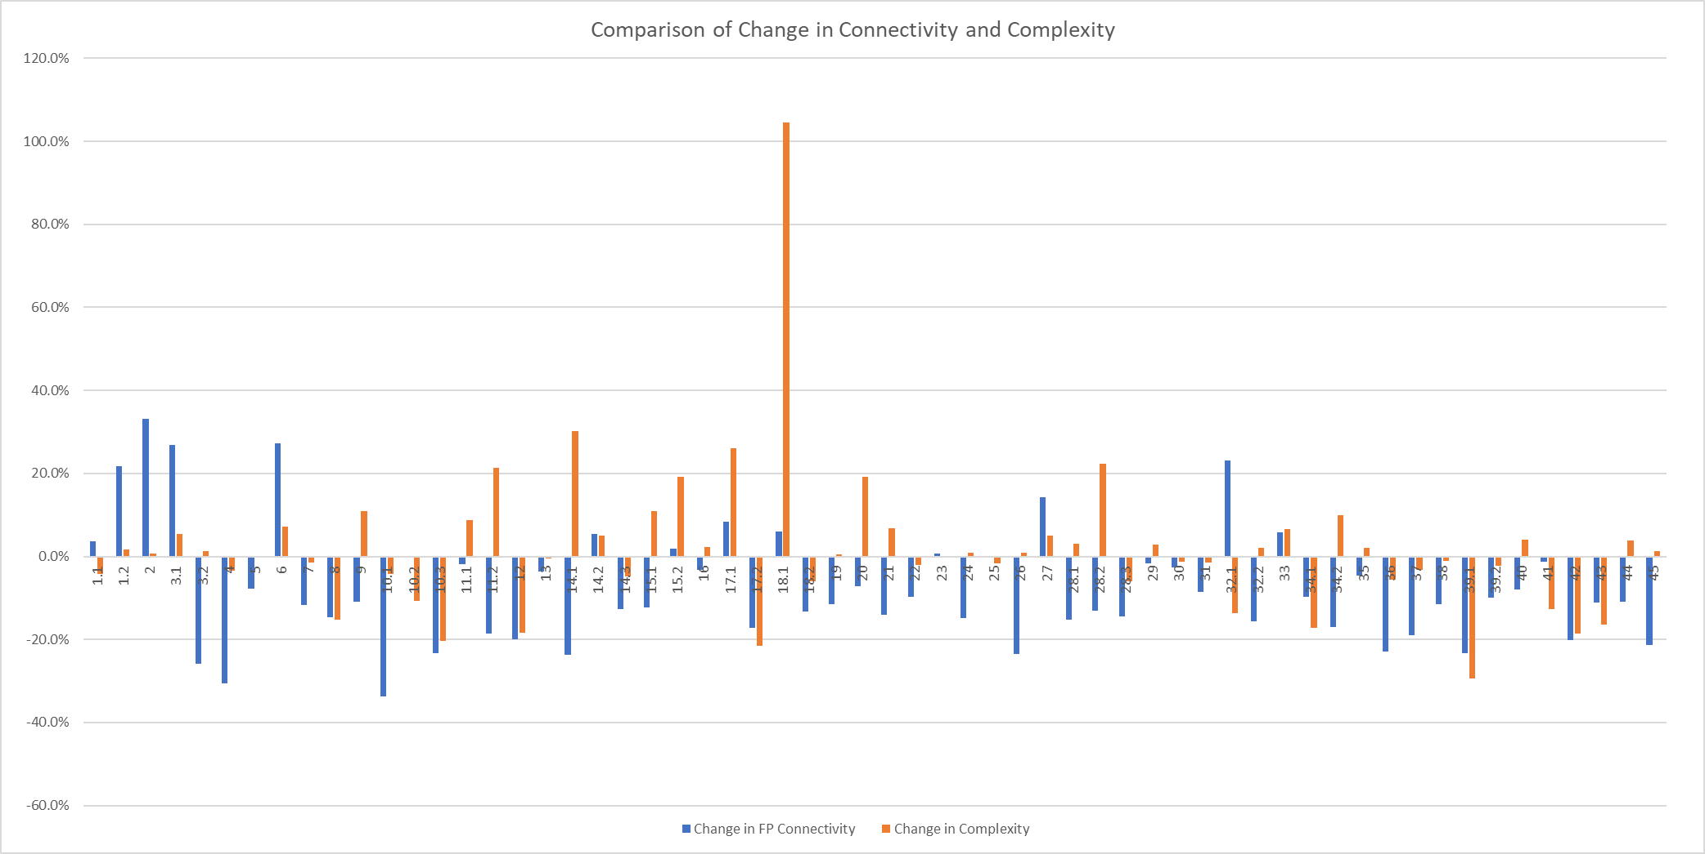
Comparison of Change in Floodplain Connectivity and Channel Complexity
Restored Sites with Different Connectivity and Complexity Response
Notes:
Then start to combine the effects of floodplain connectivity and channel complexity for the watershed. You start to see restored sites with differences between connectivity and complexity. Why does PA 18 have such a high degree of complexity but still a relatively low degree of floodplain connectivity for instance.

Slide 21
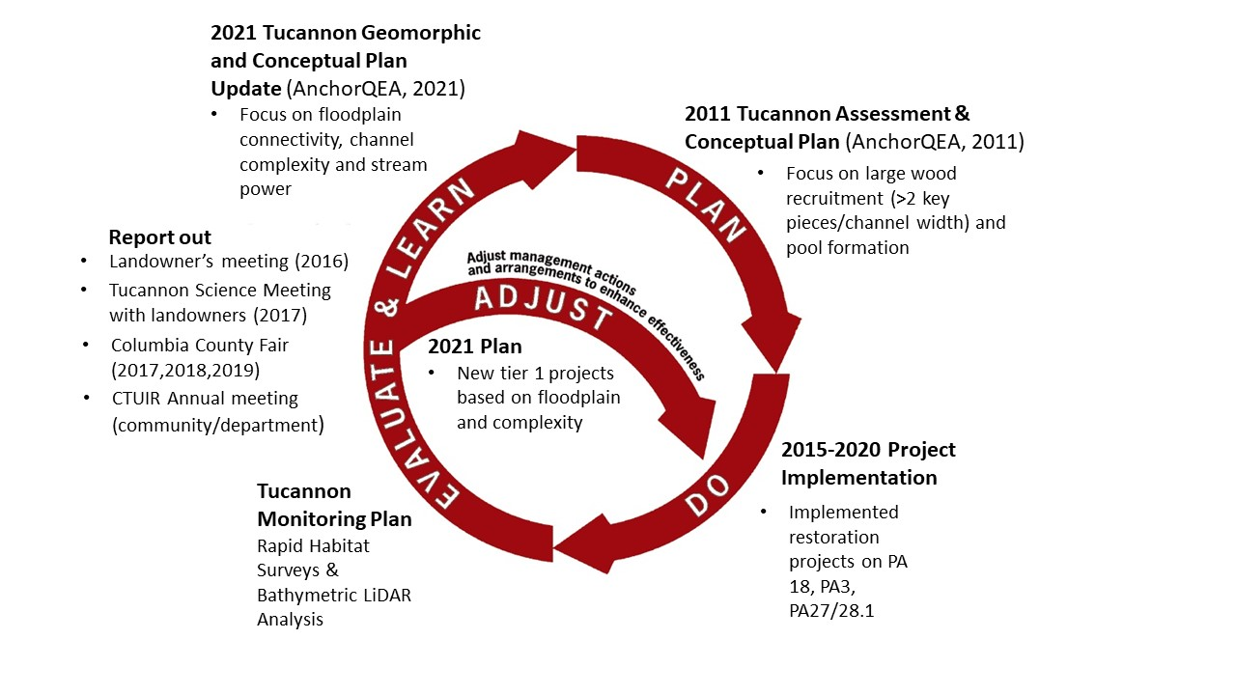
Managing adaptively…
Notes:
The Tucannon Project adaptively manages completed restoration projects.
Since 2015, the project has implemented 3 large scale restoration projects based on the 2011 restoration plan.
In addition, the Tucannon Project assists the Programmatic with rapid habitat surveys and has contracted bathymetric lidar services in 2017 and 2020 to help monitor channel change detection. This will lead to further reporting out at several different levels.
The newly updated 2021 Plan identified and prioritized future restoration projects by floodplain availability and channel complexity opportunities in each project area by generating an interactive GIS webmap (Tucannon River Restoration (arcgis.com)).
The new project areas were then reprioritized by these new objectives (floodplain/complexity) and tiered into three priority levels to assist project sponsors with project area selection. The Adjustment phase will refocus project sponsors toward the new tier 1 projects.

Slide 22
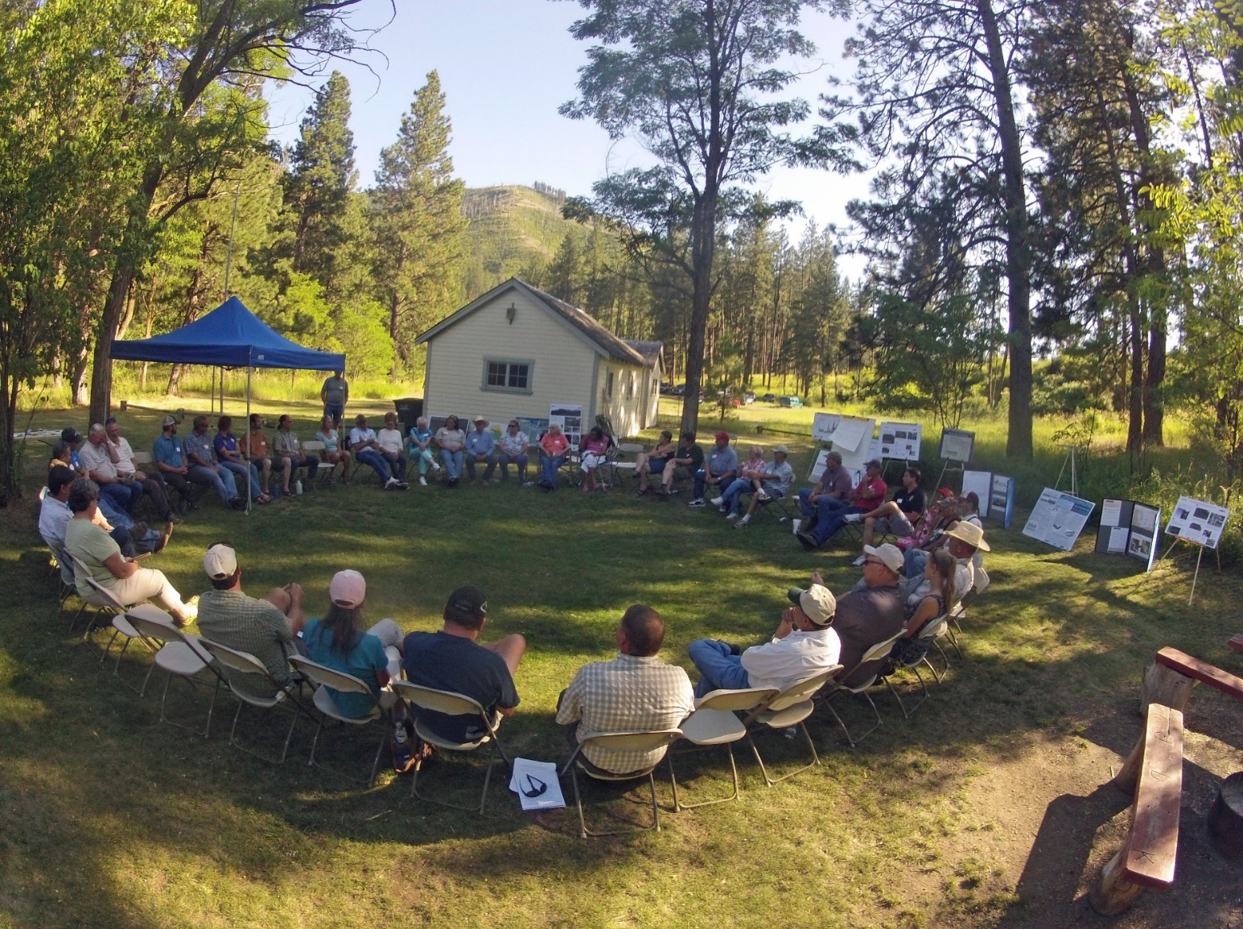
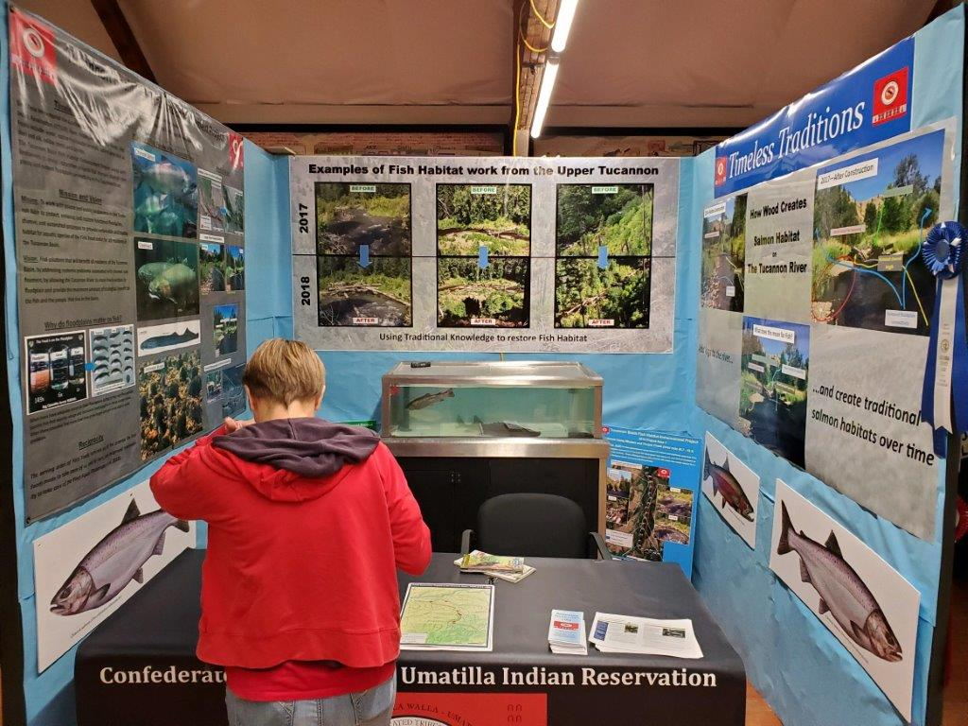
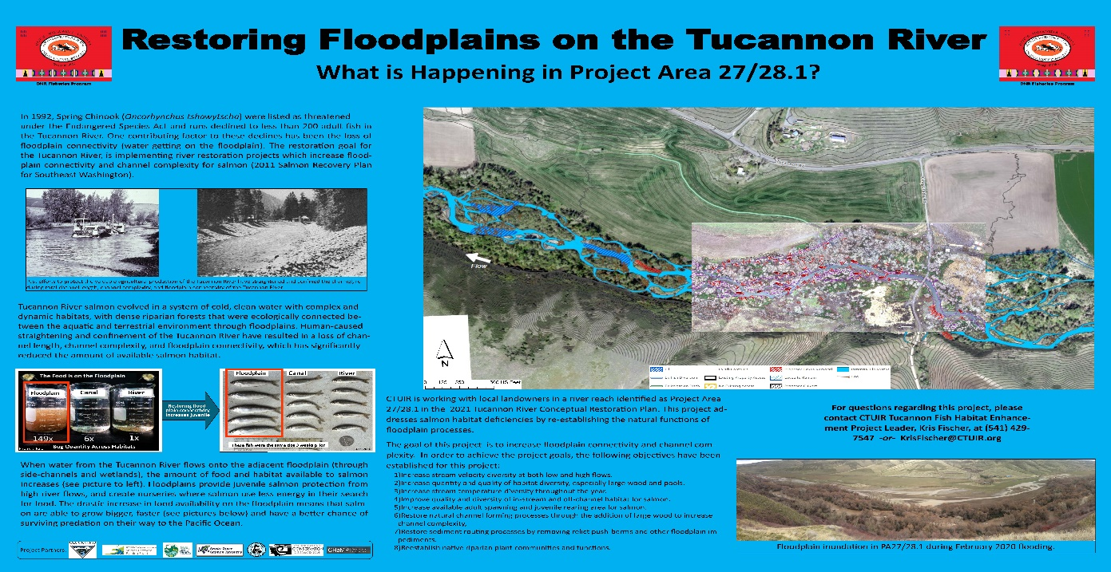
2019 Columbia Co Fair Booth
PA 27/28.1 informational signs
Community Outreach
2015 Tucannon Landowner Meeting
Notes:
The Tucannon Basin is split roughly 50/50 between private and public ownership.
Making it critical that the Tucannon Implementers find novel ways to communicate the restoration plan and associated actions to the folks living on the ground. This also allows landowners to communicate their concerns back to the project implementers.

Slide 23
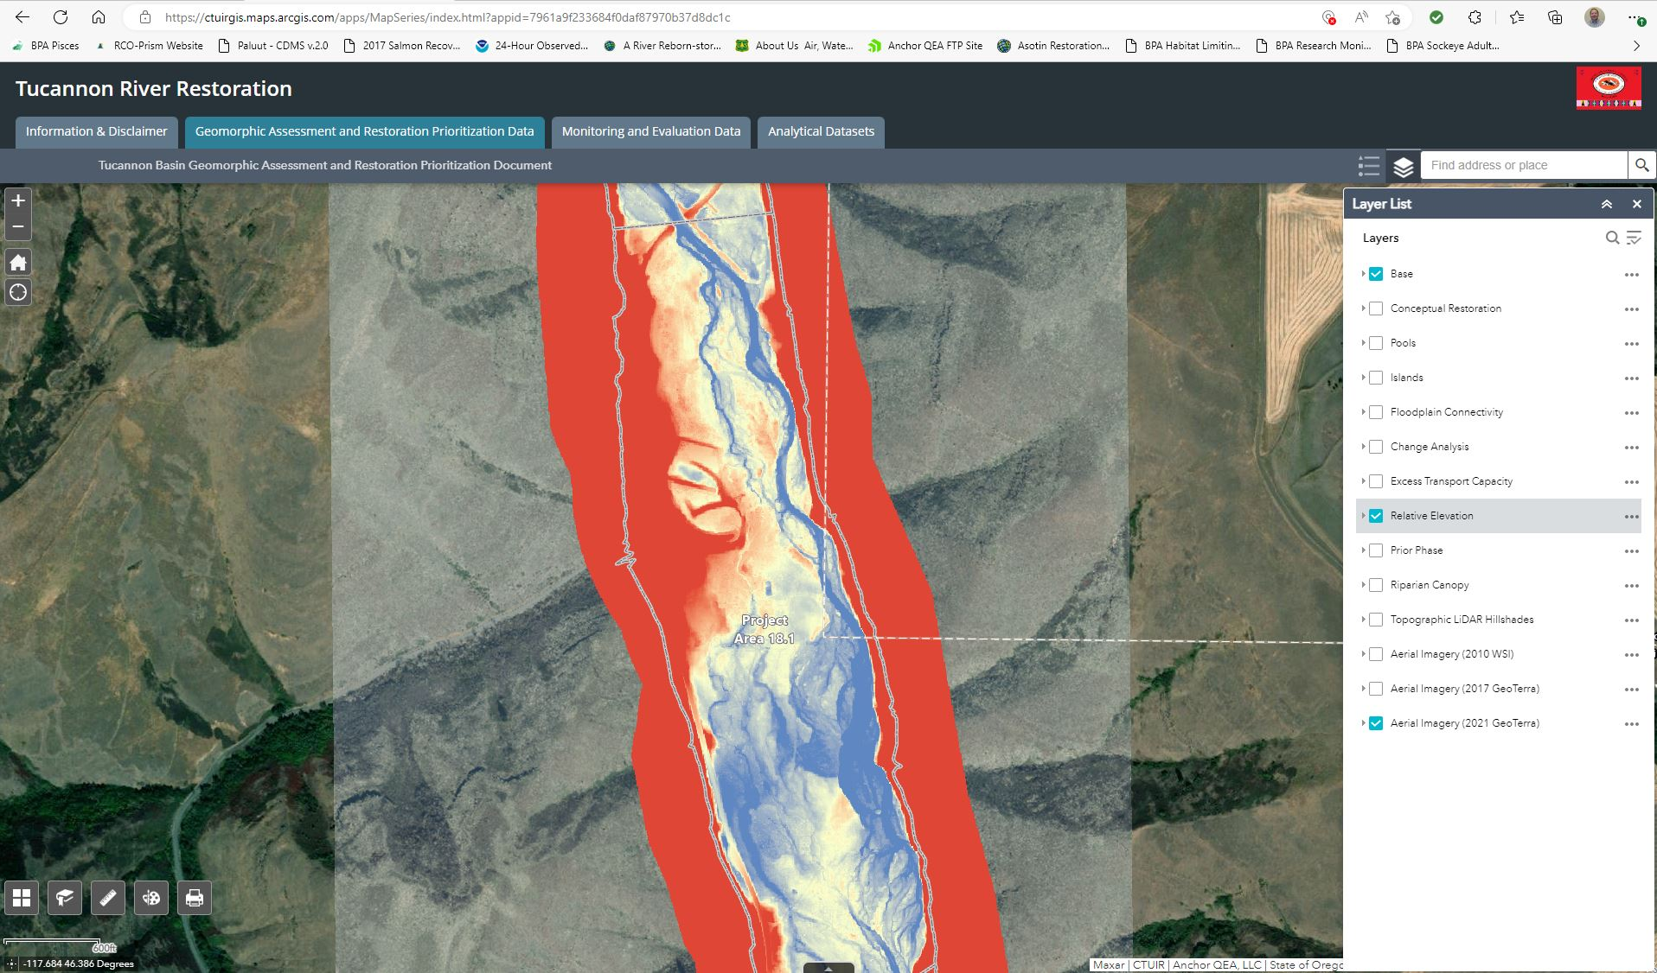
Tucannon Web map (tucannonriver.org Maps and Media)
Notes:
We use the Tucannon Web Map to house all the Lidar, aerial phots and geomorphic change detection analysis. This allows us to share the data with anyone who wants to see it.
We started including the fish monitoring data which included redd surveys and interrogation sites for the fish in and fish out work in the basin.

Slide 24
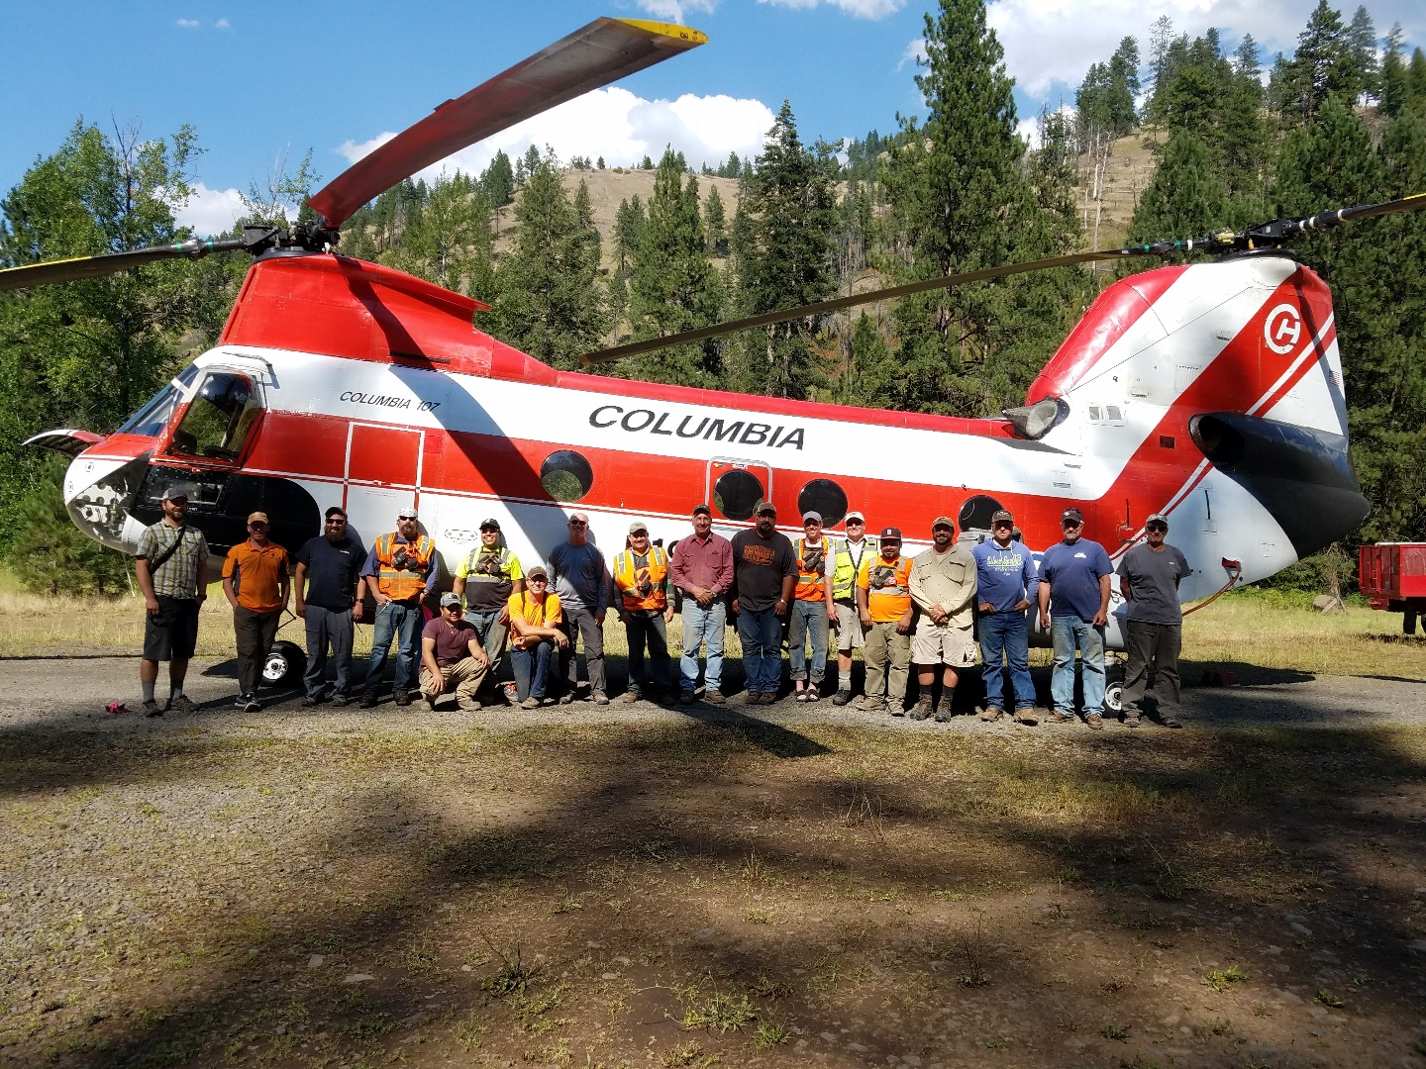






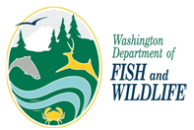
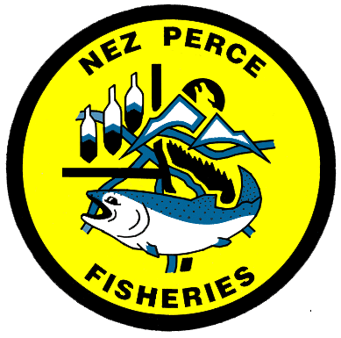
Tucannon Implementers Workgroup
Tucannon Landowners
Species recovery is only possible through the planning, coordination and implementation by all Tucannon partners.
Notes:
And finally a shout out to all those who help work in the Tucannon, as species recovery is only possible with the help of the Tucannon Partners.

Slide 25

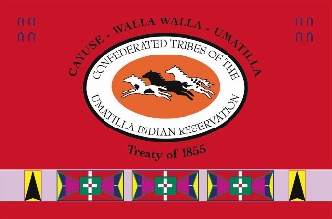
Thanks
Floodplain connectivity on PA 18 completed in 2017
Notes:
Slide 25 – Thanks again. I appreciate the time to share the results of the past several years of work in the Tucannon. I encourage you to check out the Tucannon River. Org website and more specifically the Tucannon webmap. This picture shows PA 18 during 2020 flow event. As you can see the site is now very complex and has floodplain connectivity.
I’d be happy to take any questions.

Slide 26
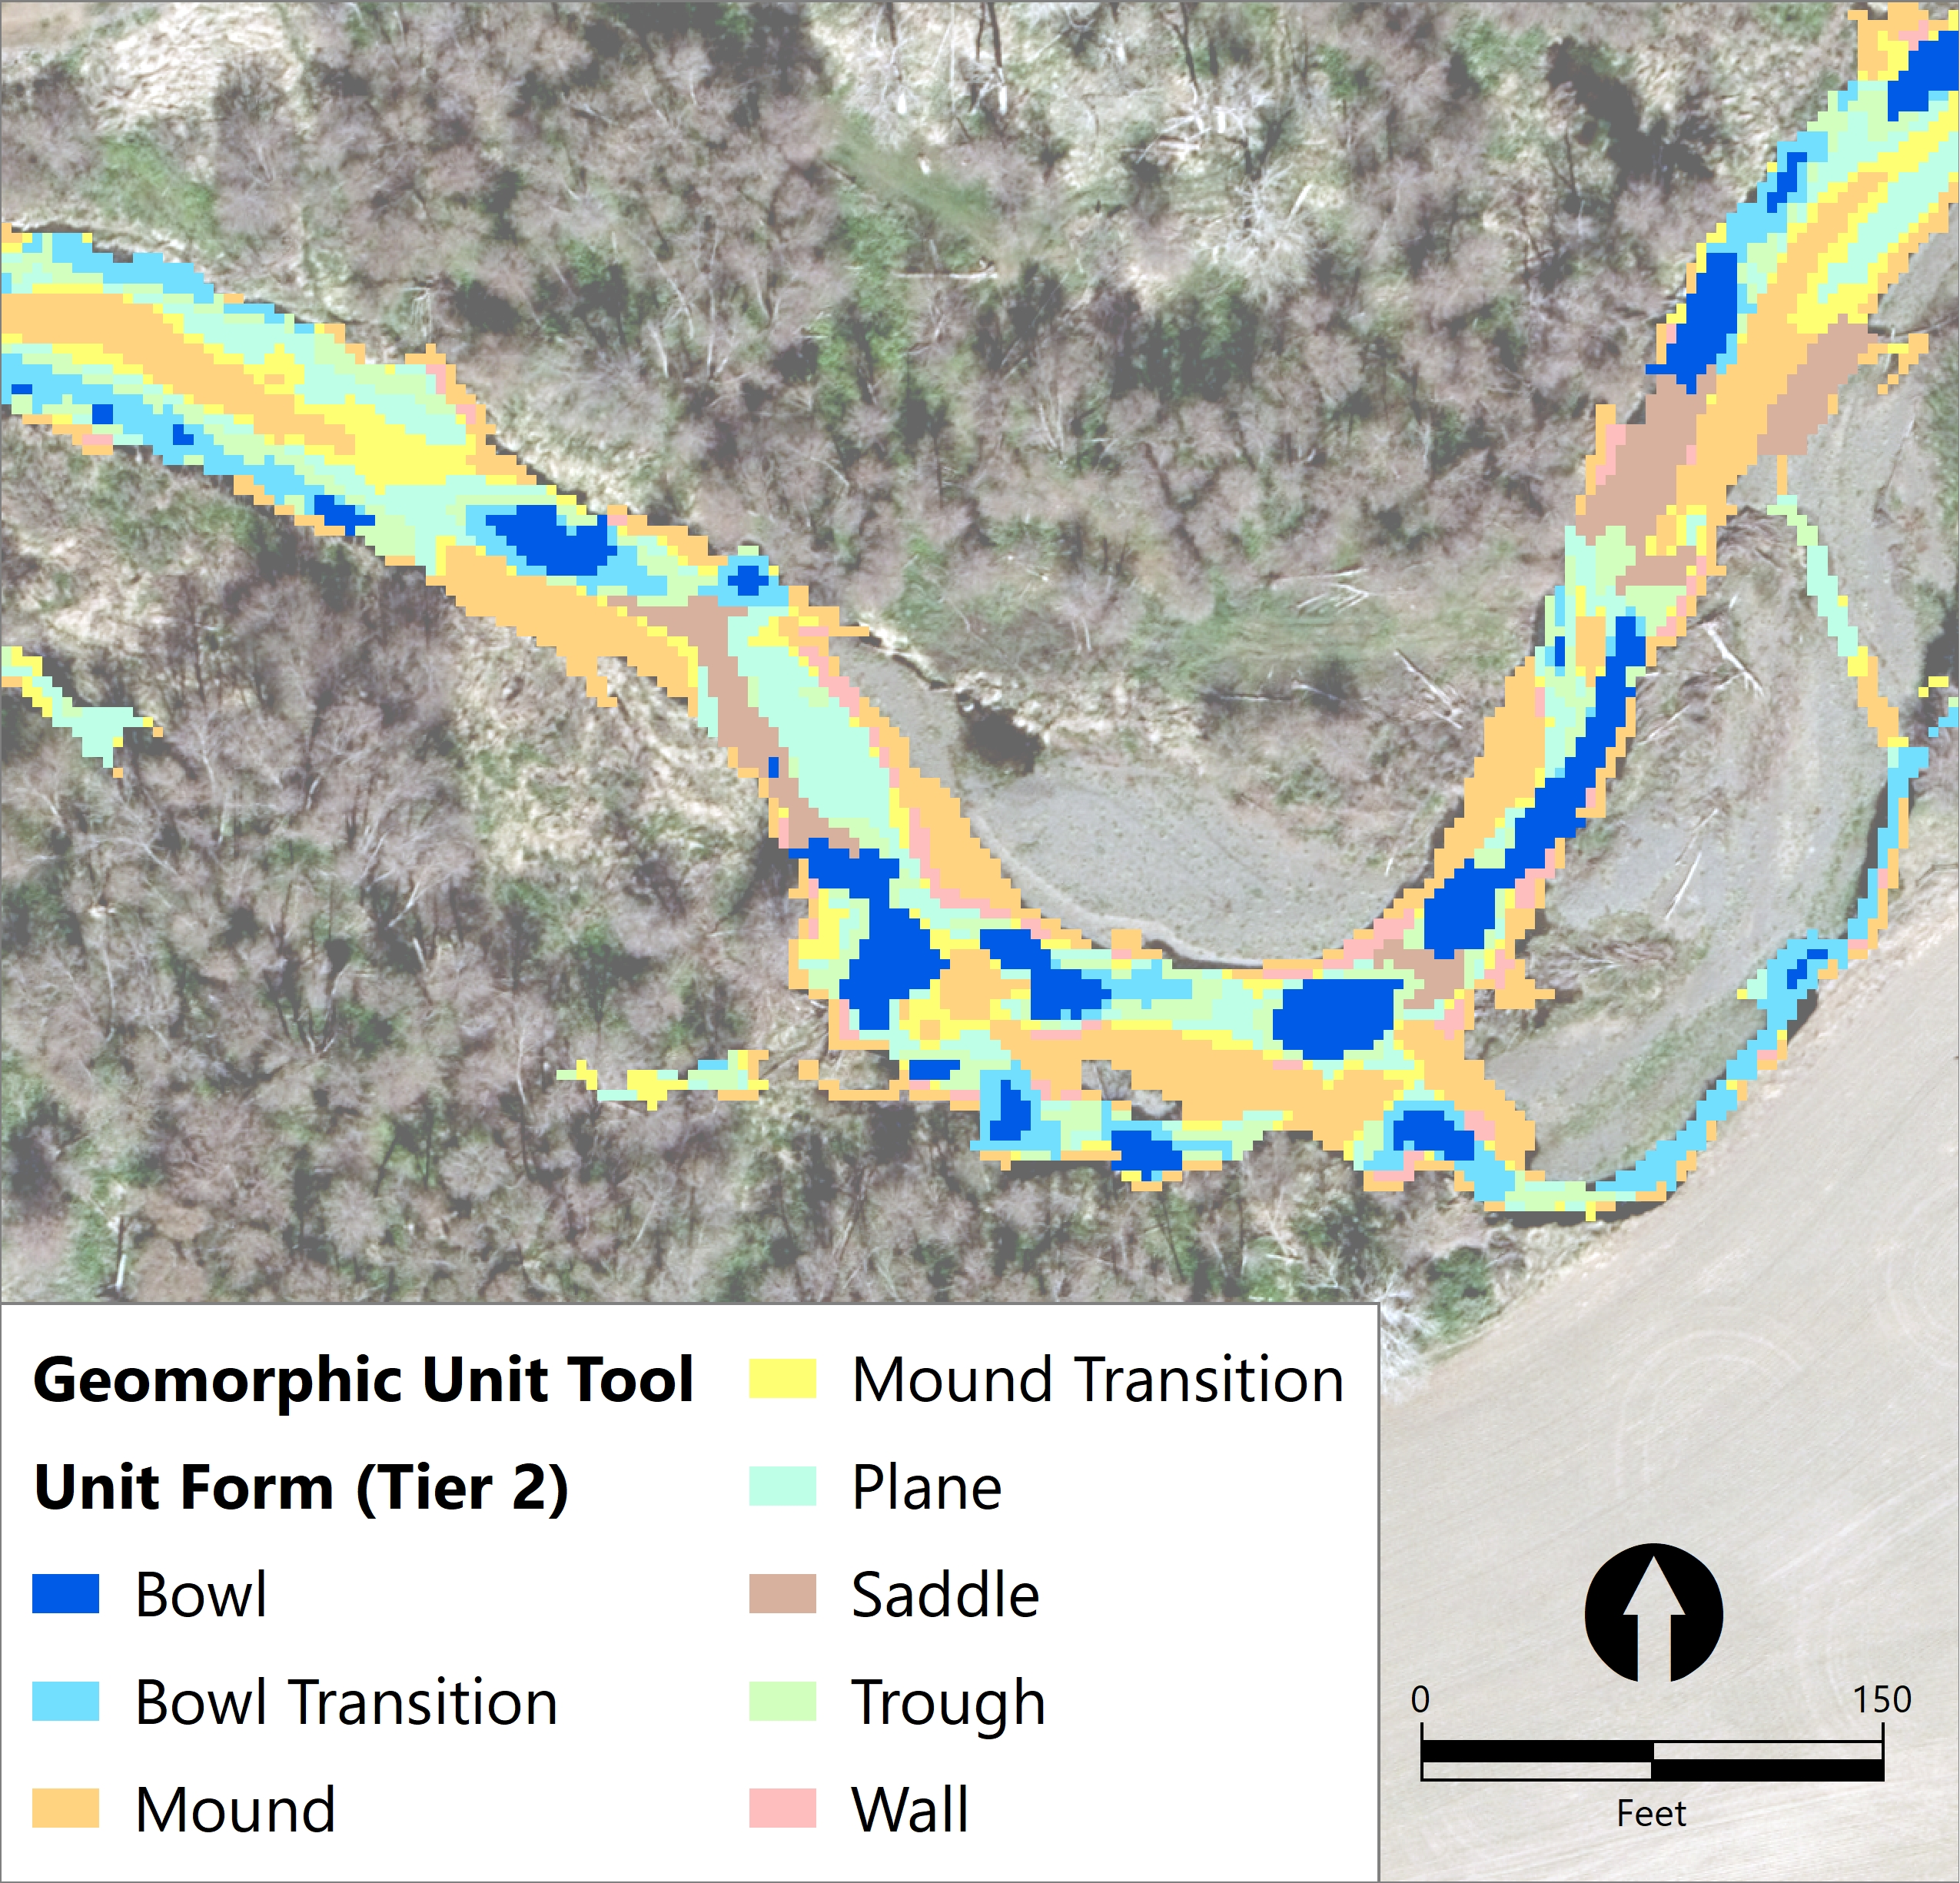
Geomorphic Unit Tool (GUT)
Based on topography, bankfull width and thalweg identification
“Bowls” are areas that may indicate the presence of a pool when LiDAR was flow.
- Summarized Bowl (Pool) Statistics for Each PA

Slide 27
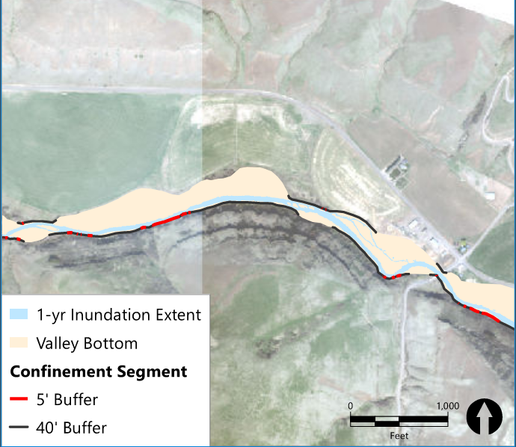
Confinement Index/Degree
Delineated Valley Bottom and Alluvial Plain
Confinement Degree
Where bankfull channel is limited by the valley bottom.
Directly (5’) or within 1 channel width (40’)
Confinement Index
Width of Channel Compared to width of alluvial plain

