Slide 1
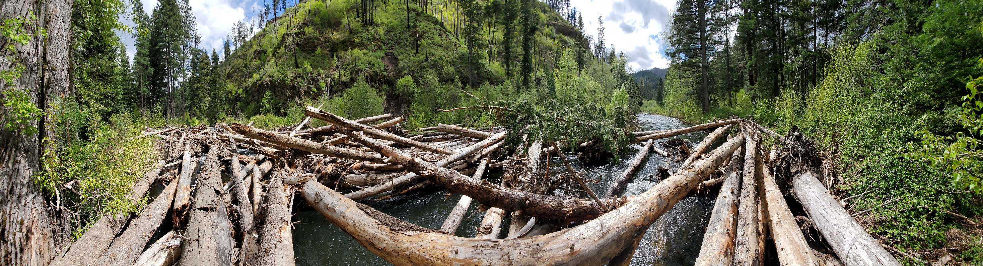
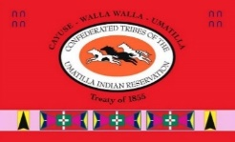
Implementing the Umatilla Tribe’s River Vision using Stage O Techniques
Kris Fischer, Tucannon Basin Project Leader
AJ Jones, Allen Dysart & Terril Stevenson, Wolf Water Resources
Panoramic of PA-3, 5/2020
Notes:
Slide 1 – Good afternoon everyone. My name is Kris Fischer and I work for the Umatilla Tribe’s as the Tucannon Basin Habitat Enhancement Project Leader. I would like to recognize my design team, Amanda Jones, Allen Dysart & Terril Stevenson from Wolf Water Resources.
This afternoon, I will be talking about implementing the Umatilla Tribes River Vision using Stage O Techniques.

Slide 2
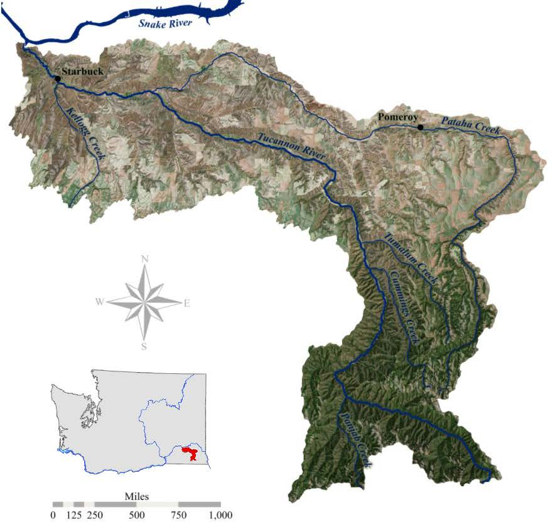
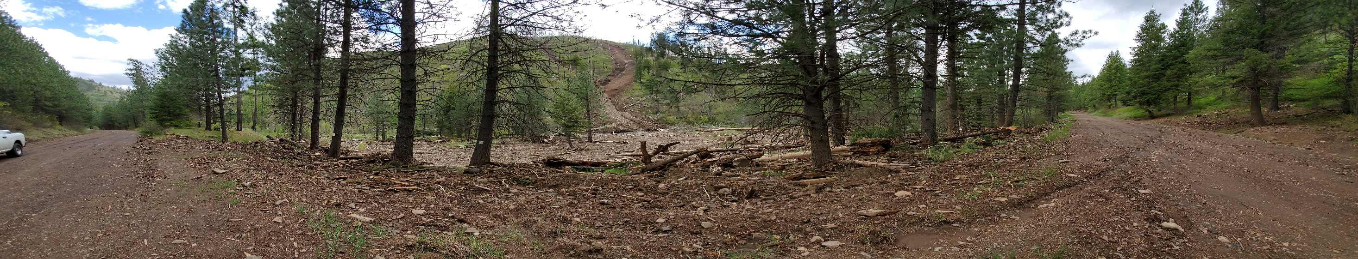
Presentation overview:
Why the Tucannon??
Restoration philosophy!
Project Area 27/28.1, past/present/future.
HEC-RAS predictions, Wetted Area/Velocity
Little Tucannon Landslide, 5/2020
Notes:
Slide 2 – Today’s presentation will include:
Why the Tucannon Basin is important and where it’s located in the Snake River Region.
Our restoration philosophy using the Umatilla Tribe’s River Vision
Highlight Project Area 27/28 showing past/present/future
Dive into some of the HEC-RAS predicted results for wetted area and velocity at the 2-year, 10-year and 25-year events.
For context, the picture on the right shows where the Tucannon River is located in SE Washington. If we zoom in a bit.

Slide 3
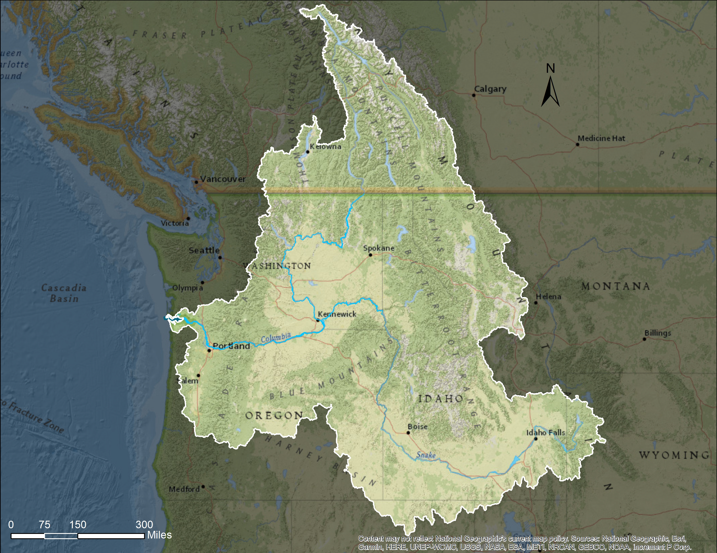
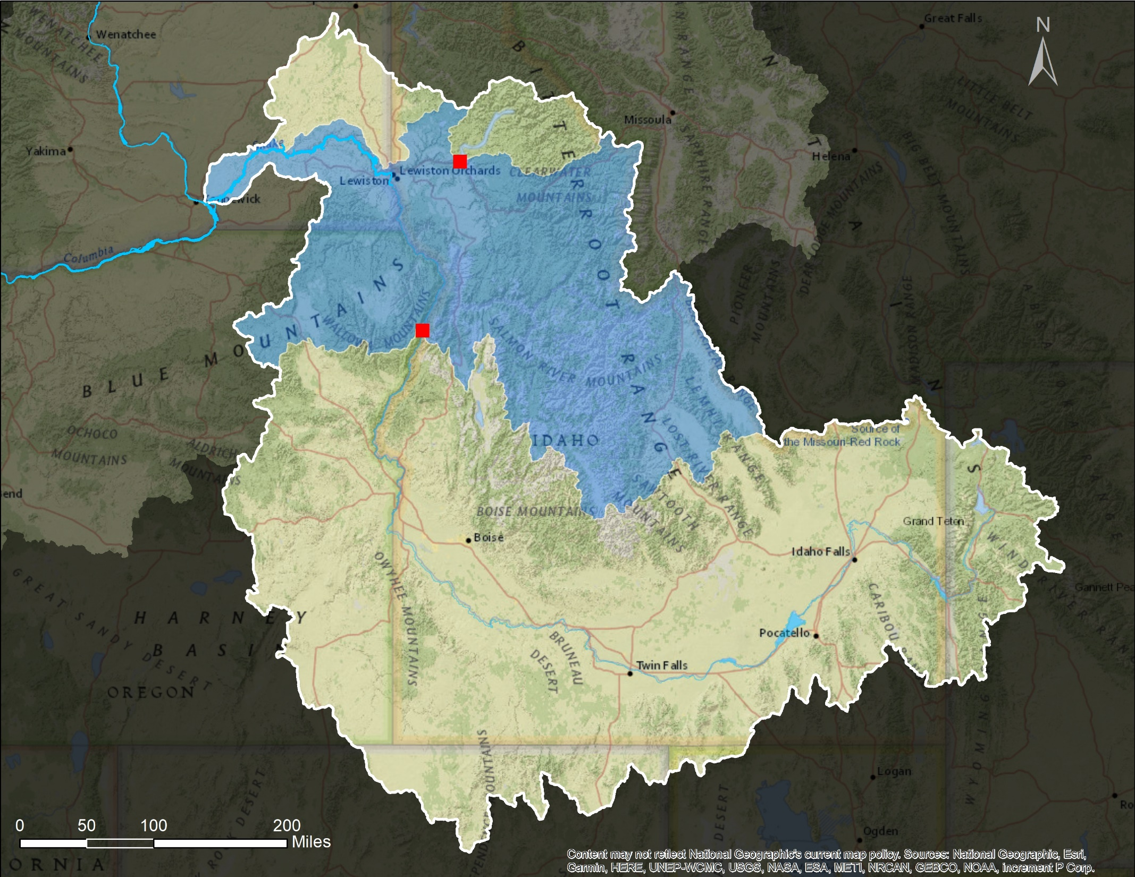
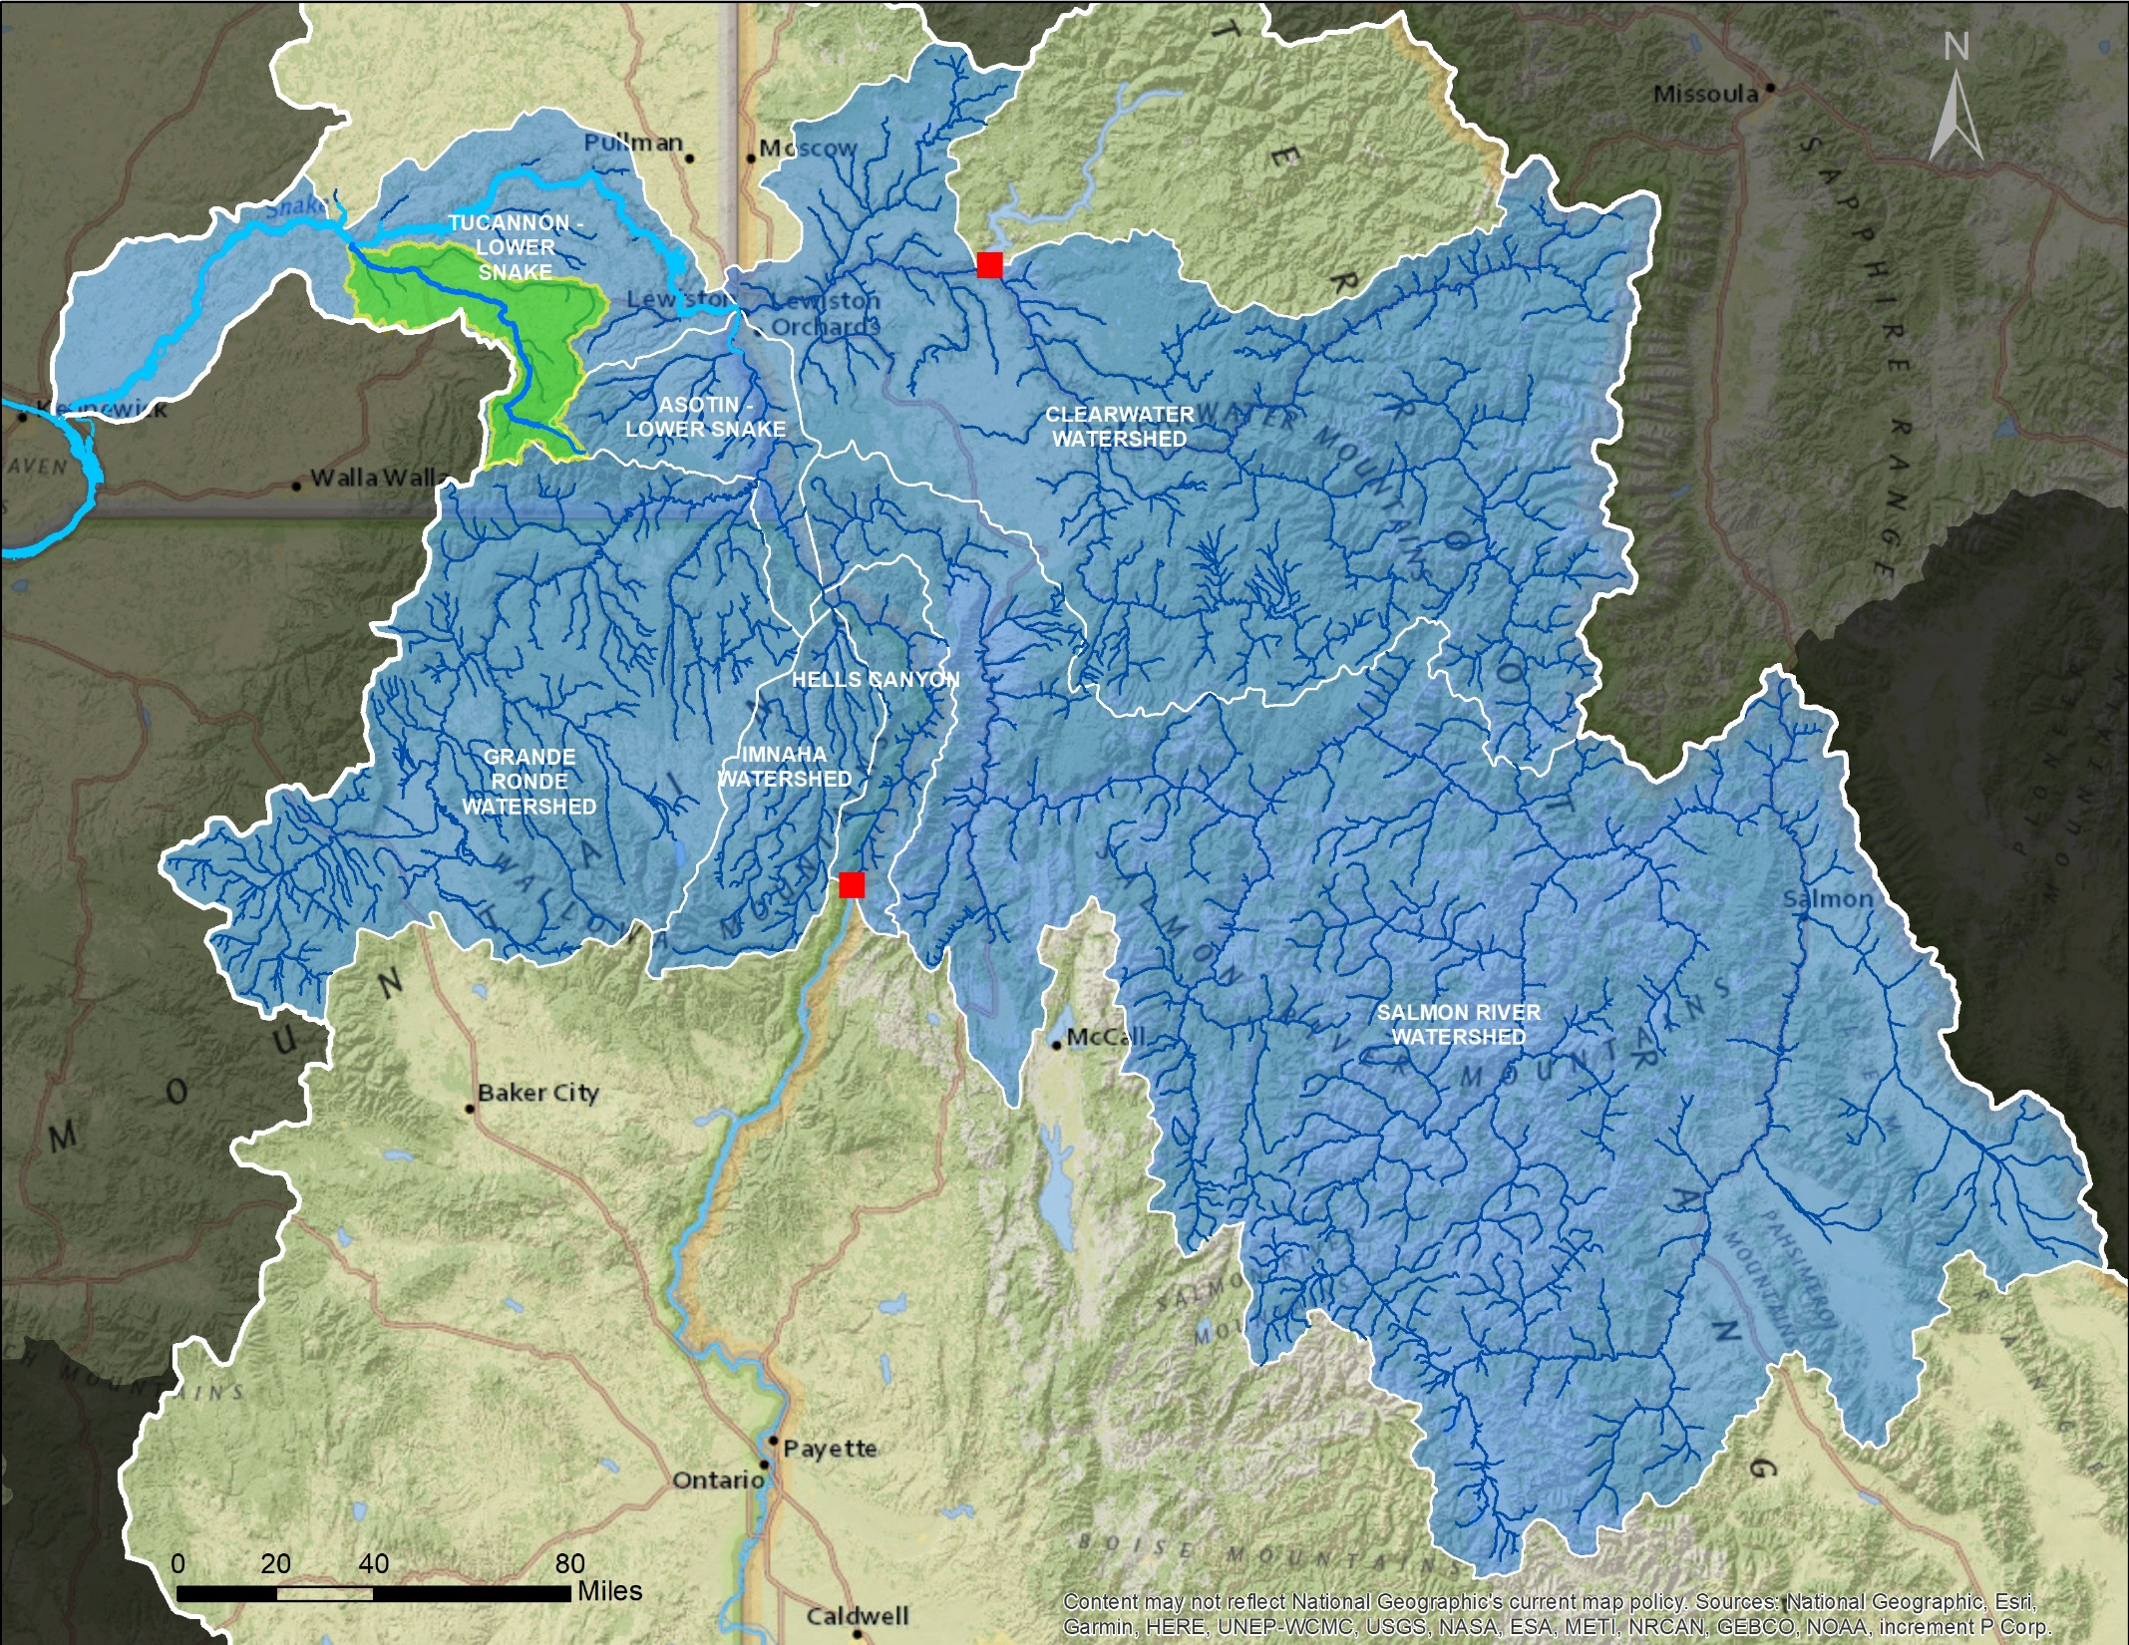
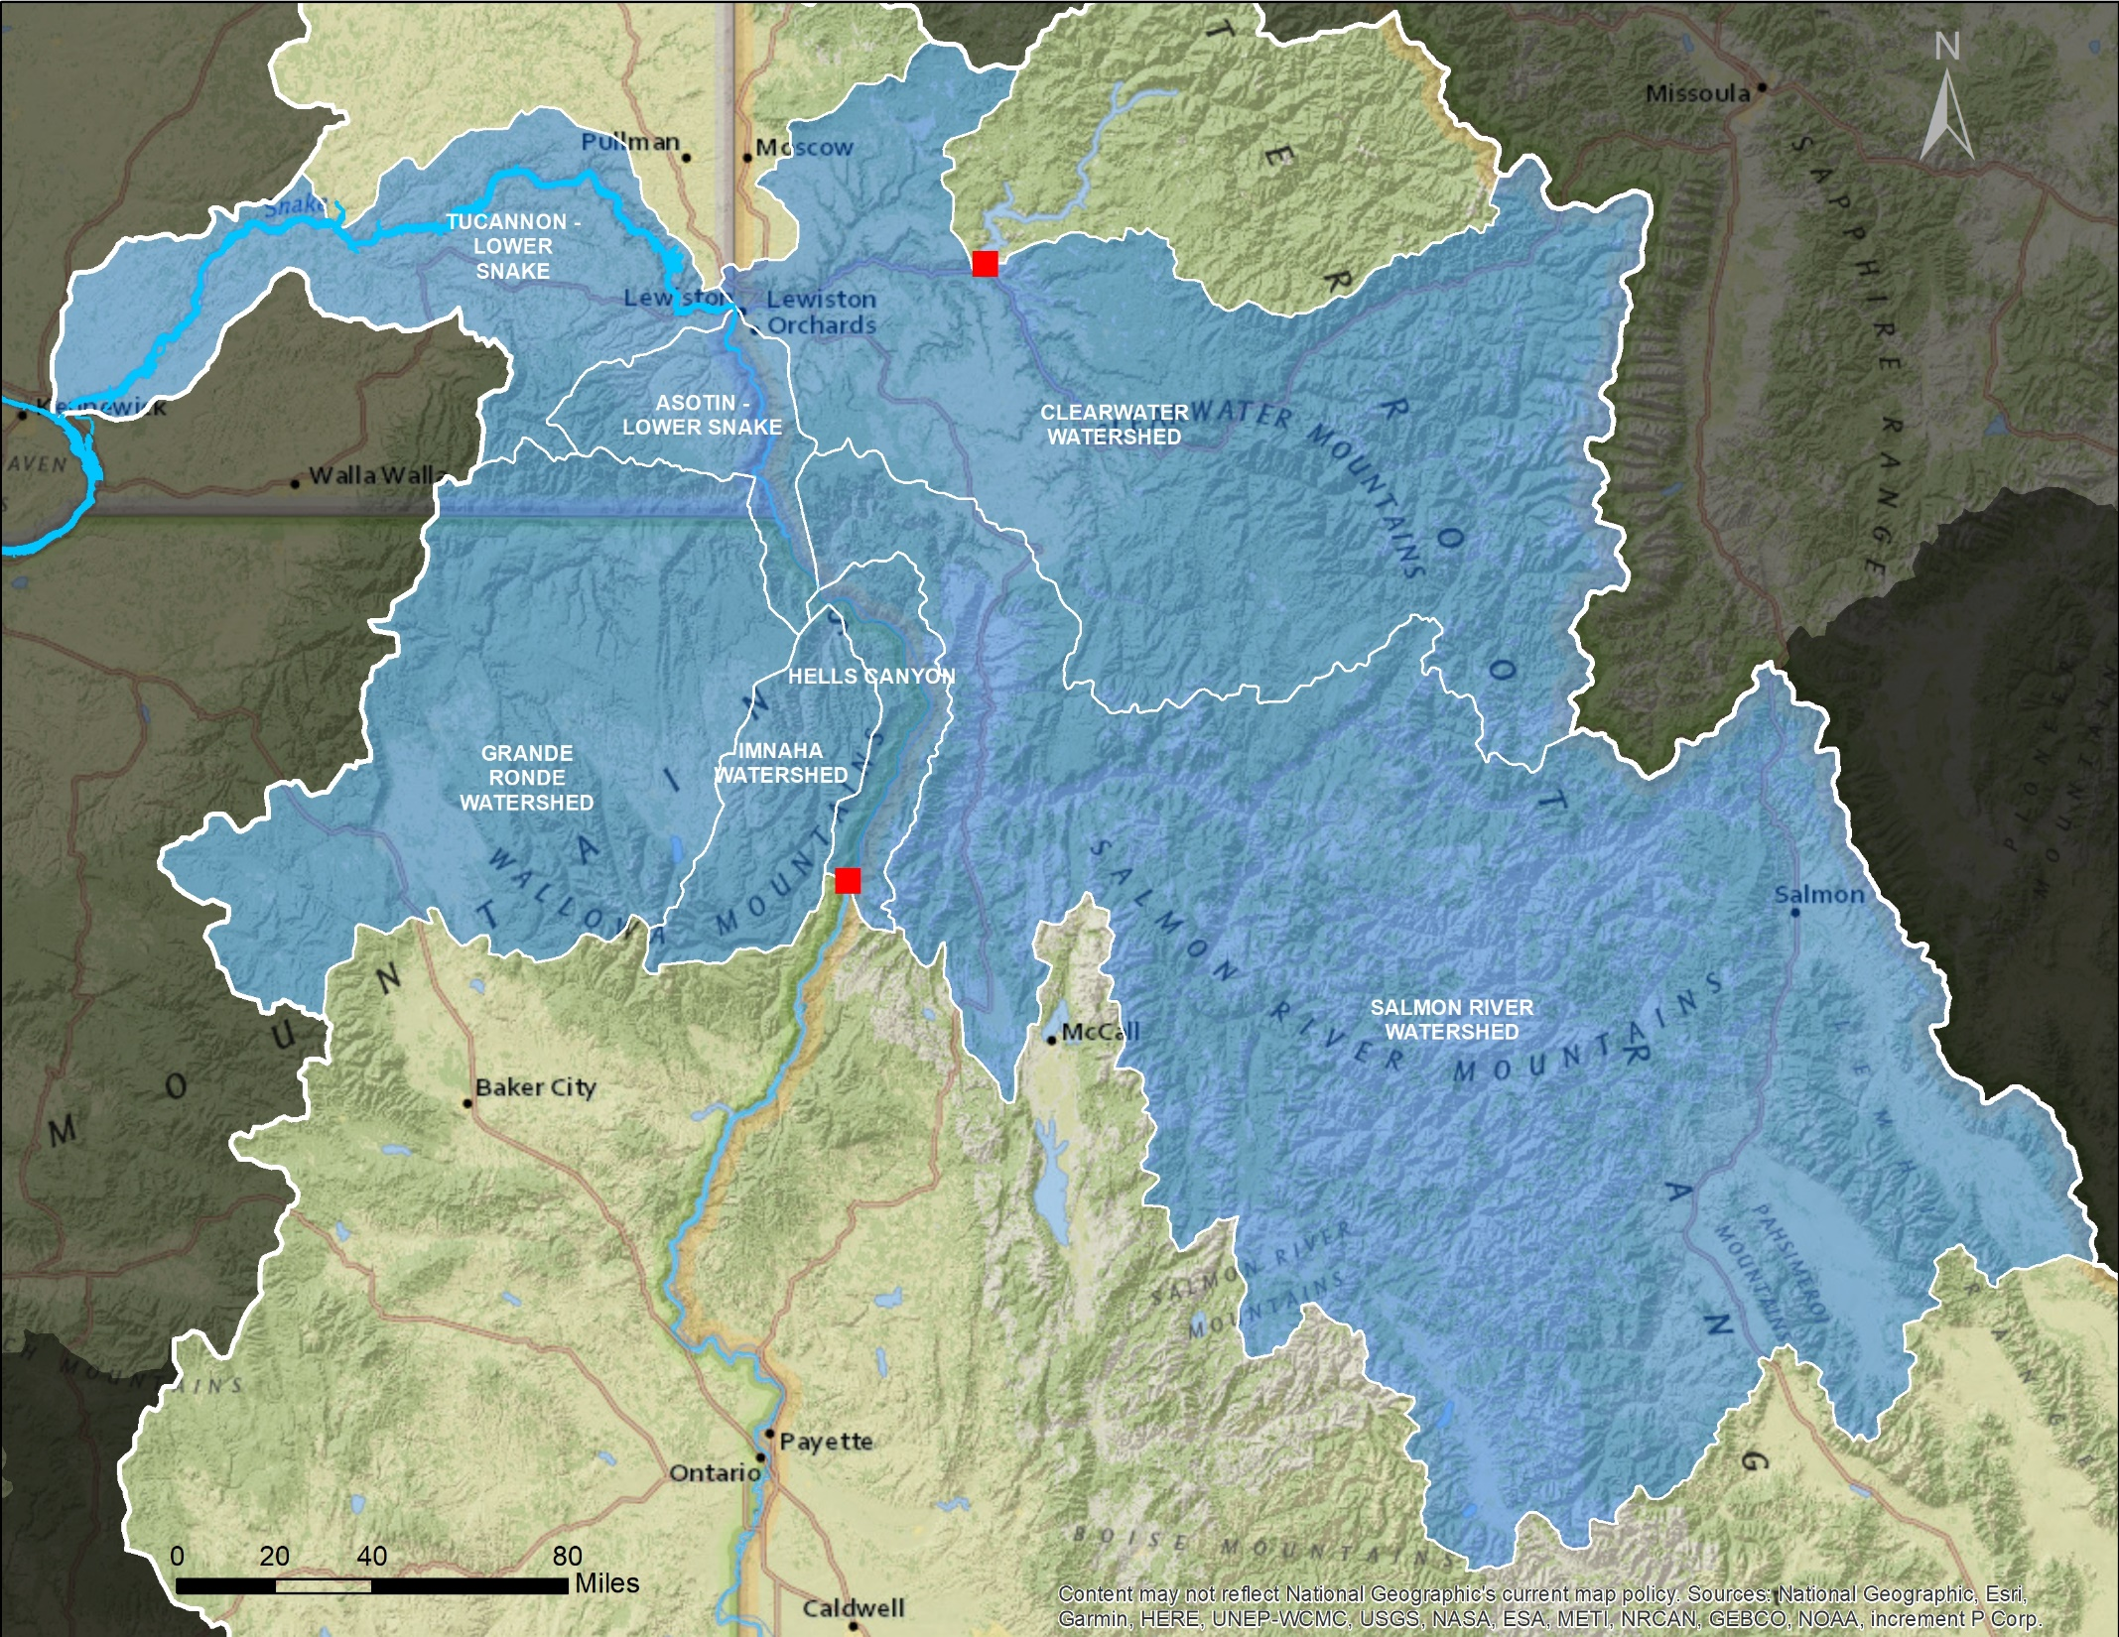
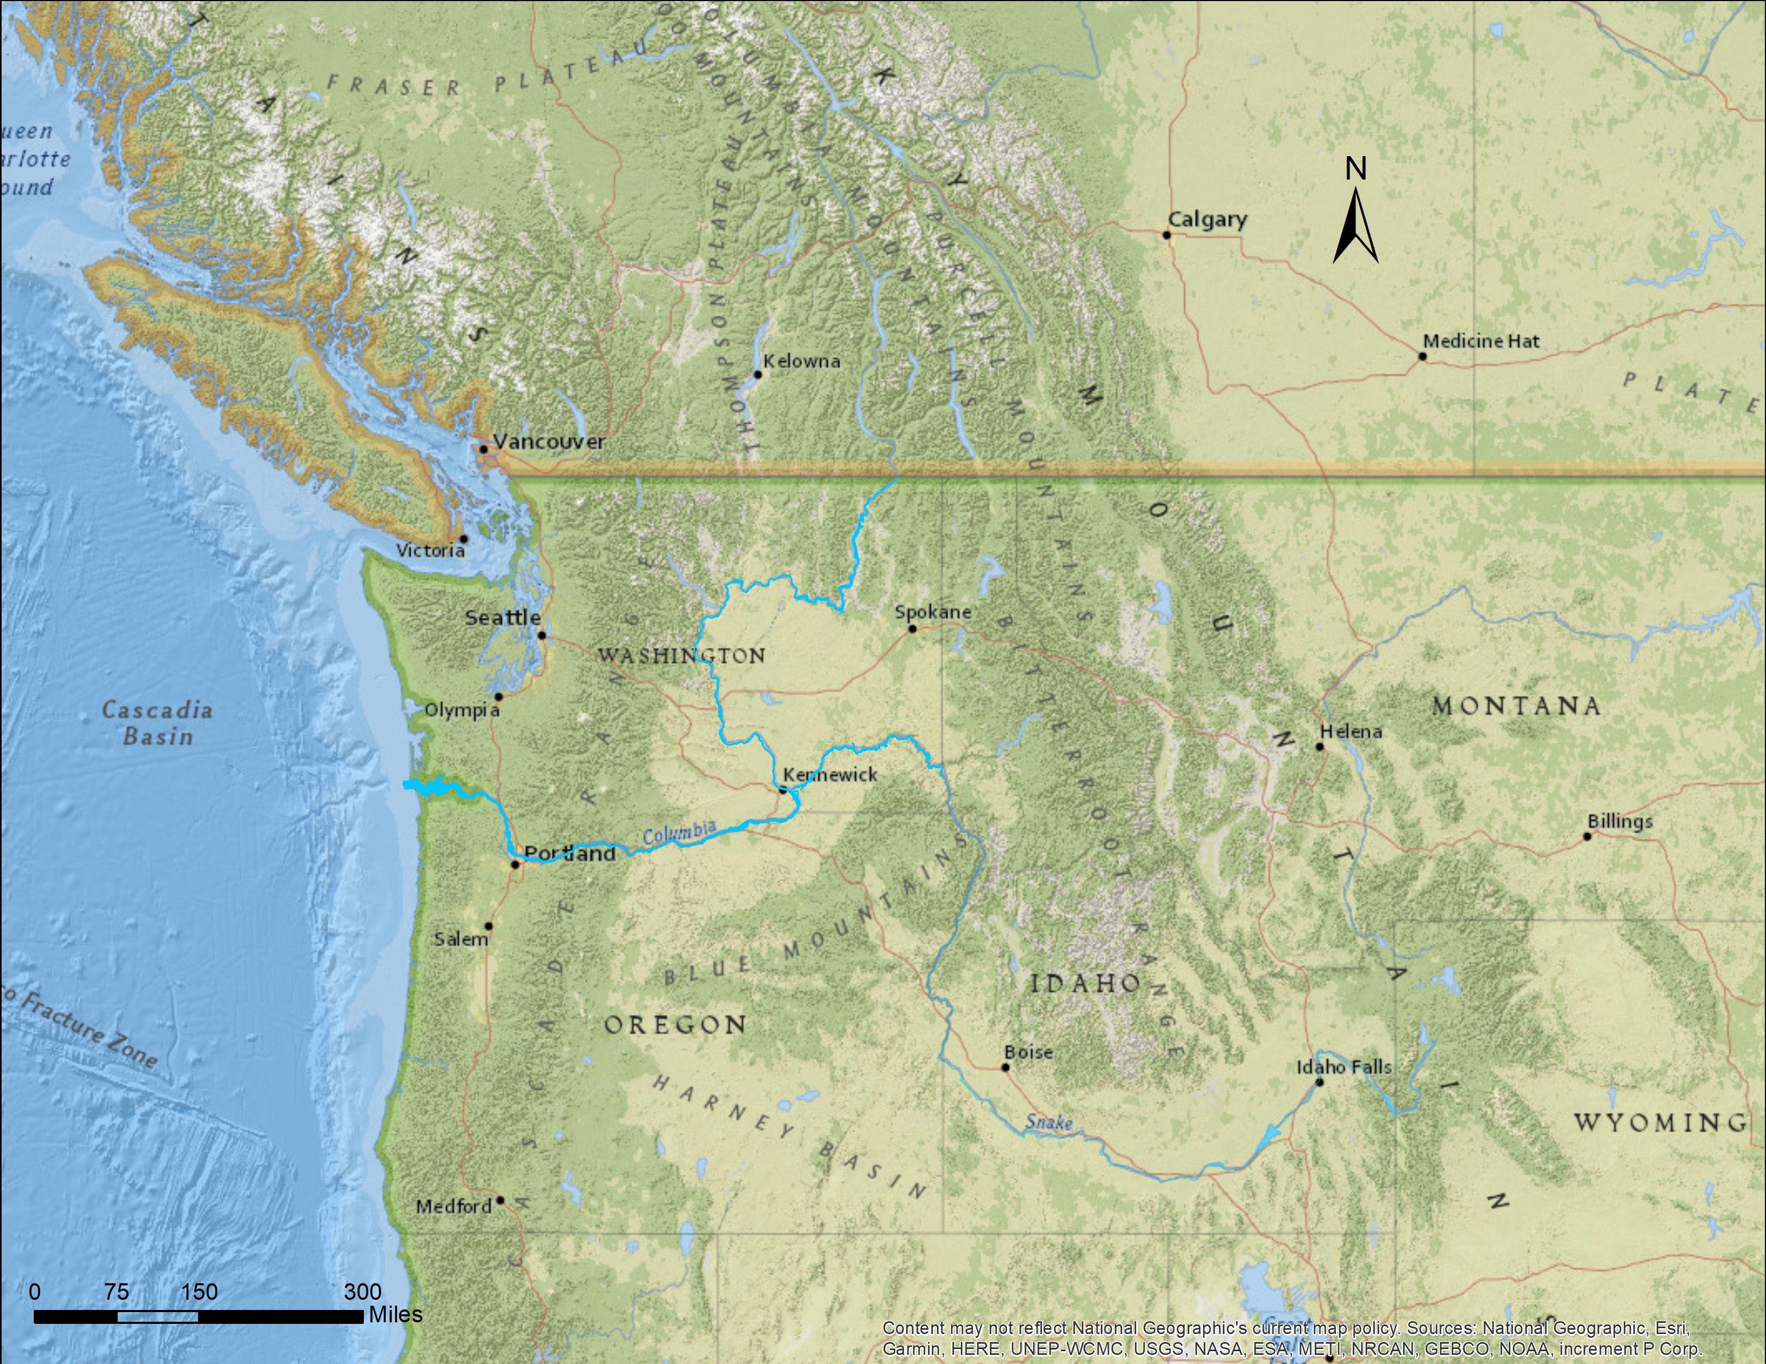
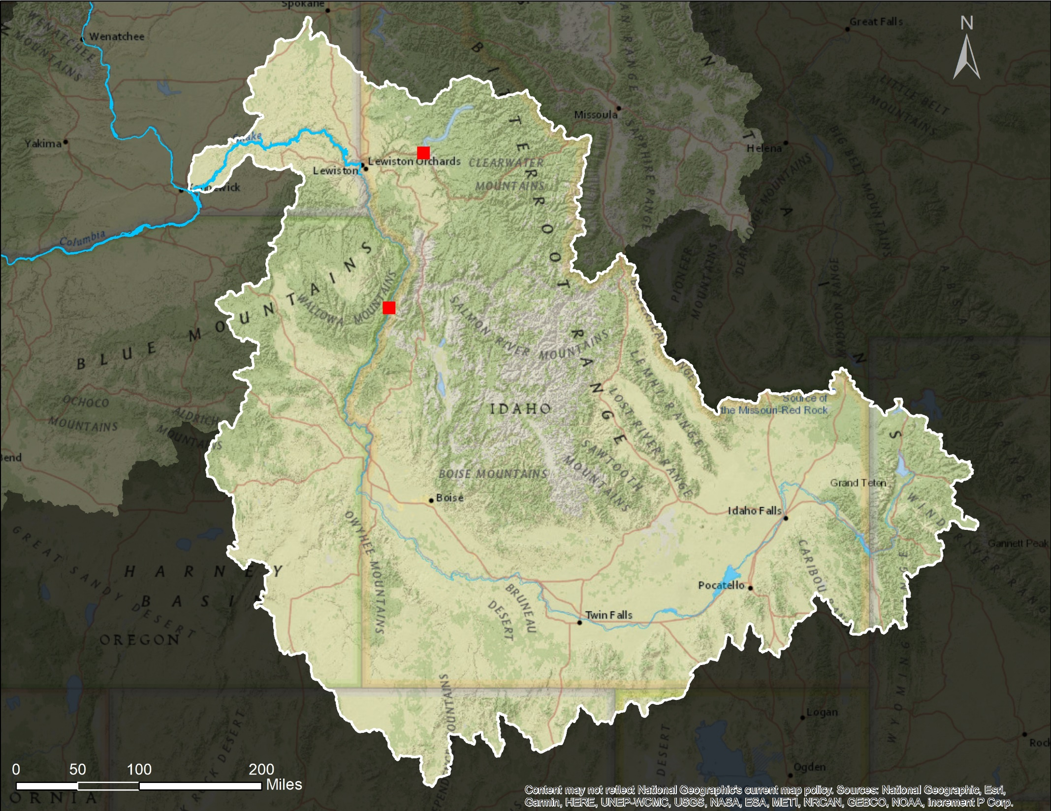

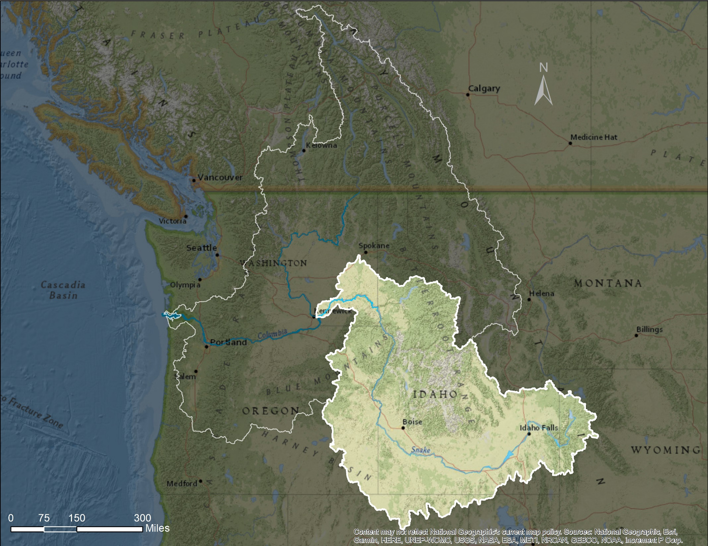
2%
Dworshak Dam
1%
25%
Walla Walla
22%
Hells Canyon Dam
5%
45%
Notes:
Slide 3 – The Tucannon Basin comprises ~2% of the remaining anadromous fish habitat in the Snake River Basin. For reference, Walla Walla is in the upper left of the slide and the 2 red dots are Dworshak Dam on the North Fork of the Clearwater and Hells Canyon Complex on the Snake River. These dams block fish from going any further into the basin.
The Tucannon is important to the Spring Chinook population in the Snake Basin, because;
It’s the only lower Snake Spring Chinook population remaining
Fish only have to pass Ice Harbor and Lower Monument Dam on the Snake reducing dam related impacts
The Tucannon River is culturally important, as it forms the ancestral boundary between the Umatilla Tribes and Nez Perce Tribes
The Tucannon Basin is recognized as a priority basin with the Grande Ronde, action agencies are obligated to mitigate for lost fisheries
Due to the small size of the basin (~58 miles long and drains an area of ~500 square miles from its headwaters in the Blue Mountains in the Umatilla National Forest north to the mouth at the confluence with the Snake River) making it a prime watershed for restoration.

Slide 4

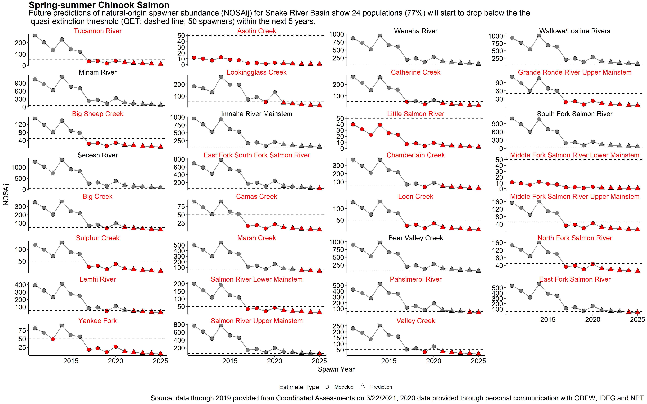

Snake Basin Chinook Quasi-Extinction Threshold Alarm and Call to Action
42% of the Snake Basin spring/summer Chinook populations have natural origin spawner abundance currently at or below QET (50 spawners)
77% of the populations predicted to drop below critical level of 50 spawners by 2025
Snake Basin Chinook and Steelhead Quasi-Extinction Threshold Alarm and Call to Action
Presented to Northwest Power and Conservation Council May 5, 2021
Nez Perce Tribe Department of Fisheries Resources Management
“We are the circle. That’s what life is all about. We take care of one another. So when we have someone in trouble, that’s when the rest of us have to step in.”
—Elmer Crow, Nez Perce
Notes:
Slide 4 – Spring Chinook populations have been teetering on the brink for years. The Nez Perce calculated the Quasi-Extinction Threshold for the Snake River Chinook. Showing that 42% of the Snake River Basin spring/summer Chinook populations have fewer that 50 natural origin spawners remaining, putting those populations below the Quasi-Extinction Threshold.
If predictions hold, by 2025 – 77% of the spring/summer Chinook spawners will be below the Quasi-Extinction Threshold.
To better show the Tucannon Returns, I have added the WDFW’s return numbers showing the downward trend the past several years. With returning number of spring chinook on the Y-axis and the Run Year on the X-axis. For reference, Spring Chinook in the Snake and Tucannon Basins were ESA listed in 1995.
In the words of Nez Perce elder – Elmer Crow – the time to act is now!

Slide 5
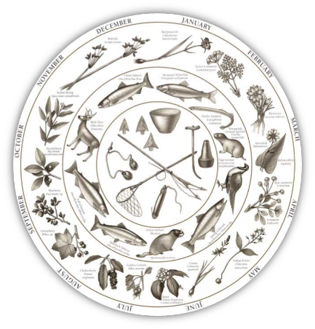





CTUIR - River and Upland Vision
“The Floodplain is the River” – Eric Quaempts, CTUIR DNR Director
RV - Requires a river that is dynamic, and shaped not only by physical and biological processes, but the interactions and interconnections between those processes
CTUIR Seasonal Round
Hydrology
Geomorphology
Connectivity
Riparian Vegetation
Aquatic Biota
Notes:
Slide 5 – What is the Umatilla Tribe’s habitat program approach to solving these problems in the Tucannon basin?
The First Foods approach requires that we get our heads out of the channel and look for restoration opportunities on the floodplain and uplands. The holistic river vision approach is necessary to provide for all first foods within the seasonal round. The first foods are shown by month of the year, highlighting which foods the tribes subsist on, explaining why the Umatilla Tribe’s River Vision is First Foods focused.
Using River Vision to rebuild ecological resilience within these river systems, means putting the missing ecological pieces (think River Vision touchstones; hydrology, geomorphology, connectivity, riparian and aquatic biota) back like puzzle pieces, allowing these systems to be resistant to disturbance, both natural and un-natural, so that the channel processes and forms are still recognizable to the native species that depend on them.
The aquatic biota touchstone functions as a response variable to the other four River Vision Touchstones.

Slide 6
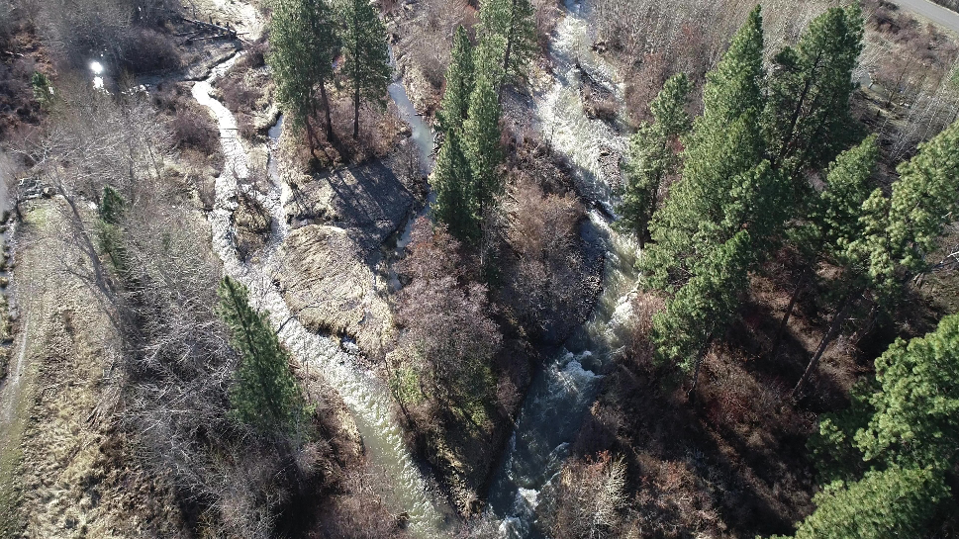
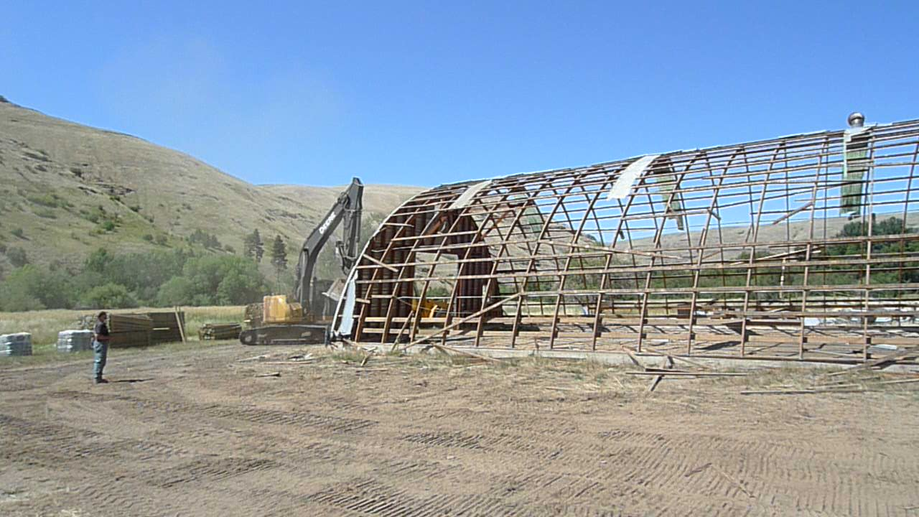
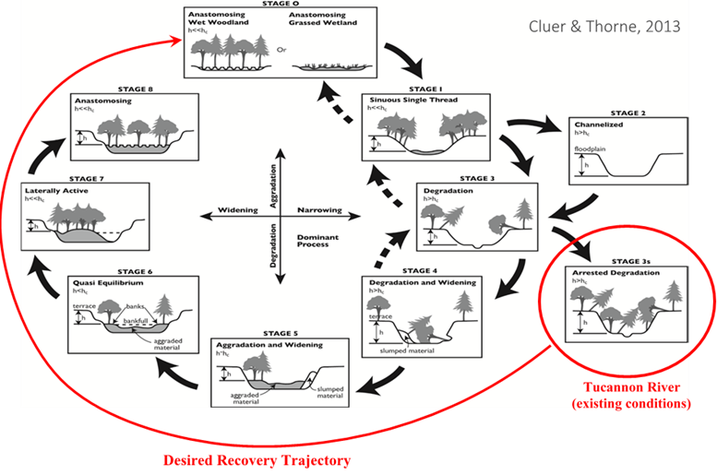
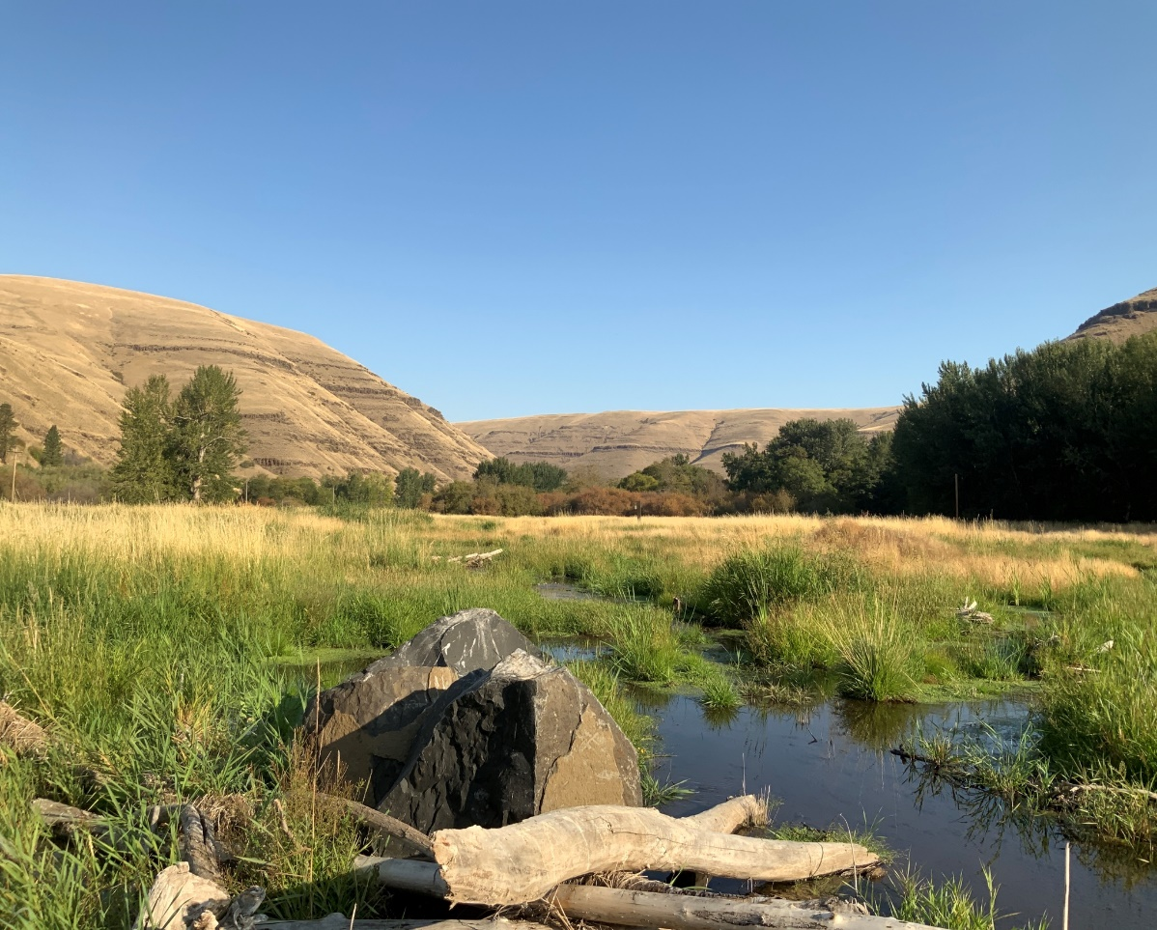
Existing Conditions:
Past Anastomosing Channel to Current Plain Bed
7-20% Loss of Channel Length Based on Reach (Hecht 1982)
With Est. as Loss of Channel Sinuosity of 50% (Hecht 1982)
Increased Slope and Stream Power (Anchor QEA 2021)
Loss of Floodplain Connectivity & Channel Complexity
August 2012
July 2020
Notes:
Slide 6 – What are the limiting factors in the Tucannon Basin and how do they exist on the ground?
The 2010 and recently updated 2020 Tucannon Basin restoration plans, identifies the limiting factors as; decreased floodplain connectivity, decreased channel complexity and increased stream power. And are being caused by
7-20% loss of channel length throughout the Tucannon Basin
With the decreased channel length increasing channel slope and stream power causing further channel incision and decreased channel complexity
Cluer & Thorne’s channel evolution model describes the Tucannon’s Stage 3s condition as arrested degradation, highlighting the need for corrective action.
Channel types on the right side of the channel evolution model (Stages 2 thru 5) have decreased habitat, water quality, biota and resilience, shown by the size of the pie graph as approximately 25% of the overall habitat and ecosystem benefits of channels in a Stage 0 condition. The channel evolution model describes the consequences of channels without floodplain connectivity. Further evidence of the need to develop restoration projects with River Vision principles.

Slide 7
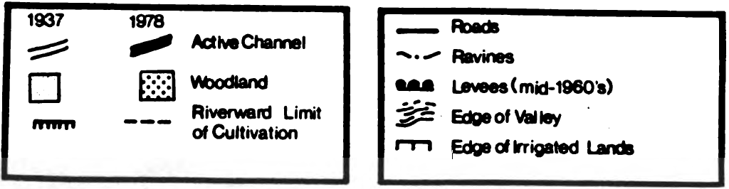
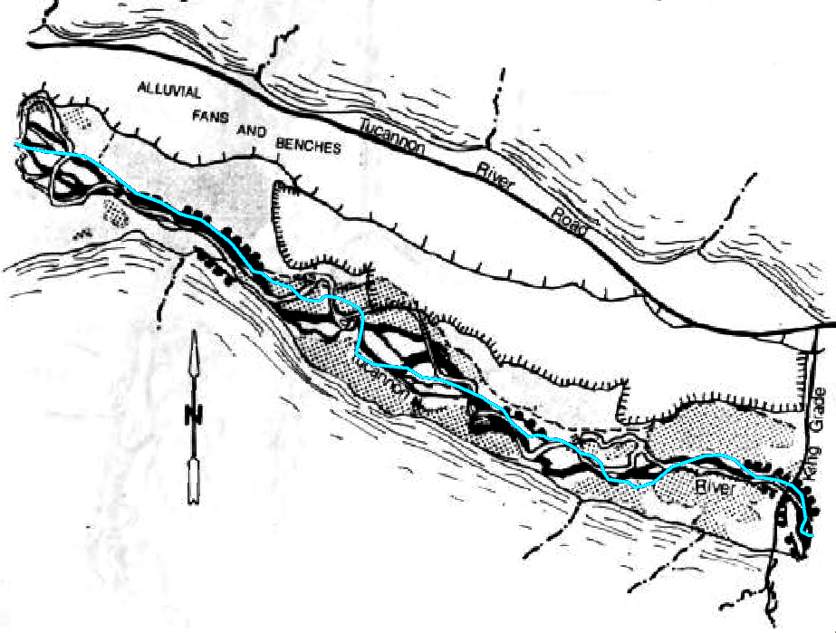
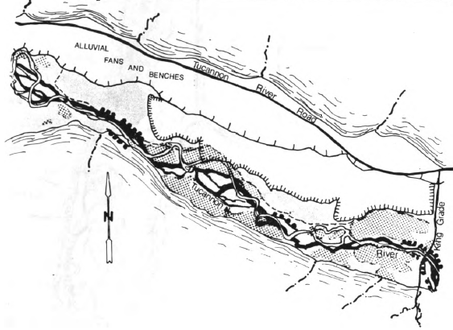
Channel length changes from 1937 to 1978 @PA-27/28.1
Channel Lengths
1937 = 8,240 ft
1978 = 7,105 ft
2021 = 7,025 ft
Hecht, 1982
Notes:
Slide 7 – As an example of the Stage 3s condition, I will take you to our restoration project at Project Area 27/28.
I’ve included the old channel traces from Barry Hecht’s analysis completed in 1982 as a visual reference to the changes in many of the reaches or Project Areas in the Tucannon. Remember we lost 7-20% of the overall channel length in the Tucannon with some of this straightening happening well before the 1937 aerial photos were available.
Notice the channel length and pattern changes from 1937 in blue to 1978 in red.
The 1937 channel length was measured at 8,240 ft and by 1978 was reduced to 7,105 ft. I’ve included the 2021 channel length as further evidence of channel straightening, showing that the channel was futher straightened to 7,025 ft.

Slide 8
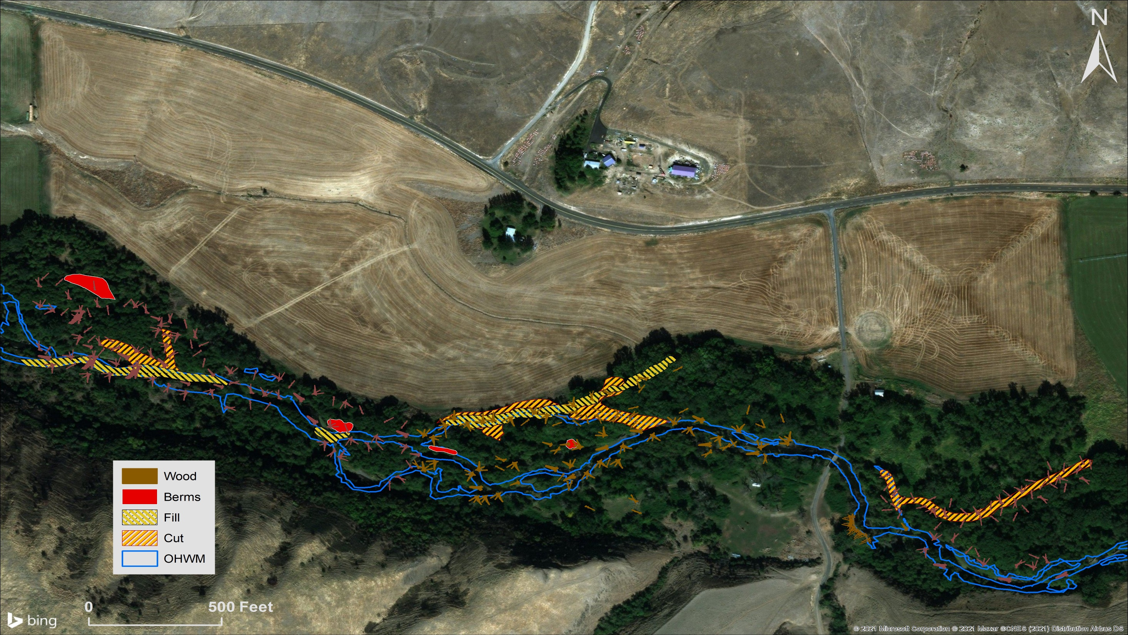
Tucannon PA-27/28.1
Phase 4
Phase 1
Phase 2
Phase 3
Notes:
Side 8 – Now an introduction to the restoration project at Project Area 27/28 in the Tucannon. The original plan for phase 1 included all the in-channel work, but with delays caused by covid-19, Phase 1 was cut in half. With the first Phase implemented in 2020 – with work starting in the middle of the project area. The in-channel work included 350 large trees both in-channel and on the floodplain to help reduce velocities thru the Project Area.
Phase 2 was completed in the summer of 2021. This phase completed the second half of the in-channel work, occurring both upstream and downstream of the 1st phase. We installed an additional 350 large trees in the channel and on the floodplain filled some of the mainstem channel with native materials generated from levee removal and reconnected several existing sidechannels . In addition, there were 4 large channel spanning log jams constructed to help dissipate stream energy at the bottom end of the project area, before the river leaves the landowner’s property.
Phase 3 – Is planned for the Spring of 2023, and includes irrigation efficiencies, water rights transfers and a ~7 acre floodplain easement. The instream water transfer and floodplain easement, will help offset the cost of the irrigation efficiencies, we plan to complete the floodplain easement and transfer water back in-stream.
Phase 4 – is the 7 acre floodplain reconnection. The floodplain reconnection project is planned for the summer of 2023. Since this phase of the project is mostly constructed out of water, we plan to start after the farms Triticale’s is harvested from the property.
The floodplain acres are currently the most productive farm ground on the property, so we want to make sure the newly installed irrigation efficiency in the upland fields help offset any production losses caused by the conversion of the lower field back to floodplain. As you can tell by the photo, plans need to be made to revegetate the lower field, before water is turned out there on an annual basis to alleviate any unintended temperature increases due to the lack of vegetation.

Slide 9
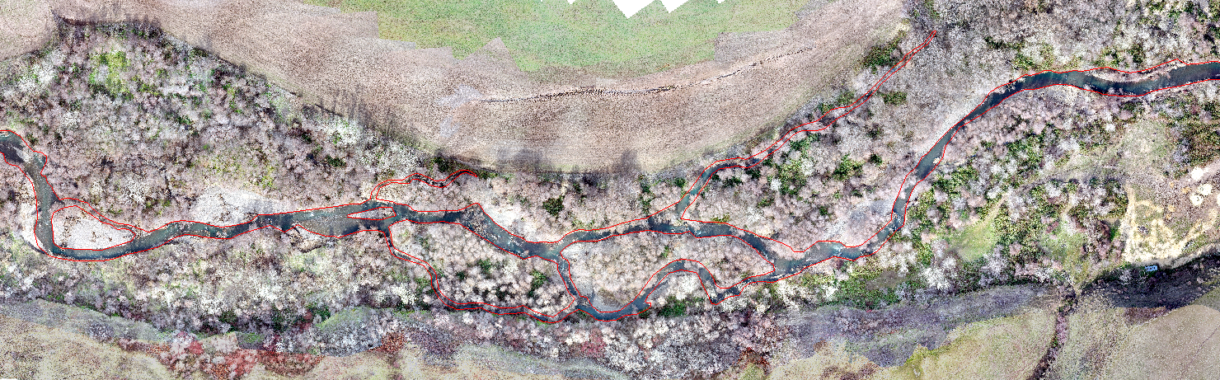
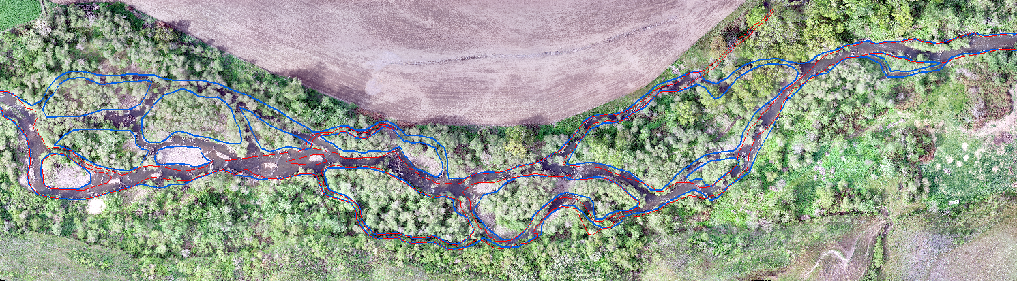
Pre-Project 2020
Post-Project 2022
Notes:
Slide 9 – This photo shows the pre-project in 2020 and the post project 2022 with Phases 1 and 2 complete. The red trace highlights the pre-project and blue trace highlights the new channel features, post project.

Slide 10
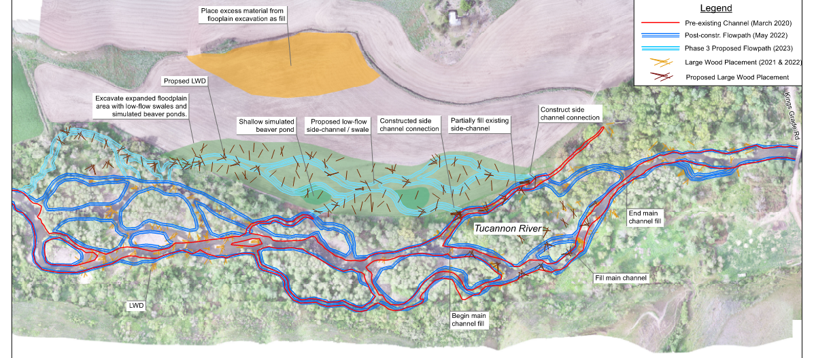
Pre-project July 2020
107 LWD (>6m long & 0.3m dia.)
43 pools (#)
1,956 (m²) pool area
474 m perennial side channel
669 m of high flow channels
1.51 km main channel length
Post-project September 2021
911 LWD (>6m long & 0.3m dia.)
81 pools (#)
5,730 (m²) pool area
2,231 m perennial side channel
2410 m of high flow channels
1.65 km main channel length
Proposed Summer 2023
226 LWD (>6m long & 0.3m dia.)
745 m perennial side channel
6.9 Acres of enhanced floodplain
7.1 Acres of passively created wetland
Notes:
Slide 10 – Here is an overview of the downstream reach metrics. You can see where we used channel fill to reconnect side channels and placed wood, including the channel spanners. Take notice of the pre-project and post-project metrics, we placed over 800 trees, doubled the amount of pools and increased the channel length while reconnecting the floodplain. The overview shows the summer 2023 work in light blue, which includes the re-connection of the 7 acres, and includes an additional 250 logs and 745 meters of side channel length.

Slide 11
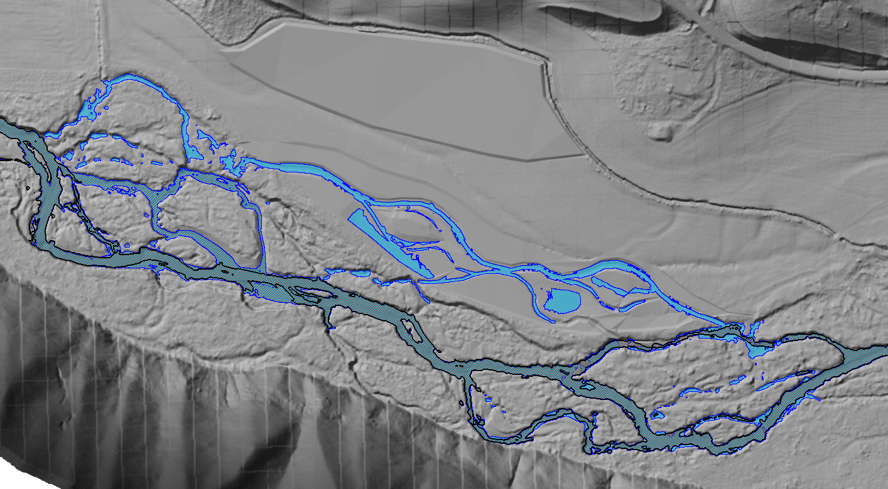
Flow Event | Change in Wetted Area (Acres) | Change in Wetted Area (%)*
Winter Base Flow | +2.2 | +53%
Q2 | +7.1 | +59%
Q10 | -0.02 | 0.0%
Q100 | -2.15 | -4%
Connection of relic channel features.
Proposed Phase 3 base-flow swale expansion.
Pre-restoration base-flow (2020) shown by black outline
Expanded base flow connection following Phase 1 and 2 construction
Proposed change in winter base-flow (100 cfs) wetted area
Notes:
Slide 11 – We created a 2D HEC-RAS model for the project area to help with project permitting. We used the model to communicate the anticipated uplift in the metrics. This first model shows the changes in percent wetted area (think floodplain connection) at the winter base-flow (at 100 cfs) in the Tucannon. The black outline shows the pre-construction. The blue hashed lines show the Phase 1 and 2 wetted area, and the light blue shows the wetted area after phase 3.

Slide 12
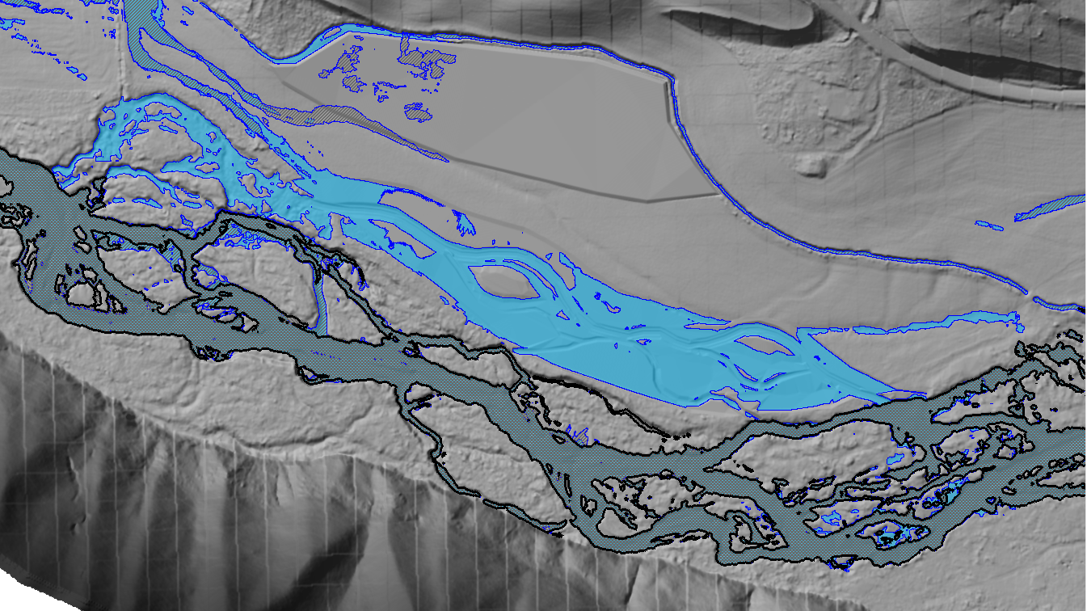
Flow Event | Change in Wetted Area (Acres) | Change in Wetted Area (%)*
Winter Base Flow | +2.2 | +53%
Q2 | +7.1 | +59%
Q10 | -0.02 | 0.0%
Q100 | -2.15 | -4%
Flow Event | Change in Wetted Area (Acres) | Change in Wetted Area (%)*
Winter Base Flow | +2.2 | +53%
Q2 | +7.1 | +59%
Q10 | -0.02 | 0.0%
Q100 | -2.15 | -4%
Connection of relic channel features.
Connection of relic channel features.
Proposed Phase 3 base-flow swale expansion.
Proposed Phase 3 base-flow swale expansion.
Pre-restoration base-flow (2020) shown by black outline
Pre-restoration base-flow (2020) shown by black outline
Expanded base flow connection following Phase 1 and 2 construction
Expanded base flow connection following Phase 1 and 2 construction
Proposed change in 2-year (792 cfs) wetted area
Post-project increase in base-flow wetted area.
Notes:
Slide 12 – This model shows the proposed changes in the wetted area at the 2-year flow (at 792 cfs). Again with the same colors for each phase (including pre construction, phase 1&2 and phase 3). Notice the large changes in percent wetted area at the lower stream flows. Making significant changes for over winter rearing habitat. Remember the ultimate goal is 90 days of floodplain inundation.

Slide 13
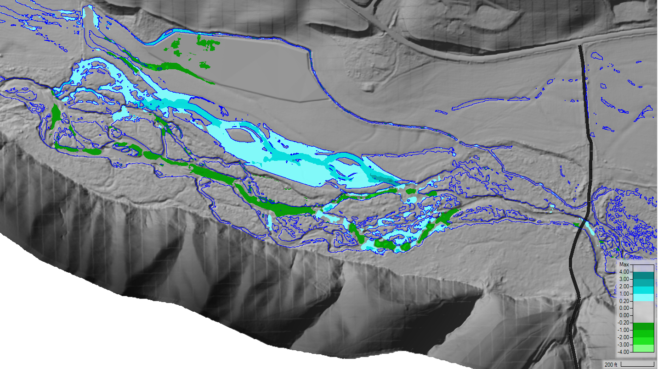
Increase velocities correspond to the activation of relic channel features
Increase velocities correspond to the increase in wetted area.
Slight decreases to mainstem velocities downstream of the proposed expansion.
Increase velocities on the floodplain correspond to the increased wetted area.
Change in Mainstem Velocity
Slight reduction in mainstem velocities adjacent to the expansion.
Flow Event | Change in Mean Velocity (%)* | Change in Max Velocity (%)*
Winter Base Flow | -5% | -2%
Q2 | -3 | 0%
Q10 | -2% | +1%
Post-project change in 2-year velocities
Notes:
Slide 13 – The next metric we try to address is stream power or increased stream velocity. I should probably highlight the reduction in stream power do to floodplain restoration, see the dark green in the mainstem channel as changes in stream velocity, shown as negative or decreases in feet per second velocity . The changes in velocity are post project at the 2-year interval ( at 792 cfs) and are associated with the new floodplain reconnection.

Slide 14
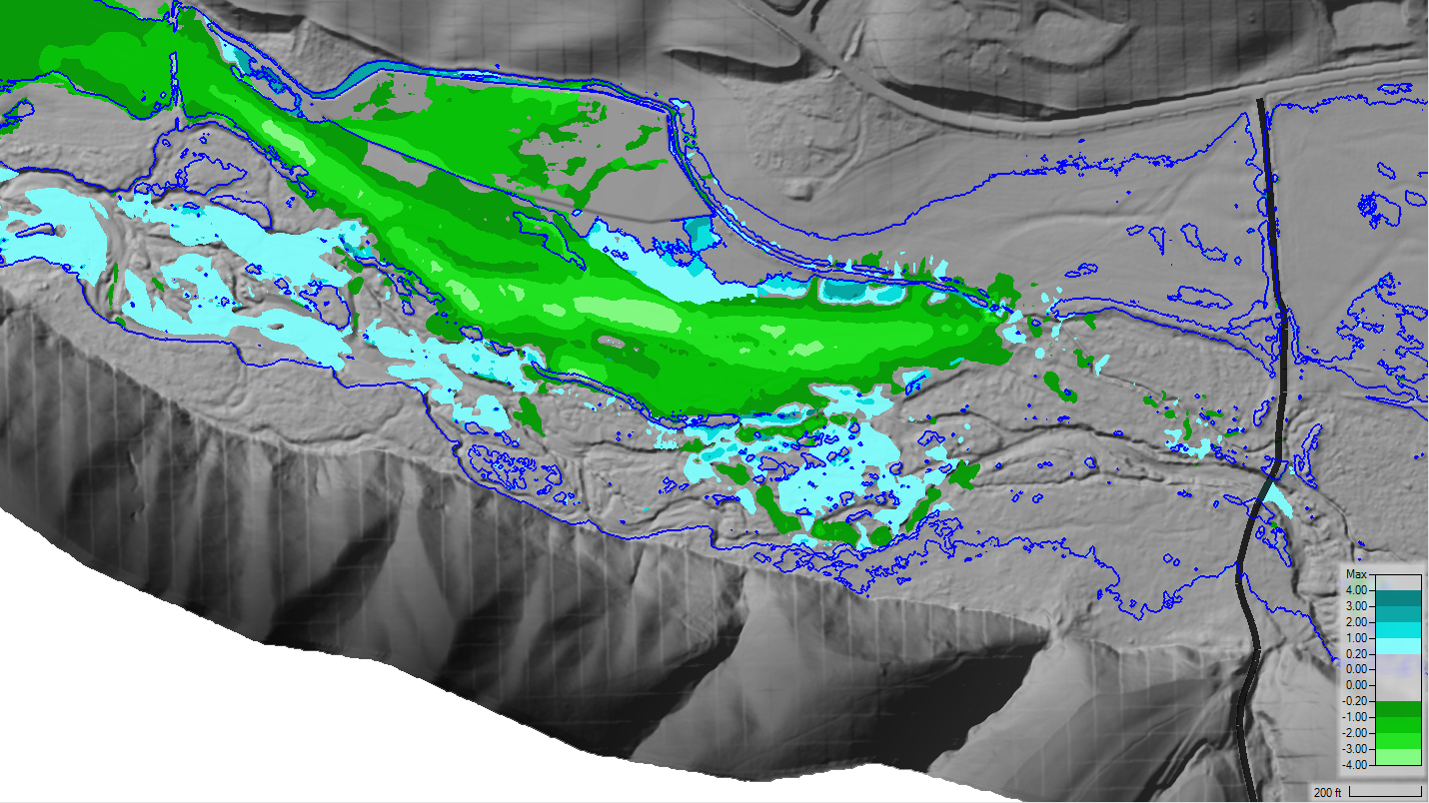
Decreased velocities on downstream property.
Decreased velocities across the expanded floodplain area are a result of additional flow depth and roughness on the floodplain, and within connected side channels.
Minimal increase (< 1 ft/s) to mainstem velocities downstream of the proposed expansion.
Change in Mainstem Velocity
Reduction in mainstem velocities adjacent to the expansion.
Flow Event | Change in Mean Velocity (%)* | Change in Max Velocity (%)*
Winter Base Flow | -5% | -2%
Q2 | -3 | 0%
Q10 | -2% | +1%
Post-project change in 10-year velocities
Notes:
Slide 14 – The next model shows changes in main stem and floodplain velocity at the 10-year flow ( at 2,440 cfs). Here you seen decreases in velocities across the floodplain in light green and reductions in the mainstem. Decreases are between 1 and 3 feet/sec which is significant for this reach in the lower part of the Tucannon.

Slide 15
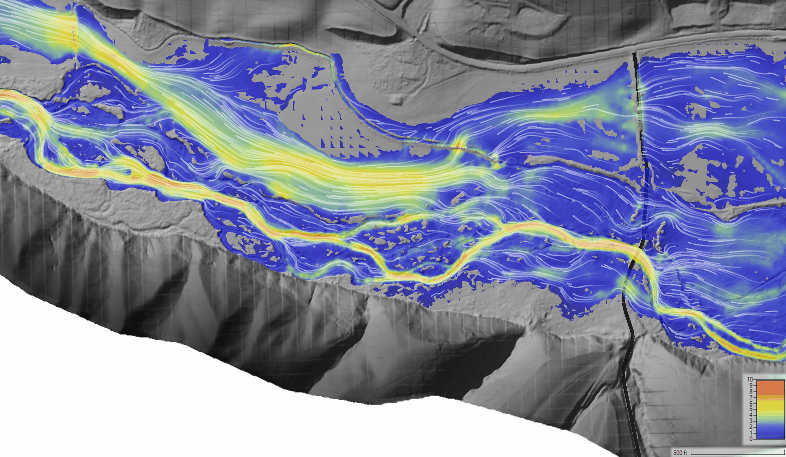
Kings Grade Rd
Post-project 25-year velocities
Existing velocities during a 25-year event.
Notes:
Slide 15 – And finally the modeled pre-project velocities at the 25-year event (at 3,560 cfs). The darker the orange the higher the velocity, with bright orange is 10 ft/sec. This model very closely resemebles the conditions in spring of 2020 when the Tucannon flooded up to the 25-year event.

Slide 16
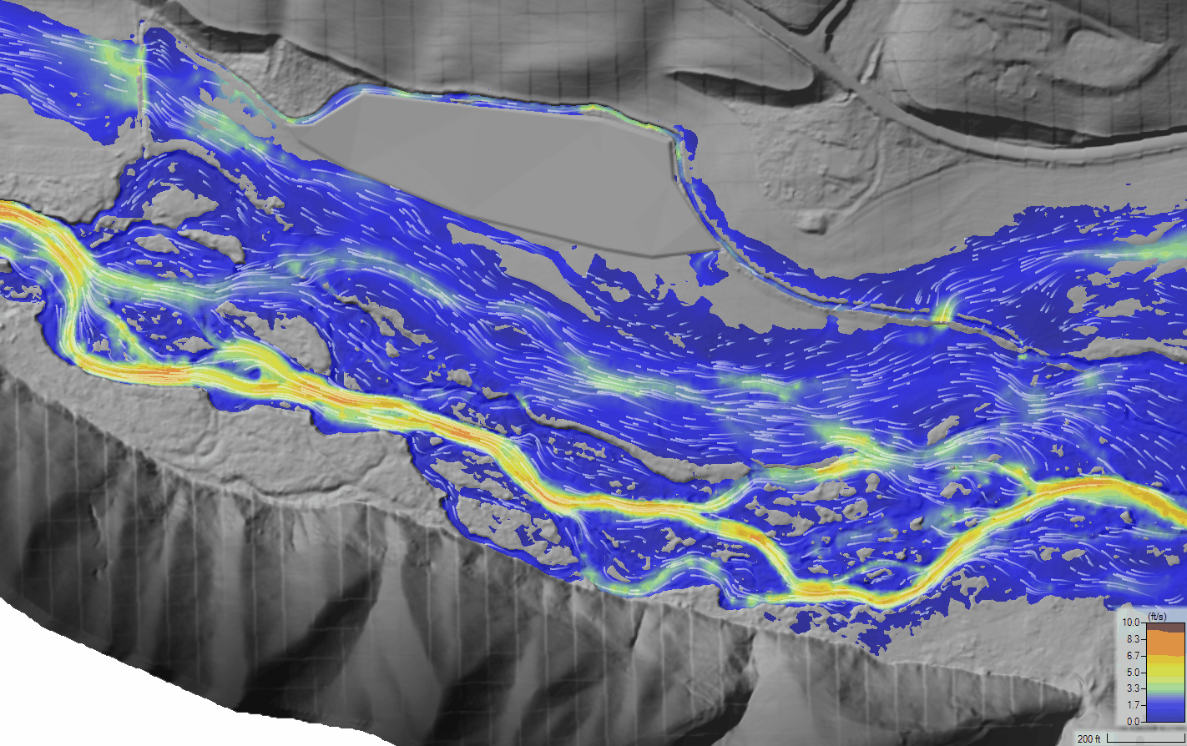
Kings Grade Rd
Post-project 25-year velocities
Modeled velocities during a 25-year event.
Proposed velocities during a 25-year event.
Notes:
Slide 16 – And the post-project velocities during the 25-year event (again at 3,560 cfs). As you can tell, there’s a significant reduction in yellow on the floodplain and orange in the mainstem Tucannon due to the presence of the new channels and increased roughness in the mainstem. If you look closely, you will see an increase in velocities at the bottom of the project area as the river moves out of the project area and returns to its straightened channel form.

Slide 17
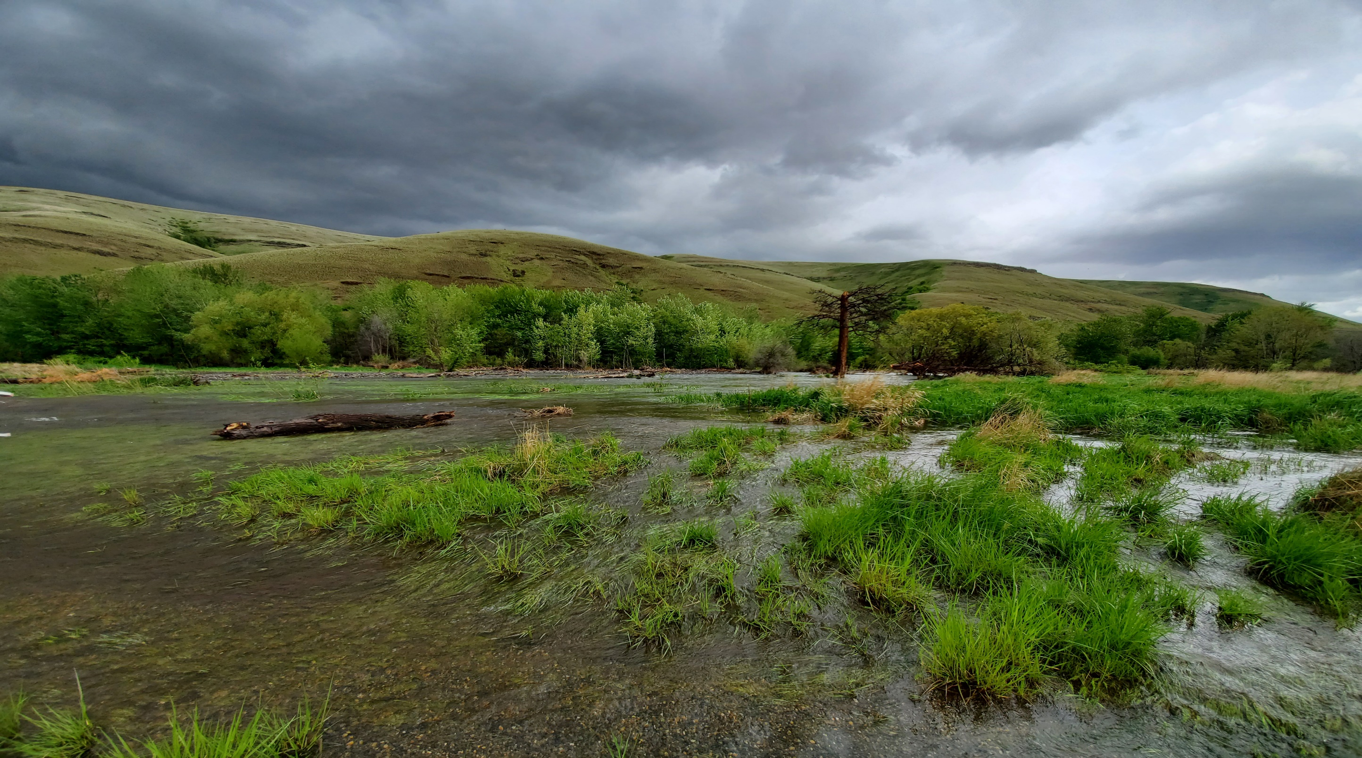
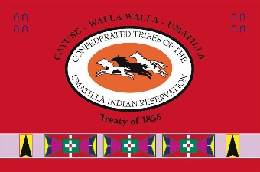
Thanks
Floodplain connectivity on PA 18 completed in 2017
Notes:
Slide 17 – Thanks again. I appreciate the time to share the results of the past several years of work in the Tucannon. I encourage you to check out the Tucannon River. Org website and more specifically the Tucannon webmap. I’d be happy to take any questions.

