Slide 1
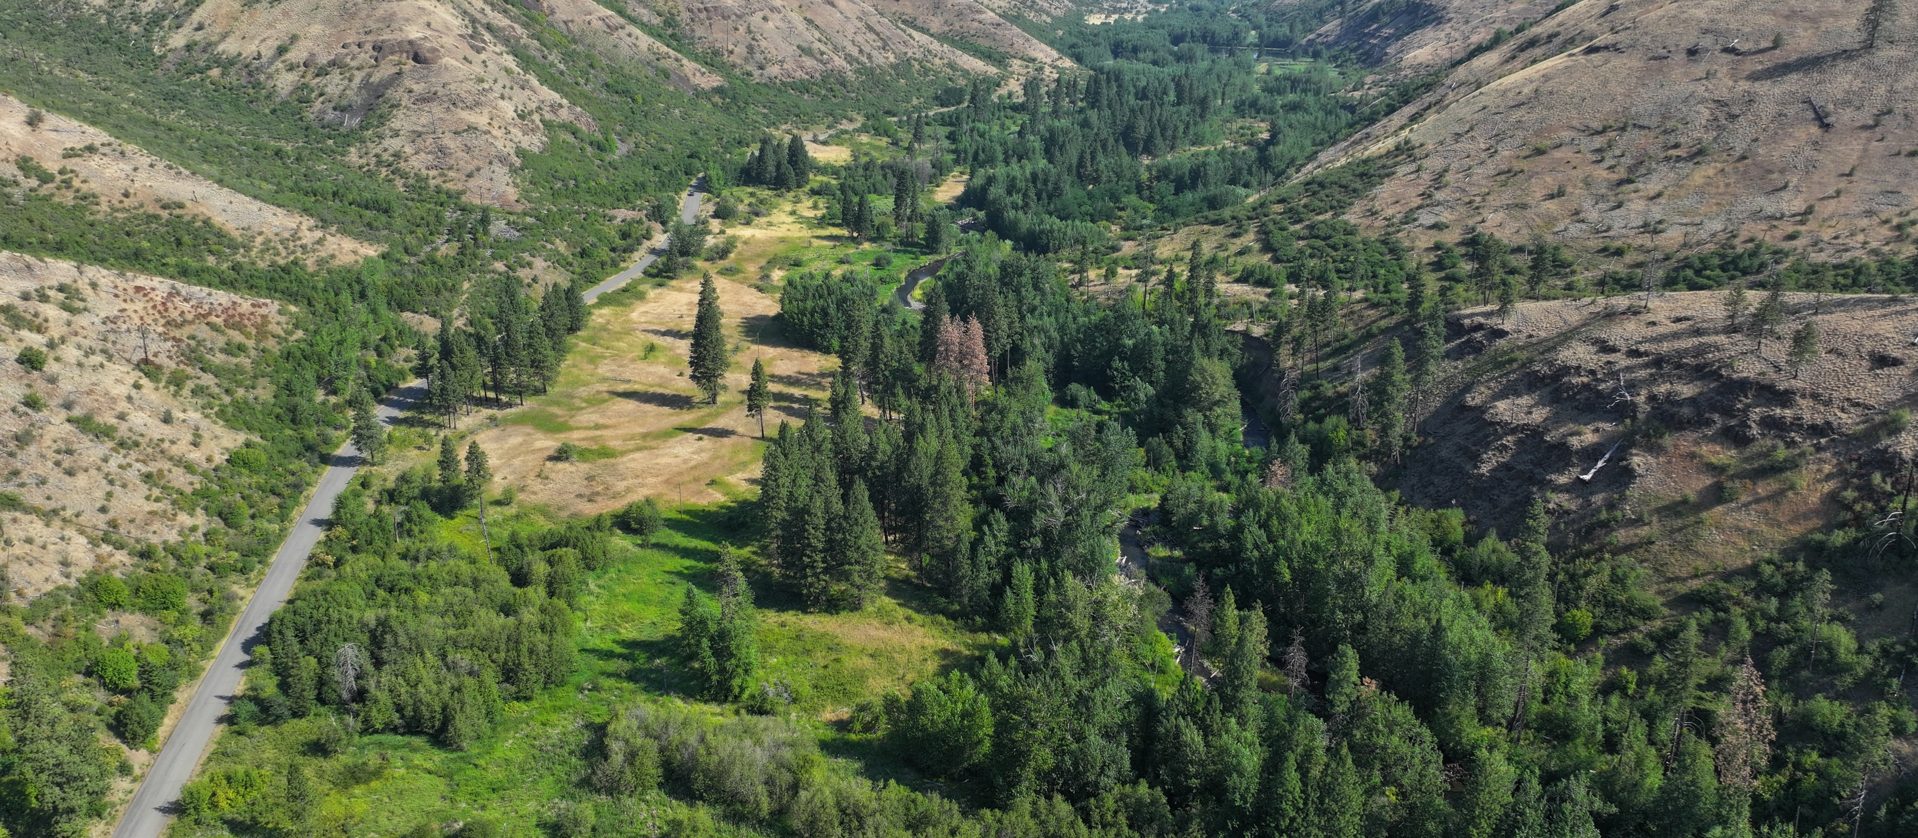
Tucannon PA 5-15 Assessment and Conceptual Design
Elizabeth Eastman, NPT
Reach-Scale Alternative
Notes:
Today’s presentation provides a brief overview of the Tucannon PA 5-15 Assessment and Conceptual Design work to date, and describes the draft Reach-Scale Preferred Alternative agreed to by the Tucannon PA 5-15 Co-Managers

Slide 2




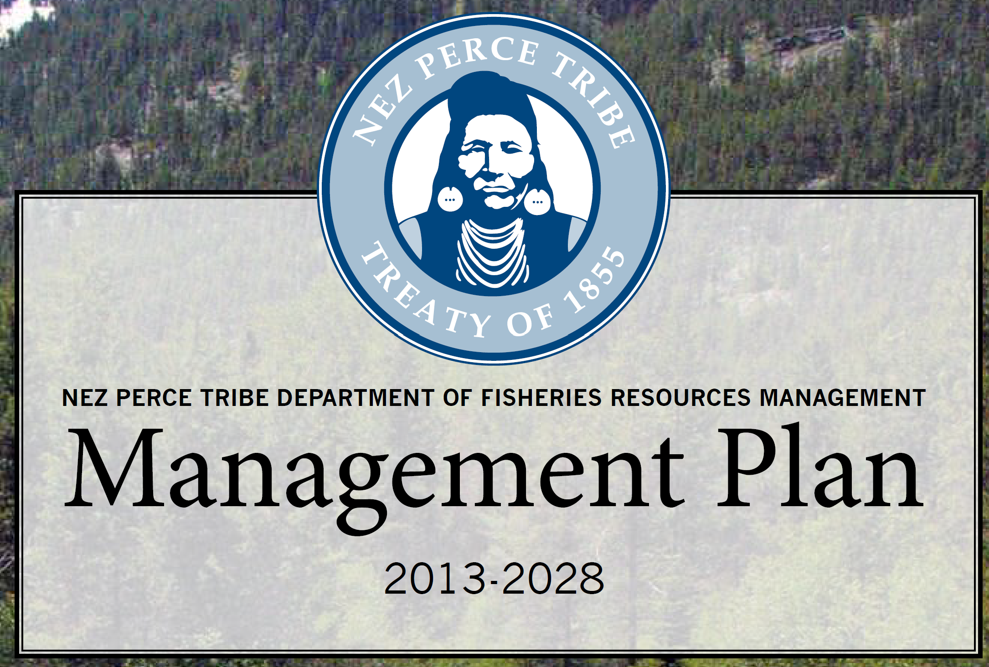
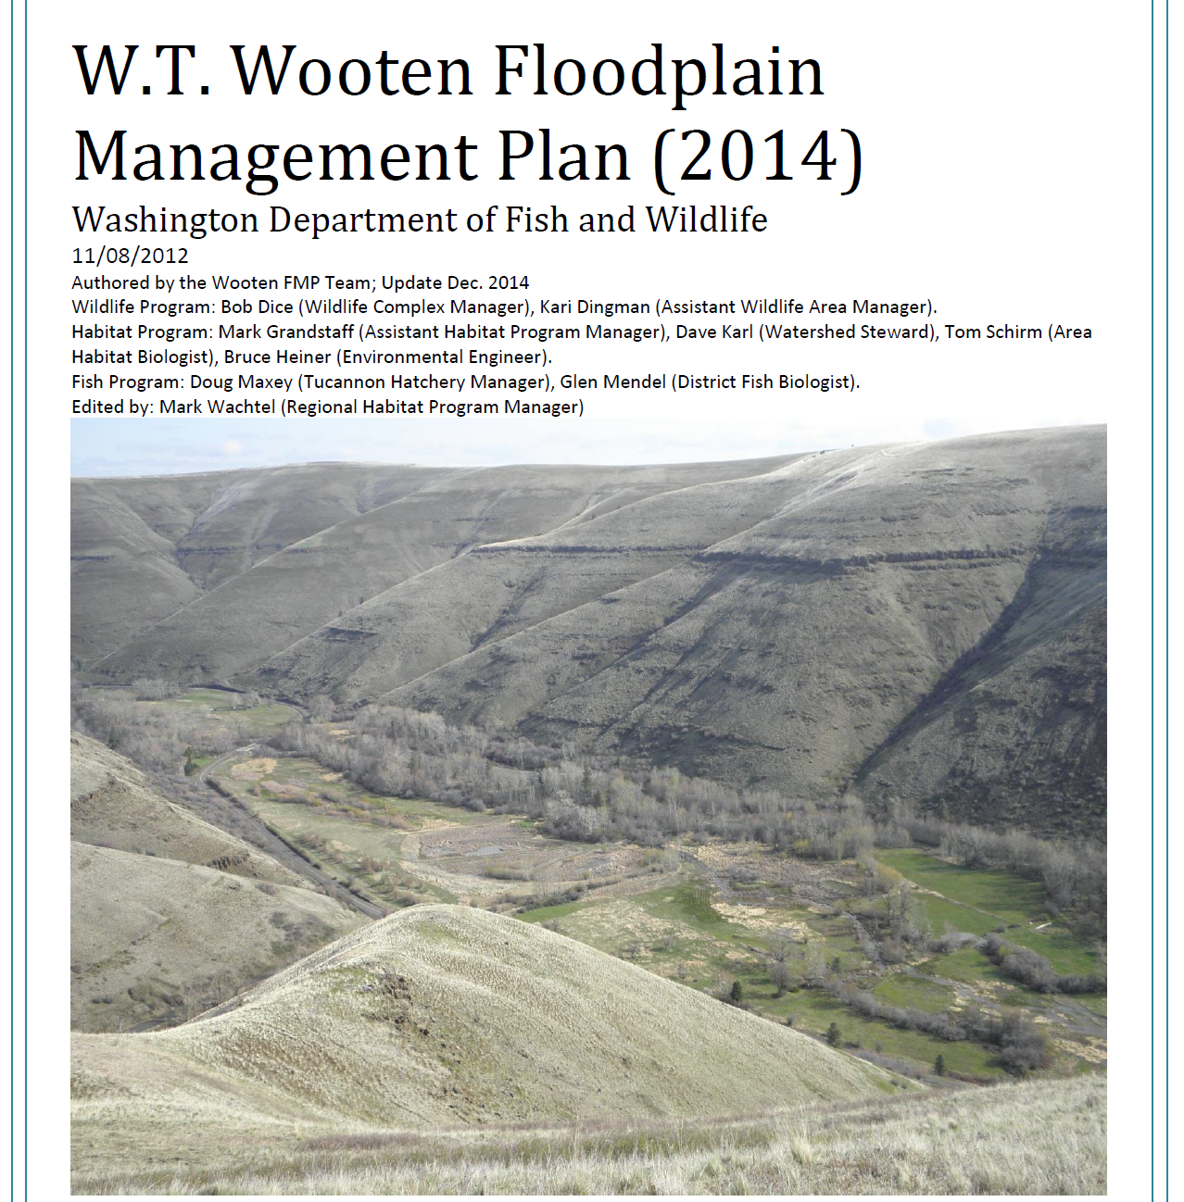




Co-Management Model
CTUIR River Vision
Riparian Vegetation
Connectivity
Hydrology
Geomorphology
Aquatic Biota

Slide 3
Background
Lakes and Infrastructure Condition
  WA Department of Ecology Dam Safety Office regulates, conducted dam safety studies in 1997, 2001, and 2005. These studies concluded that all of the lake dams (embankments) and inlets/outlets were in need of maintenance, most needed significant repairs or replacement
  Dams are average 70-years old, Lifespan of infrastructure is 50-years
  Typical deficiencies are erosion of dams/embankments, embankment slopes too steep, top widths too narrow, leakage through dams, failing and collapsing inlet and outlet structures, danger of overtopping and failure in large floods, and lack of emergency spillways
  Threatened and Endangered Species Status
  Treaty Rights obligations

Slide 4
Background
Costs for maintenance, repair and replacement of infrastructure are increasing
    dams/embankments for lakes
    inlet and outlet structures
    sedimentation in lakes – dredging and water quality concerns
    roads, gates, trails
    campgrounds, parking areas, restrooms
  Water quality concerns
  Algae blooms
  Temperature
  Habitat degradation and simplification

Slide 5
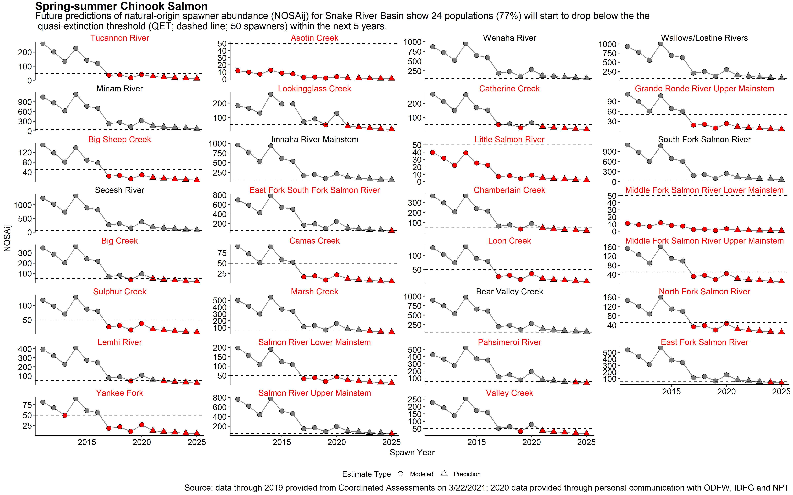


Action Needed:
Chinook Reaching Quasi-Extinction Status
Fewer than 50 wild pairs showing up
Notes:
42% of the Snake Basin spring/summer Chinook populations have natural origin spawner abundance currently at or below QET (50 spawners)
77% of the populations predicted to drop below critical level of 50 spawners by 2025

Slide 6
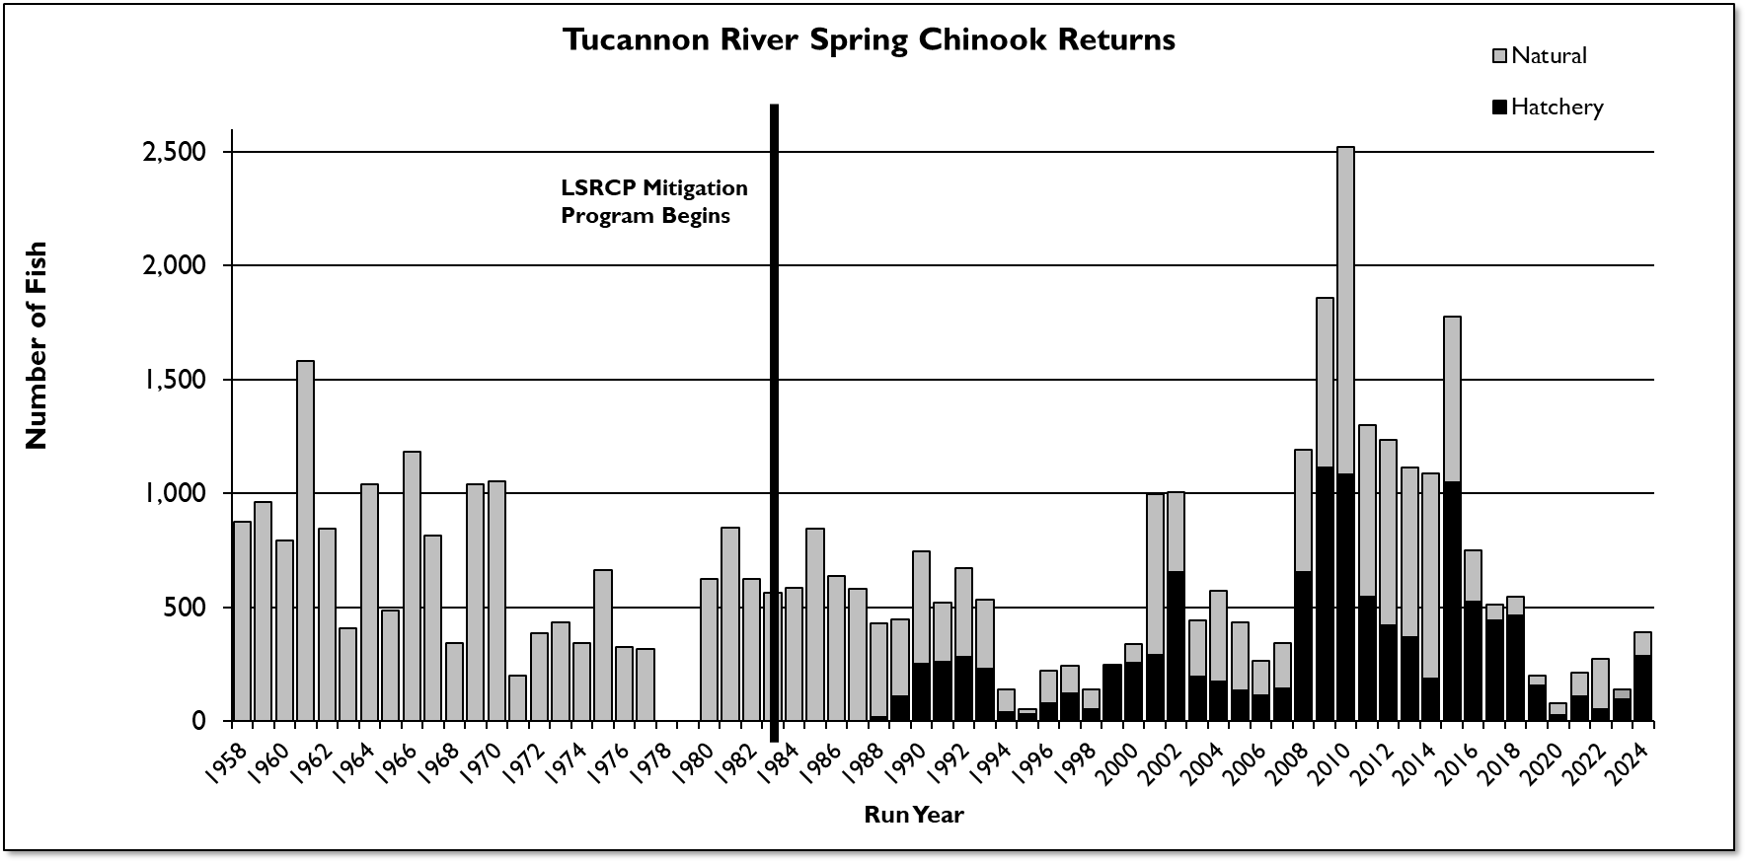
Action Needed:
Chinook Reaching Quasi-Extinction Status
Fewer than 50 wild pairs showing up
NPT Ecological Goal – 22,000
Recovery Plan Goal = 750-3,000
Hatchery Goal = 1,152
Notes:
Snake River dam construction started in 1955 and continued thru 1970s.
For those who know about shifting baselines, Before the SR dams there were over 22,000 spring/summer chinook.

Slide 7
Comprehensive, Multi-Use Strategy
Fish and Ecosystems
Urgency for spring Chinook recovery
Long-term investments
Needs to be sustainable for land managers (WDFW)
Climate change
Community input is critical
Recreation and Community
Infrastructure

Slide 8
Tucannon PA 5-15 Assessment and Conceptual Design
Elizabeth Eastman, NPT
Reach-Scale Alternative
Notes:
Today’s presentation provides a brief overview of the Tucannon PA 5-15 Assessment and Conceptual Design work to date, and describes the draft Reach-Scale Preferred Alternative agreed to by the Tucannon PA 5-15 Co-Managers

Slide 9
Assessment and Conceptual Design
Assessment Components
  Lakes and Infrastructure Condition
  Geomorphic Assessment and State of the Floodplain
  Floodplain Space and Connectivity related to stream power, channel resilience vs incision, and redd scour
  Vegetation
  Climate Change Impacts
  Focal Species Production and Habitat Suitability Assessment

Slide 10
Assessment and Conceptual Design
Assessment Technical Outcomes
  Lakes and infrastructure aging, Operation & Management/ Replacement costs increasing, some in need of replacement and/or major repair
  70% of floodplain disconnected by lateral confinement (infrastructure) and vertical incision (excess stream power)
  450-feet minimum target floodplain width to address confinement and infrastructure, and excess stream power
  Reduced riparian and floodplain vegetation complexity
  Reduced aquatic species function
  Climate warming trend/higher temperatures
  Decline in function and total wetland area

Slide 11
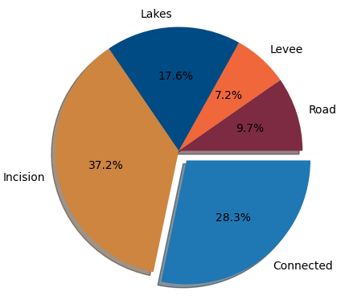
State of the Floodplain
Floodplain is ~30% of its historical extent
Lakes, levees, and road infrastructure disconnect ~35% of historical floodplain
~37% of historical floodplain is vertically disconnected

Slide 12
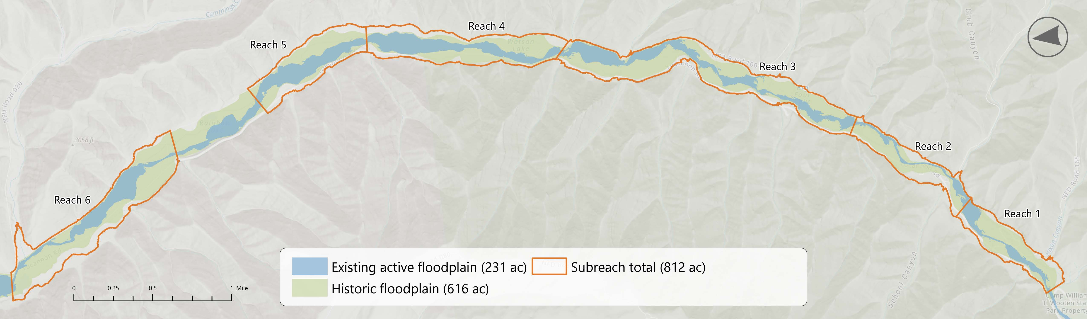
Existing compared to Historic Floodplain

Slide 13
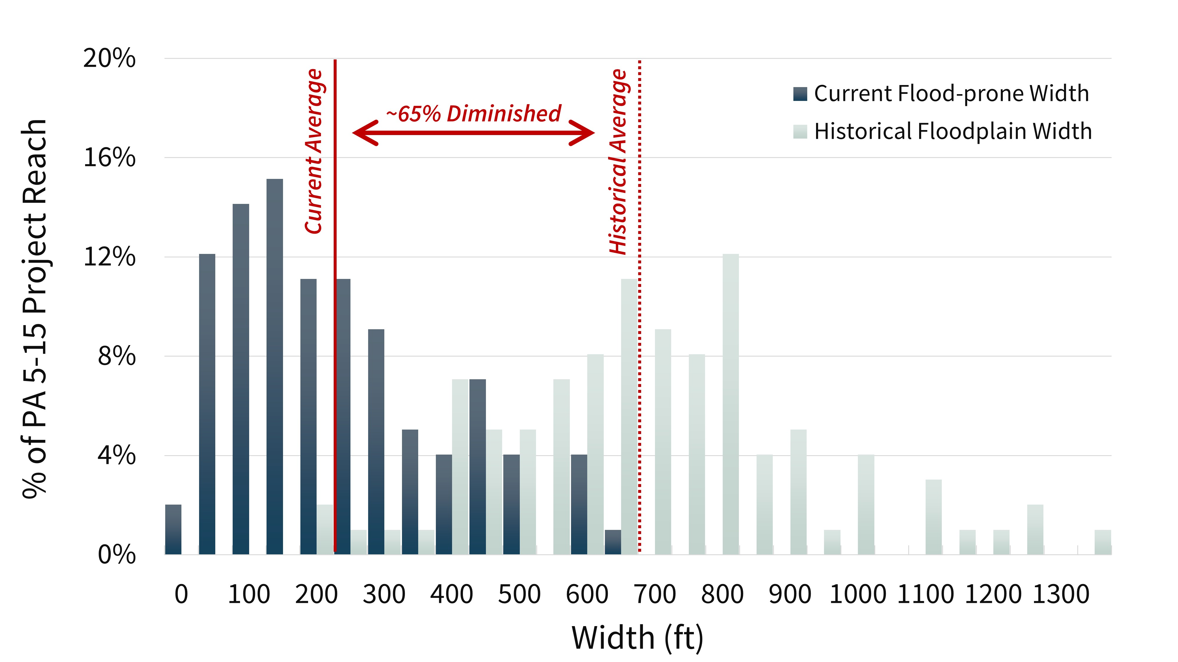
Historical v. Present Day Widths (Narrowing = Disconnection)

Slide 14
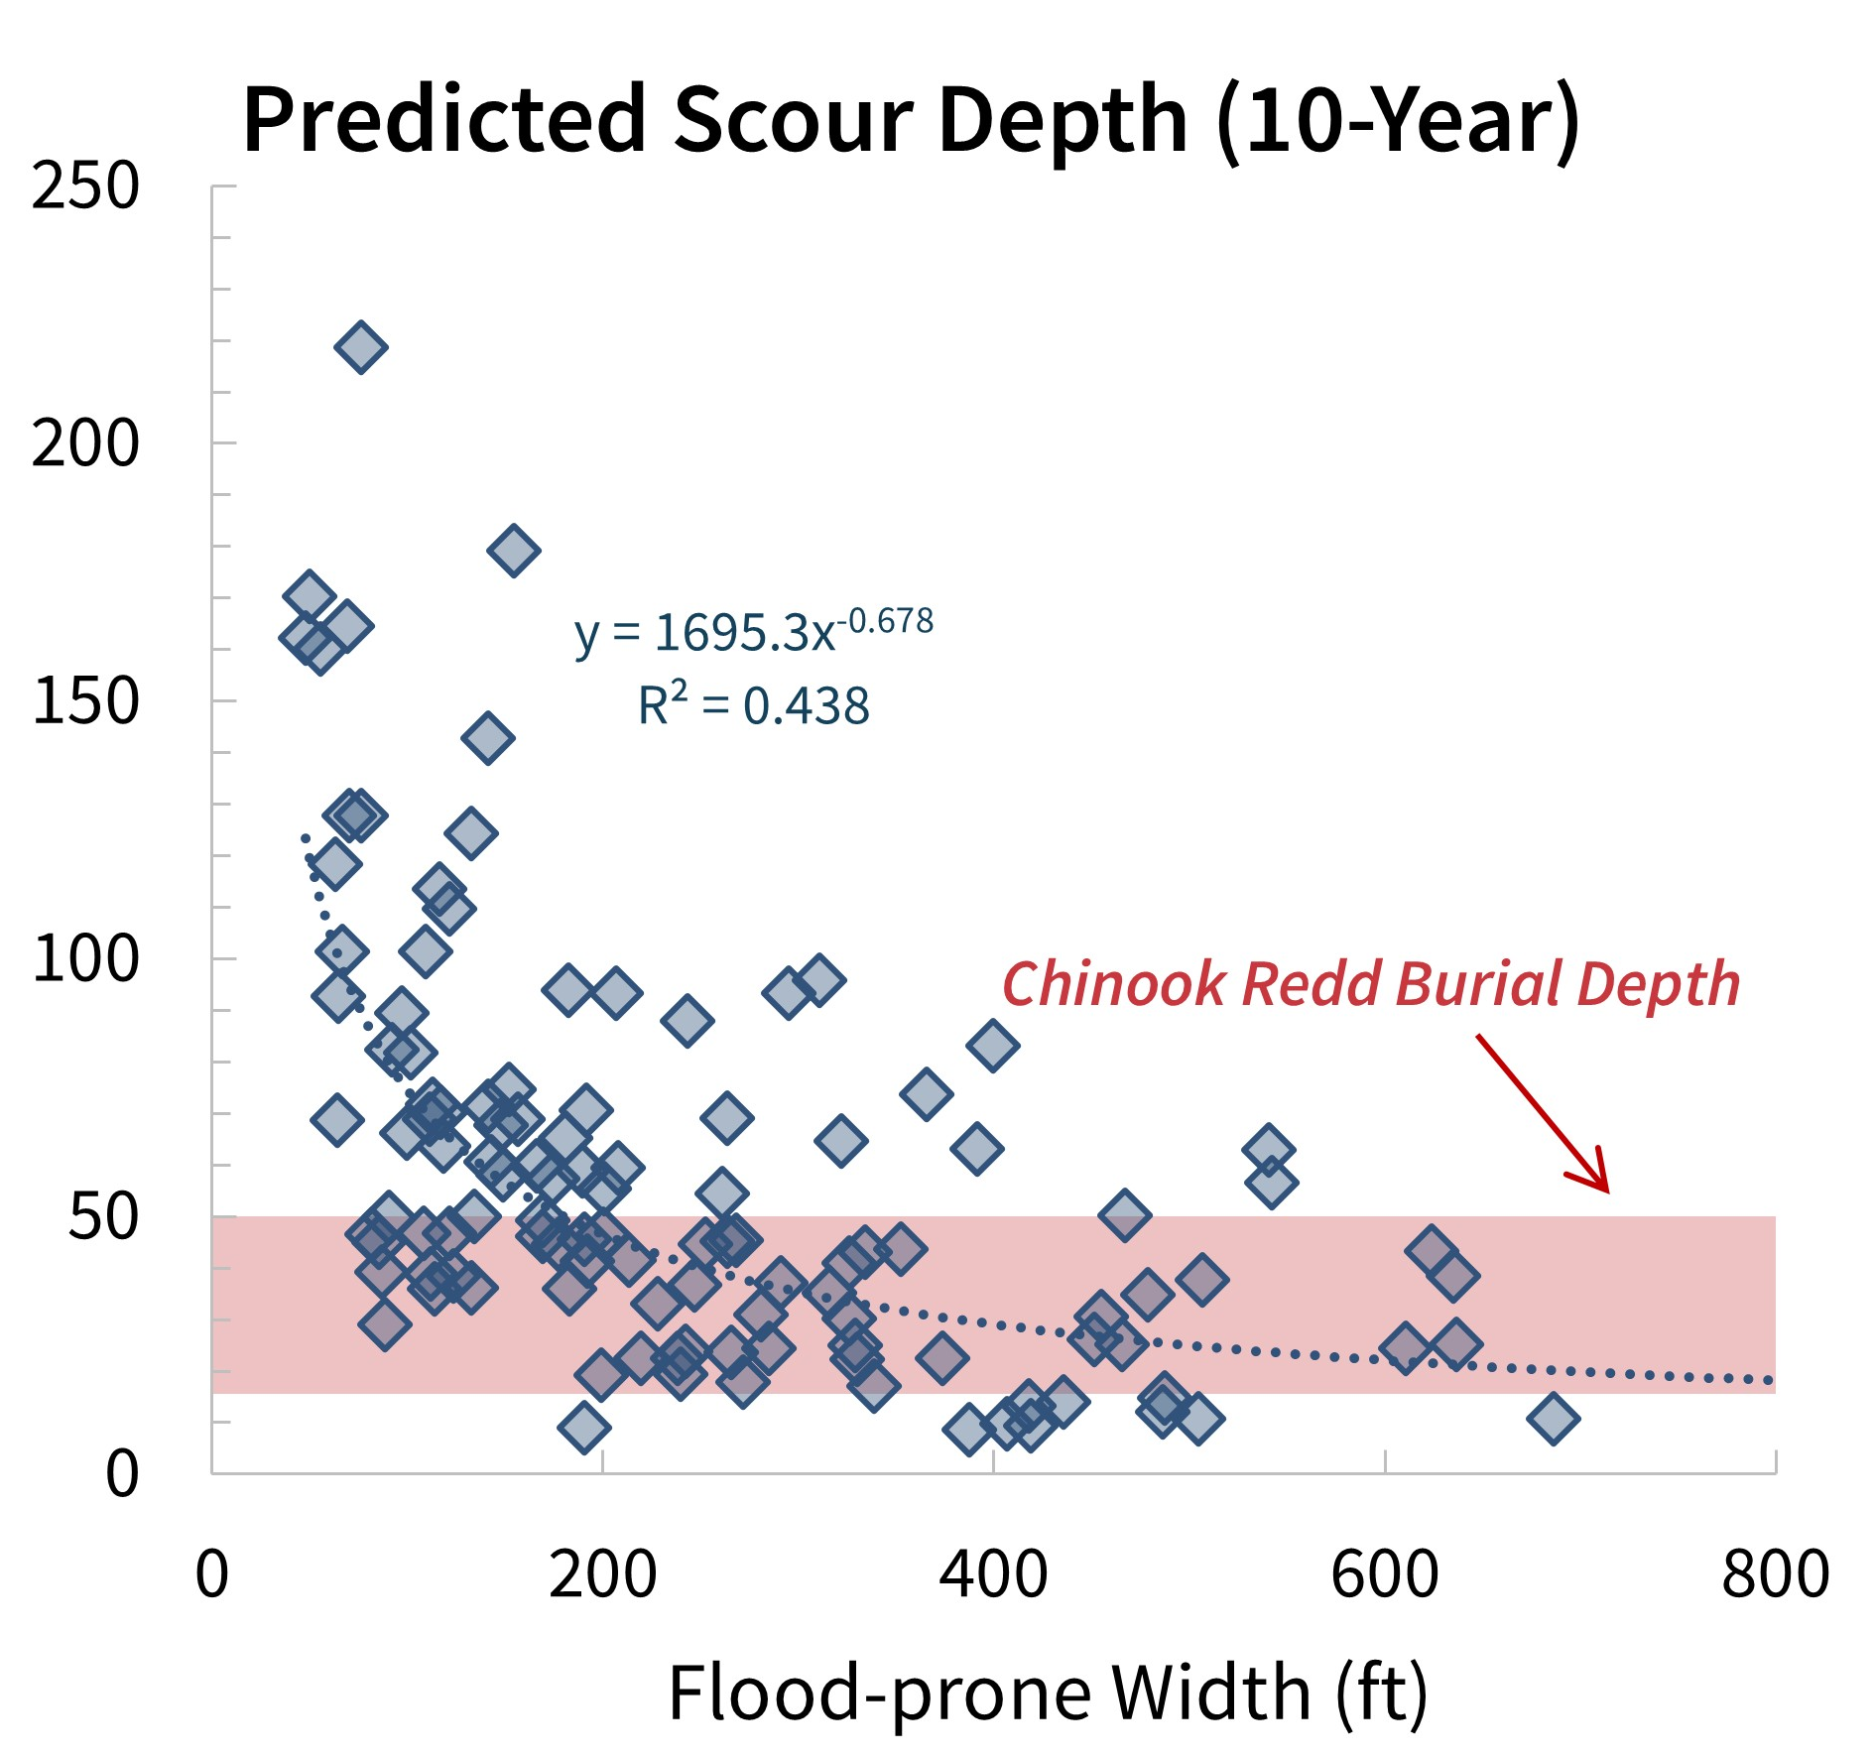
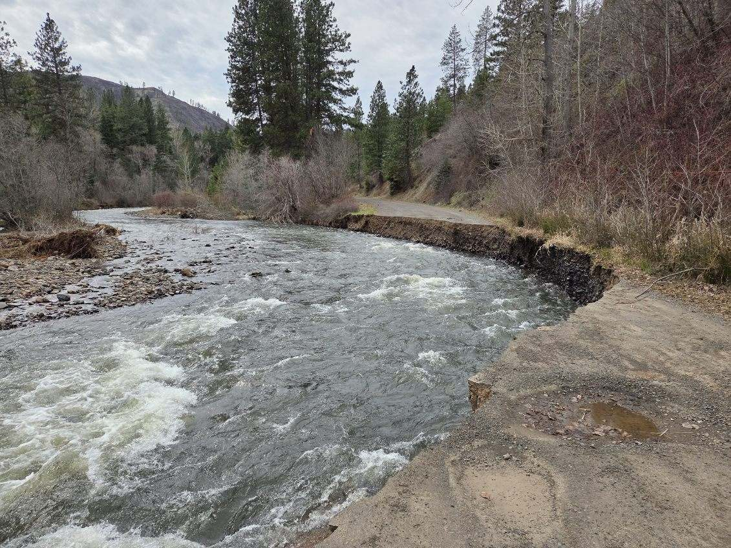
Space as a Unifying Framework
Quantified benefits of space:
Increased ecosystem resilience
Direct benefits for life history bottlenecks (redd scour)
Reduced stream power
Increased infrastructure resilience
Reduced flood risk
Scour Depth (cm)
Road wash-out in March 2026 flood near Camp Wooten

Slide 15
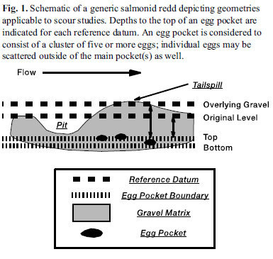
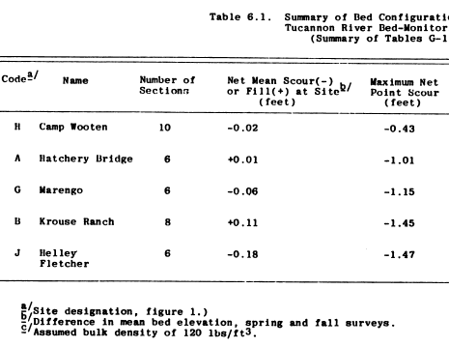
Potential Consequence of Stream Power = Increased Redd Scour
Chinook Egg Burial Depth 15-50 cm (~0.5-1.5 ft)
[Paul DeVries, 1997]
Barry Hecht 1982 measure scour depths from 0.43-1.47 feet

Slide 16
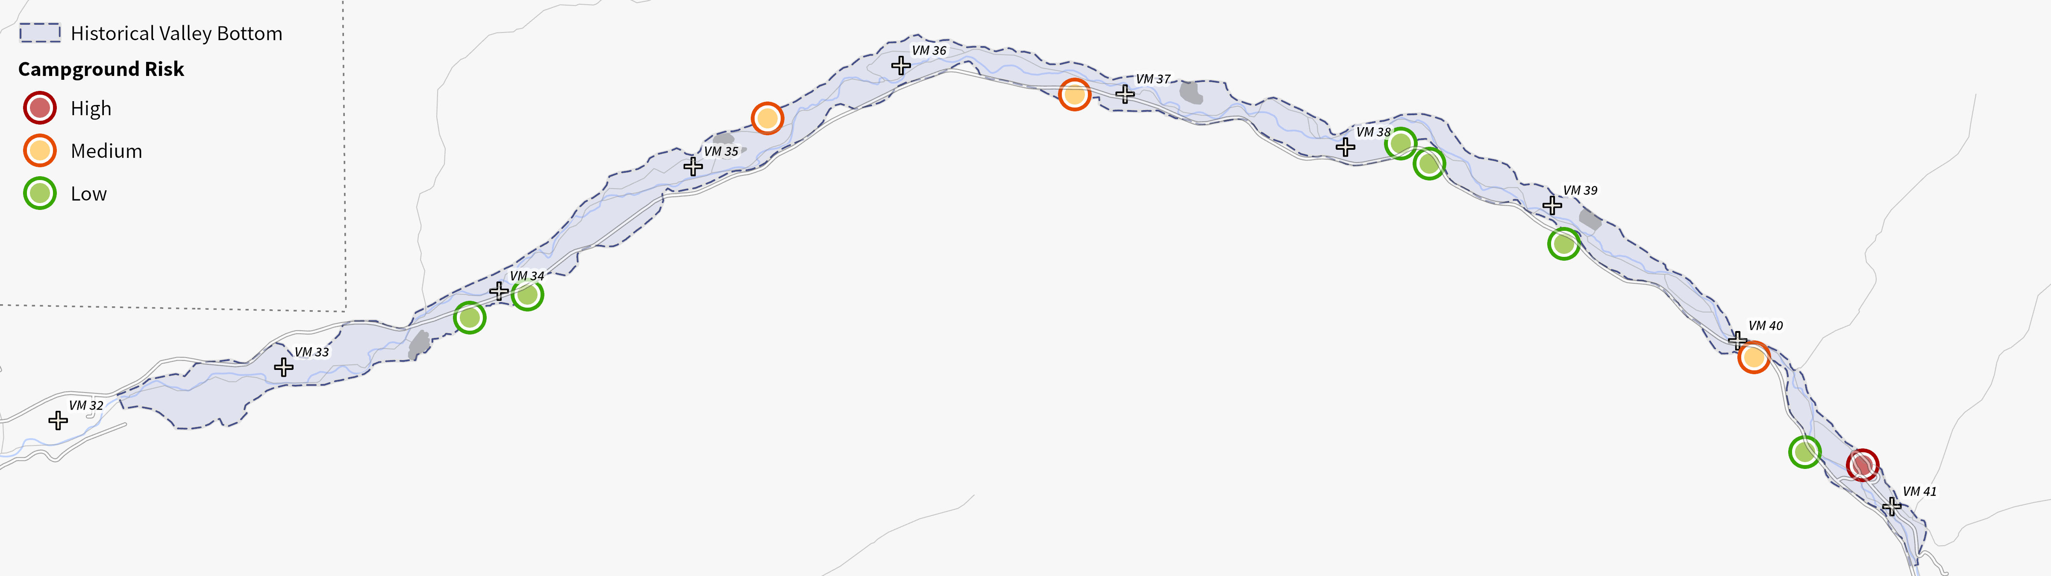
Recreational Risk during Flood Events
March 2026 Flooding

Slide 17
Interconnected Benefits
Increased groundwater recharge
Community
Agricultural
Habitat
Recreation
Flood Risk
Reduced scour potential through peak flow attenuation
Reduced Campground Risk
Improved Lake Infrastructure
Improved hunting, fishing and wildlife viewing opportunities

Slide 18
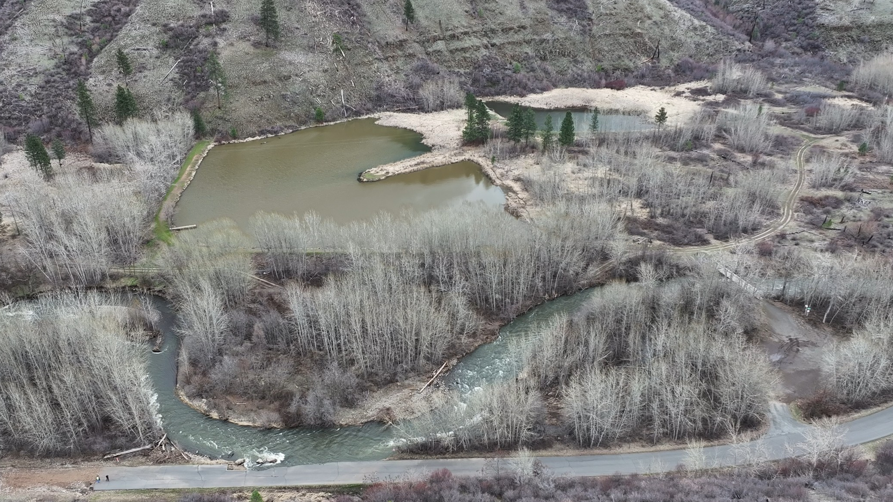
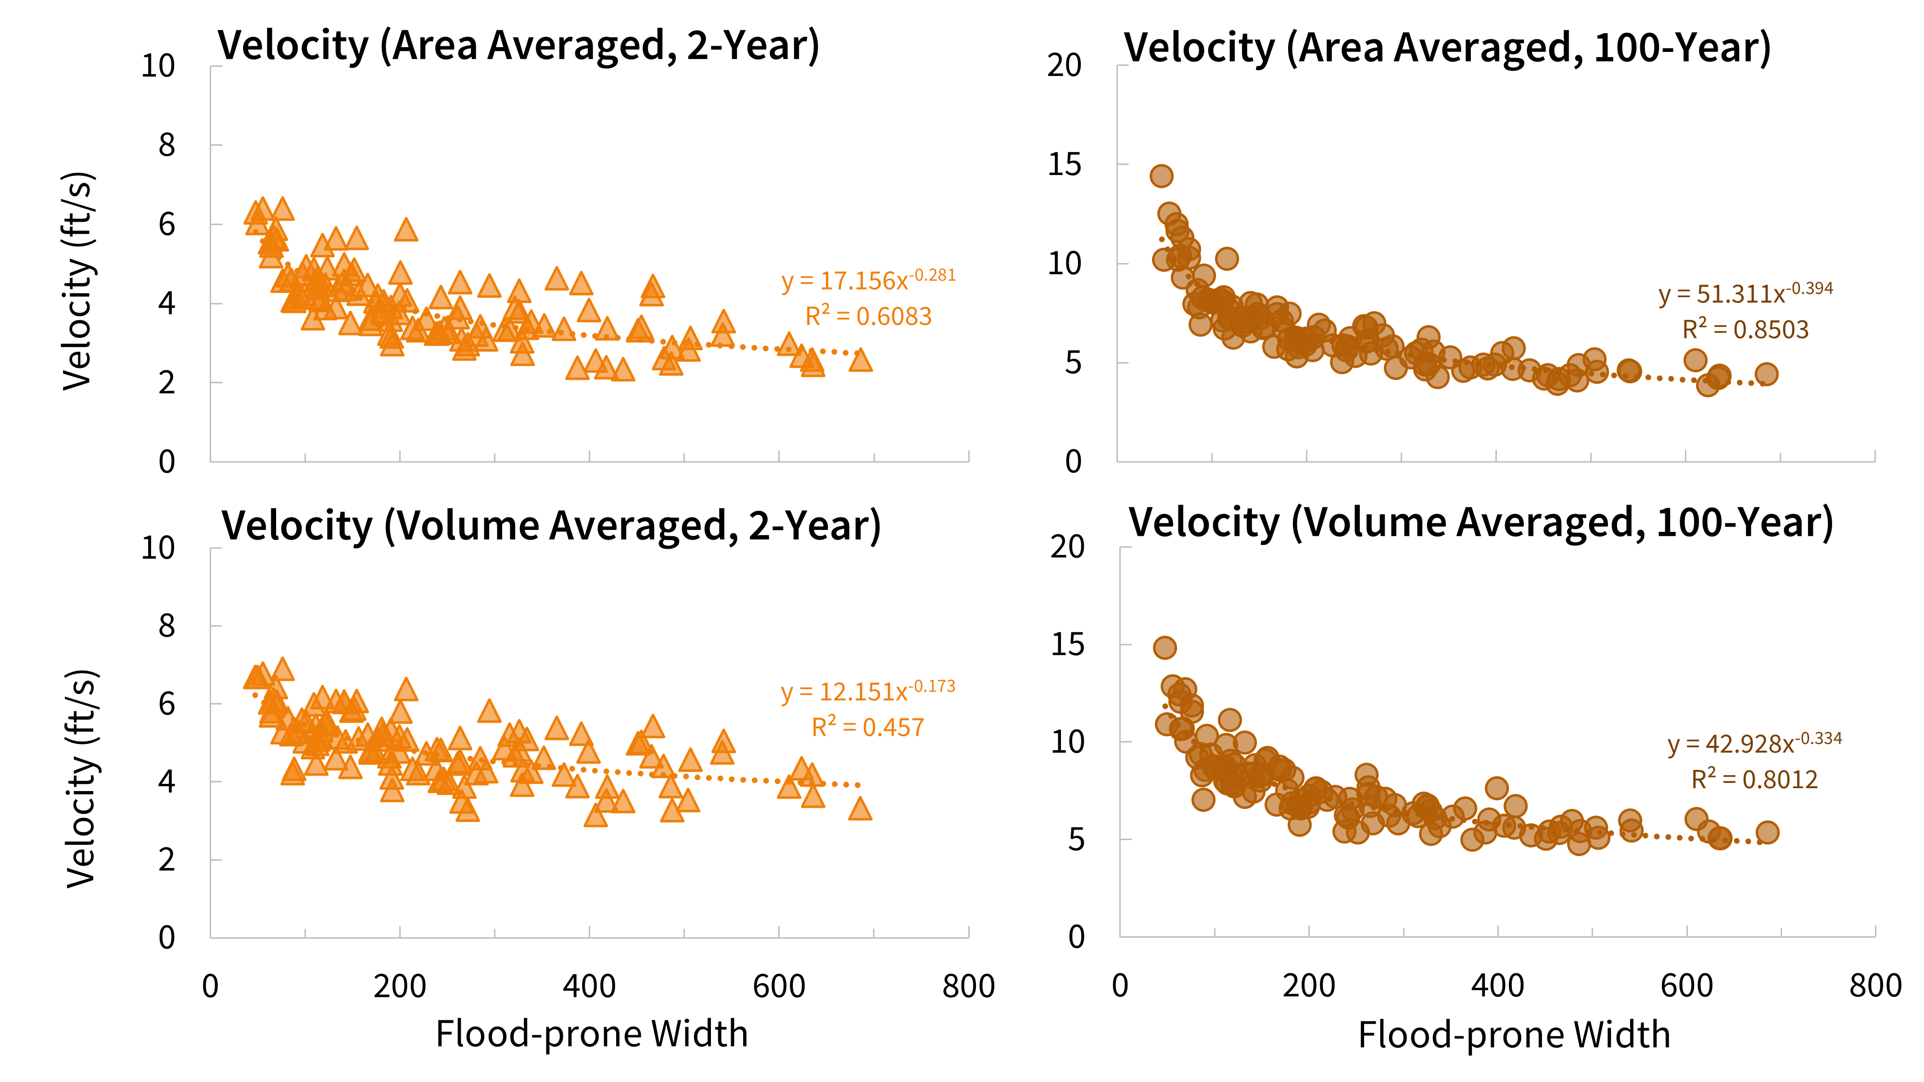
Flood Risk Benefits
Quantified benefits of space:
Increased ecosystem resilience
Direct benefits for life history bottlenecks (redd scour)
Reduced stream power
Increased infrastructure resilience
Reduced flood risk
Beaver-Watson
Lack of space
Erosion of Road (March 2026)

Slide 19
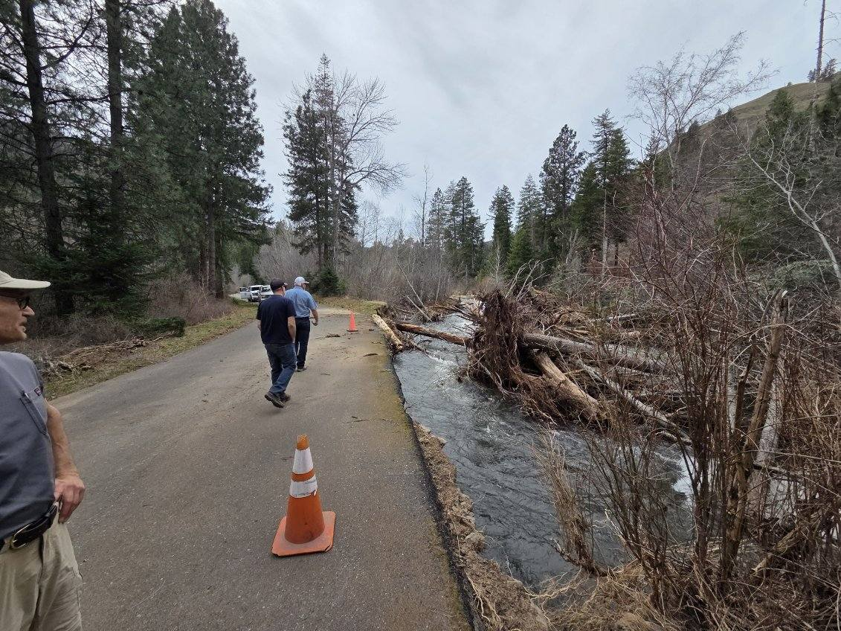
Community Benefits
Recreation drives tourism and visitation to Columbia County
Upgraded lakes provide long-term recreational value
Increased flood attenuation and floodplain water storage benefits downstream irrigators and producers
Floodplain restoration improves habitat for salmon and other First Foods essential to Tribal Communities and Treaty Rights
Road Damage between Camp Wooten and USFS Tucannon Campground

Slide 20
Vision for the Future
The Reach-Scale Preferred Alternative is based on our understanding of the Upper Tucannon River ecosystem, and considers the range of Project Goals and Objectives including restoration of watershed function to support Tribal Treaty Rights, Chinook salmon and Steelhead trout, and recreational use​.
  The Reach-Scale Preferred Alternative was developed as a coordinated effort of Co-Manager Leadership and the Project Core/Technical Team.
Development included Recreation Values; the five River Vision Touchstone categories: Hydrology, Geomorphology, Connectivity, Riparian Vegetation, and Aquatic Biota; combined with Chinook Salmon Limiting Factors.
Notes:
Animate this, bring in one statement at a time

Slide 21
Recreation Values
Fishing Opportunity
Fishable lake shoreline (linear feet)
Lake fishable area (acres)
Duration of fishing availability
River fishing - recovery of salmon and steelhead fishery
Experiential quality
Spacing between lakes
Parking
Campgrounds
Amenities
Proximity to lakes
Other
Trails
Access

Slide 22
Preferred Alternative
Includes:
New lake between Spring and Blue Lakes
Reconfigure and move Deer Lake upstream on alternate water source
Removal of Beaver and Watson Lakes
Removal of Big Four Lake Remnants
Removal of Curl Lake in coordination with USFWS
Reconfigure USFS Tucannon Campground
Road segment setbacks to increase floodplain connectivity
Powerline relocation to road alignment
SUBREACH/ACTION | EXISTING FISHABLE SHORELINE (ft) | PROPOSED FISHABLE SHORELINE (ft) | EXISTING LAKE AREA (ac) | PROPOSED LAKE AREA (ac) | FLOODPLAIN AREA RESTORED (ac)
1 - Tucannon Campground | NA | NA | NA | NA | 30.7
2- Curl Lake | 1112.0 | 0.0 | 2.0 | 0.0 | 32.0
3 - Big Four | 0.0 | 0.0 | 0.0 | 0.0 | 118.7
4 - Beaver-Watson | 1642.0 | 0.0 | 4.2 | 0.0 | 83.9
5 - Deer Lake | 605.0 | 2080.0 | 2.3 | 4.3 | 58.2
6 - New Lake | 0.0 | 1793.0 | 0.0 | 4.2 | 55.8
Total | 3359.0 | 3873.0 | 8.5 | 8.5 | 379.3
380 acres of Floodplain Restored
  Includes 148 acres of Reconnected Floodplain Gained
514 feet of Fishable Shoreline Gained
0 acres of Lake Surface Area lost.
Fishing platforms for additional “shoreline” access are included In consideration for all remaining and new lakes.

Slide 23
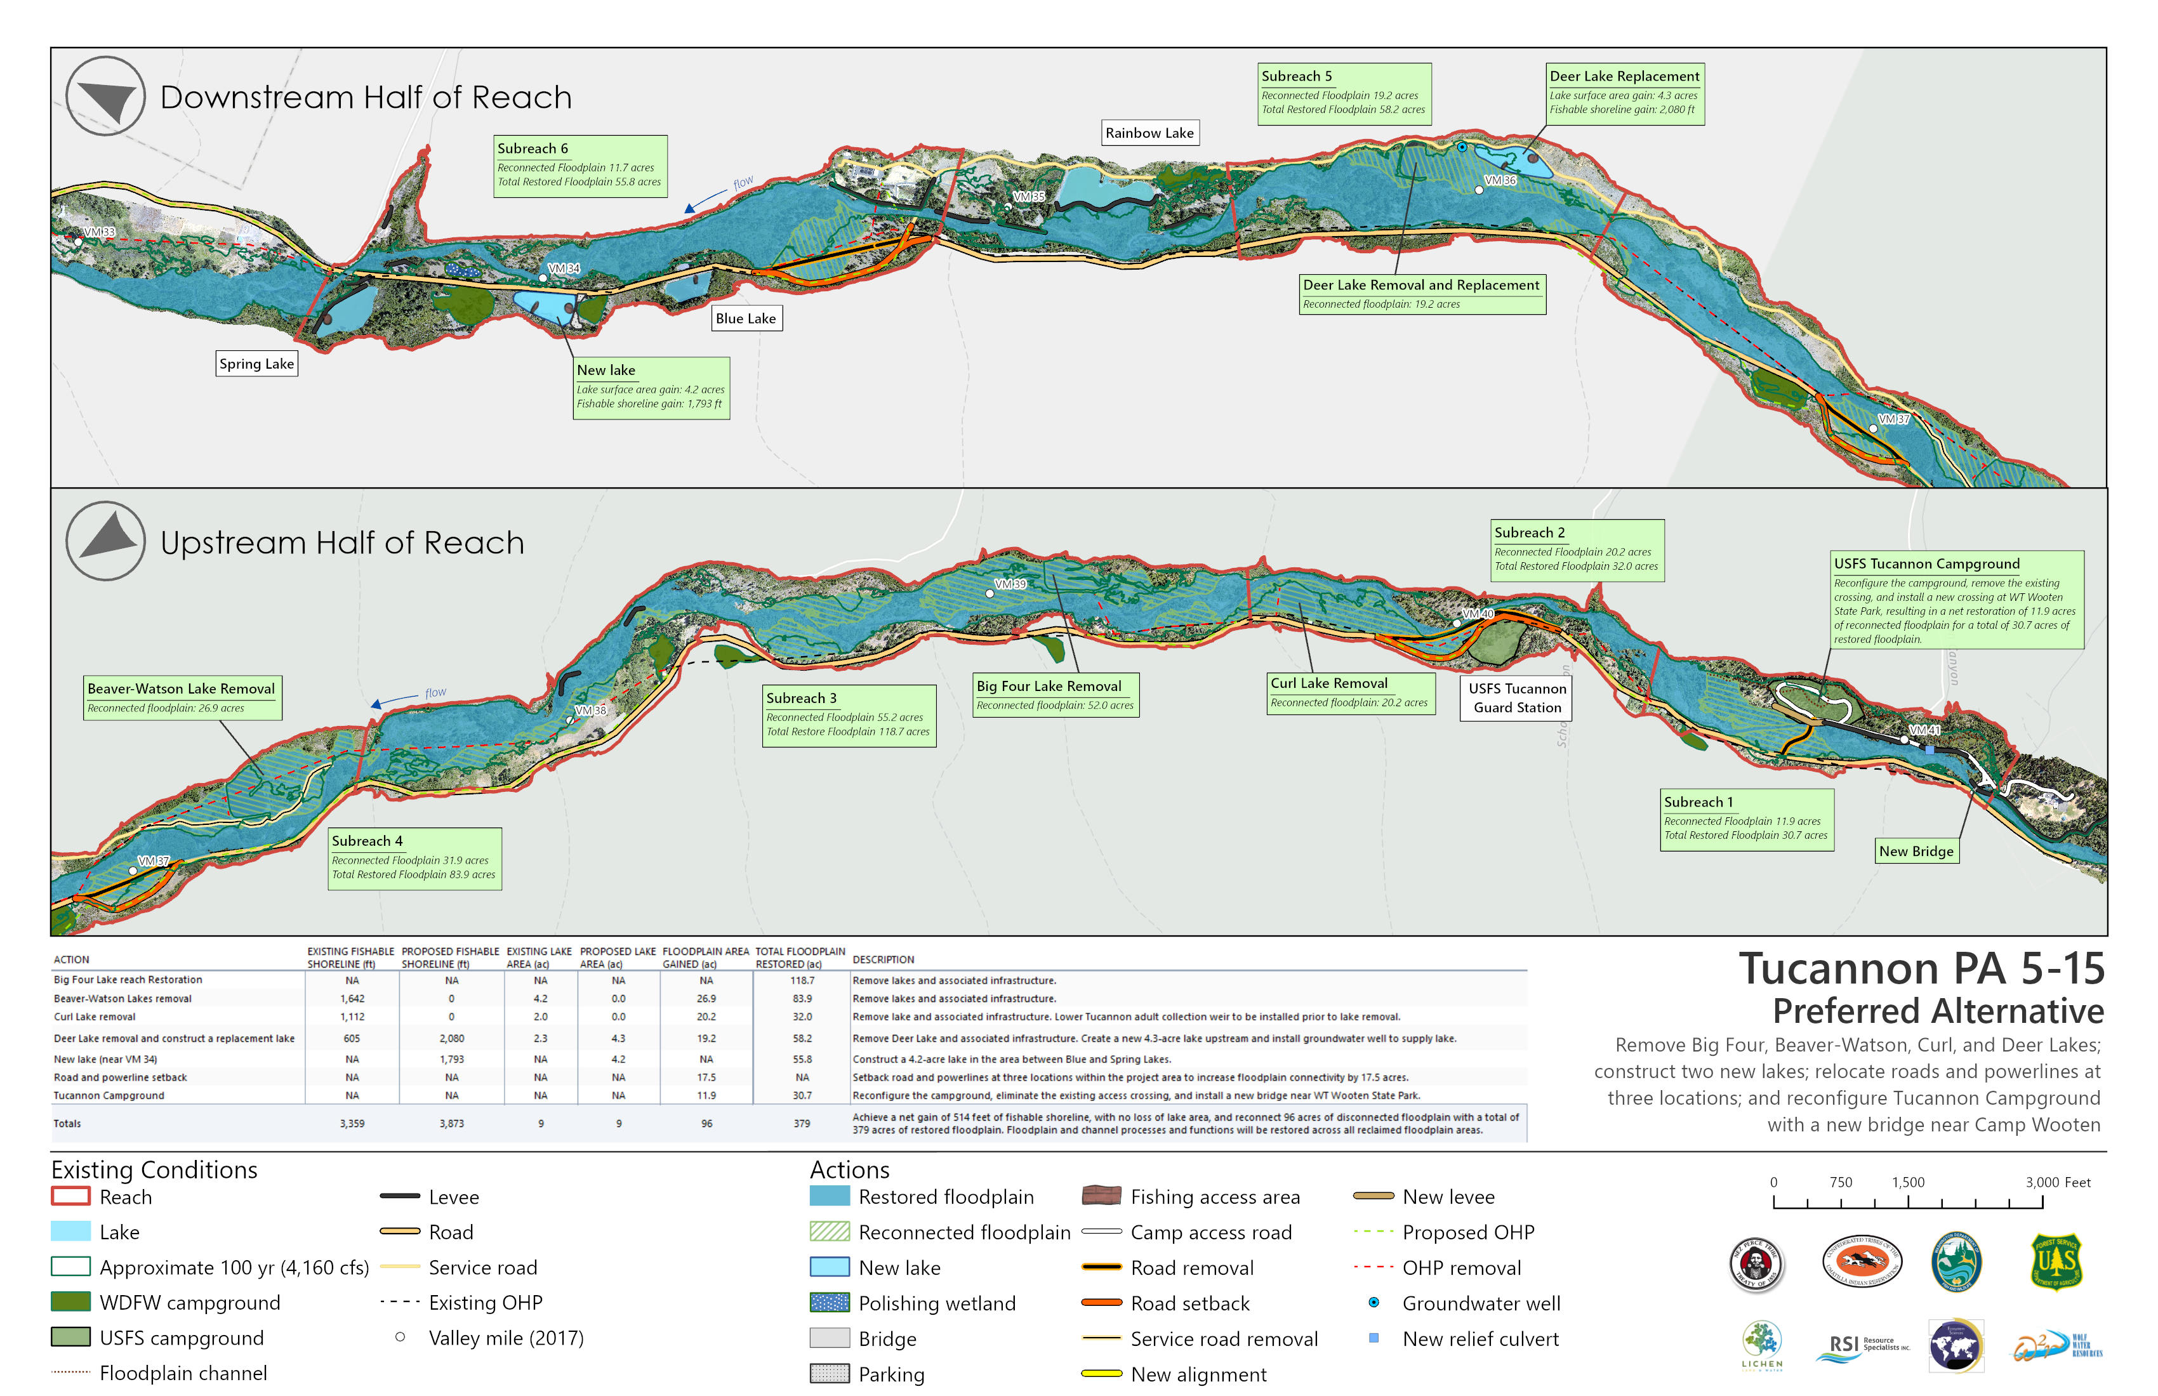

Slide 24
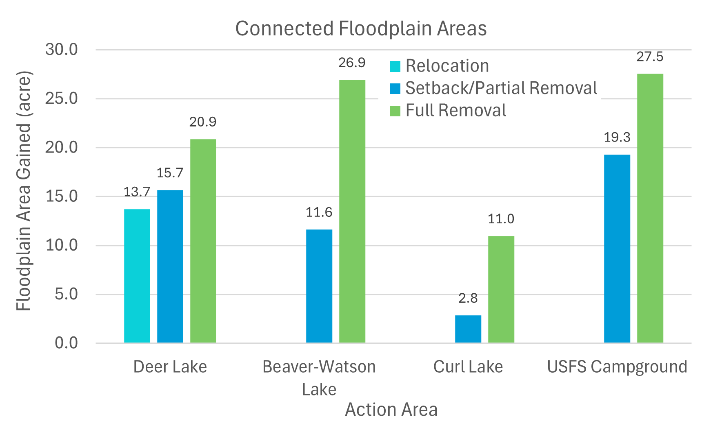
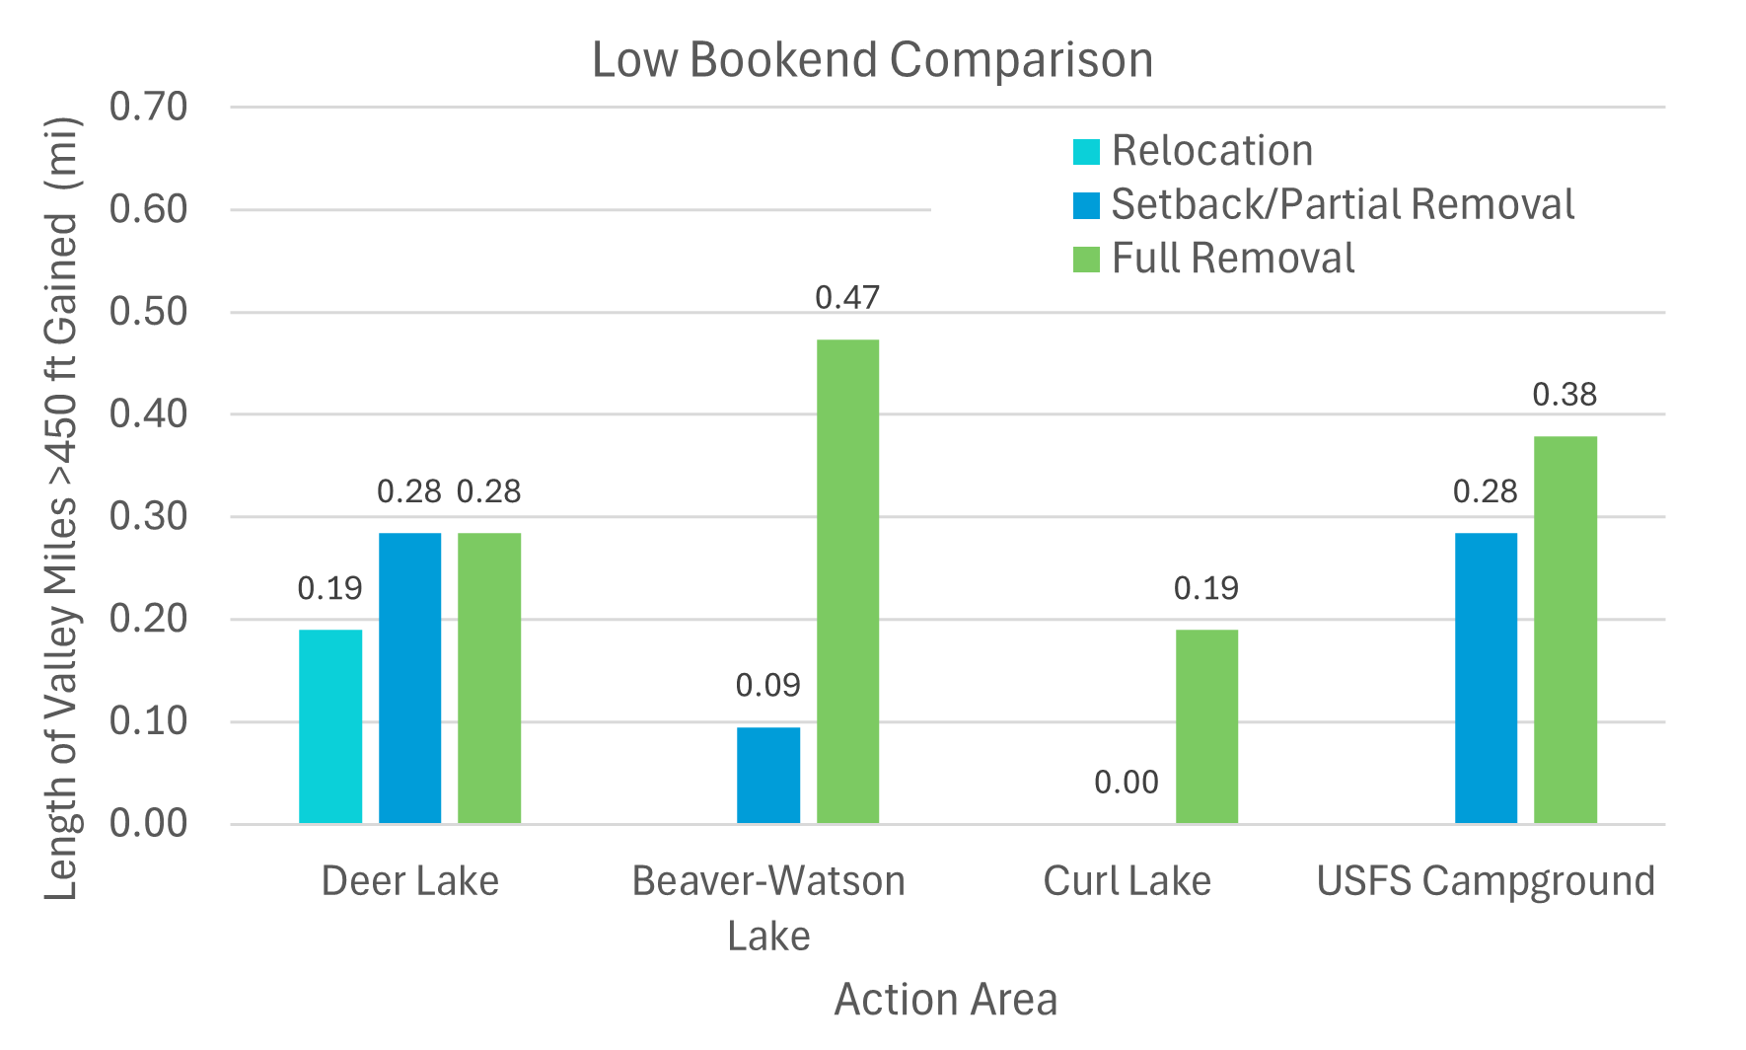
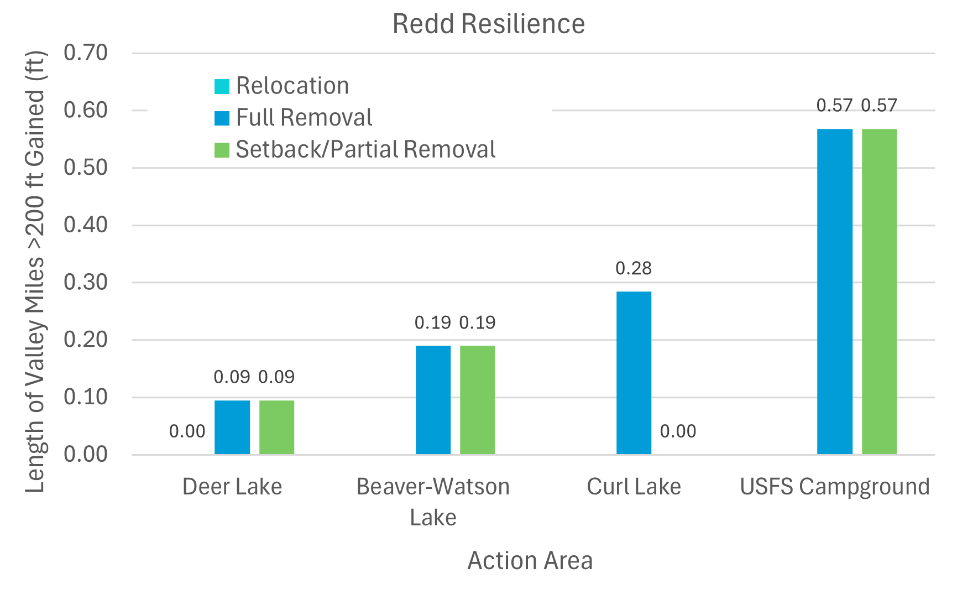
Comparing Space Benefits Across Action Areas
Rainbow Lake
Floodplain Increase (already complete)

Slide 25
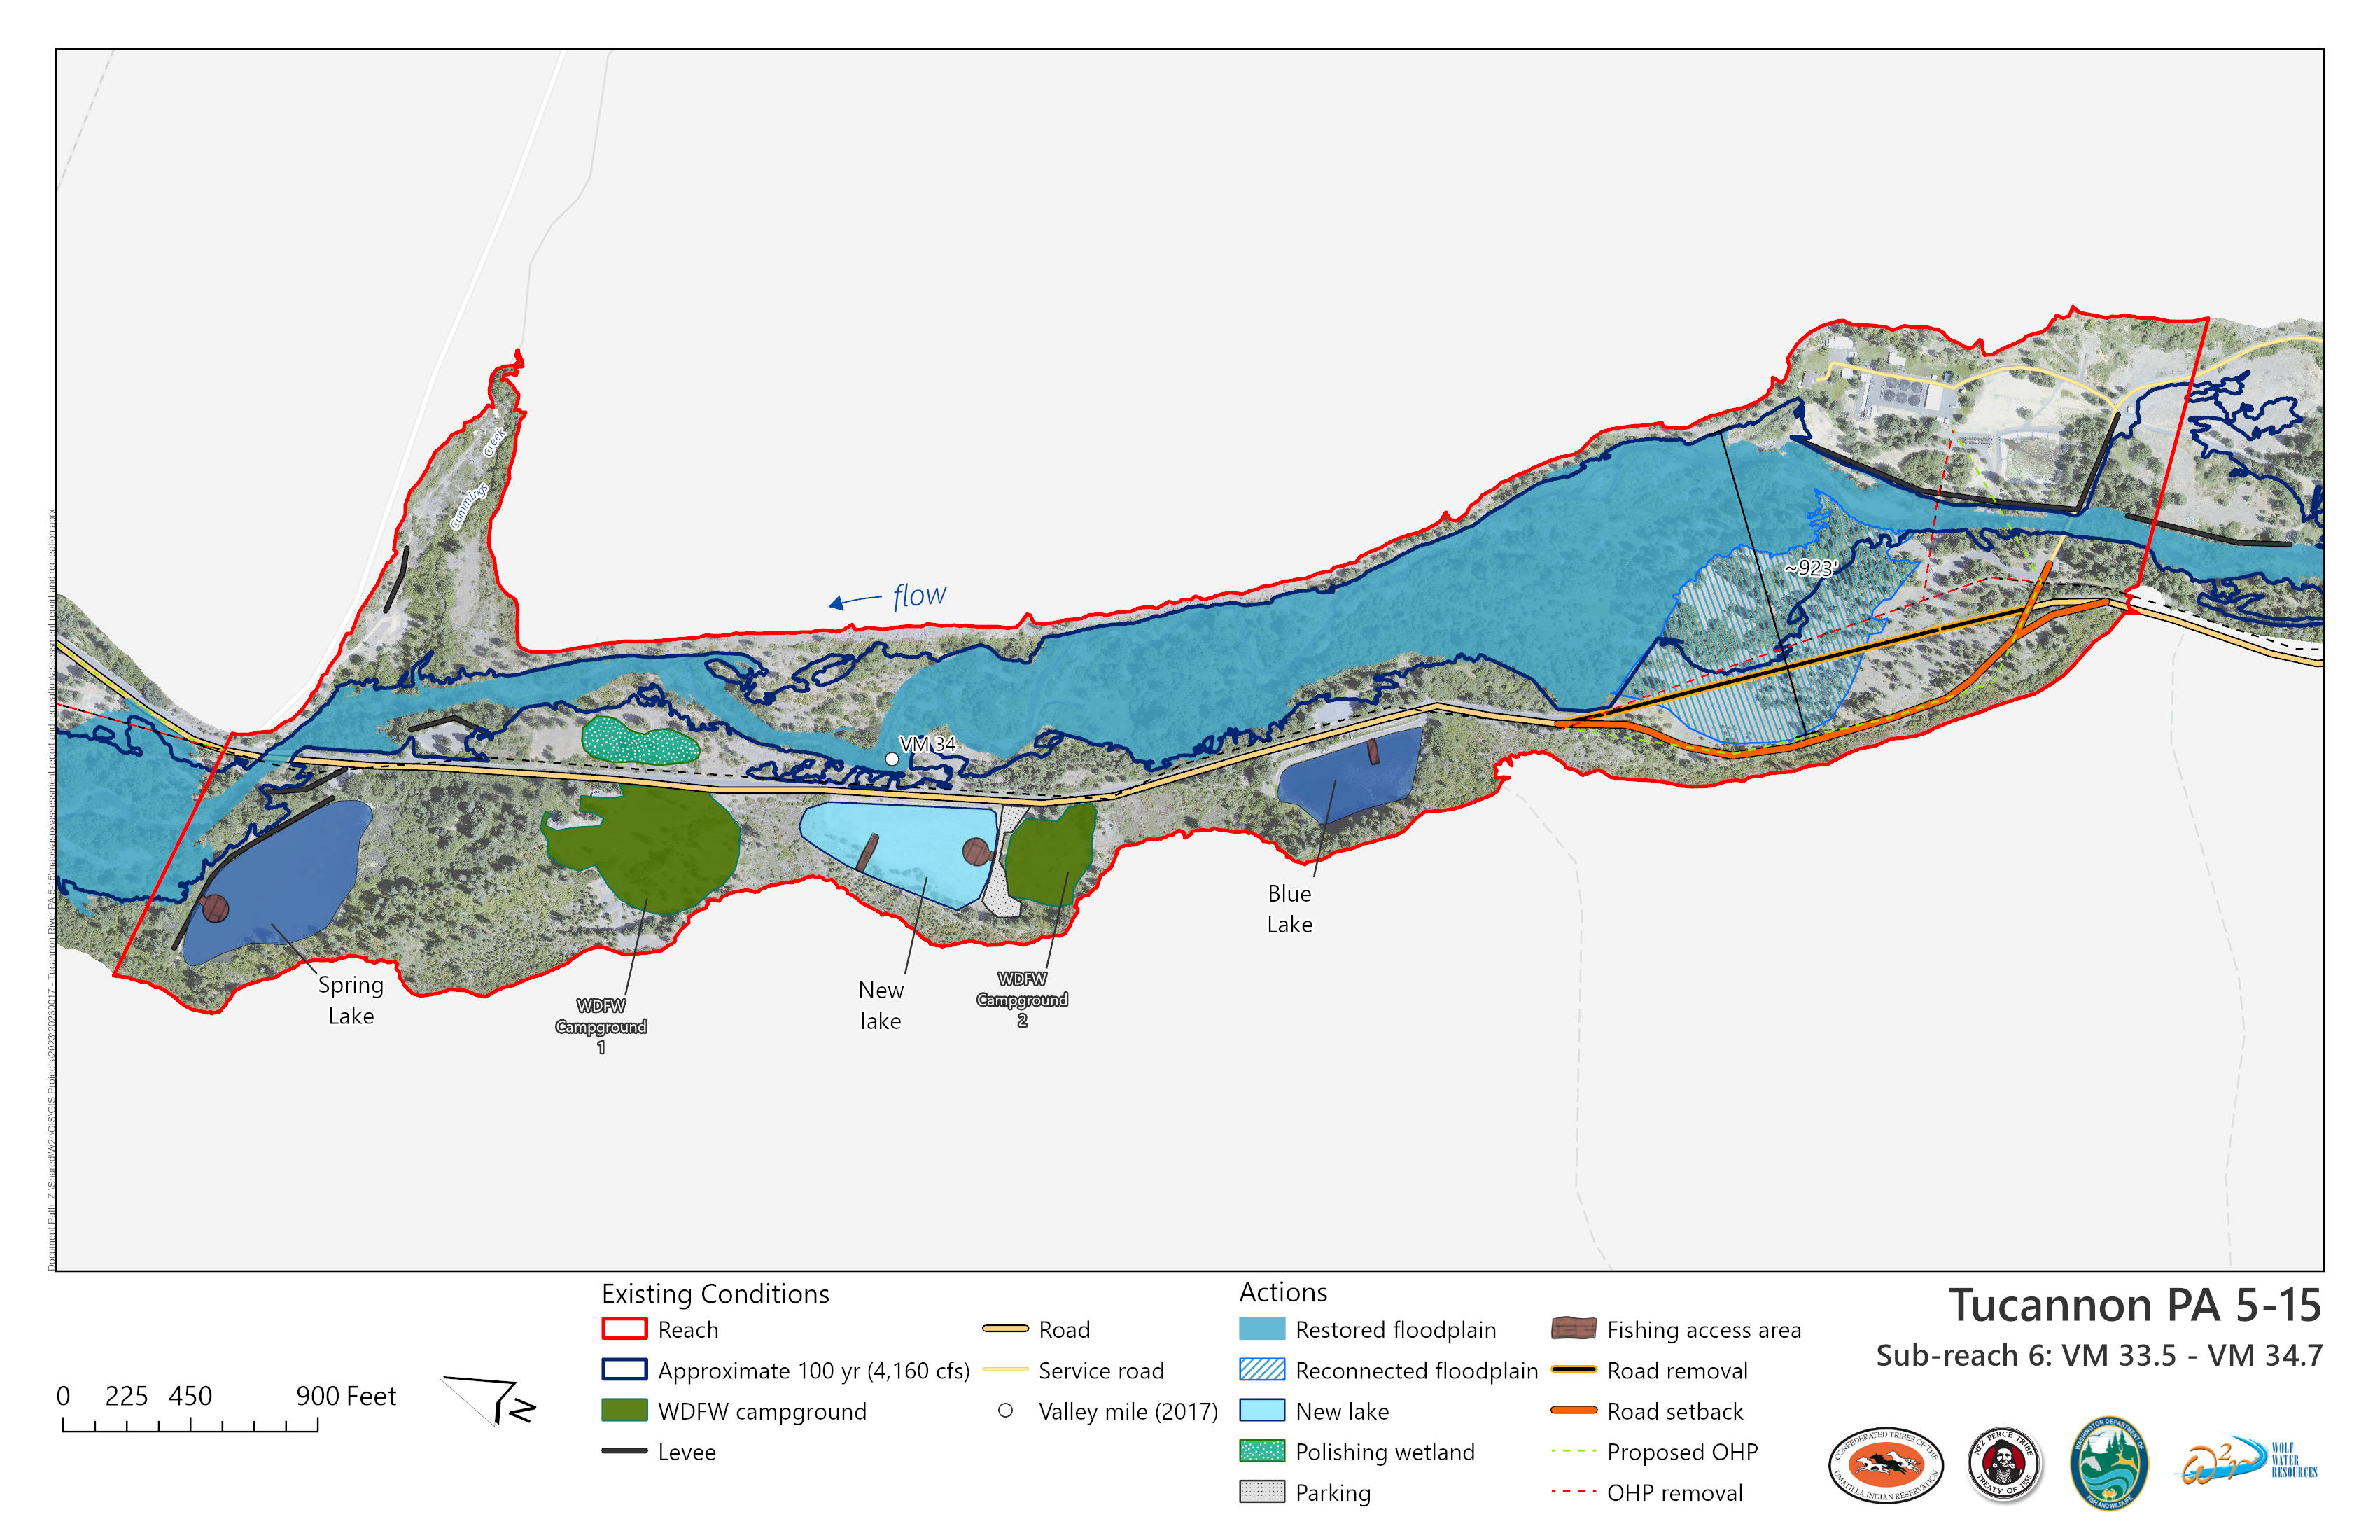

Slide 26
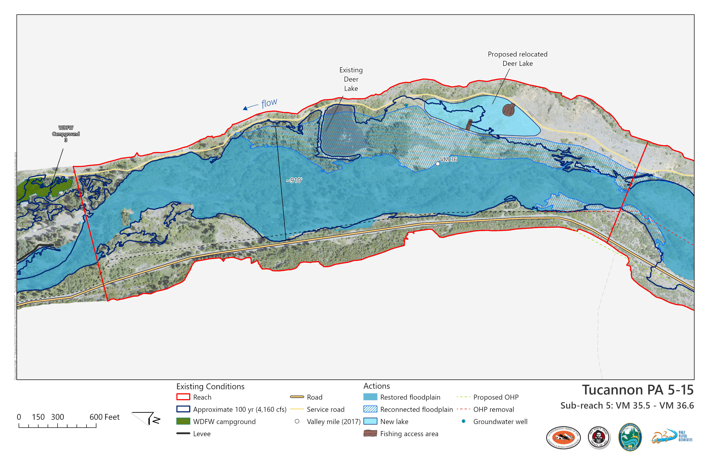

Slide 27
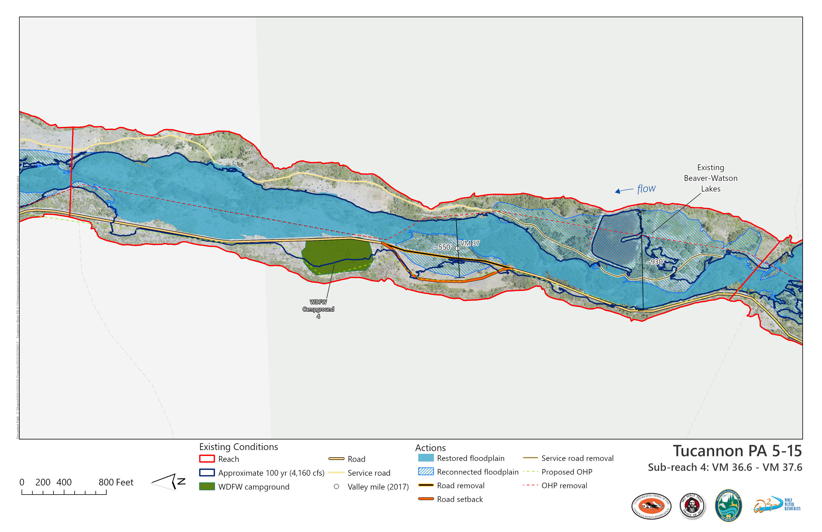

Slide 28
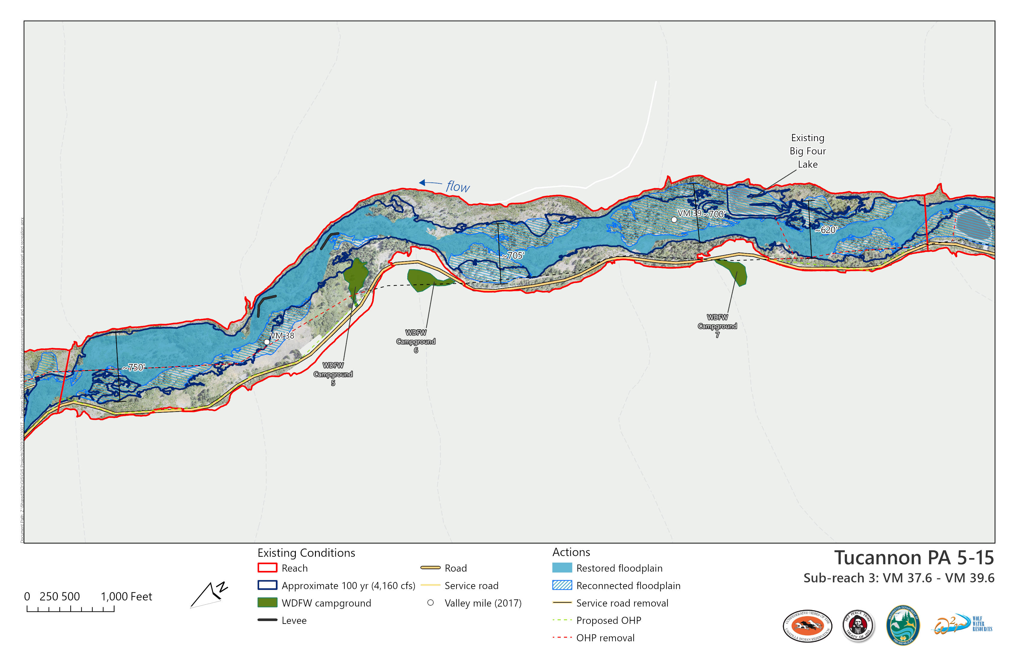

Slide 29
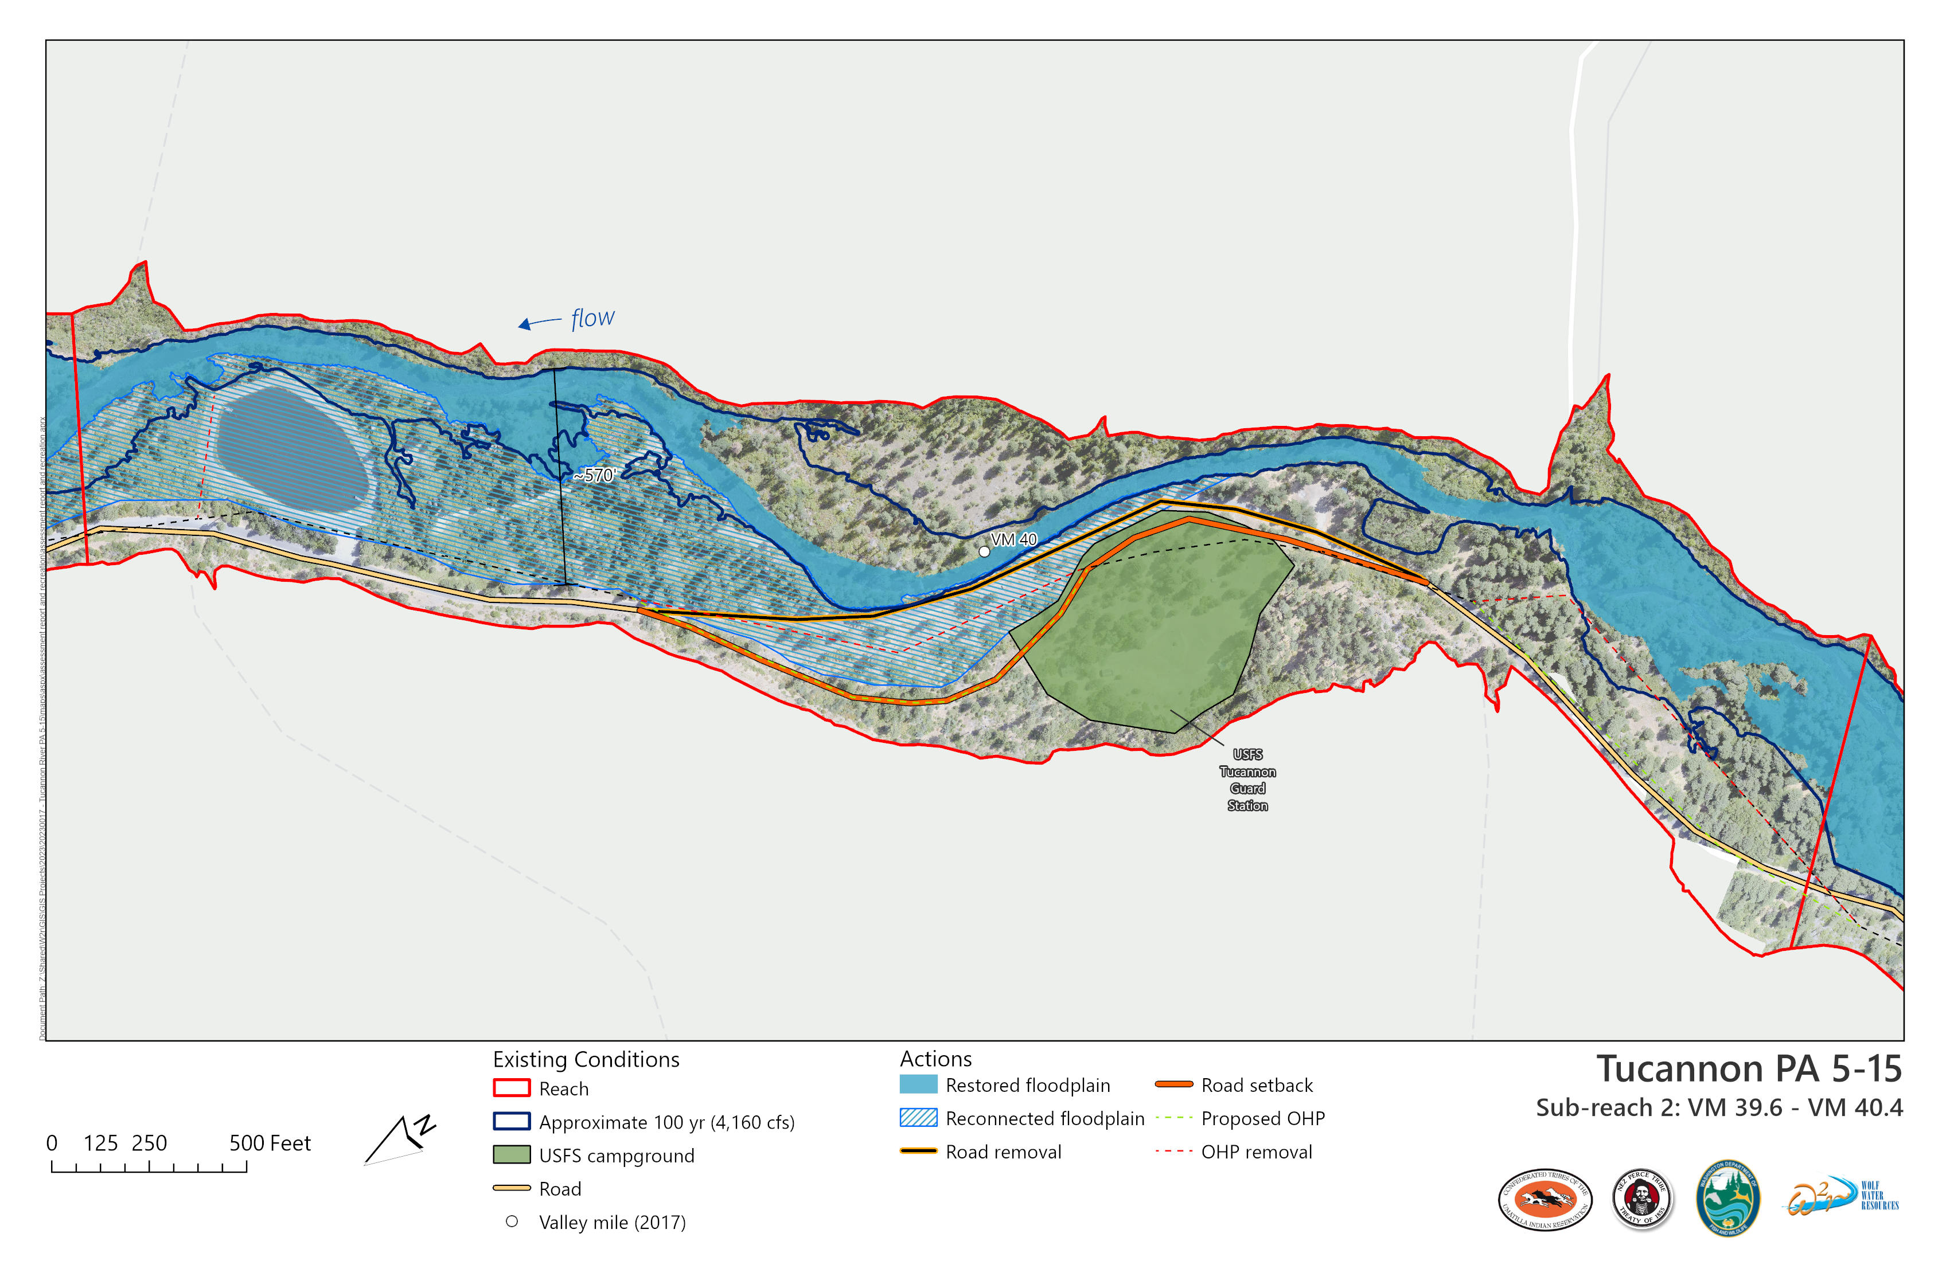

Slide 30
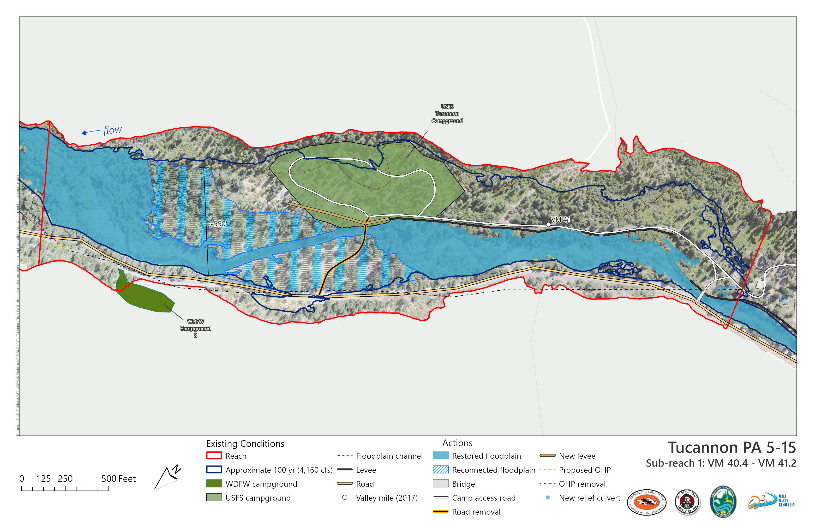

Slide 31
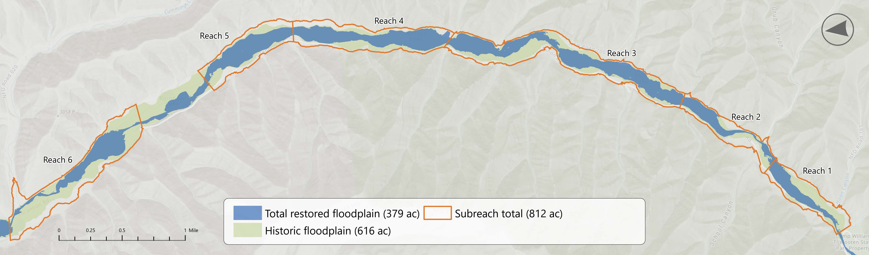
Notes:
JEREMIAH? - Add “Hist vs Exist Map” Floodplain Accounting Figure at top, and “Hist vs total” Map figure below that

