Slide 1
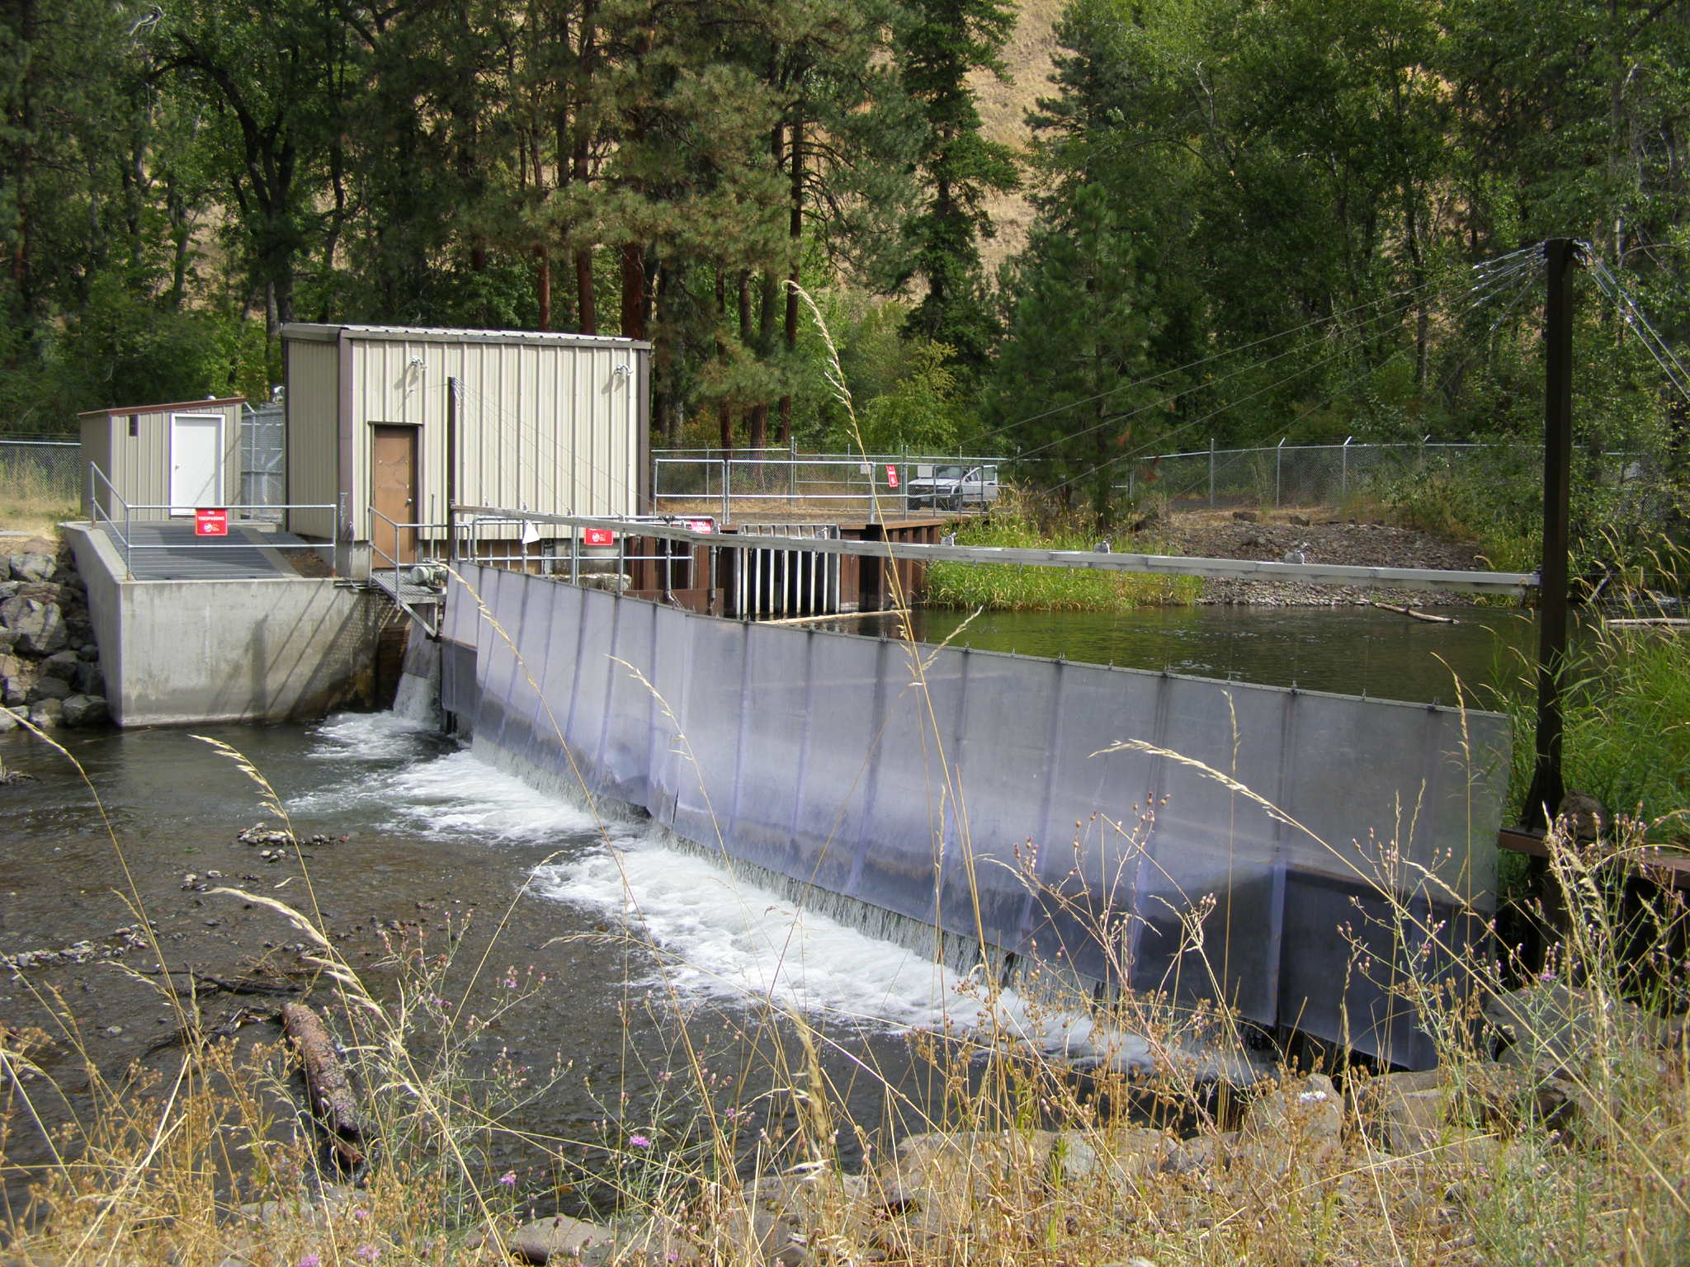
Tucannon Spring Chinook
2022 Return
2023 Forecast
And Other Fun Facts!
And Some Steelhead……
And Some Fall Chinook/Coho……

Slide 2
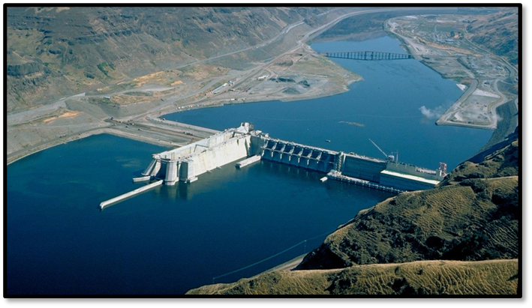
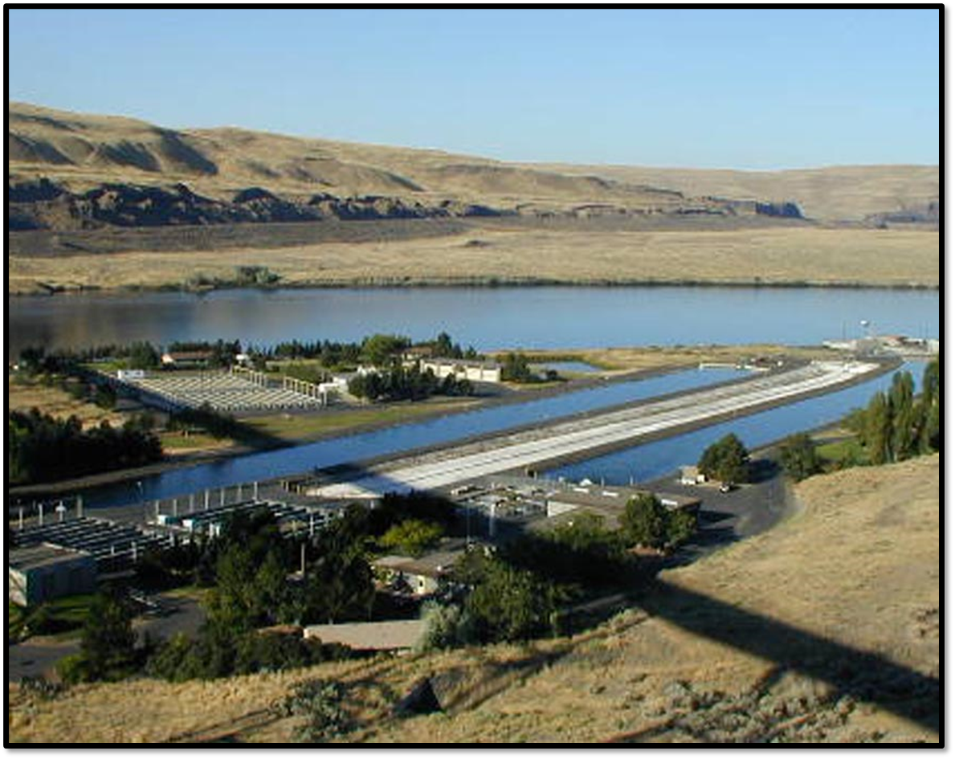
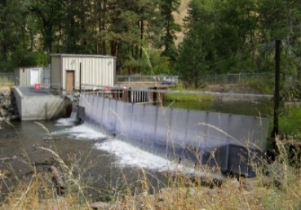
Tucannon River – Summary Data provided by Michael Gallinat
PIT Tag Returns
Bonneville Est = 30
(2 Total PIT Tags)
Estimated Conversion to Tucannon FH Weir/Trap ~ 47
Pre-Season Forecast
(~125 Total, ~80 to Weir/Trap)
50% of Program Needs
Co-manager Decision to Collect All Fish Trapped for Broodstock
Returns to the Tucannon Trap
227 Total
189 Natural
+ 38 Hatchery
~75% of HOR returns were Ad-clipped Strays (Umatilla, Touchet, unknown)
Spawned at Lyons Ferry
85 Females Spawned
~289,000 Eggs
Expect to get 250K to 260K smolts (~110-115% of program) ☺

Slide 3
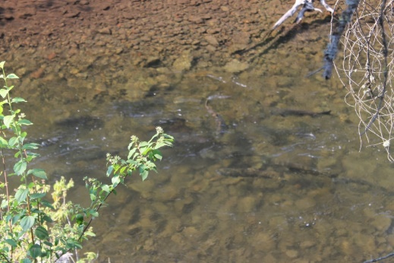
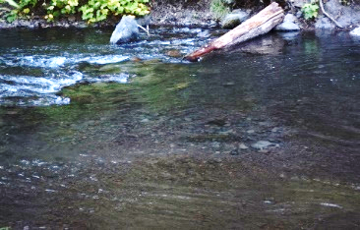
Tucannon River – Continued
Spawning Ground Surveys
41 redds - 2022
35 redds - 2021
14 redds - 2020
11 redds - 2019
109 redds - 2018
Adult Outplants
18 Females, 28 (males)
outplanted on August 30th.
80-90% success from Outplanted Females
2023 Pre-Season Forecast ~100 Total (80 H, 20 N)
~70 to Weir/Trap
Why So Low? 4-Year (2019 Brood) is Dominate Age Class
2019 Brood Eggs in Gravel – 2020 Flood, <500 smolts estimated
2019 Hatchery Brood
BKD issues
Estimated 35% survival to LOMO
60% survival is the more normal average
Pre-Season Adjustments based on PIT Tags – hope we’re wrong!
TOTAL RETURN = 273
220 NOR
44 HOR (80% Stray)
(~218% of Pre-Season)

Slide 5
HOR = 1.8 R/S, 8 of 33 below replacement
NOR = 0.6 R/S, 22 of 33 below replacement

Slide 6
Tucannon Hatchery Origin Spring Chinook
Juvenile Survival - DART Point Estimates to Downstream Locations
Notes:
PIT Array at TFH was installed in 2012…so the times series for this and the next graph are only from 2012 forward. Shows comparative survival estimates to TFH, UTR, MTR, LTR and LOMO

Slide 7
Juvenile Mortality
Tucannon River Mouth to Lower Monumental Dam
Why the recent increase in mortality?

Slide 8
Juvenile Mortality
Tucannon River Mouth to Lower Monumental Dam
Walleye in Juvenile Bypasses

Slide 9
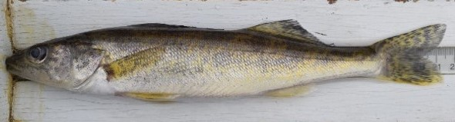
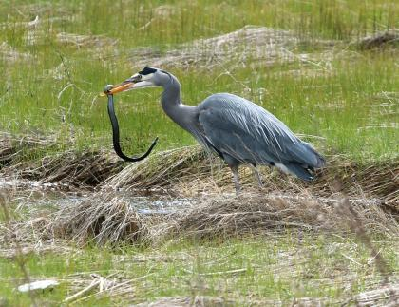
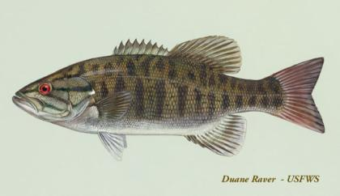

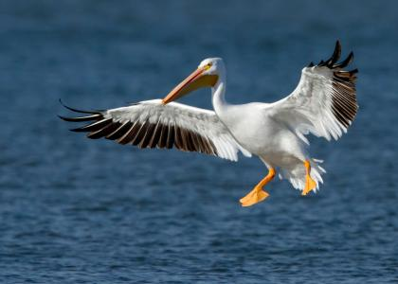
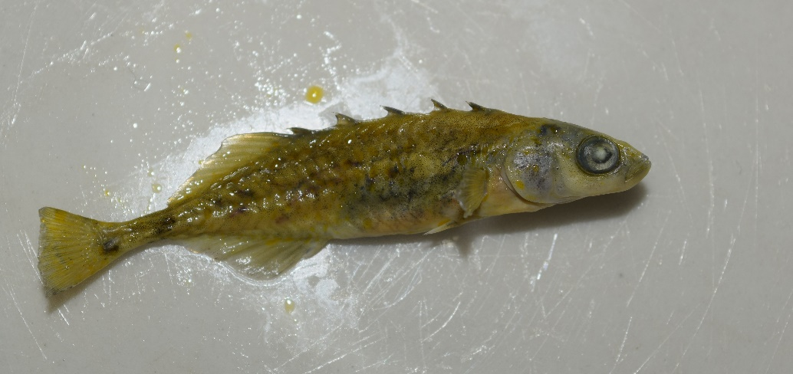
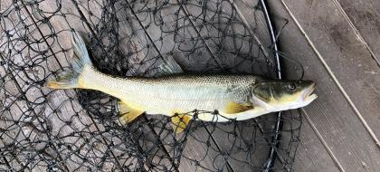
Walleye
Other Predators Contributing
5 Walleye captured in Tucannon smolt trap in 2022
0 captured in the previous 25 years at the same trap location

Slide 10
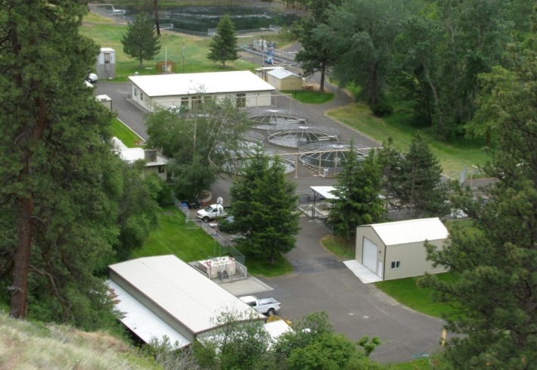
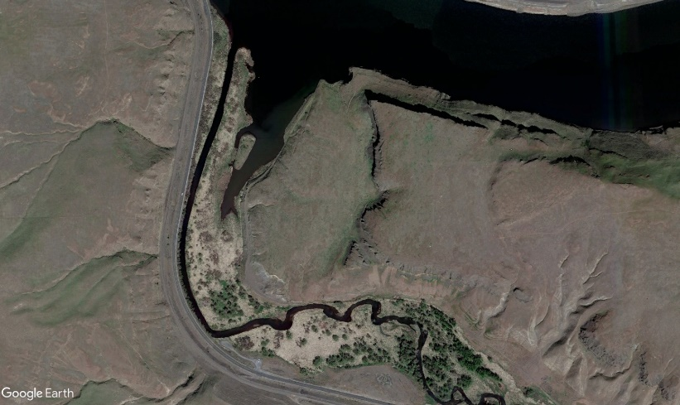
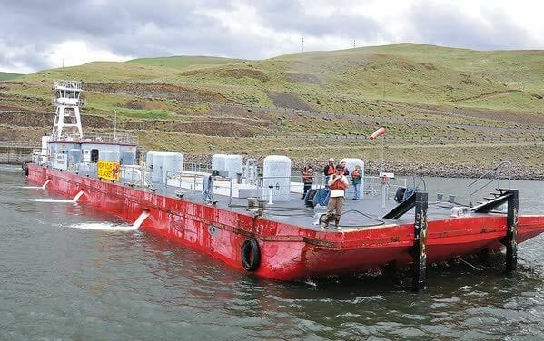
What are some options going forward…
  Local Vicinity Releases (On-Going LSRCP Funded Evaluation)
    Comparing returns/distributions between releases at Tucannon FH, the Tucannon River Mouth, or Barged from Lyons Ferry
Tucannon FH
Snake River
Tucannon River

Slide 11
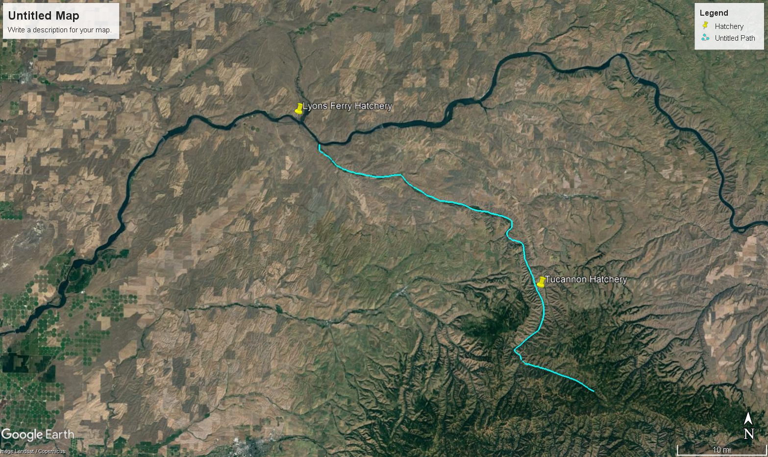

Local Vicinity Release Evaluation
LSRCP Funded
Juveniles Overwinter at Tucannon for 5-6 Months for Imprinting
Snake River
Snake River
Tucannon River
15,000 PIT tags/Study Group
Addresses the high mortality rates observed from release to Tucannon River mouth, LOMO or Bonneville Dam
Notes:
Visual description of the alternative juvenile release study we’ve started

Slide 12
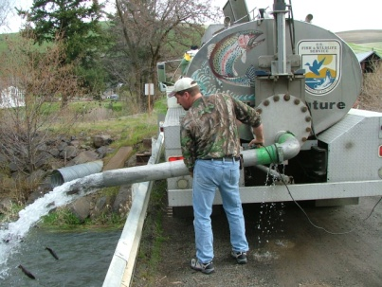
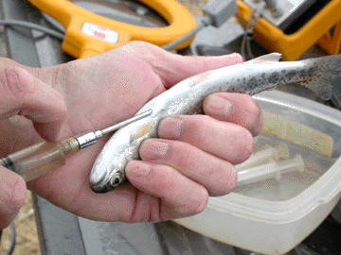
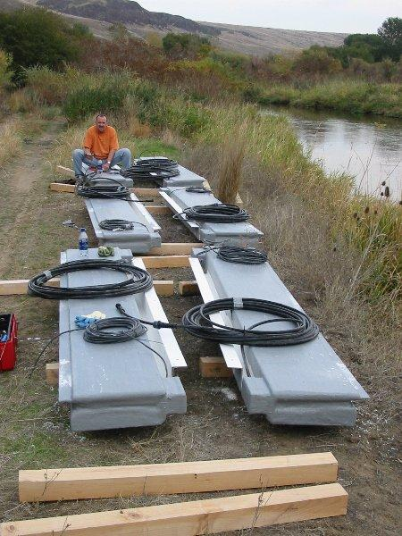
Tucannon Spring Chinook
2022 Releases
60,000 fish total production
Two Release Groups
  TFH Release (20,000 PIT tags)
  Mouth Release (20,000 PIT tags)
    timed to coincide with the majority of TFH released fish
    arriving at the mouth using PIT tag detections in Lower Tucannon River
  Assess juvenile migration and survival – Change if needed

Slide 13
Tucannon Spring Chinook
2022 Survival to Downstream Locations
Results Encouraging!
But…will we see greater survival in the adults?
Concerns regarding straying/overshoot rates and return distribution within the Tucannon River?
Jacks returns in 2023
As of 5/10/2023
1 Jack from Mouth Rel
2 Jacks from TFH Rel

Slide 14
Tucannon Spring Chinook
2023 Releases
120,000 fish total production
Three Release Groups
  TFH Release (15,000 PIT tags)
  Mouth Release (15,000 PIT tags)
  Barge Release (15,000 PIT tags)
    Released Below Bonneville Dam – No Juvenile PIT detections

Slide 15
Tucannon Spring Chinook
2023 Survival to Downstream Locations
Preliminary downstream survival
as of today
Still Early in the Migration

Slide 16
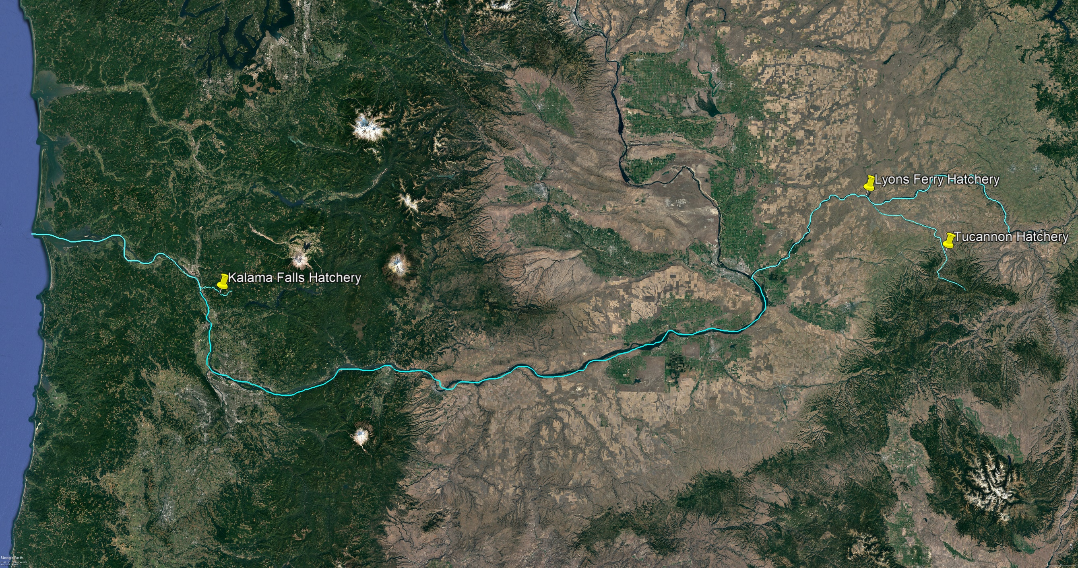
Kalama River Release
Adults will be hauled back to LFH to use as broodstock (if needed) or outplanted in Upper Tucannon River
Funding Needed
Columbia River
Snake River
Tucannon
River
RM 425
RM 82
Columbia River
~50,000 Smolts: uniquely marked
Columbia River
Snake River
Juveniles Overwinter at KFFH for 5-6 months
Addresses the mortality observed from release to Bonneville Dam
Columbia River
Notes:
Conceptual Plan for the Kalama River Release.

Slide 17
Tucannon Steelhead Return – 2022 Run Year
Over Ice Harbor – Expanded PIT Tags
Tucannon Hatchery Origin – 500
Columbia River
Tucannon Natural Origin – 350
RM 425
RM 82
Columbia River
Columbia River
No estimates yet for what came into the Tucannon River based on PIT Tags
Snake River
Columbia River
Notes:
Conceptual Plan for the Kalama River Release.

Slide 18
Tucannon Fall Chinook/Coho – 2022 Return
Columbia River
RM 425
RM 82
Columbia River
Columbia River
Snake River
Columbia River
Notes:
Conceptual Plan for the Kalama River Release.

